Slide 1
S3. CONSORT flow diagram of safety analysis and full analysis set
First registration,
patients assessed for eligibility
(n=246)
SF (n=213)
＋
HER2- confirmed by central laboratory (n=29)
Confirmation by central lab was not done (n=1)
Withdrew consent (n=1)
FAS (n=212)
Secondary registration and randomisation
(n=215)
Secondary registration: April 2012 to September 2013
Regimen A
(n=45)
Regimen B
(n=48)
Regimen C
(n=42)
Regimen D
(n=40)
Regimen E
(n=40)
HER2- confirmed
after starting
study drug
administration
(n=1)
Withdrew consent
(n=1)
HER2- confirmed
(n=1)
Excluded from FAS
FAS
(n=44)
FAS
(n=48)
FAS
(n=41)
FAS
(n=39)
FAS
(n=40)
Excluded from PPS,
mainly because of
withdrawn consent
(n=3)
(n=3)
(n=2)
(n=2)
PPS
(n=41)
PPS
(n=45)
PPS
(n=39)
PPS
(n=39)
PPS
(n=38)

Slide 2
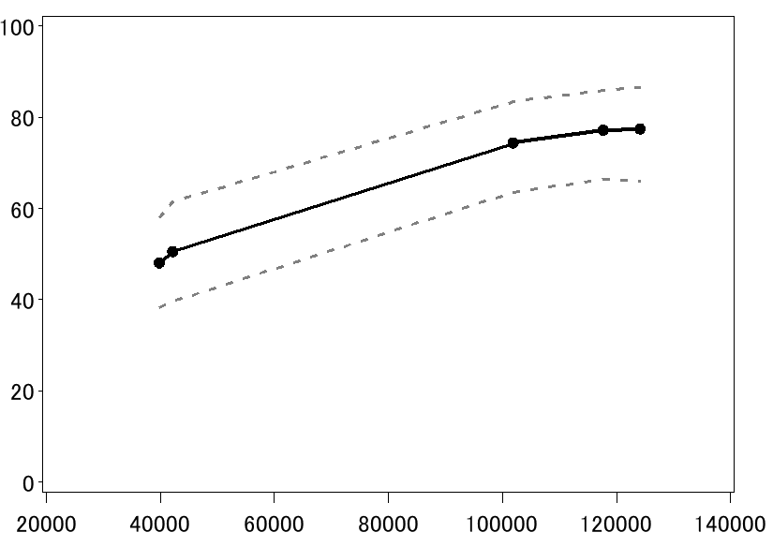
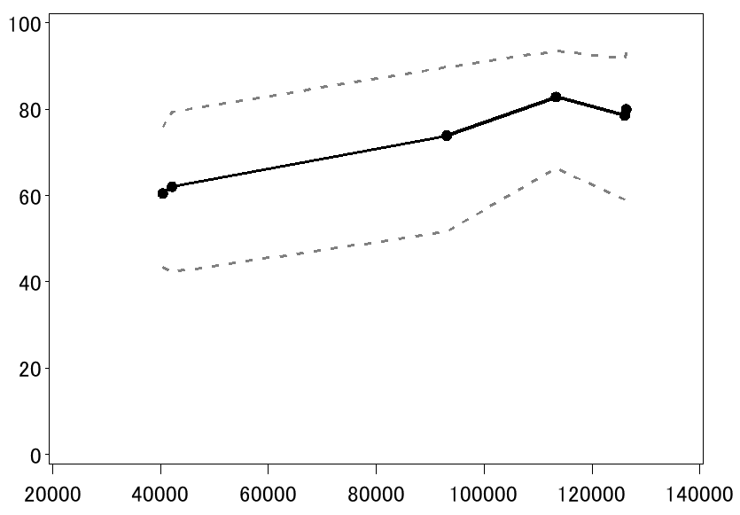
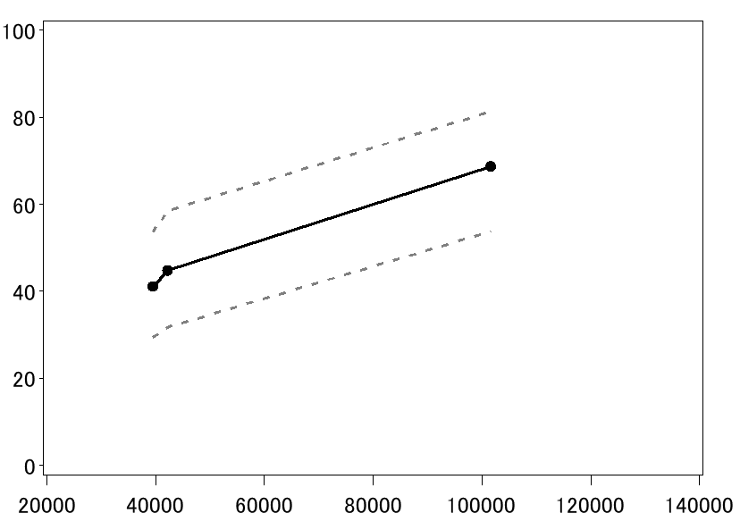
S7. STEPP analysis: relationship between clinical response and the accumulation dose of lapatinib
Total
ER (-)
ER (+)

Slide 3
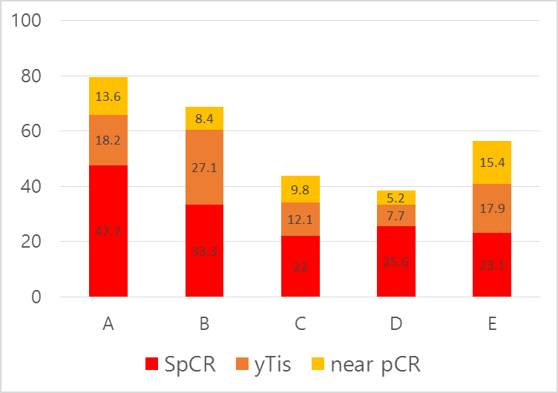
S8. Efficacy (QpCR=CpCR + near pCR)

Slide 4
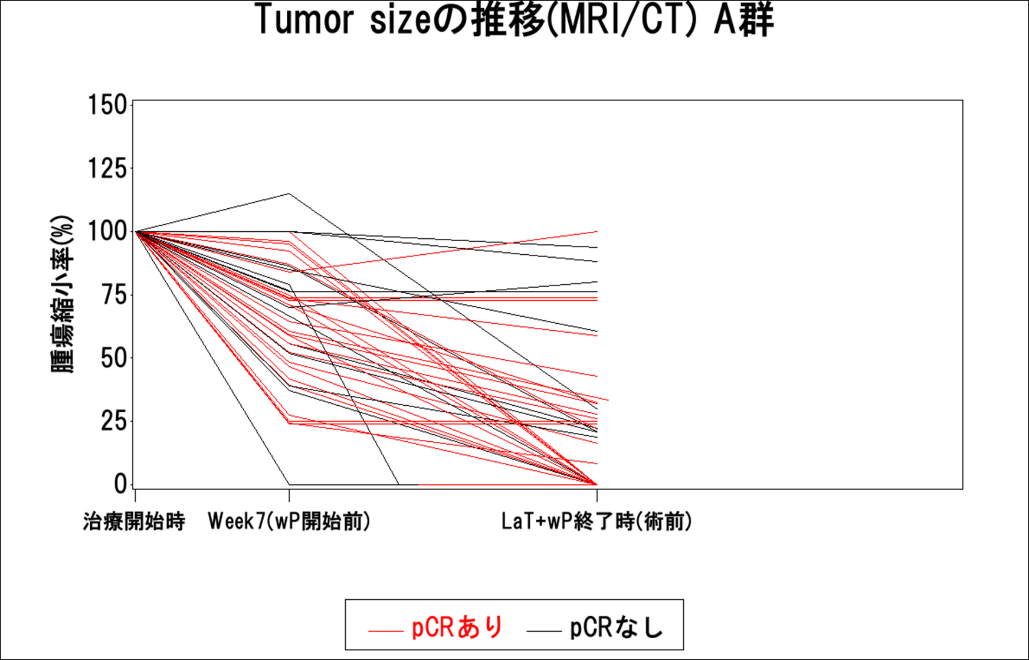
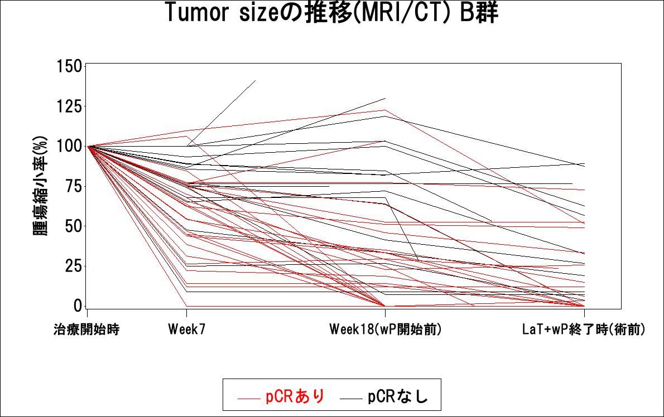
S9. Time course of tumour response and relationship between clinical response and pathological response (ER−)
Group A
Start
La+T (6 wks)
La+T+wP
Group B
Start
La+T (6 wks)
La+T (18 wks)
La+T+wP

Slide 5
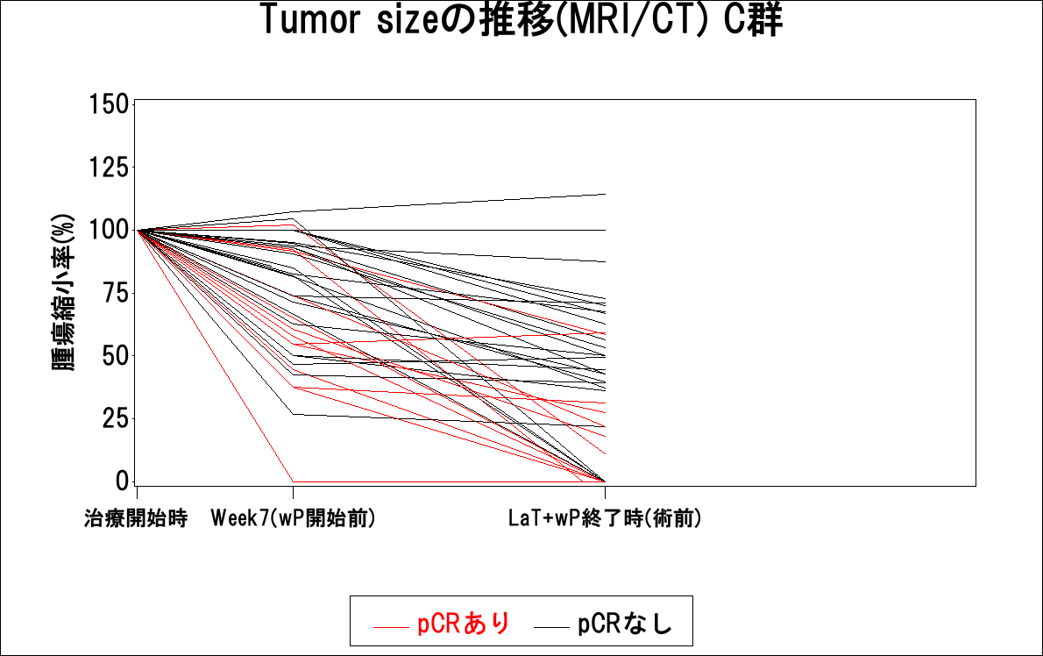
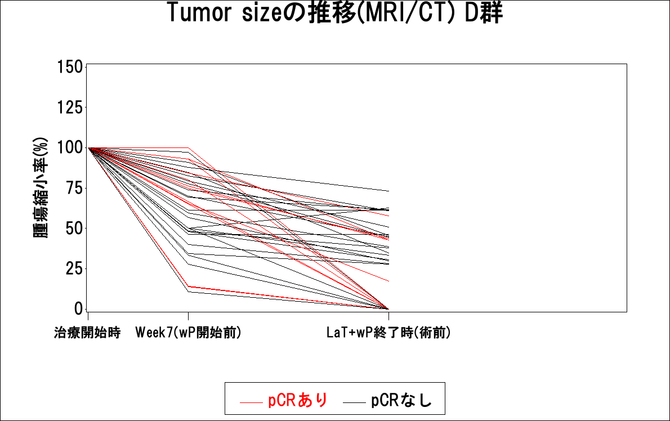
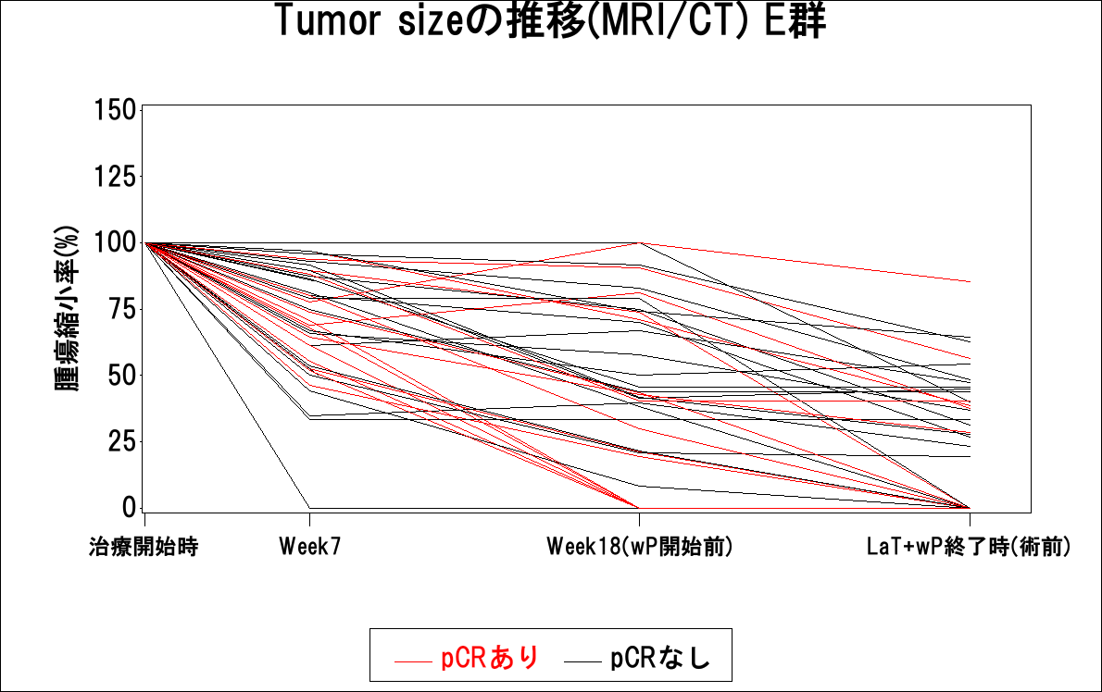
S9. Time course of tumour response and relationship between clinical response and pathological response (ER+)
Group C
Start
La+T (6 wks)
La+T+wP
Group D
Start
La+T (6 wks)
La+T+wP
Group E
Start
La+T (6 wks)
La+T (18 wks)
La+T+wP

