Slide 1
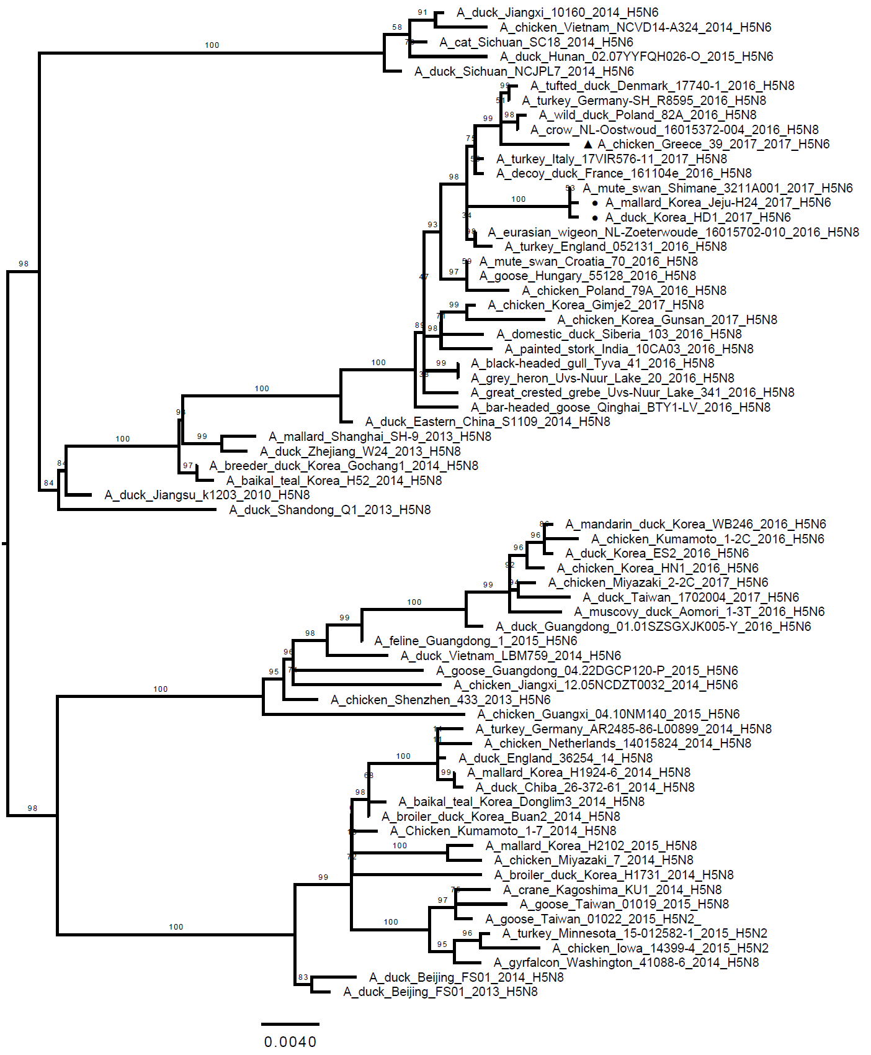
Suppplementary Fig S1. (A) HA
D
B
C
A

Slide 2
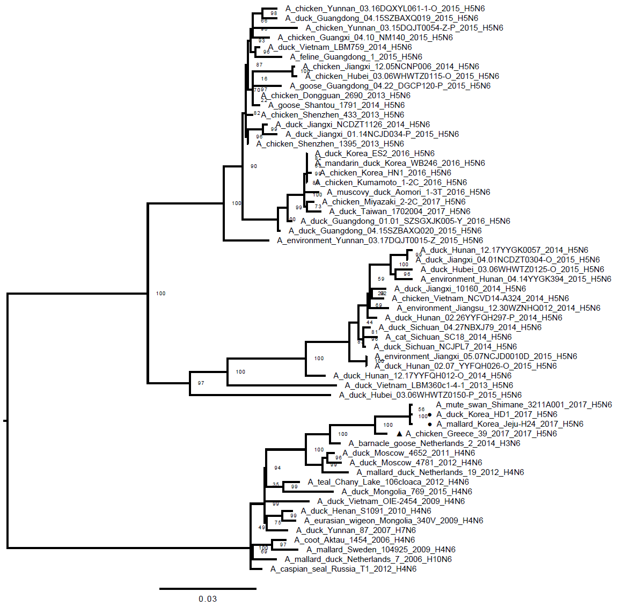
Suppplementary Fig S1. (B) NA
H5N6
HPAI
Eurasian
LPAI

