Slide 1
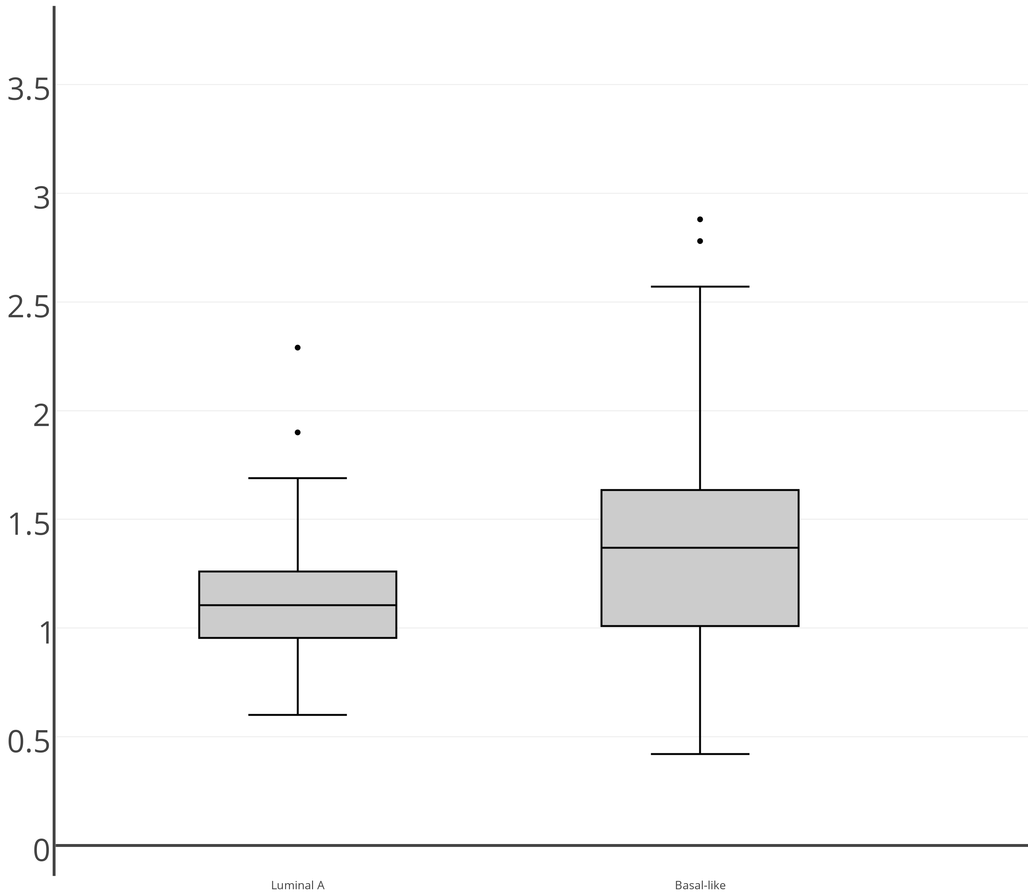




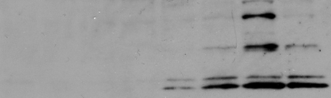


A
Figure S1
Luminal A
Normal
Basal-like
B
Luminal A cluster
C
Normal cluster
Basal-like cluster
*
Luminal A
Basal-like
Normal
SF3B4
LSM2
LSM4
LSM7
SNRPA1
SNRPB
SNRPC
SNRPD1
SNRPE
SNRPG
RNA splicing genes
(fold-changes relative to normal)
Luminal A
Basal-like
E
D
siRNA:
BPE
MB468
+
-
-
-
+
-
-
-
CTRL
-
+
-
-
-
+
-
-
PRPF8
MB436
PRPF38A
-
-
+
-
-
-
+
-
HCC1187
HCC1806
BT549
HCC1937
HCC1954
-
-
-
+
-
-
-
+
AU565
RBM22
BPE
BT474
MB468
MCF7
PRPF8
PRPF8
PRPF38A
PRPF38A
RBM22
RBM22
CASP3
(cleaved)
Tubulin
Tubulin

Slide 2
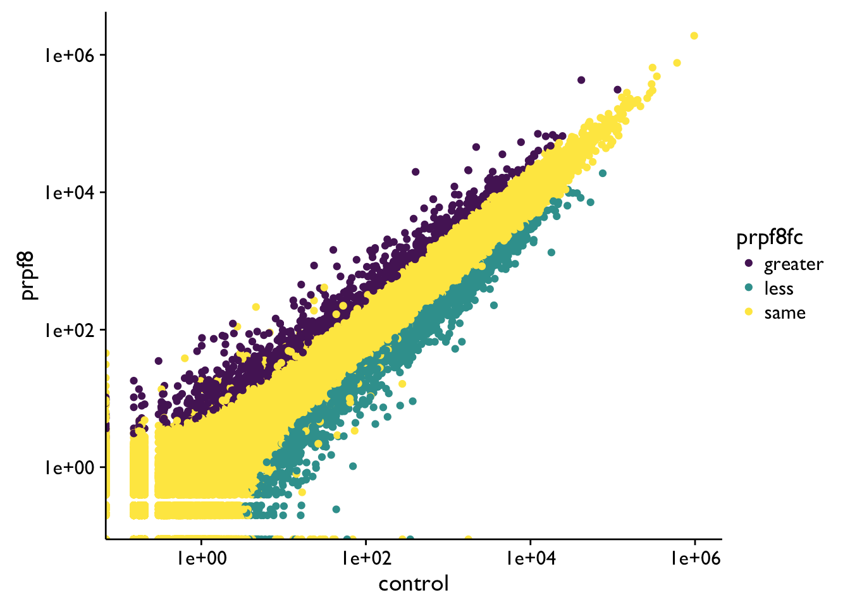
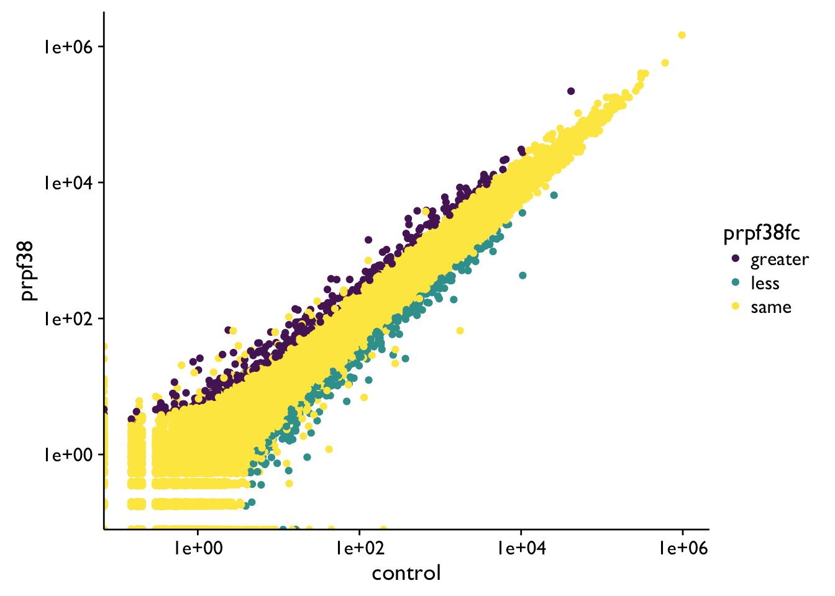
A
B
Figure S2
siRNA:
CTRL
PRPF8
01
PRPF8
02
CTRL
PRPF38A02
PRPF38A03
PRPF8 mRNA relative to
GAPDH, % of CTRL
PRPF38A mRNA relative to
GAPDH, % of CTRL
PRPF8
PRPF38A
γ-tubulin
C
D
E
PRPF8 UP
PRPF38A UP
887
406
173
Mean of normalized counts (PRPF8)
Mean of normalized counts (PRPF38A)
PRPF8 DOWN
PRPF38A DOWN
Up
Up
Down
Down
1805
456
154
Same
Same
Mean of normalized counts (Control)
Mean of normalized counts (Control)
F
G
**
*
**
* *
*
**
**
**
**
**
**
*
**
**
*
*
**
**
**
*
**
*
**

Slide 3
Figure S3
A
B
Control
PRPF8-01
PRPF8-04
siRNA:
Control
PRPF8-01
PRPF8-02
PRPF8-05
siRNA:
pHH3
Tubulin

Slide 4
Figure S4
*
****
* *
***
*
*
*
*
****
****
*
MB468
**
**
**
**
**
*
**
*
HCC1187
**
**
**
*
**
**
**
MCF7
**
**
**
**
**
**
*
BPE
**
*
**
*
**
**
**
*
BT549
**
**
**
*
*
*
*
MB436

Slide 5
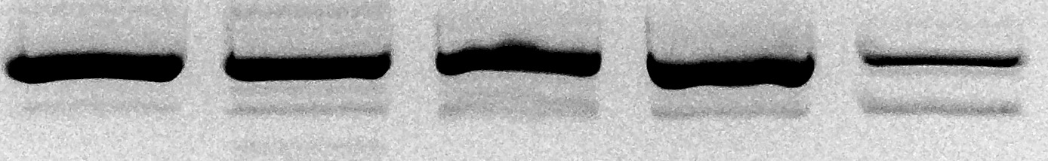
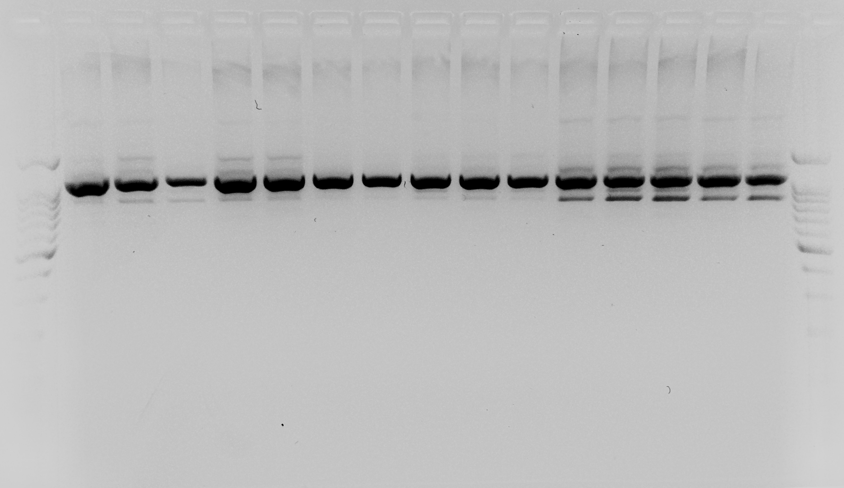
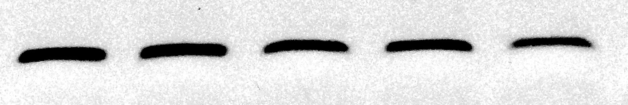
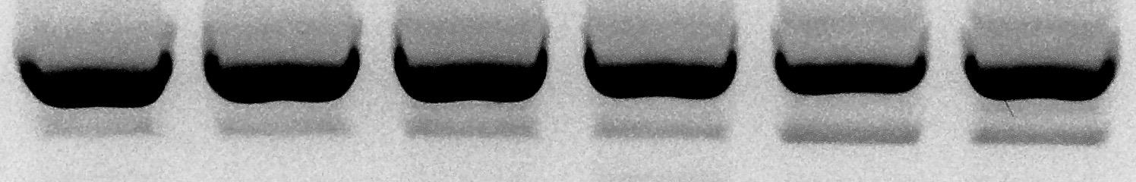
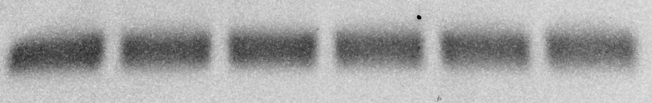
Figure S5
MB468
HCC1187
BPE
siRNA:
CTRL
PRPF8-1
PRPF8-2
PRPF8-4
PRPF8-5
CTRL
PRPF8-1
PRPF8-2
CTRL
PRPF8-1
PRPF8-2
MCL-1L
MCL-1S
*
*
*
*
*
*
*
*
GAPDH
BT549
MCF7
MB436
siRNA:
CTRL
PRPF8-1
PRPF8-2
CTRL
PRPF8-1
PRPF8-2
CTRL
PRPF8-1
PRPF8-2
MCL-1L
MCL-1S
*
*
GAPDH

Slide 6
Figure S6
A
B
*
*
*
*

Slide 7
A
Figure S7
HCC1187 (N=7)
*
*
*
*
*
Dosing

