Slide 1
Fig. 1.
A
B

Slide 2


Fig. 2.
A
B
AAV8
AAV8-GSH
AAV8-THR
AAV8-LAH4
AAV8-Angiopep-2
AAV8-TAT（48-60）
AAV8-Leptin 30（61-90）
AAV8-ApoE(159-167)2
C
D
Notes:
Add heart muscle, and lung, spleen

Slide 3








Fig. 3.
A
B
3rd day
c
7th day
AAV8
AAV8-0.001mM THR
AAV8-0.01mM THR
AAV8-0.1mM THR

Slide 4
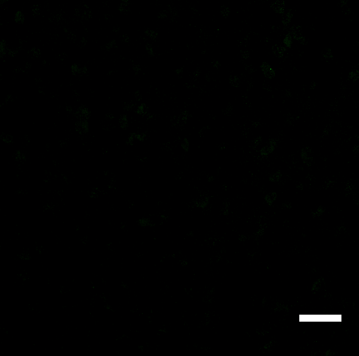
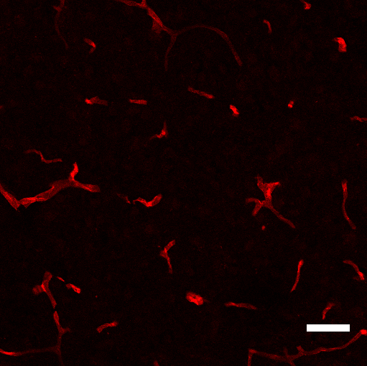
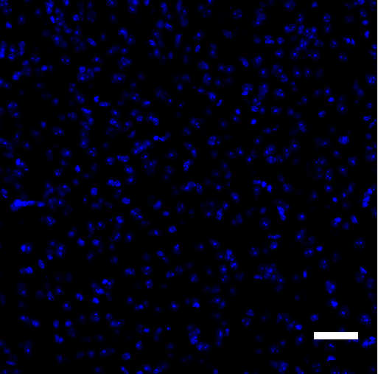
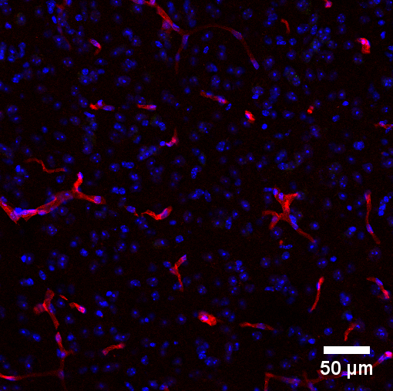
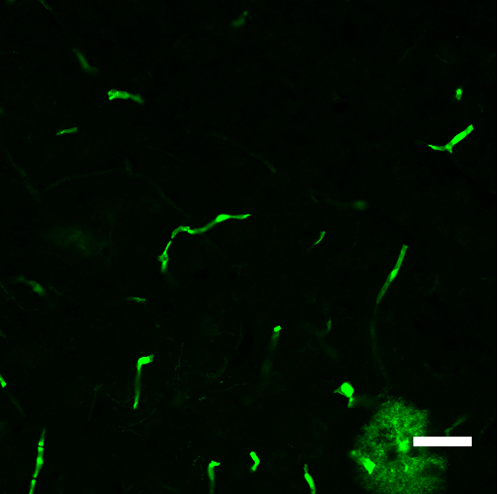
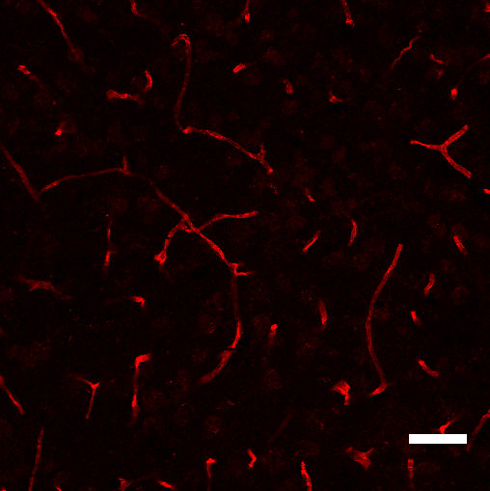
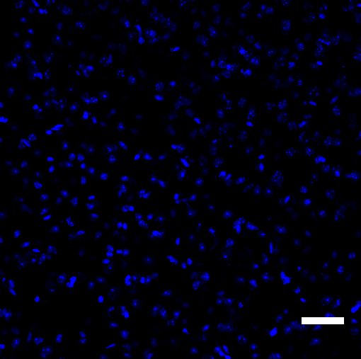
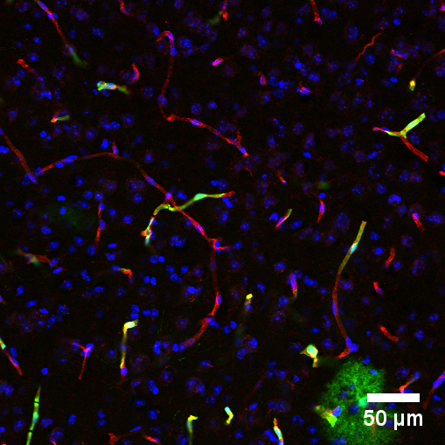
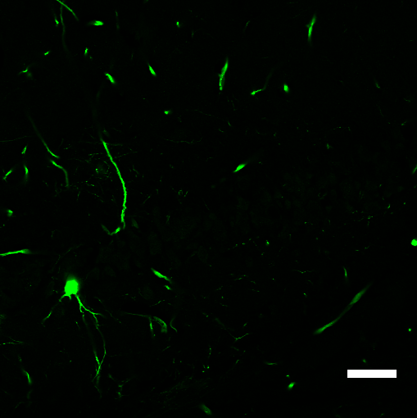
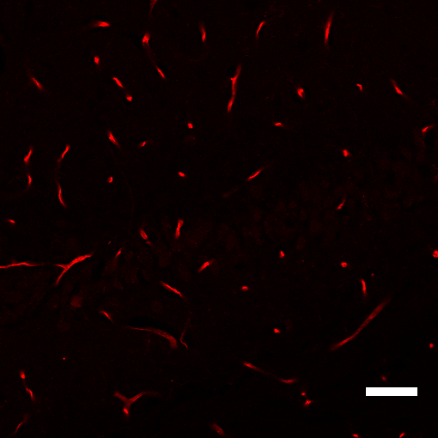
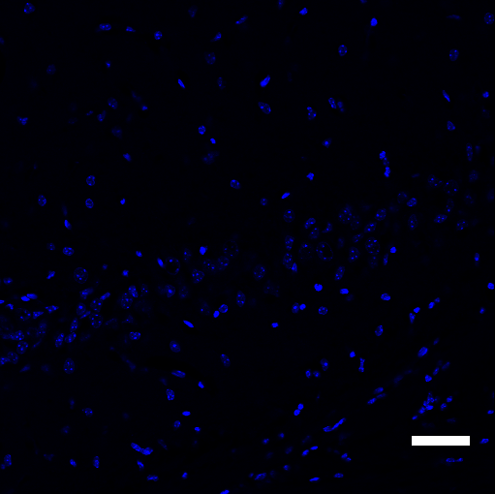
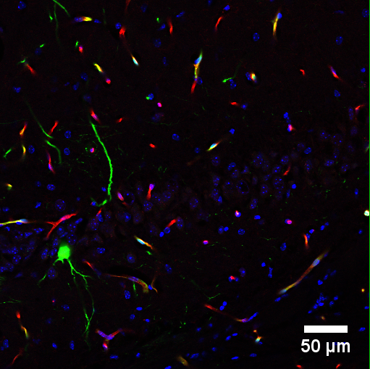
Fig. 4.
A
GFP CD31 DAPI Merged
Negative
scAAV8-CBh-eGFP
scAAV8-CBh-eGFP-THR

Slide 5
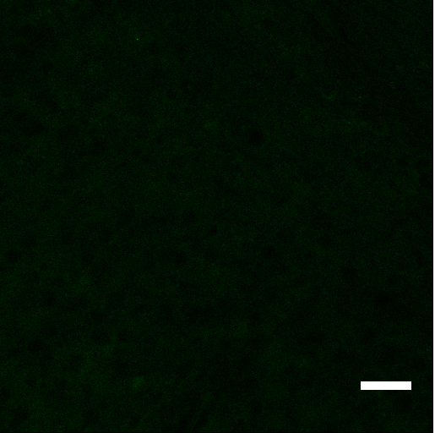
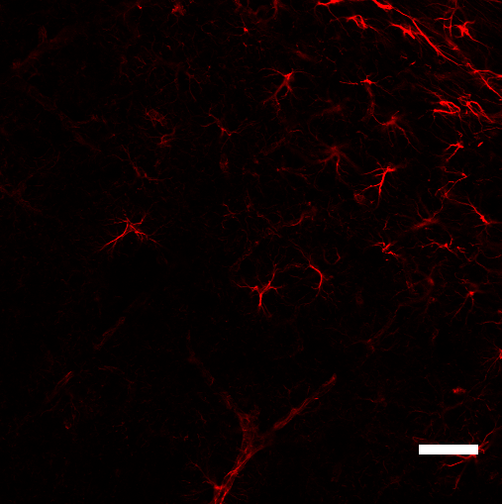
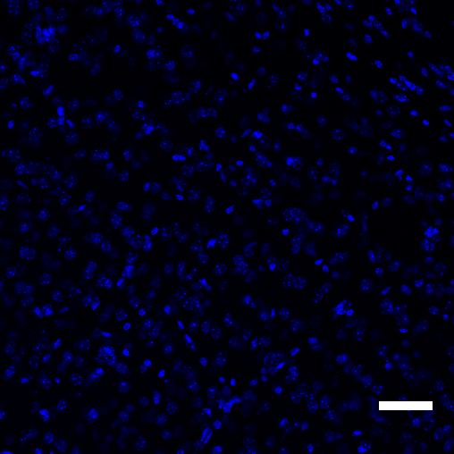
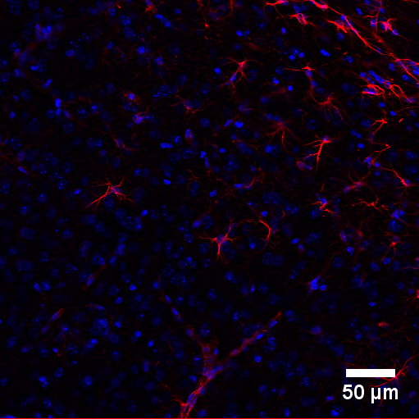
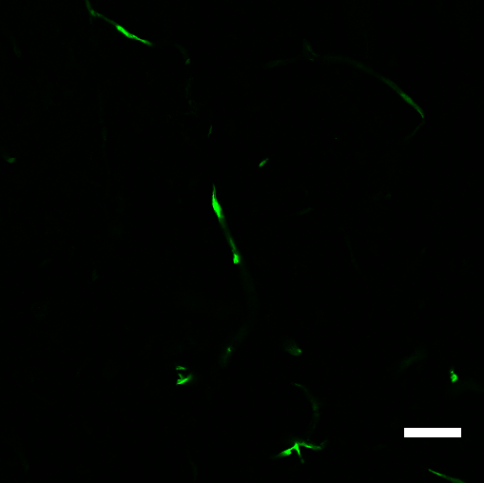
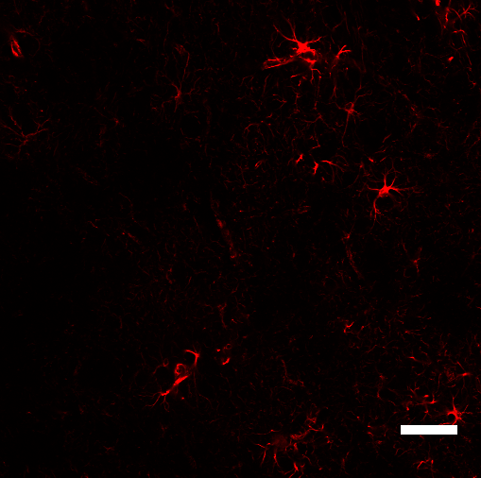
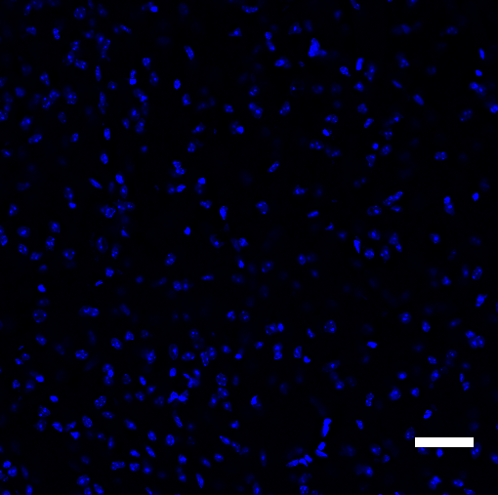
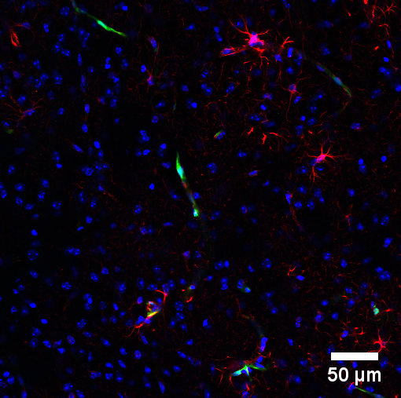
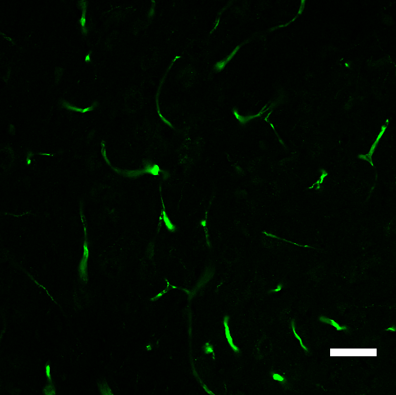
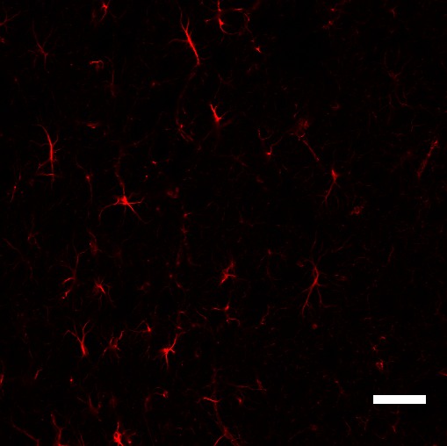
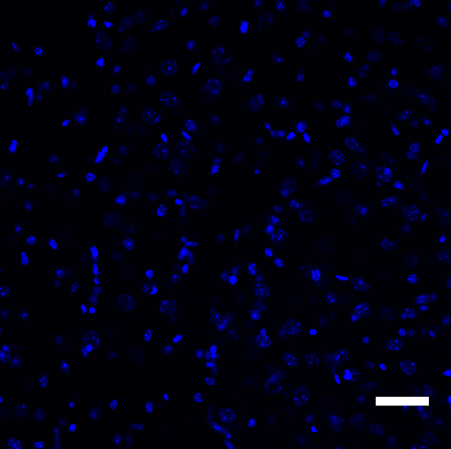
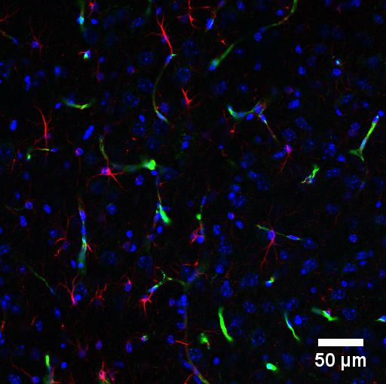
Fig. 4.
B
GFP GFAP DAPI Merged
Negative
scAAV8-CBh-eGFP
scAAV8-CBh-eGFP-THR

Slide 6
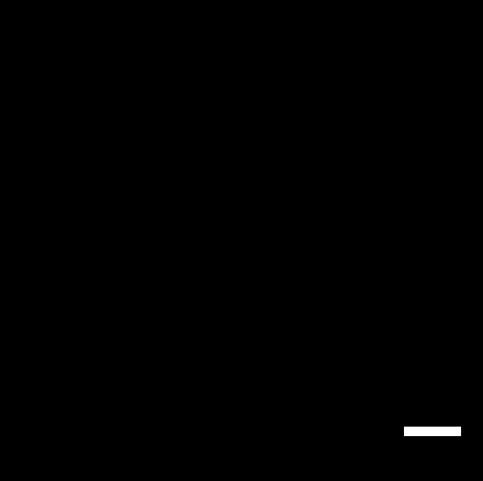
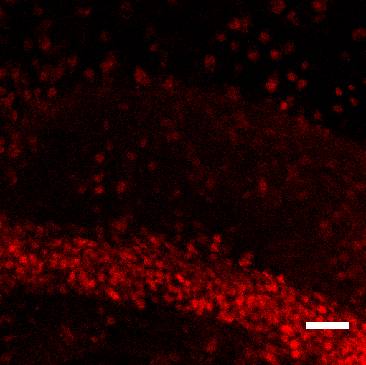
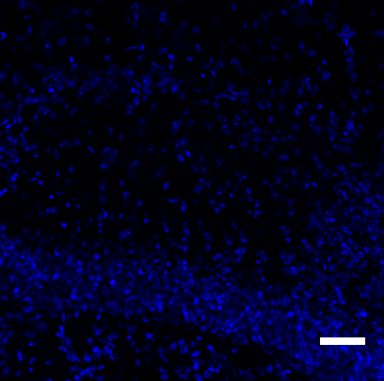
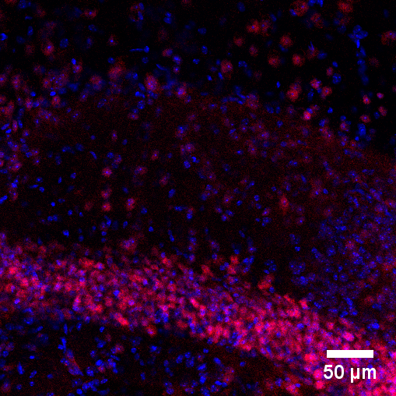
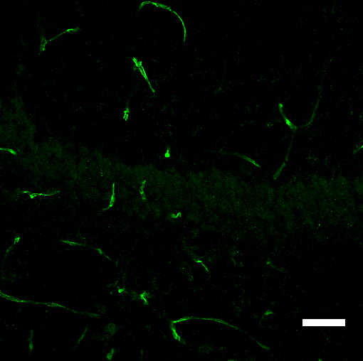
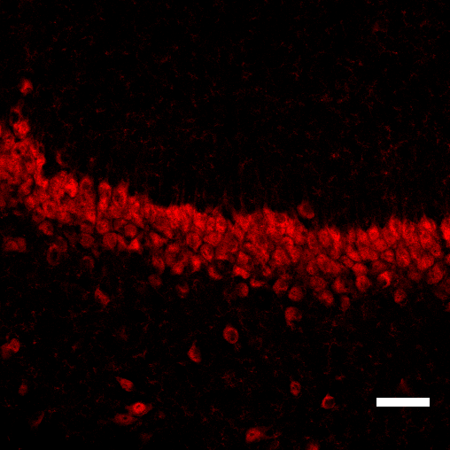
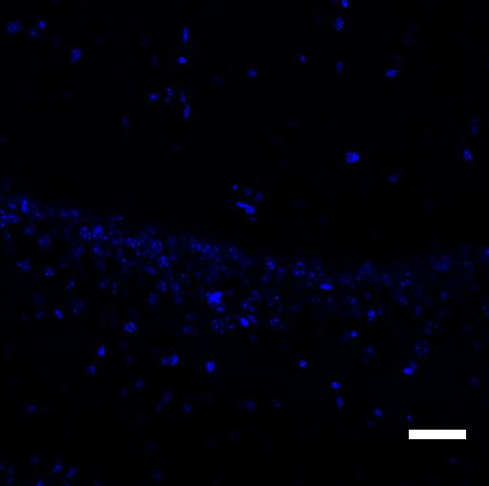
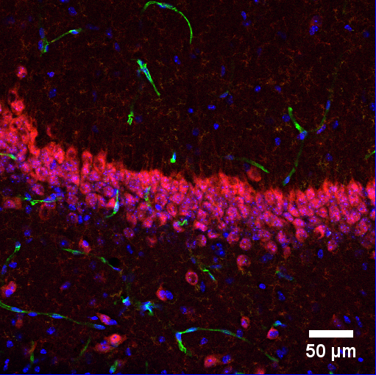
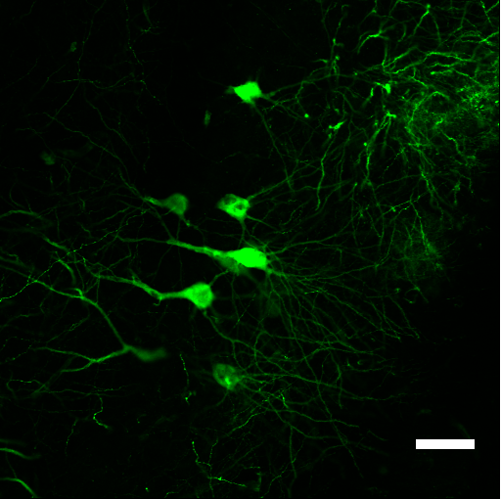
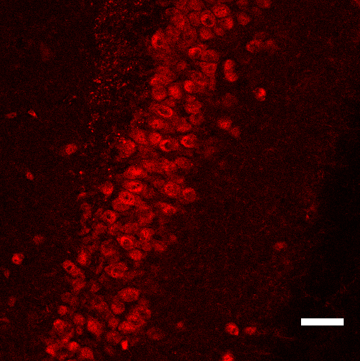
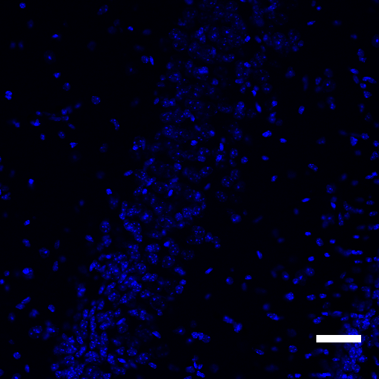
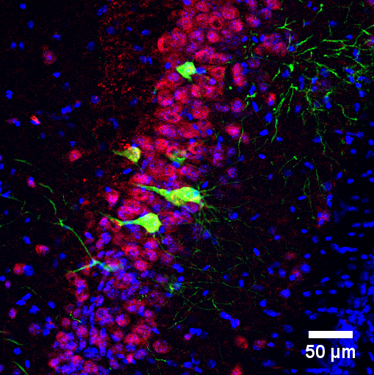
Fig. 4.
C
GFP NeuN DAPI Merged
Negative
scAAV8-CBh-eGFP
scAAV8-CBh-eGFP-THR

Slide 7
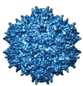














Fig. 5
B
A
3rd day
7th day
14th day
21st day
AAV8
AAV8/0.1 mM THR
AAV8-0.1 mM THR
AAV8
C
AAV8/0.1 mM THR
D
AAV8-0.1 mM THR

Slide 8
Fig. 6.
A
B

Slide 9





Fig. 7.
A
B
2nd day
7th day
AAV8
C
AAV8-0.1 mM THR

Slide 10
Fig. 8.

Slide 11
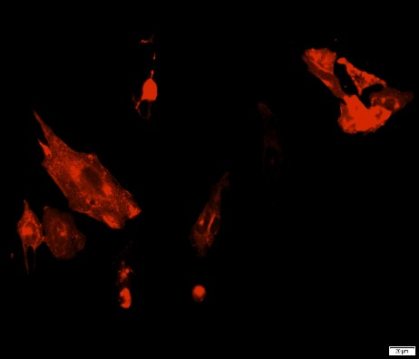
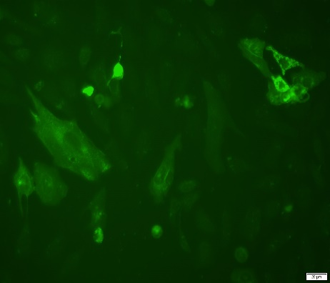
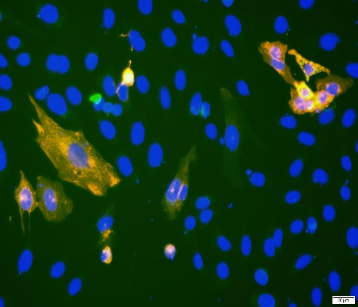
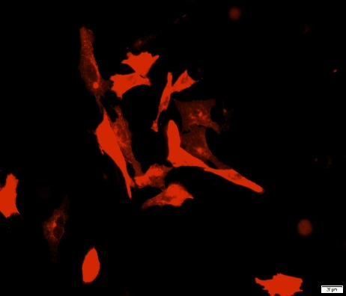
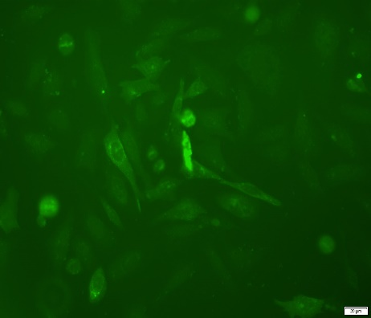
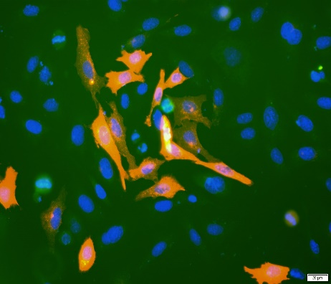
Fig. S1.
mcherry-hTfR1
5’FAM-THR
Merge
A
B
40 um
mcherry-mTfR1
5’FAM-THR
Merge

Slide 12






Fig. S2.
A
B
7th day
AAV8
AAV8-0.1mM PEPXT-1
AAV8-0.1mM PEPXT-2
AAV8-0.1mM PEPXT-3
AAV8-0.1mM PEPXT-4
C
D

Slide 13


Fig. S3.
A
B
C
6 h
48 h
AAV8/THR
AAV8-THR
No virus
AAV8
AAV8-THR
No virus
AAV8/THR
AAV8
ZO-1
GAPDH

Slide 14
Fig. S4.
A
B

Slide 15





Fig. S5.
A
3rd day
7th day
B
AAV9
AAV9-0.1mM THR

