Slide 1
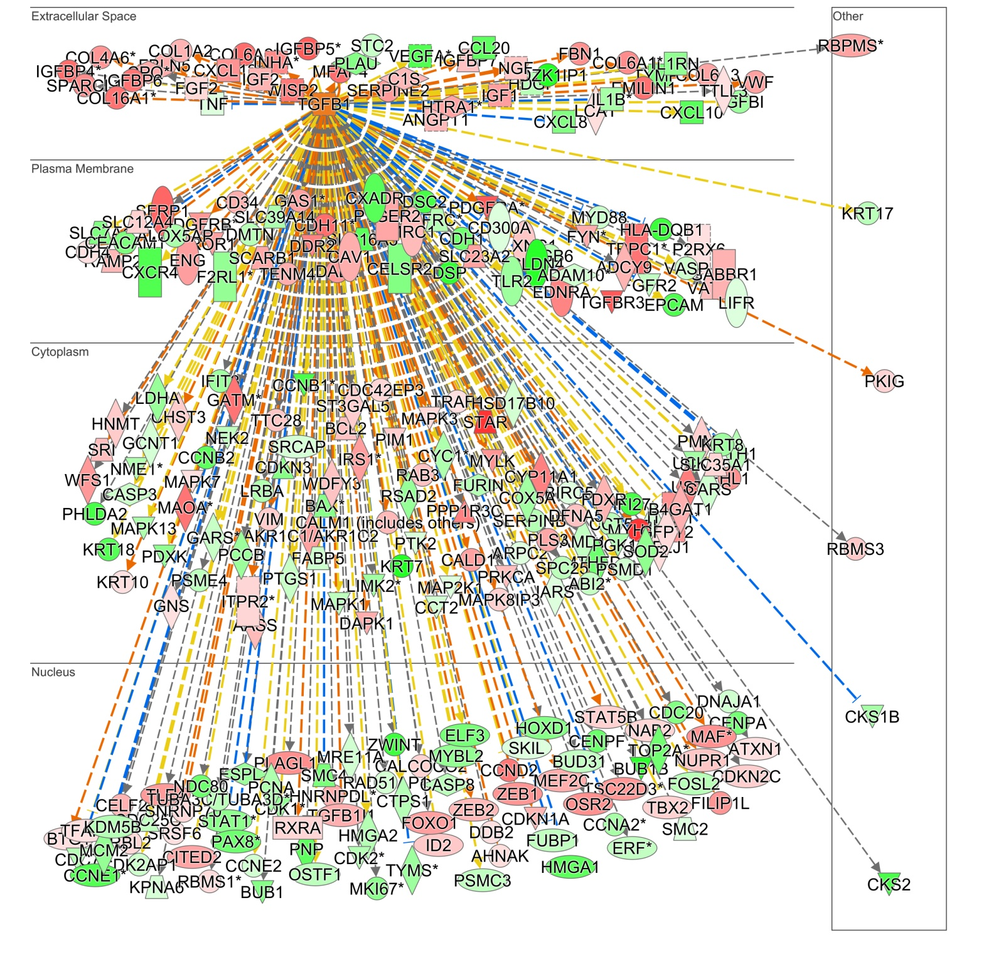
Supplementary Figure 1.
Supplementary Figure 1. Chemotherapy-associated differentially expressed genes that are regulated by TGF-β. Genes colored with green are inhibited and colored red are stimulated by chemotherapy in various cellular compartments. A yellow connection represents positive correlation and blue indicates negative correlation, gray indicates ambiguous correlation with TGF-β signal. Solid connections indicate direct regulation, while dash lines indicate indirect interaction.
Notes:
Figure2

Slide 2
Supplementary Figure 2.
Supplementary Figure 2. Density analysis of P-Smad2 and P-Smad3 bands in Figure 3. The density of corresponding total Smad2 (T-Smad2) and total Smad3 (T-Smad3) bands were used for normalization.

Slide 3
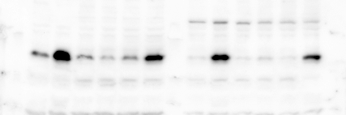
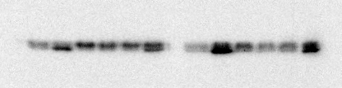




Supplementary Figure 3.
A
B
Control
β1+RER
β1+HTS
Control
β1+RER
β1+HTS
TGF-β1
TGF-β1
RER
HTS
RER
HTS
P-Smad2
P-Smad2
P-Smad3
P-Smad3
T-Smad2
T-Smad2
T-Smad3
T-Smad3
HeLa
C-4Ⅰ
Supplementary Figure 3. HeLa and C-41cellswere treated with TGF-β1 (80pM), RER (40nM) or HTS (100nM) alone or in combination for 6 h. The cell extracts were used for Western immunoblotting analysis to measure the levels of P-Smad2, P-Smad3, T-Smad2, and T-Smad3 with their respective antibodies.
Notes:
Supplementary Figure 1.

Slide 4
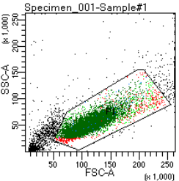
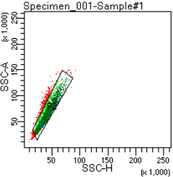
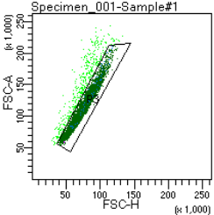
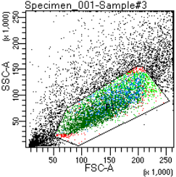
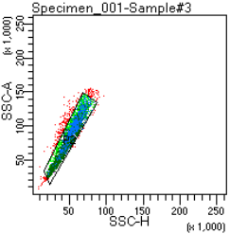
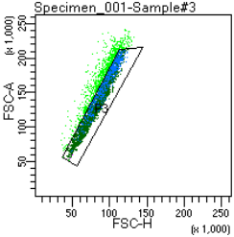
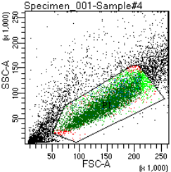
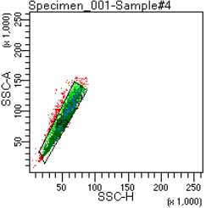
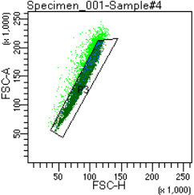
Supplementary Figure 4.
SCATTER
SSC DOUBLETS
FSC DOUBLETS
Aggregates
Cells clump
Cells clump
CONTROL
90%
Live cells
93%
Single cells
10%
86%
Debris/Dead cells
Single cells
80%
DDP
19%
93%
49%
DDP+RER
82%
19%
57%
94%
Supplementary Figure 4. Forward and side scatter (FSC and SSC) density plots for excluding dead cells and debris. Cells were analyzed using the BD FACS Celesta and FACSDiva 8.0.1.1 software. Viable and single cells were gated using FSC and SSC. The FSC eliminates the debris and SSC often characterizes the granularity. Dead cells and debris often have lower forward scatter than live cells as shown in the dot plots above. Then we gated for single cells to exclude the doublet cells from the analysis. To do so, the cells are plotted using a FSC-Height (FSC-H) vs FSC-Area (FSC-A) as well as a SSC-Height (SSC-H) vs SSC-Area (SSC-A). Doublets will have double the area as shown in the figure (population above the single cells gate).

Slide 5
Supplementary Figure 5.
A
B
Supplementary Figure 5. OVCAR-3 cells were treated with TGF-β1 (80pM), cisplatin (1μM), HTS (100nM), or RER (40nM) alone or in combination for 4 days. Total RNA was extracted for the measurements of the mRNA levels of E-cadherin and snail with qRT-PCR. Data are presented as mean±SEM. *P< 0.05; ** P< 0.01; *** P< 0.001.
Notes:
Supplementary Figure 2.

