Slide 1
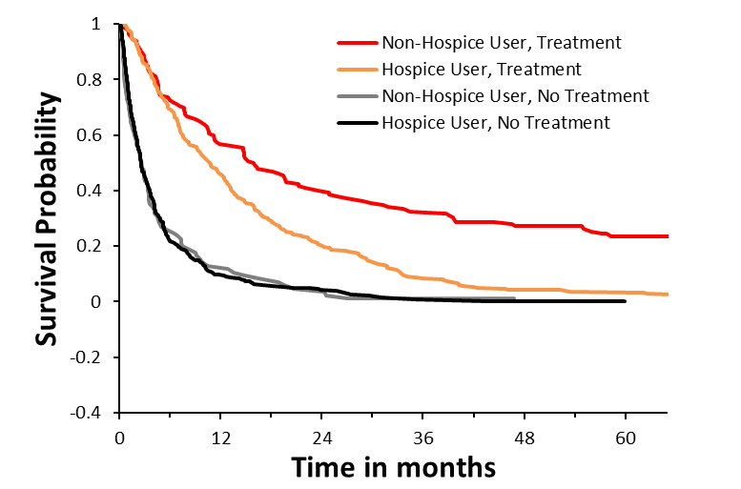
Supplemental Figure 1: Kaplan-Meier survival analysis of late stage HCC patients (BCLC stage C and D) grouped by hospice use and treatment status.
Logrank p < 0.0001
96 75 53 43 34 23
184 122 54 24 11 9
22 11 4 1 0
72 32 14 3 1 0

