Slide 1
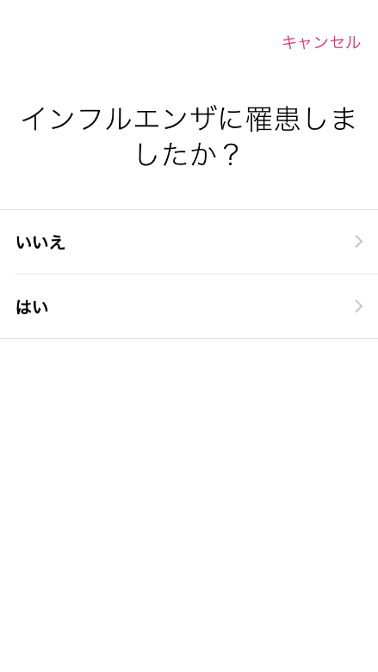

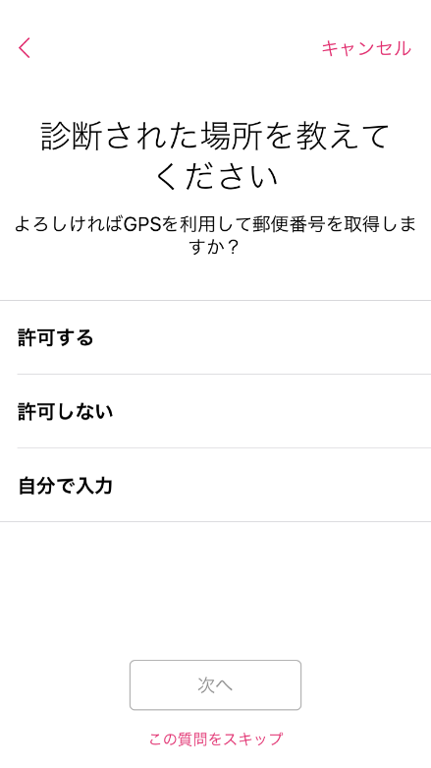
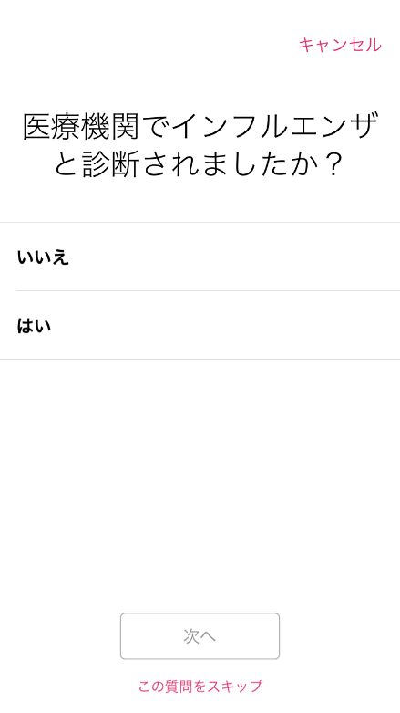
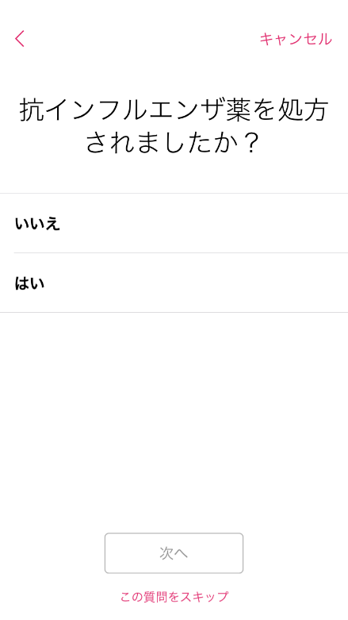
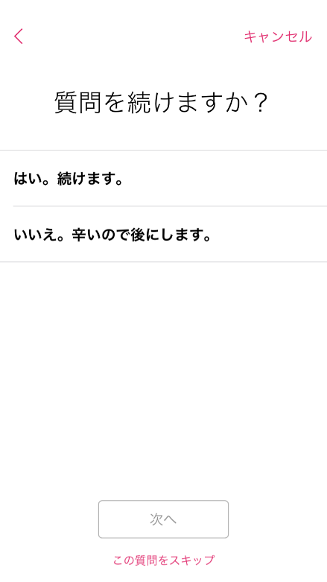
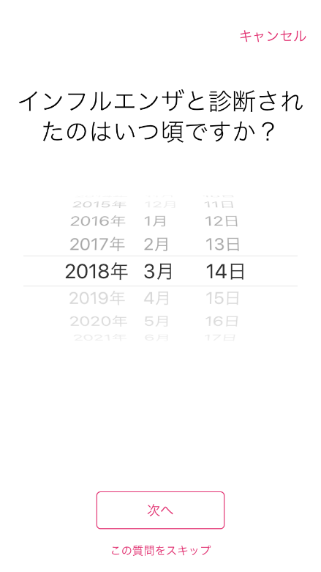
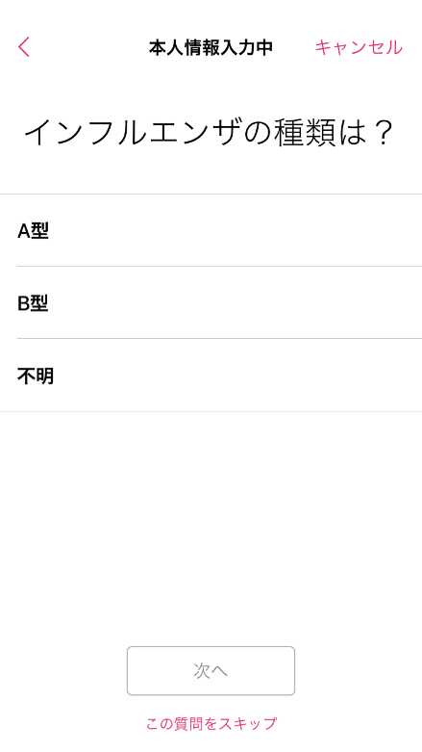
Who had influenza?
Do you have influenza?
Where were you diagnosed with influenza?
Have you been diagnosed influenza by a doctor?
No
No
Yes
Allow use of GPS
Yes
Do not allow use of GPS
Enter information yourself
Can you continue to answer the questionnaire?
What type of influenza did you have?
Did the doctor prescribe you antivirals?
Yes
When were you diagnosed with influenza?
Influenza A type
No
No
Influenza B type
Yes
Unknown type

Slide 2
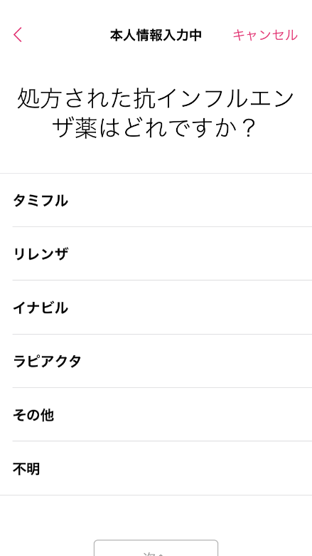
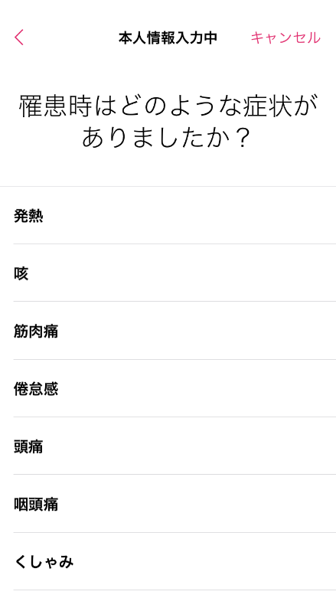
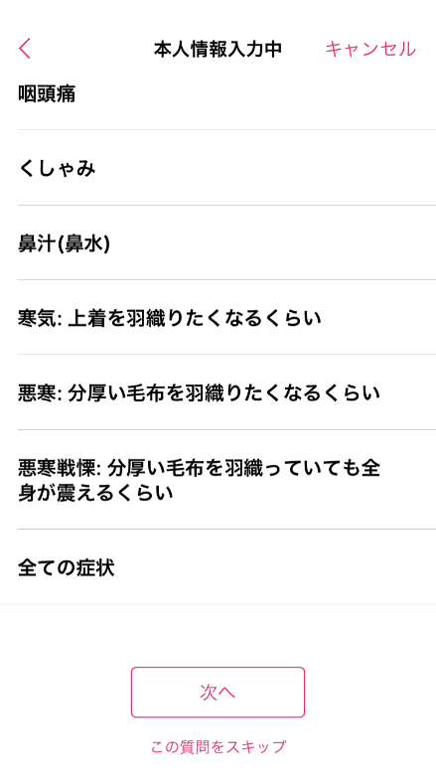
Sore throat
Sneezing
What antiviral was prescribed by a physician?
What symptoms do you have now?
Runny nose
Tamiflu
Fever
Relenza
Cough
Chills (enough to wear a coat)
Inavir Dry Powder Inhaler
Muscle pain
Chills (requiring a thick blanket)
RAPIACTA
Malaise
Chills (cannot stop trembling)
Others
Headache
All symptoms
Unknown
Sore throat
Sneezing

