Slide 1
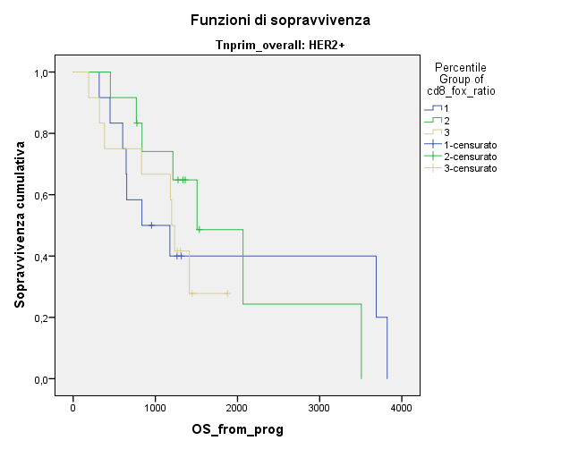
Figure S1. Overall survival for HER2+ patients according to CD8/FOXP3 ratio.
100
CD8/FOXP3 ratio 1° tertile
CD8/FOXP3 ratio 2° tertile
80
CD8/FOXP3 ratio 3° tertile
60
OS%
40
20
Log-rank p=0.693
0
10
40
70
100
130
MONTHS
Percentile group of CD8/FOXP3 ratio | n | Median OS | 95% CI
1 | 12 | 27,51 m | 0,88-54,15
2 | 12 | 1,63 m | 25,64-73,52
3 | 12 | 1,29 m | 36,57-42,26

