Slide 1
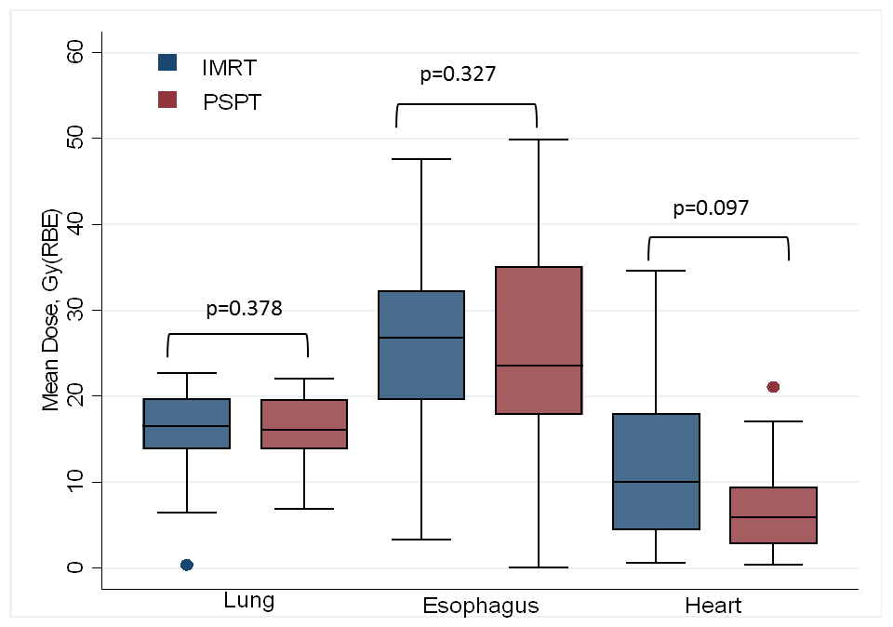
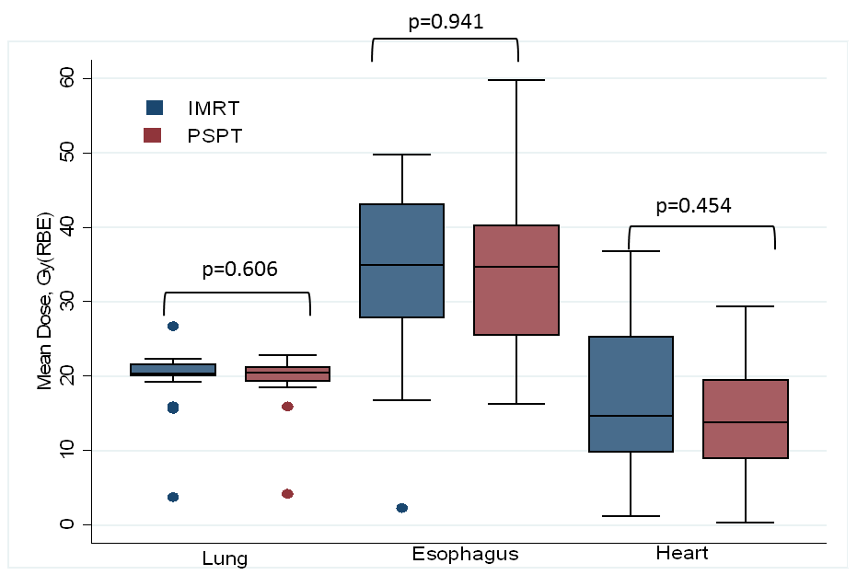
Liao et al., Suppl Fig S1 (corresponds to Fig 2A}. Mean dose to lung, esophagus, and heart for patients given IMRT (blue) or PSPT (red) in the intent-to-treat (ITT) group (n=173), left, and the non-randomizable group (n=39), right.
Intent-to-treat group
Non-randomizable group

Slide 2
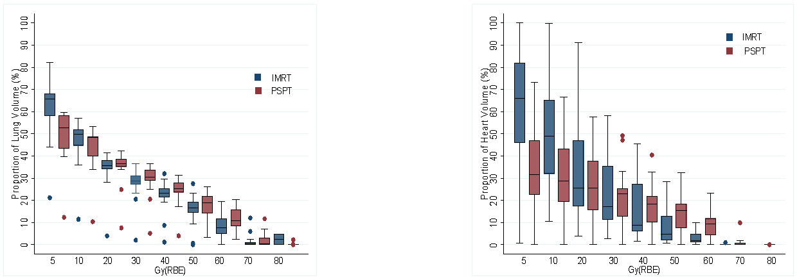
Liao et al., Suppl Fig S2 (corresponds to Fig 2B). Dose volume histogram data for lung, left, and heart, right, for patients given IMRT (blue) or PSPT (red) in the intent-to-treat (ITT) group, top, and the non-randomizable group, bottom. In the ITT group, the volume of the lung receiving >20 Gy(RBE) was higher in the PSPT group than in the IMRT group, but PSPT protected the heart at all dose levels.
ITT group (n=173)
Non-randomizable
group (n=39)

Slide 3
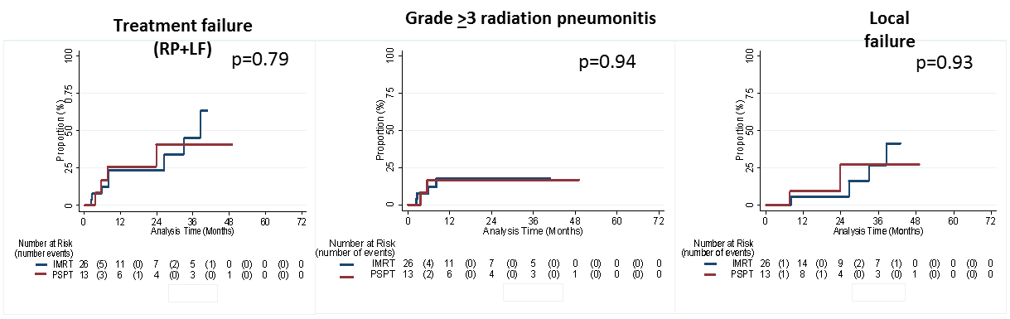
Liao et al., Suppl Fig S3 (corresponds to Fig 3). Comparison of combined primary endpoint (grade ≥3 radiation pneumonitis and local failure), left, RP-only middle, and LF-only, right, between IMRT (blue) and PSPT (red), for the intent-to-treat group (n=-173), top, and the non-randomizable group (n=39), bottom. No differences were found in the primary endpoints between treatment groups in either comparison.
Treatment failure (RP+LF)
Grade >3 radiation pneumonitis
Local failure
p=0.78
p=0.58
p=0.99

Slide 4
Liao et al., Suppl Fig S4. Overall survival by IMRT (blue) vs. PSPT (red) for the randomized group (n=149), right; for the intent-to-treat group (n=173), middle; and the non-randomizable group (n=39), right. Overall survival did not differ by treatment type in any of the three groups.
P=0.30
P=0.30
p=0.97
Notes:
Supplemental Figure 1. Overall survival of patients who were randomized and treated according to protocol for all (right), and for IMRT (left, blue line) and PSPT (left, red line). There is no statistical significant differences between the two groups. Results from analyses as intent to treat, and treatment received for all randomized and non-randomized patients showed consistent finding.

Slide 5
Liao et al., Suppl Fig S5 (corresponds to Fig 4A). Primary endpoints (treatment failure, i.e., radiation pneumonitis and local failure) between patients enrolled before Sept 27, 2011 (early; blue lines) or afterward (later; red lines) for patients treated with IMRT, left, or PSPT, right, for the intent-to-treat group (n=173), top, and the non-randomizable group (n=39), bottom. Among the ITT group, patients enrolled later did better regardless of treatment type (IMRT vs PSPT).
Treatment failures, IMRT group
Treatment failures, PSPT group
ITT group (n=173)
Non-randomizable
group (n=39)

Slide 6
Liao et al., Suppl Fig S6 (corresponds to Fig 4B). Radiation pneumonitis between patients enrolled before Sept 27, 2011 (early; blue lines) or afterward (later; red lines) for patients treated with IMRT, left, or PSPT, right, for the intent-to-treat group (n=173), top, and the non-randomizable group (n=39), bottom. Among the intent-to-treat group given IMRT, RP was no different by enrollment time; however, RP was better among patients given PSPT who were enrolled later.
RP, IMRT group
RP, PSPT group
p=0.44
ITT group (n=173)
p=0.01
p=0.43
p=0.85
Non-randomizable
group (n=39)

