Slide 1
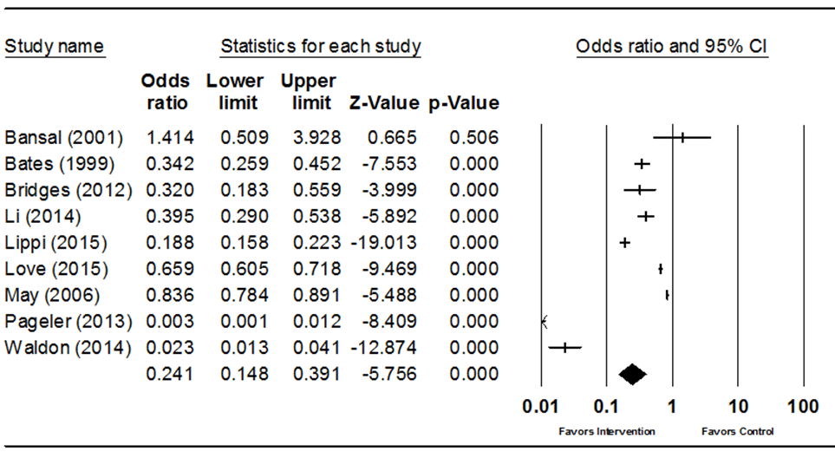
Supplemental Figure 1 - CPOE modifications subgroup forest plot: redundant test alerts

Slide 2
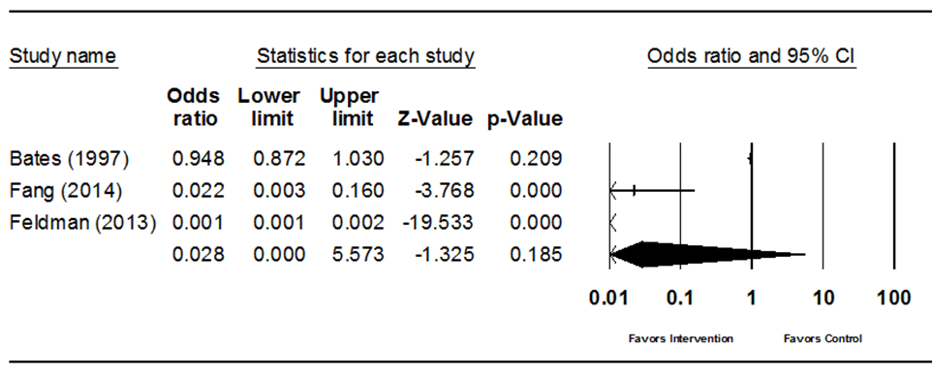
Supplemental Figure 2 – CPOE modifications subgroup forest plot: display of test cost

Slide 3
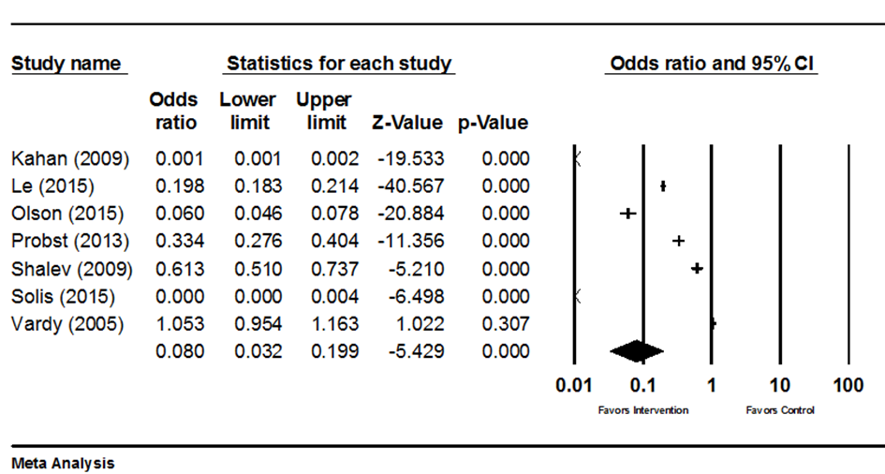
Supplemental Figure 3 - CPOE modifications subgroup forest plot: limit test availability

Slide 4
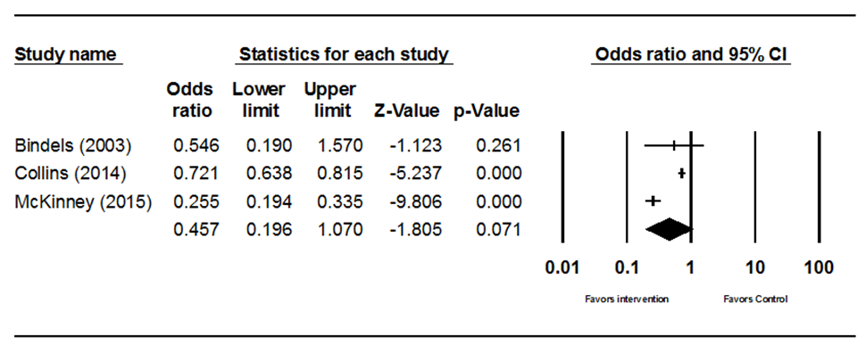
Supplemental Figure 4 – CDSS/CDST subgroup forest plot: reminder of guidelines

Slide 5
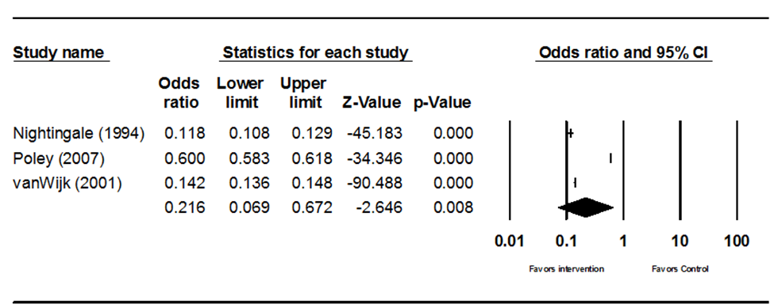
Supplemental Figure 5 – CDSS/CDST subgroup forest plot: proposed testing

Slide 6
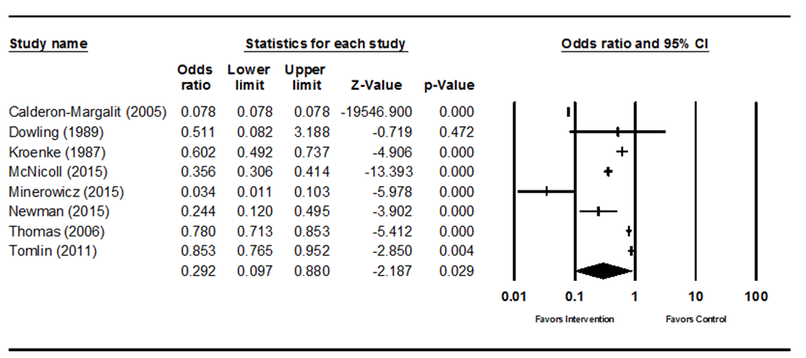
Supplemental Figure 6 - Combined practices subgroup forest plot: education + feedback

Slide 7
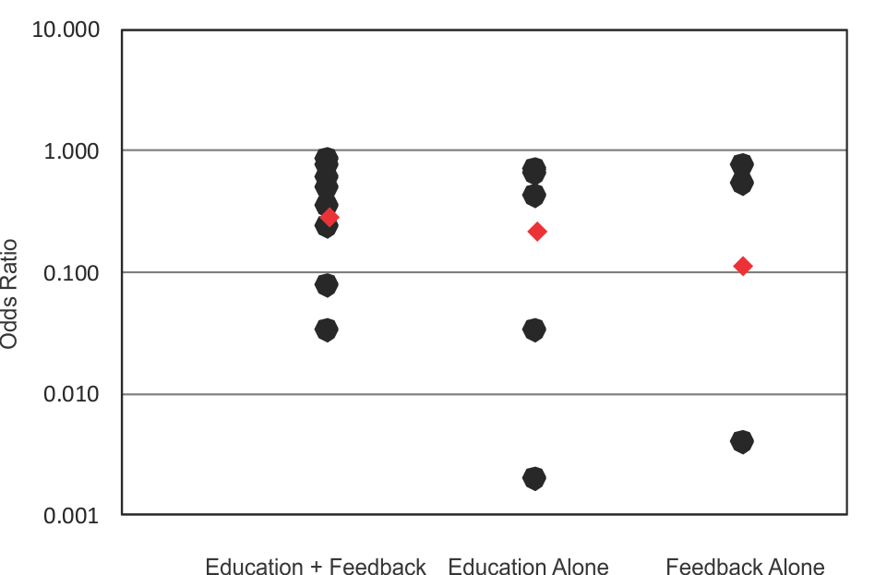
Supplemental Figure 7 - Comparison of effects of education + feedback combination studies to education-alone and feedback-alone studies
Dots represent effect size point estimates for the individual studies, diamonds represent the pooled effect point estimate for the group of studies

Slide 8
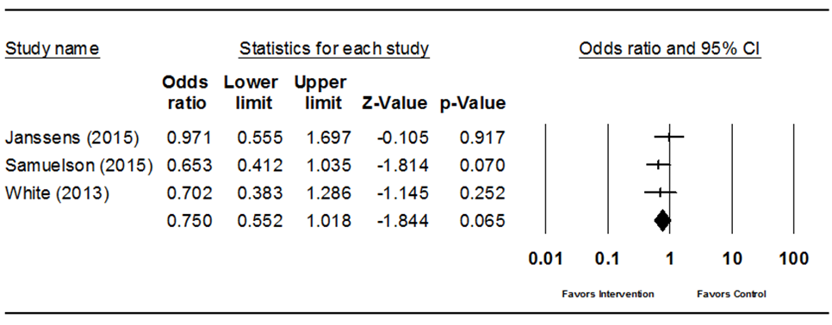
Supplemental Figure 8 - Combined practices subgroup forest plot: CDSS and/or CPOE component

Slide 9
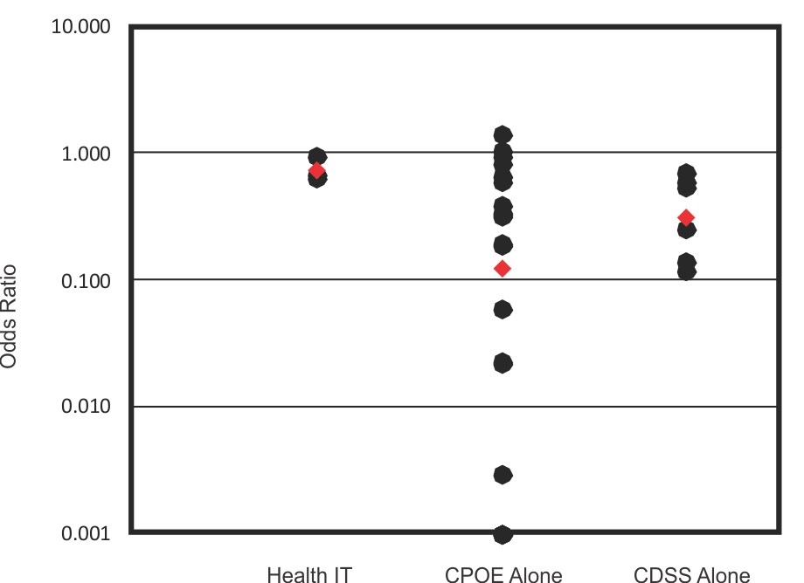
Supplemental Figure 9 - Comparison of effects of CDSS and/or CPOE combination studies to CPOE-alone and CDSS-alone studies
Dots represent effect size point estimates for the individual studies, diamonds represent the pooled effect point estimate for the group of studies

Slide 10
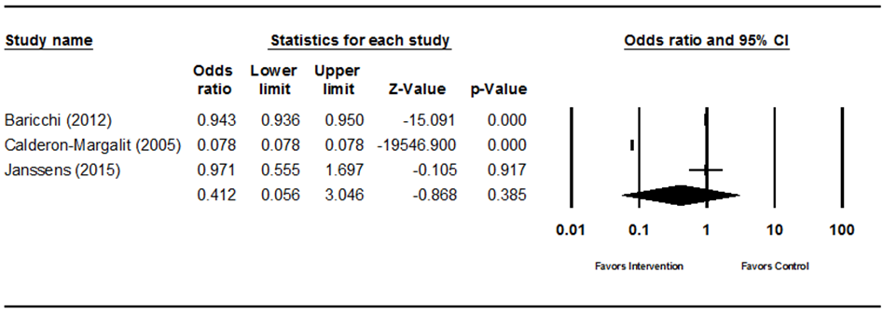
Supplemental Figure 10 - Combined practices subgroup forest plot: LTU component

Slide 11
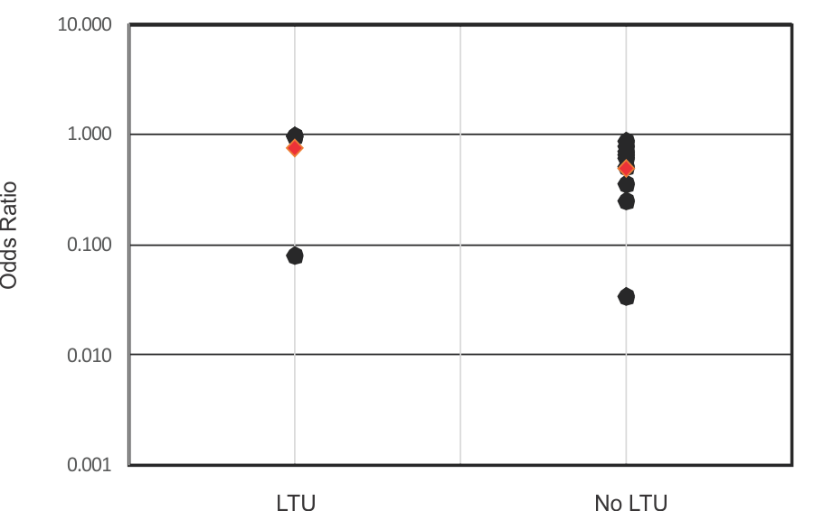
Supplemental Figure 11 - Comparison of effects of combination studies with an LTU component to combination studies without an LTU component
Dots represent effect size point estimates for the individual studies, diamonds represent the pooled effect point estimate for the group of studies

Slide 12
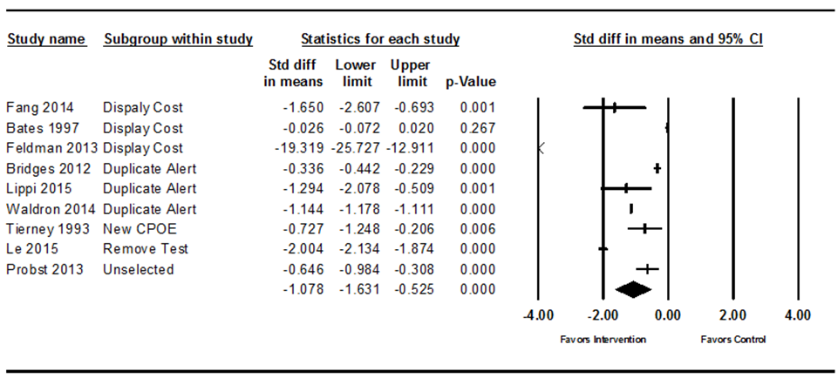
Supplemental Figure 12 – Forest plot and strength of evidence for cost of tests outcome within CPOE modification practice
Study | Quality Rating | Effect Size Rating | Overall Strength of Evidence of Effectiveness Rating
Bates 1997 | Fair | Minimal | High 3 Studies = Good/Substantial 2 Studies = Fair/Substantial 2 Studies = Fair/Moderate 1 Studies = Good/Minimal 1 Studies = Fair/Minimal
Bridges 2012 | Good | Minimal*
Fang 2014 | Good | Substantial*
Feldman 2013 | Good | Substantial*
Le 2015 | Fair | Substantial*
Lippi 2015 | Fair | Substantial*
Probst 2013 | Fair | Moderate*
Tierney 1993 | Fair | Moderate*
Waldron 2014 | Good | Substantial*
 |  | * p<0.05

Slide 13
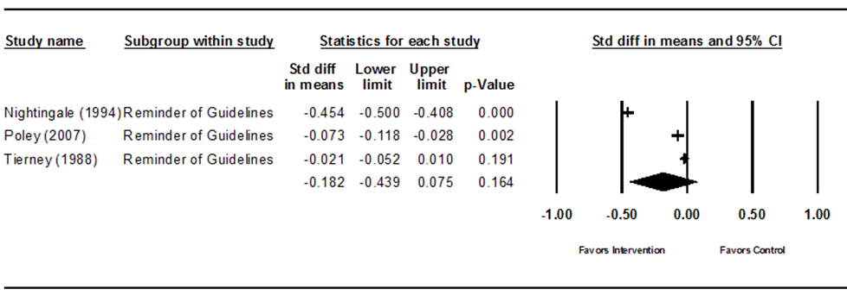
Supplemental Figure 13 – Forest plot for cost of tests outcome within CDSS/CDST practice
Study | Quality Rating | Effect Size Rating | Overall Strength of Evidence of Effectiveness Rating
Nightingale 1994 | Fair | Minimal* | Insufficient 1 Study = Good/Minimal 2 Studies = Fair/Minimal
Poley 2007 | Good | Minimal*
Tierney 1988 | Fair | Minimal
 |  | * p<0.05

Slide 14
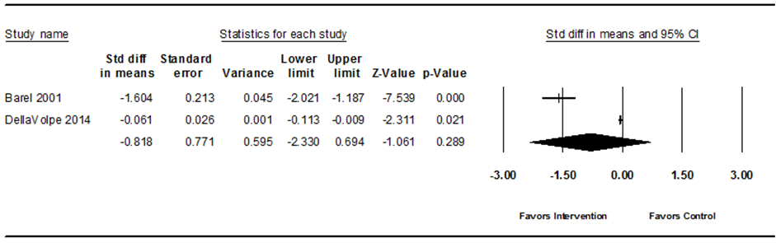
Supplemental Figure 14 – Forest plot and strength of evidence for cost of tests outcome within education practice
Study | Quality Rating | Effect Size Rating | Overall Strength of Evidence of Effectiveness Rating
Baral 2001 | Fair | Substantial* | Insufficient 1 Study = Fair/Substantial 1 Study = Fair/Minimal
DellaVolpe 2014 | Fair | Minimal*
 |  | * p<0.05

Slide 15
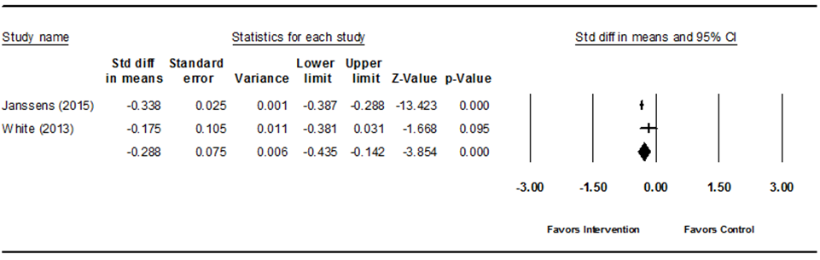
Supplemental Figure 15 – Forest plot and strength of evidence for cost of tests outcome within combined practices category
Study | Quality Rating | Effect Size Rating | Overall Strength of Evidence of Effectiveness Rating
Janssens 2015 | Good | Minimal* | Insufficient 2 Studies = Good/Minimal
White 2013 | Good | Minimal
 |  | * p<0.05

