Slide 1
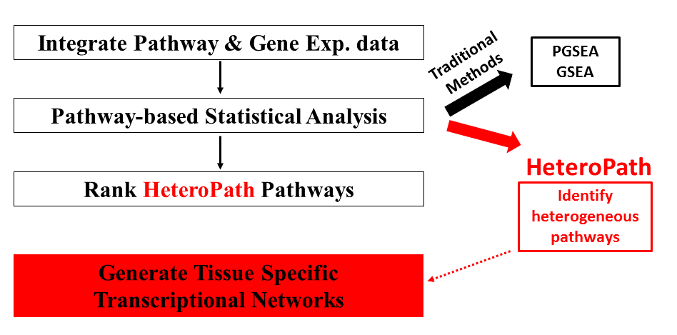
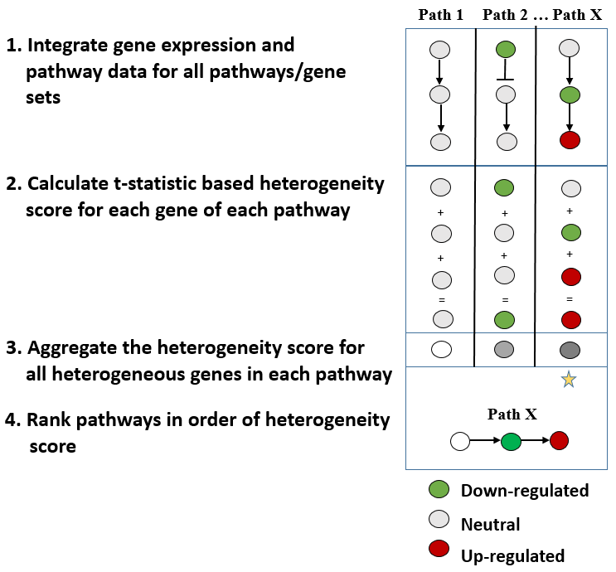
Figure 1
A
B
Down-regulated
Median expression
Up-regulated

Slide 2
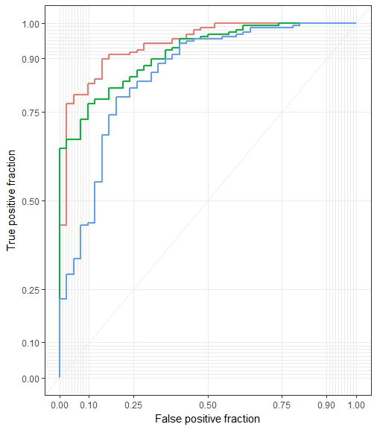
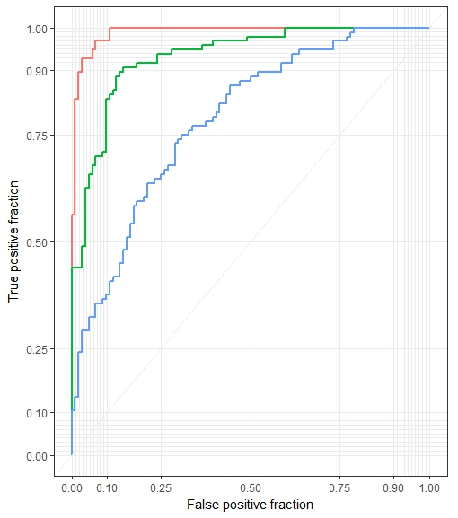
Figure 2
A
Pathway Analysis Methods | Top 10 pathways (enrichment score) | Top 10 p-values | Number of Significant Sets | Unique significant sets (%)
HeteroPath | 2.19 | 4.3E-4 | 56 | 25%
GSEA | 1.53 | 6.8E-2 | 81 | 20%
PGSEA | 10.90 | 8.8E-28 | 96 | 29%
B
Pathway Analysis Methods | Top 10 pathways (enrichment score) | Top 10 p-values | Number of Significant Sets | Unique significant sets (%)
HeteroPath | 6.72 | 3.3E-7 | 39 | 55%
GSEA | 1.07 | 4.2E-2 | 48 | 46%
PGSEA | 1.33 | 9.8E-3 | 51 | 45%
C
D
fc=3 AUC = 0.8633 CI: 0.79 – 0.93 p-val: 0.0442
fc=3 AUC = 0.9549 CI: 0.91 – 0.99 p-val: 0.0033
fc=2 AUC = 0.8514 CI: 0.82 – 0.88 p-val: 0.0117
fc=2 AUC = 0.8877 CI: 0.86 – 0.89 p-val: 0.0027
fc=1.5 AUC=0.7856 CI: 0.74 – 0.81 p-val: 0.0343
fc=1.5 AUC=0.7192 CI: 0.66 – 0.77 p-val: 0.0145

Slide 3
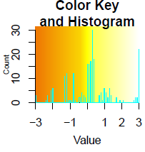
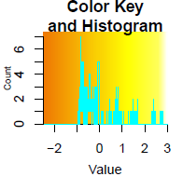
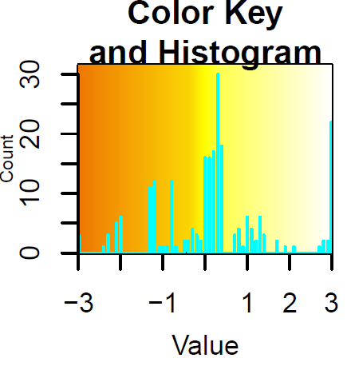
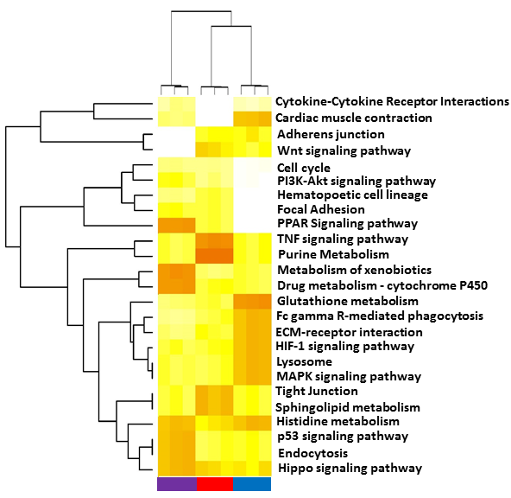
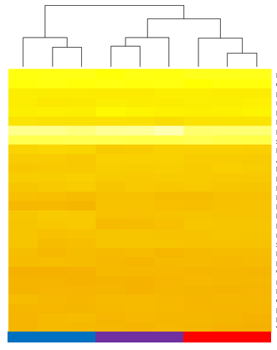
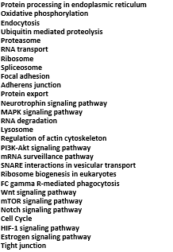
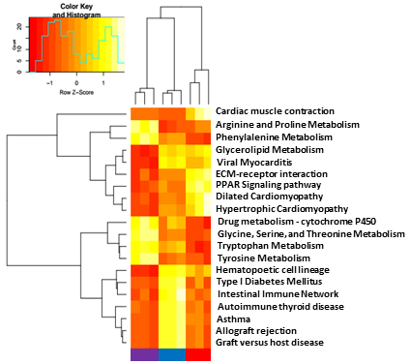
A
HeteroPath
Figure 3
B
GSEA
Row Z-score
Row Z-score
Brain ECs
Heart ECs
Lung ECs
C
PGSEA
D
PGSEA
GSEA
HeteroPath
28
Row Z-score
18
41
9
15
14
16

Slide 4
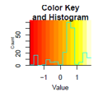
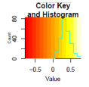
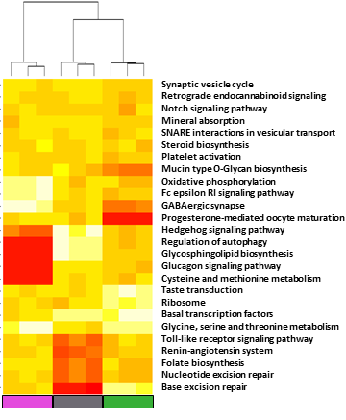
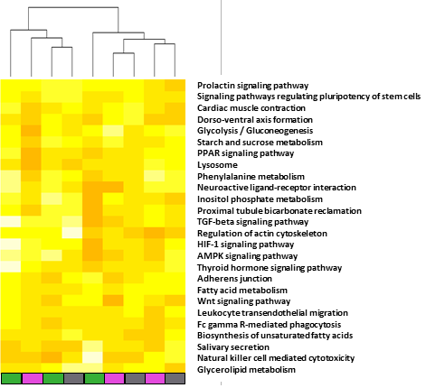

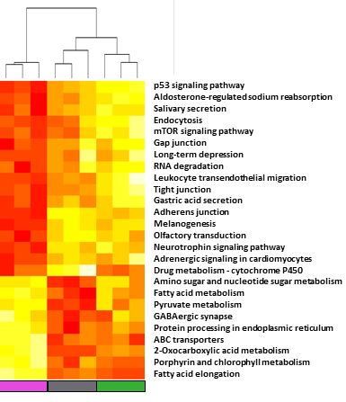
A
HeteroPath
B
GSEA
Figure 4
Row Z-score
Row Z-score
Amygdala Neurons
Hippocampal Neurons
Cingulate Cortex Neurons
C
PGSEA
D
PGSEA
GSEA
HeteroPath
Row Z-score
23
9
13
6
7
17
22

Slide 5
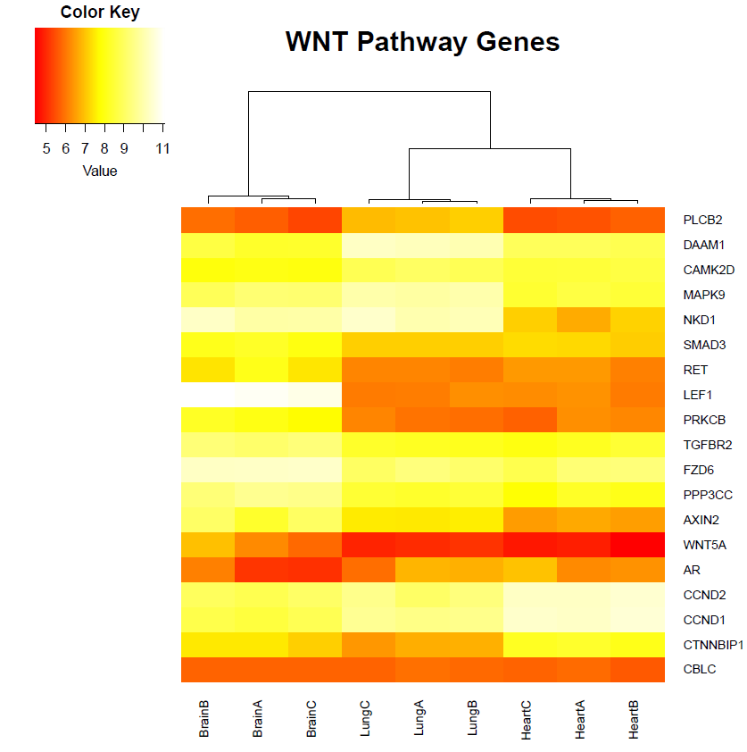
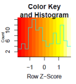
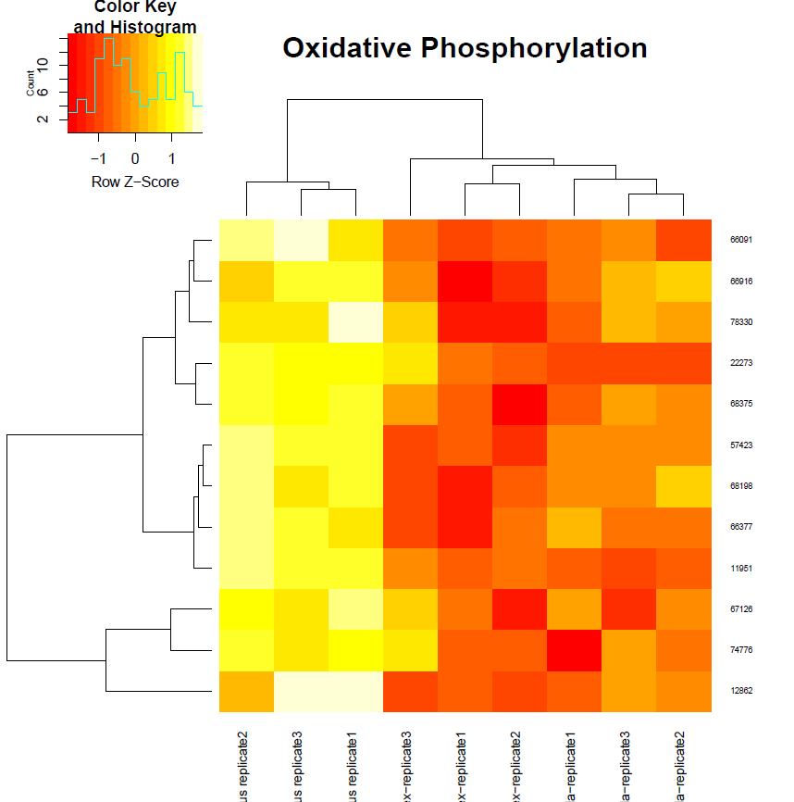
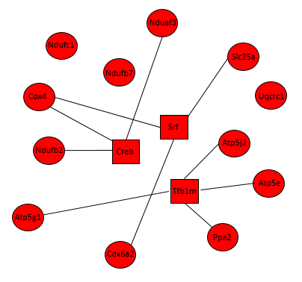
A
B
Figure 5
Wnt Signaling Pathway
Row Z-score
Row Z-score
PLCB2
DAAM1
CAM2KD
MAPK9
NKD1
SMAD3
RET
LEF1
PRKCB
TGFBR2
FZD6
PPP3CC
AXIN2
WNT5A
AR
CCND2
CCND1
CTNNBIP1
CBLC
Upregulated gene
Downregulated gene
Brain ECs
Heart ECs
Lung ECs
C
Upregulated transcription factor
TF binds motif in promoter of target gene
D
Row Z-score
Nduaf3
Ndufb7
Slc25a12
Uqcrc1
Cox4
Atp5j2
Ndufb2
Ndufc1
Atp5g1
Atp5e
Ppa2
Cox6a2
Amygdala Neurons
Hippocampal Neurons
Cingulate Cortex Neurons

Slide 6
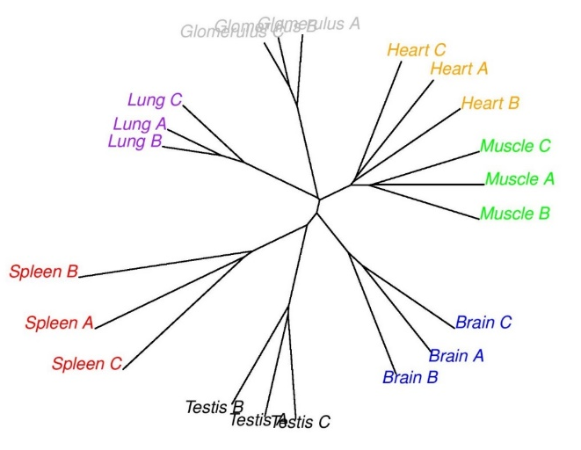
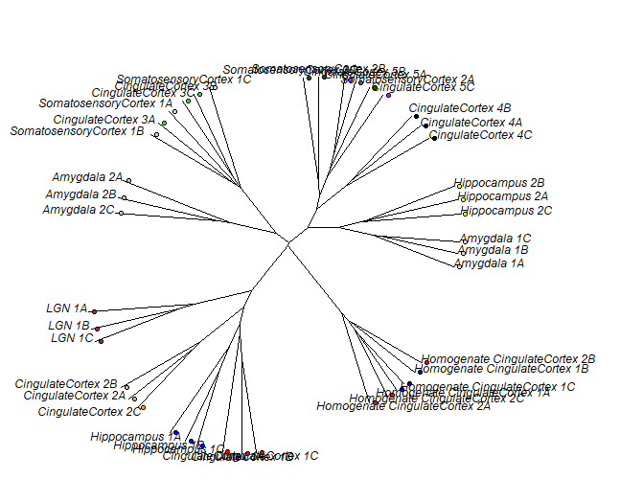
A
Sup. Figure 1
B

Slide 7
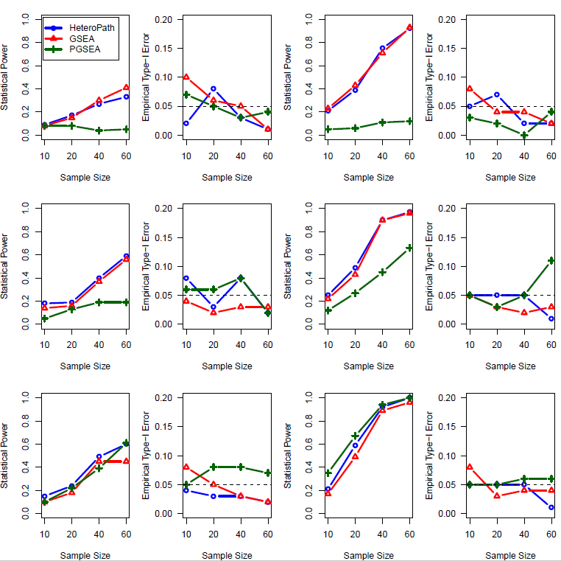
Sup. Figure 2
Gene Set size: 50 genes, Weak and Strong signal-to-noise ratios, Fraction of DEGs: 25%, 50%, and 80%
Weak Signal to Noise Ratio (0.5)
Strong Signal to Noise Ratio (1.0)
25%
DEGs
50%
DEGs
80%
DEGs

Slide 8
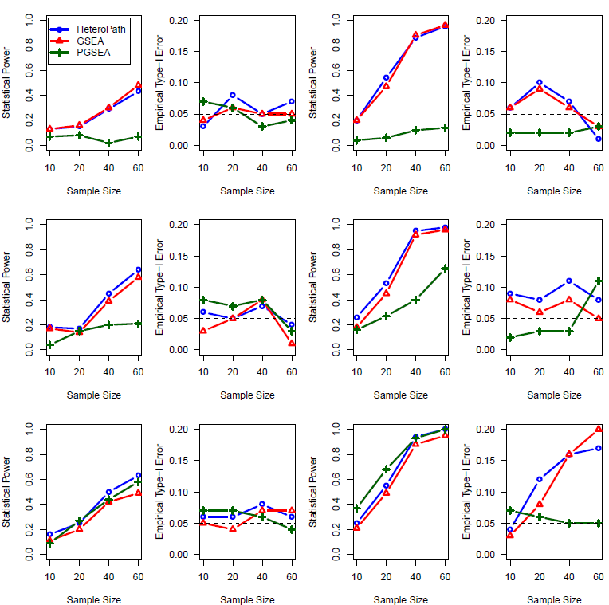
Sup. Figure 3
Gene Set size: 150 genes, Weak and Strong signal-to-noise ratios, Fraction of DEGs: 25%, 50%, and 80%
Weak Signal to Noise Ratio (0.5)
Strong Signal to Noise Ratio (1.0)
25%
DEGs
50%
DEGs
80%
DEGs

Slide 9
Sup. Figure 4
A
Enriched Motifs in Wnt Signaling Heterogeneous Genes
Motif Consensus Sequence | Hits | Sig Value | Upregulated TFs which bind motif | P-Value
CTTTGA | 193 | 69.9 | LEF1 | 1.81e-03
AAGAAGARR | 27 | 65.7
NRYTTCCGGH | 111 | 49.4 | FLI1 | 3.87e-03
CTTTGT | 54 | 48.6 | LEF1 | 2.93e-03
CGCNNNCCC | 68 | 44.5
B
Enriched Motifs in Oxidative Phosphorylation Heterogeneous Genes
Motif Consensus Sequence | Hits | Sig Value | Upregulated TFs which bind motif | P-Value
BCSGVB | 1321 | 867.6
TGACGTCA | 246 | 243.8 | CREB | 2.23e-02
TCCTBYYBYYBYTCCT | 48 | 194.0 | SRF | 5.36e-03
CGCCG | 136 | 143.3 | TFB1M
CGGAG | 124 | 100.8

