Slide 1
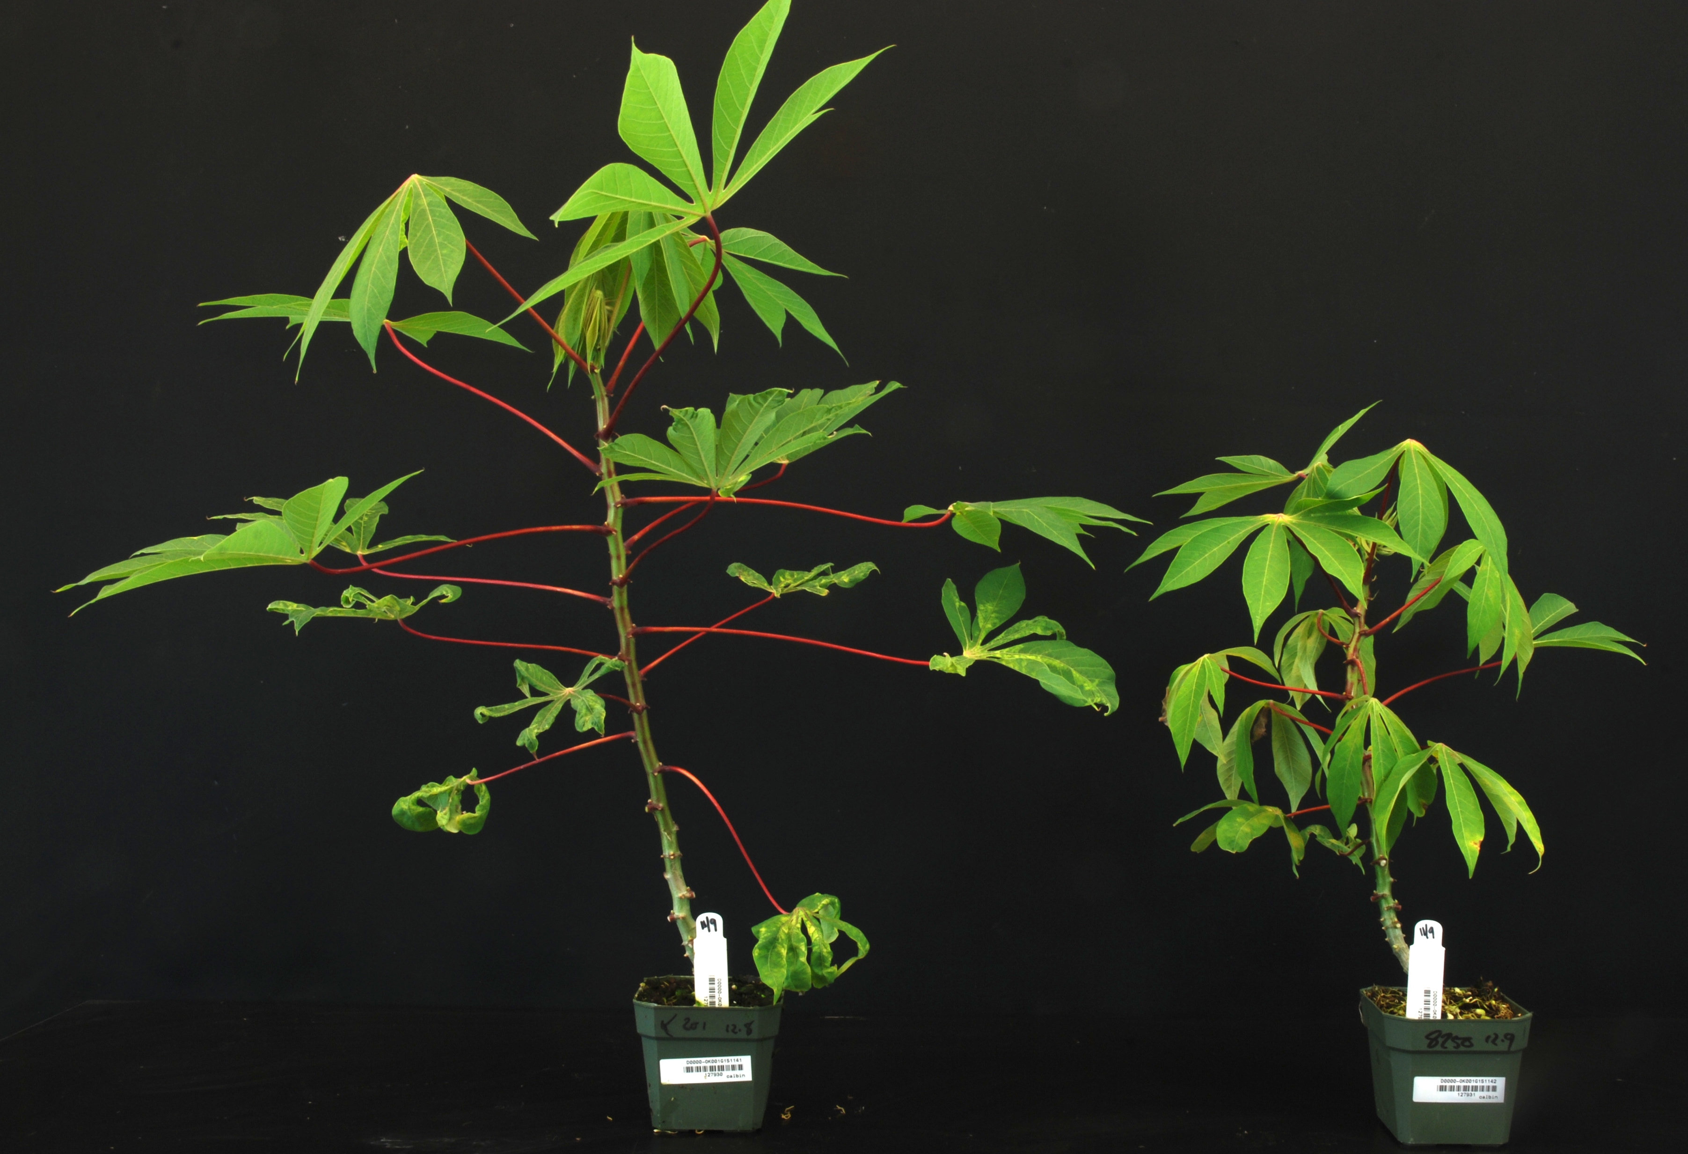
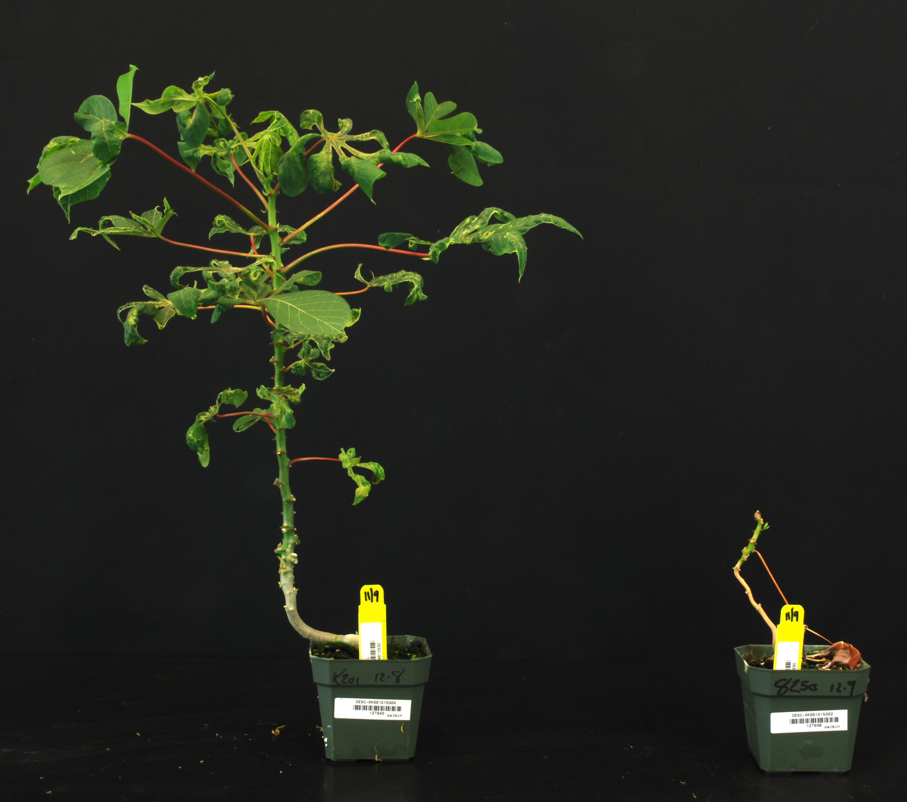
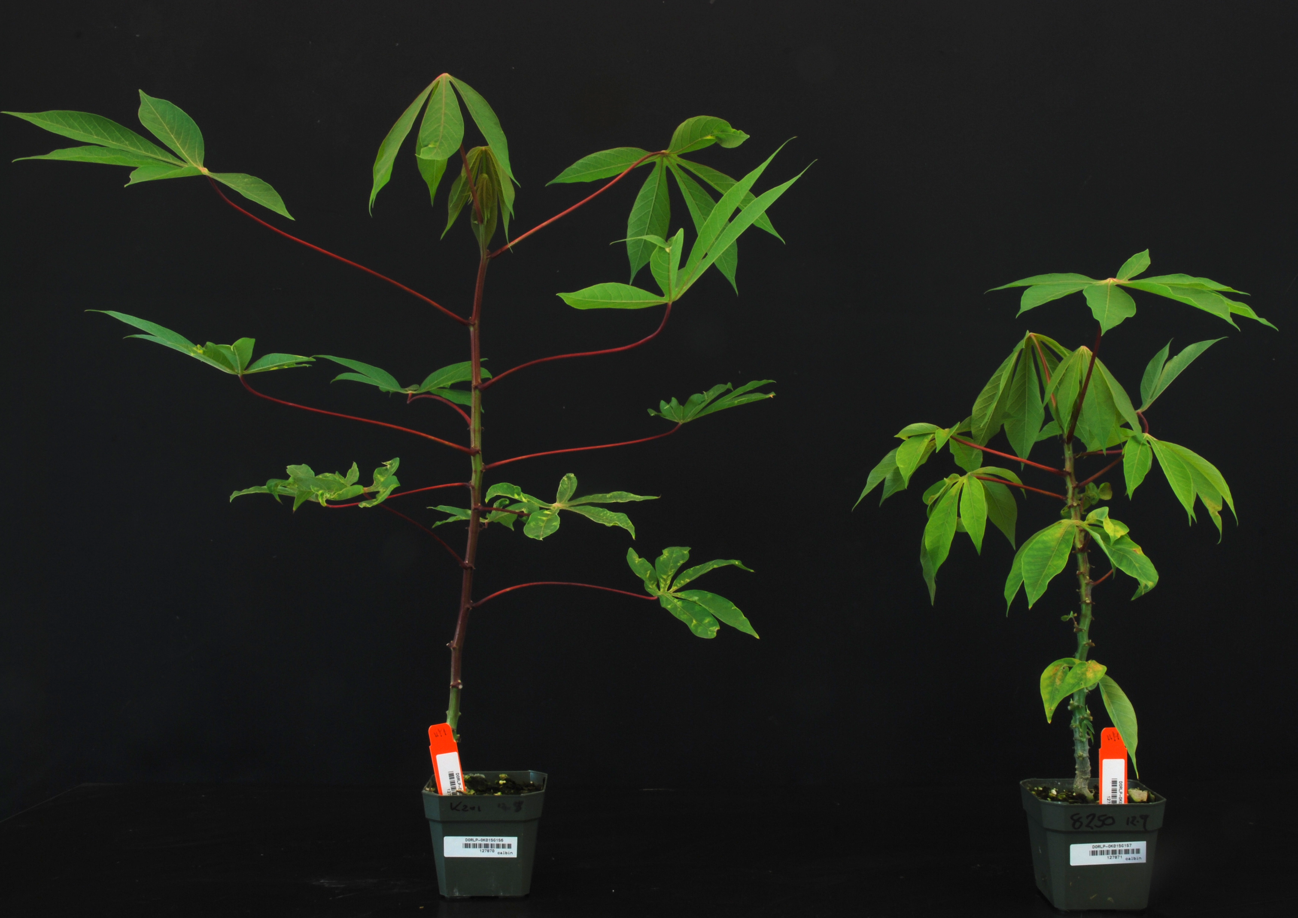
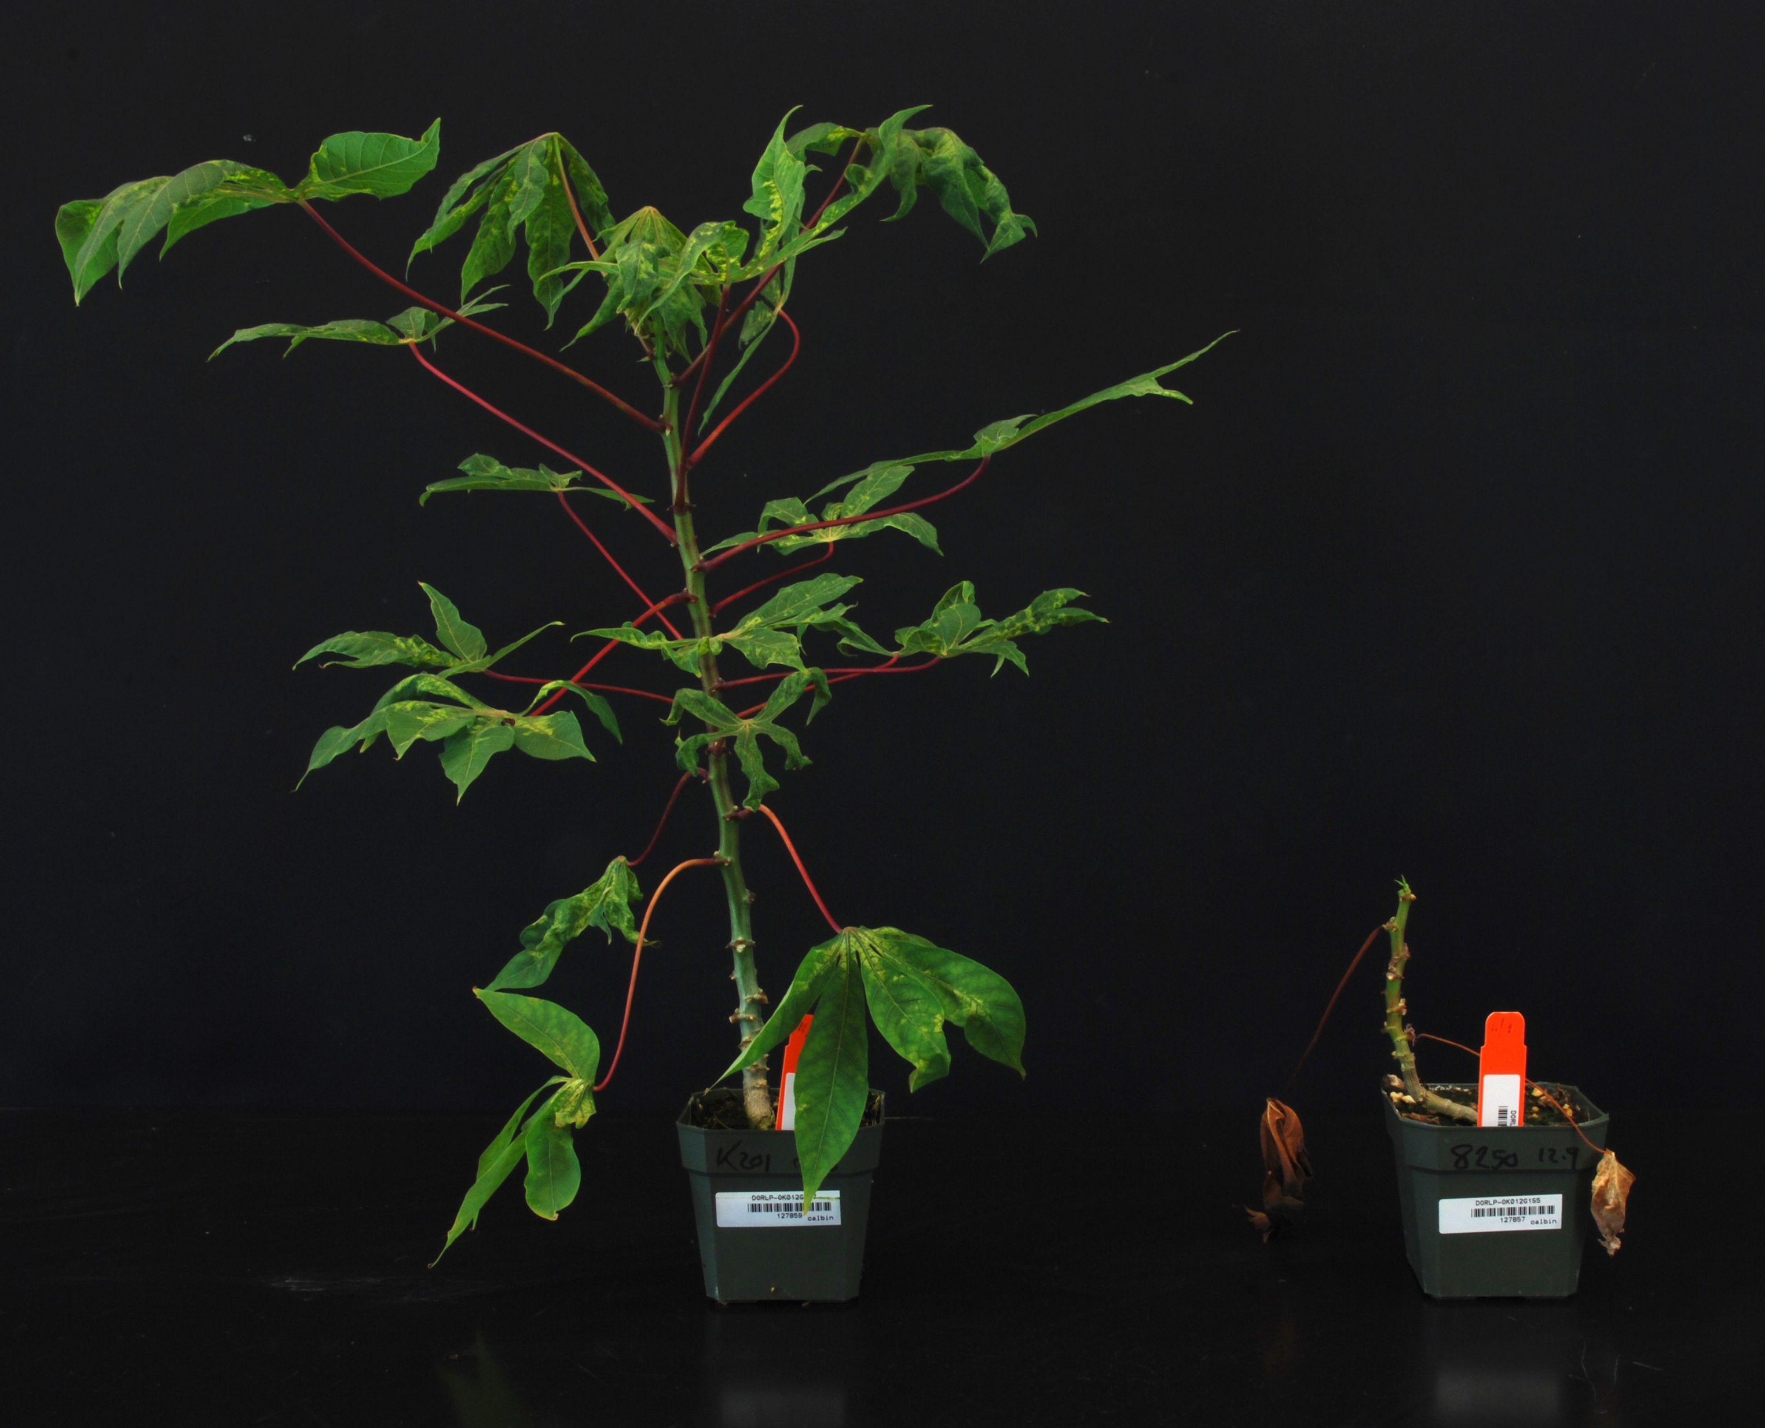
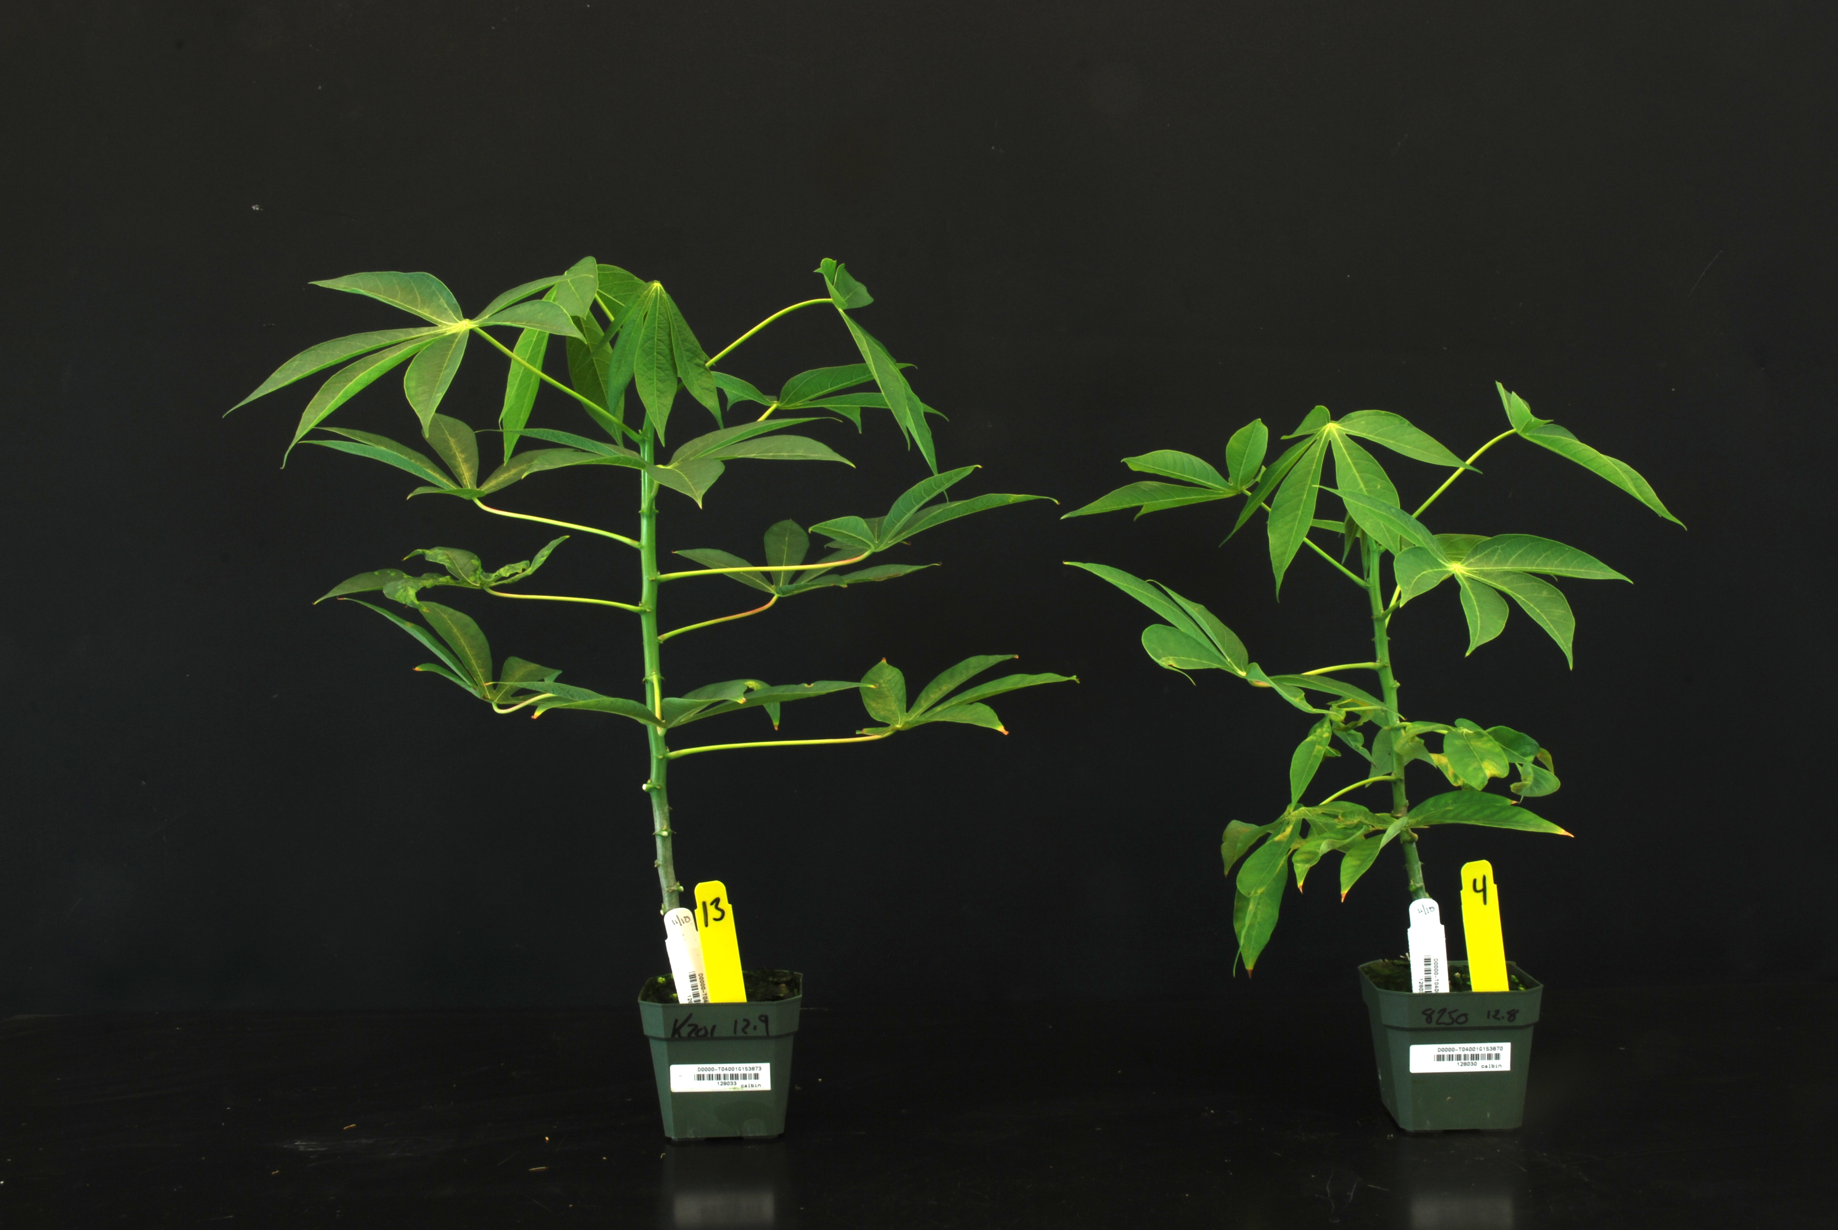
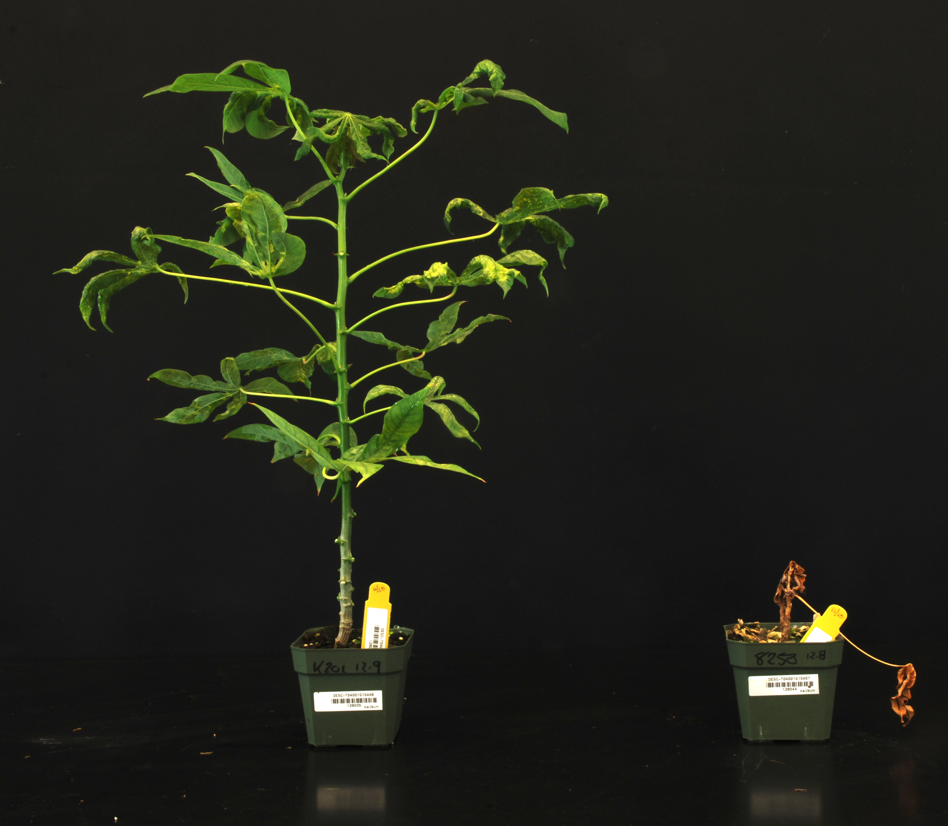
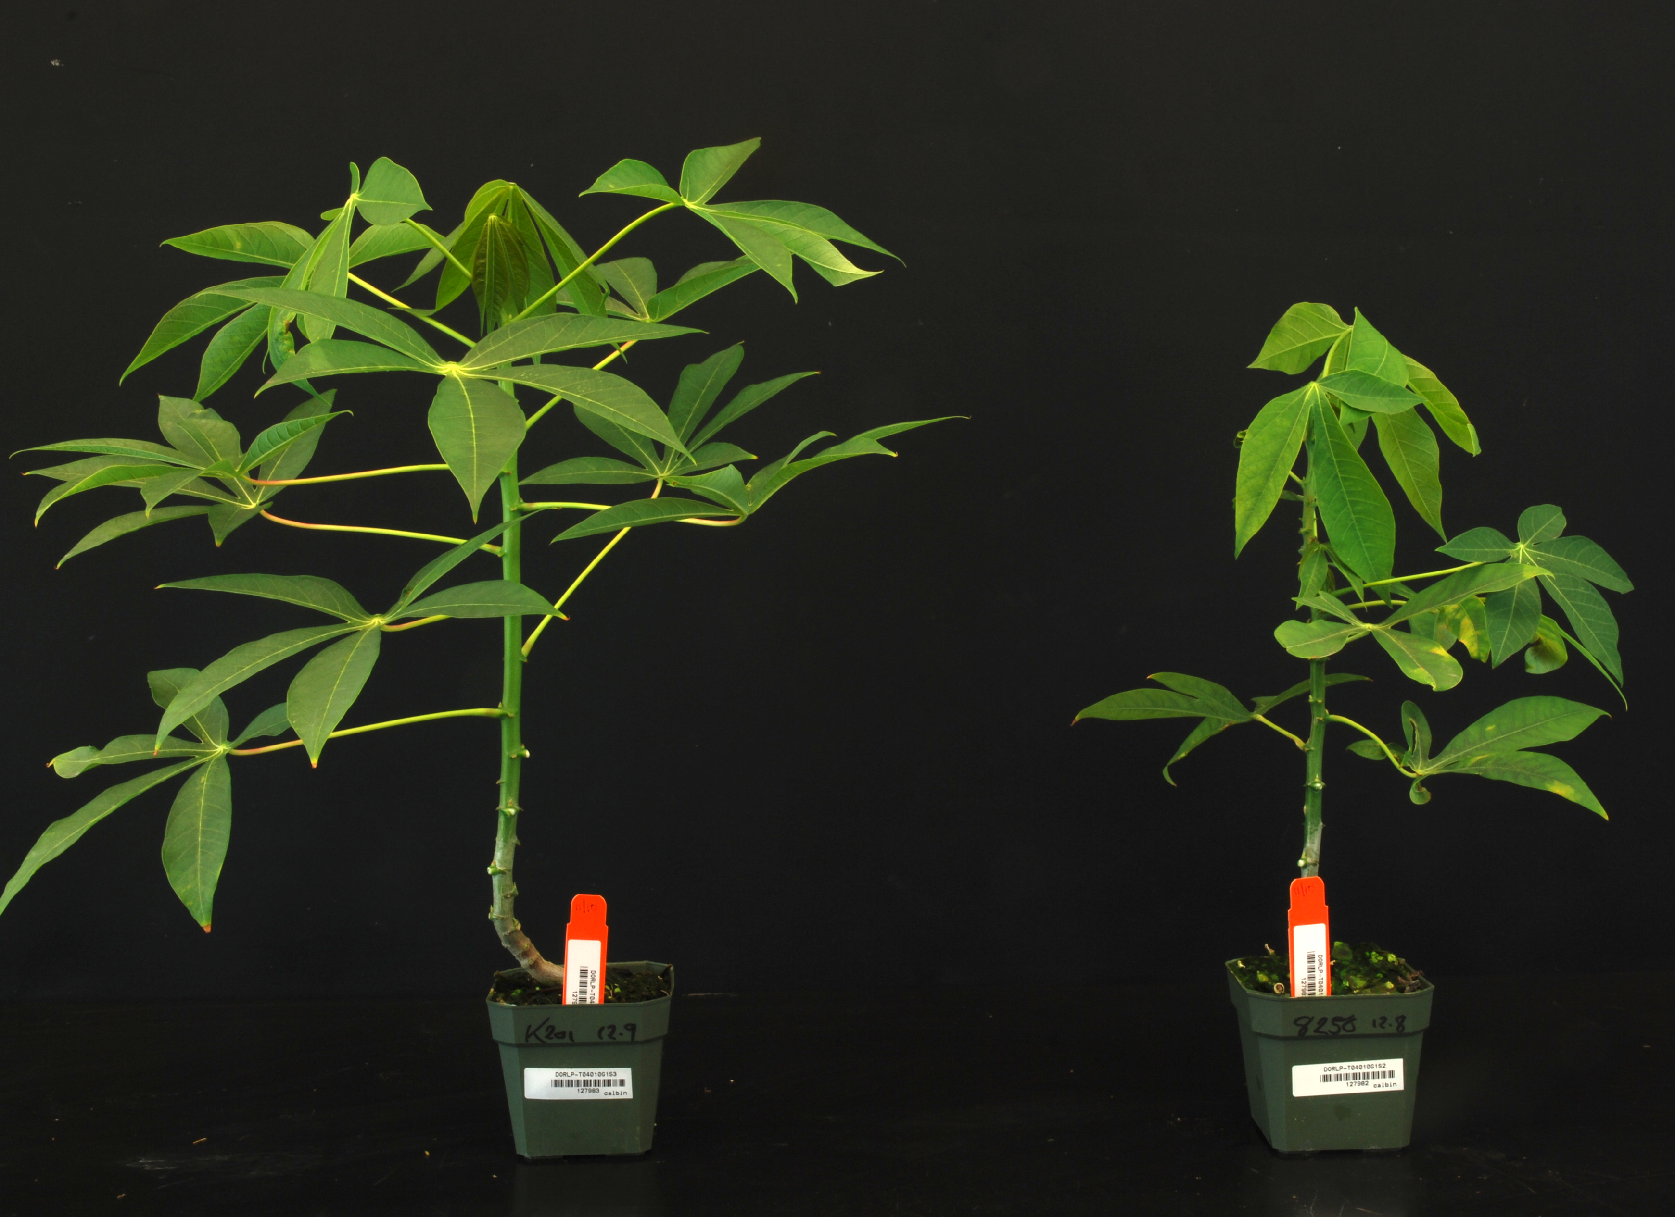
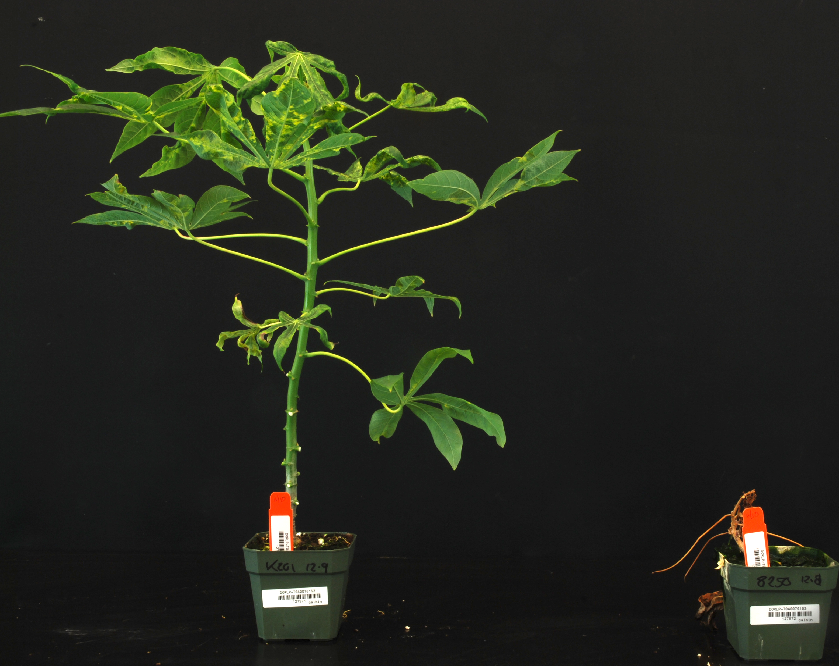
A
B
C
D
E
F
G
H
Supplemental Figure 1. Response of organogenesis-derived plants of cassava to inoculation with an infectious geminivirus clone of EACMV-K201and MeSPY1–VIGS. (A) EACMV-K201 (left) and MeSPY1-VIGS (right) challenged plants of micropropagated TME 7. (B) EACMV-K201 (left) and MeSPY1-VIGS (right) challenged FEC derived plants of TME 7. (C &D) EACMV-K201 (left) and MeSPY1-VIGS (right) challenged organogenesis derived plants of TME 7. (E) EACMV-K201 (left) and MeSPY1-VIGS (right) challenged plants of micropropagated TME 204. (F) EACMV-K201 (left) and MeSPY1-VIGS (right) challenged FEC derived plants of TME 204. (G &H) EACMV-K201 (left) and MeSPY1-VIGS (right) challenged organogenesis derived plants of TME 204.

