Slide 1
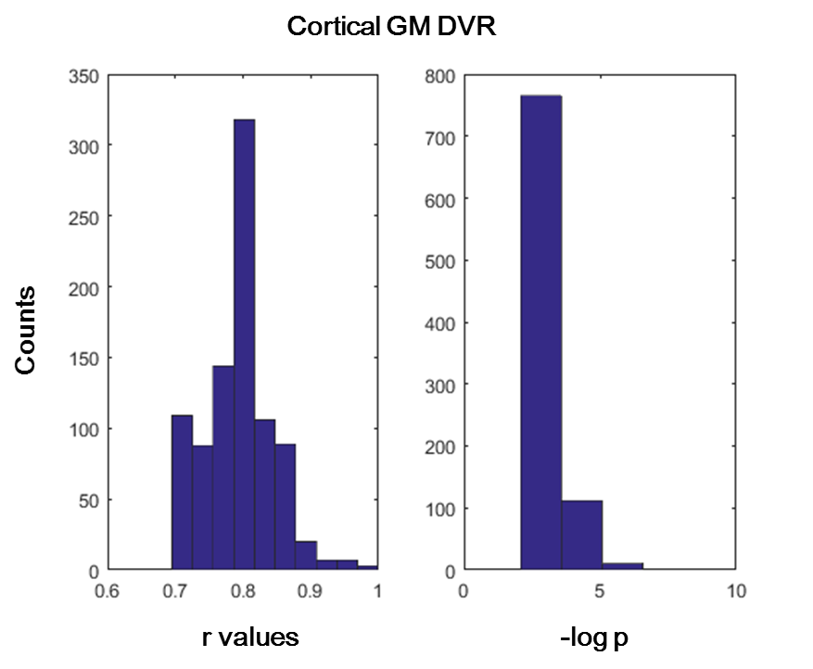
Figure S4. A positive correlation between the volume of the region with the maximum coefficient in the regression model and [¹¹C]PBR28 gray matter V_{T} in the temporal lobe of UHR (a) and the distribution of r and –logp for the 1000 regressions (b).
Normalized Volume of Left Transverse Temporal Cortex
(a)
(b)
Controls (CTRL); Ultra-High Risk (UHR); gray matter (GM); Volume of Distribution (V_{T})

