Slide 1


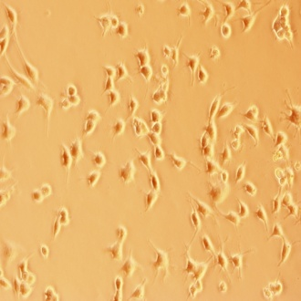
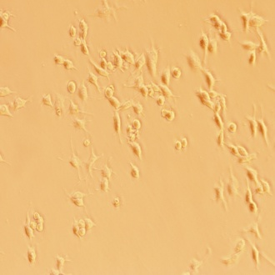
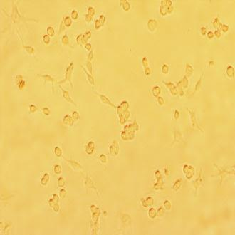
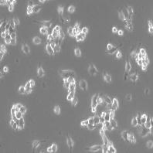
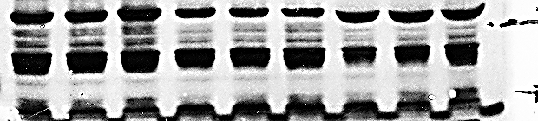
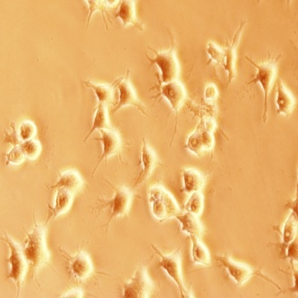
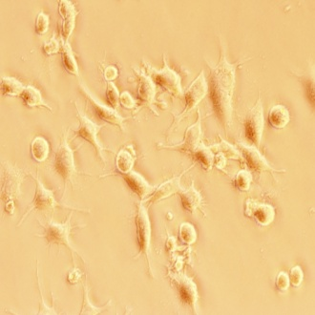
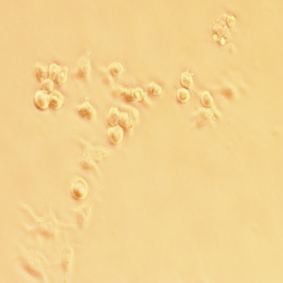
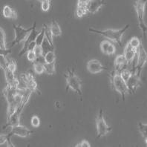

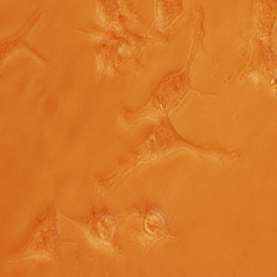
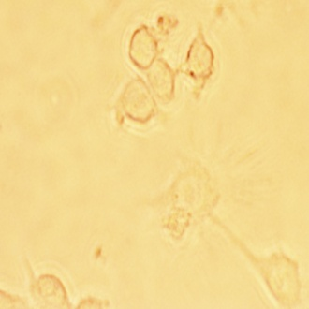
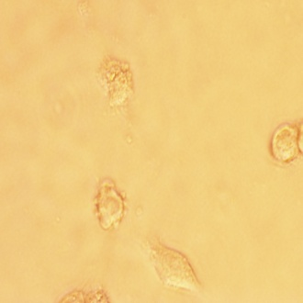
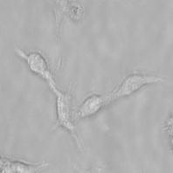
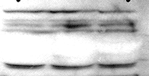

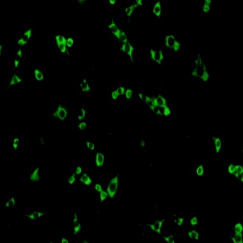
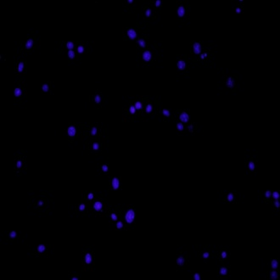
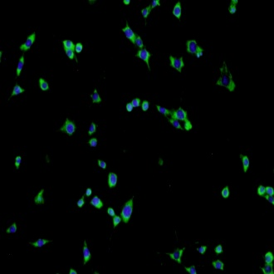
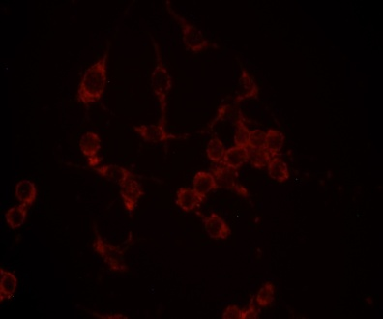
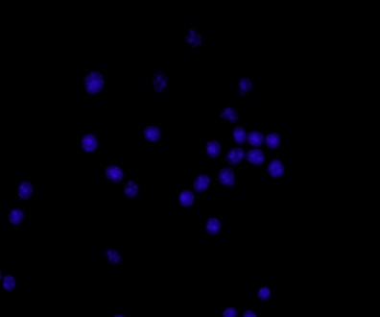
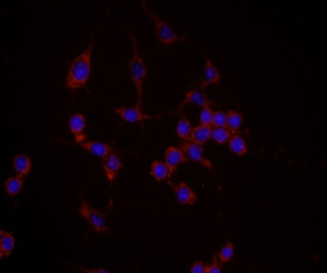
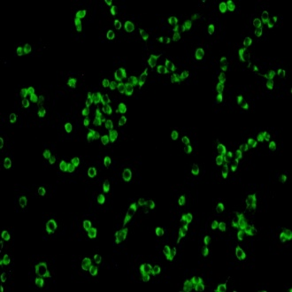
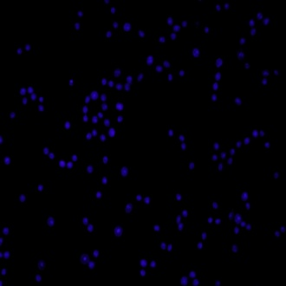
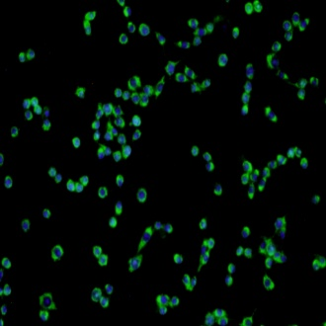
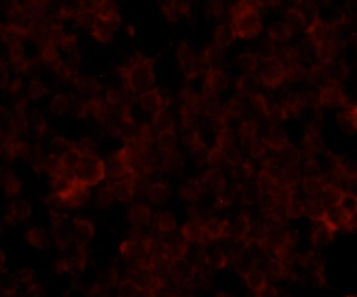
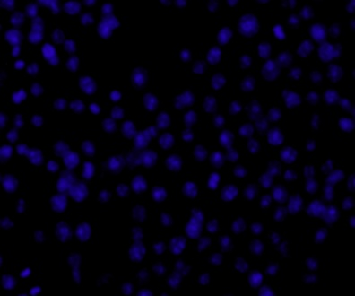
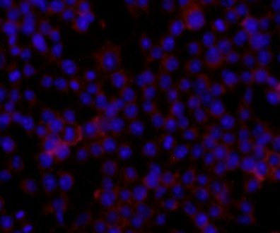
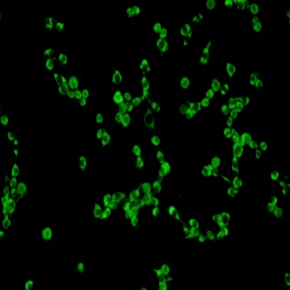
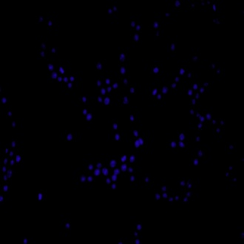
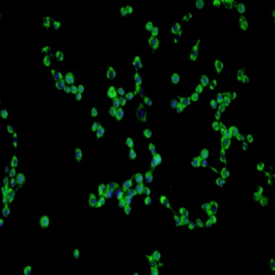
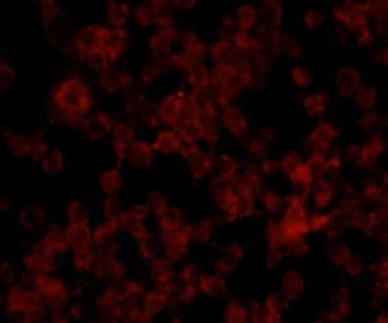
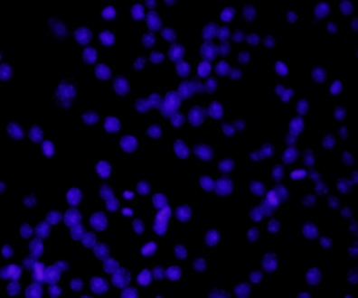
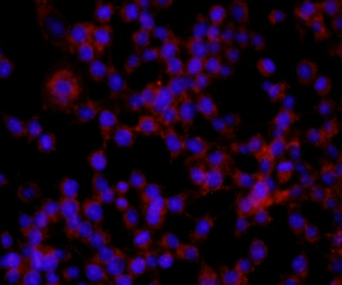
Supplementary Fig. -1
A
C
30 min.
1 h
0 0.2 2 0 0.2 2
ATO (µM)
p-PERK
*
β-actin
**
**
GRP78
**
**
β-actin
***
p-eIf2α
***
β-actin
CHOP
β-actin
B
D
Control
ATO (0.2 μM)
ATO (2 μM)
PBA + ATO (2 µM)
(I)
0 0.2 2
ATO (µM)
10X
Spliced, 54- 56kDa
XBP-1
Un-spliced, 29 kDa
β-actin
20X
(II)
WB
0 0.2 2
ATO(µM)
ATF-6α-90kDa
40X
ATF-6α-50kDa
β- actin
E
(I)
Spliced XBP-1
Hochest 33342
Merge
(II)
ATF-6
Hoechst 33342
Merge
Control
Control
0.2 μM
0.2μM
3 h
3 h
2 μM
2μM
10X
10X

Slide 2
Supplementary Fig. -2
A
WB-densitometry
**
*
GRP-78
##
#
*
##
##
##
***
T-eIF2α
**
##
###
###
(a)-PBS treated cells control, (b)-ATO (2 µM for 3 h)-treated cells, (c)-NAC (10 mM for 2 h)-treated cells, (d)-Pretreatment NAC (10 mM for 2 h) + ATO (2 µM for 3 h)-treated cells, (e)-NAC (10 mM for 24 h)-treated cells, (f)-Pretreatment NAC (10 mM for 24 h) + ATO (2 µM for 3 h)-treated cells
B
***
##

Slide 3
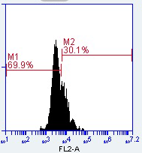
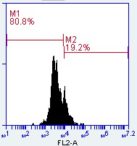
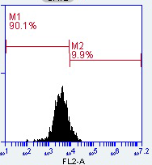
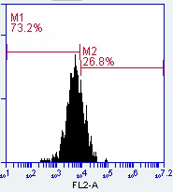
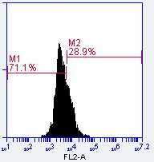
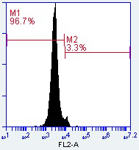
Supplementary Fig.-3
Control
ATO (0.2 µM)
ATO (2 µM)
PBA + ATO (2 µM)
NAC + ATO (2 µM)
4⁰ C

Slide 4
Supplementary Fig.-4
IL-1β
TNF-α
#
***
*
**
**
IL-10
TGF-β
***
#
**
**

