Slide 1
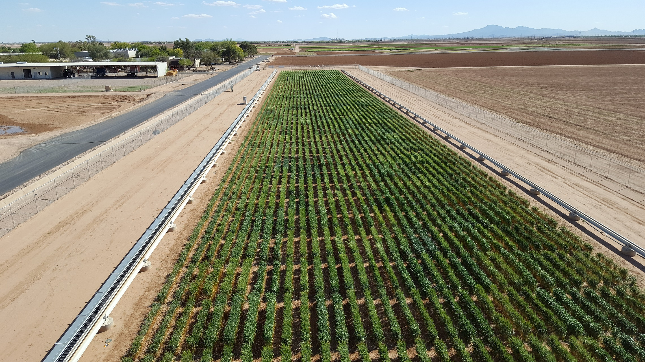
Supplementary Figure 1 | The field trial was conducted at Maricopa Agricultural Center (southward view) lat. 33.070° N, long. 111.974° W, elev. 360 m on a Casa Grande sandy loam soil (fine-loamy, mixed, superactive, hyperthermic Typic Natrargids). The plant material included 248 accessions of durum wheat “Durum panel” representing a large portion of the genetic diversity present in the most important improved durum wheat gene pools.

