Slide 1
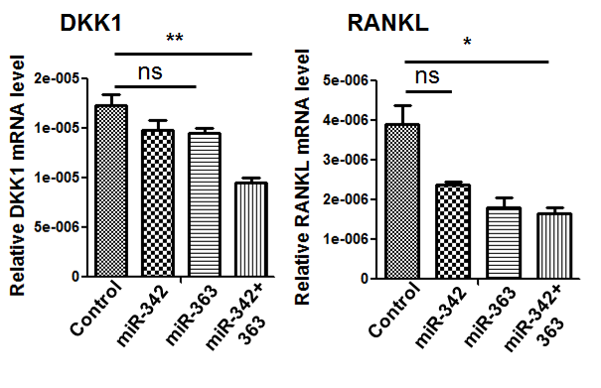
Supplementary Fig. S1
Supplementary Fig. S1: Assess expression levels of DKK1 and RANKL. Relative expression of DKK1 and RANKL between CAG cells transfected with NS-miR-control, miR-342, miR-363 and miR-342+363 was measured by RT-qPCR. The P values were obtained by one-way ANOVA followed by Tukey-kramer post hoc test (ns: non-significant; *P<0.05; **P<0.005).

