Slide 1
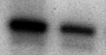
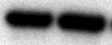
S2
A
B
NT
Tumor
ECM29
Tubulin

