Slide 1
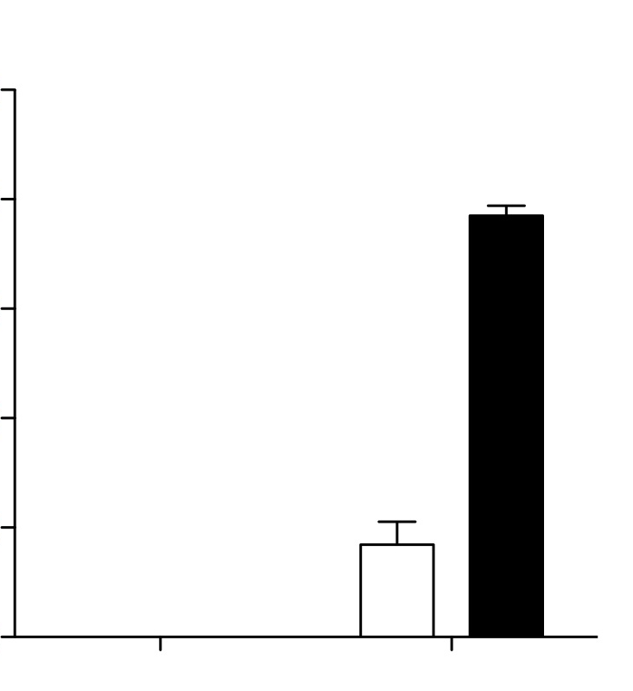
Supplementary Figure S3
Control biAb
CS1-NKG2D biAb
500
**
400
300
IFN-gamma (pg/mL)
200
100
0
Without IL-2
priming
With IL-2
priming

