Slide 1
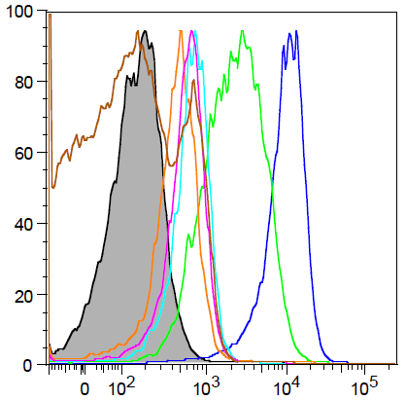
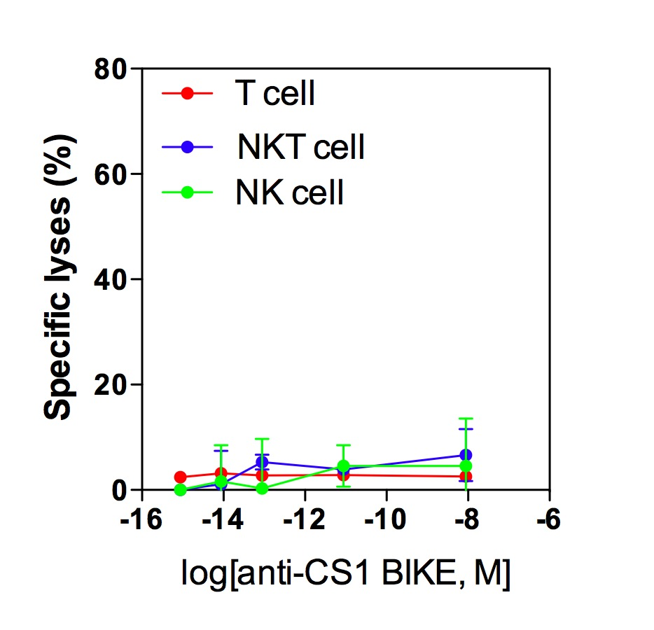
Supplementary Figure S4
A
B
80
T cell as target
CD56⁺ NKT cell as target
60
NK cell as target
40
Specific lyses (%)
20
% of Max
0
-16
-14
-12
-10
-8
-6
CS1
Isotype
Log[αCS1-NKG2D biAb]
MM.1S
NCI-H929
RPMI 8226
T cell
NK cell
CD56⁺ NKT cell

