Slide 1
Figure S1 Non-mosaic mutations at target sites revealed by Sanger sequencing in all Cas9 edited T0 lines chosen for WGS.

Slide 2
Figure S1 Non-mosaic mutations at target sites revealed by Sanger sequencing in all Cas9 edited T0 lines chosen for WGS. (continued)

Slide 3
Figure S1 Non-mosaic mutations at target sites revealed by Sanger sequencing in all Cas9 edited T0 lines chosen for WGS. (continued)

Slide 4
Figure S2 Non-mosaic mutations at target sites revealed by Sanger sequencing in all Cpf1 edited T0 lines chosen for WGS.

Slide 5
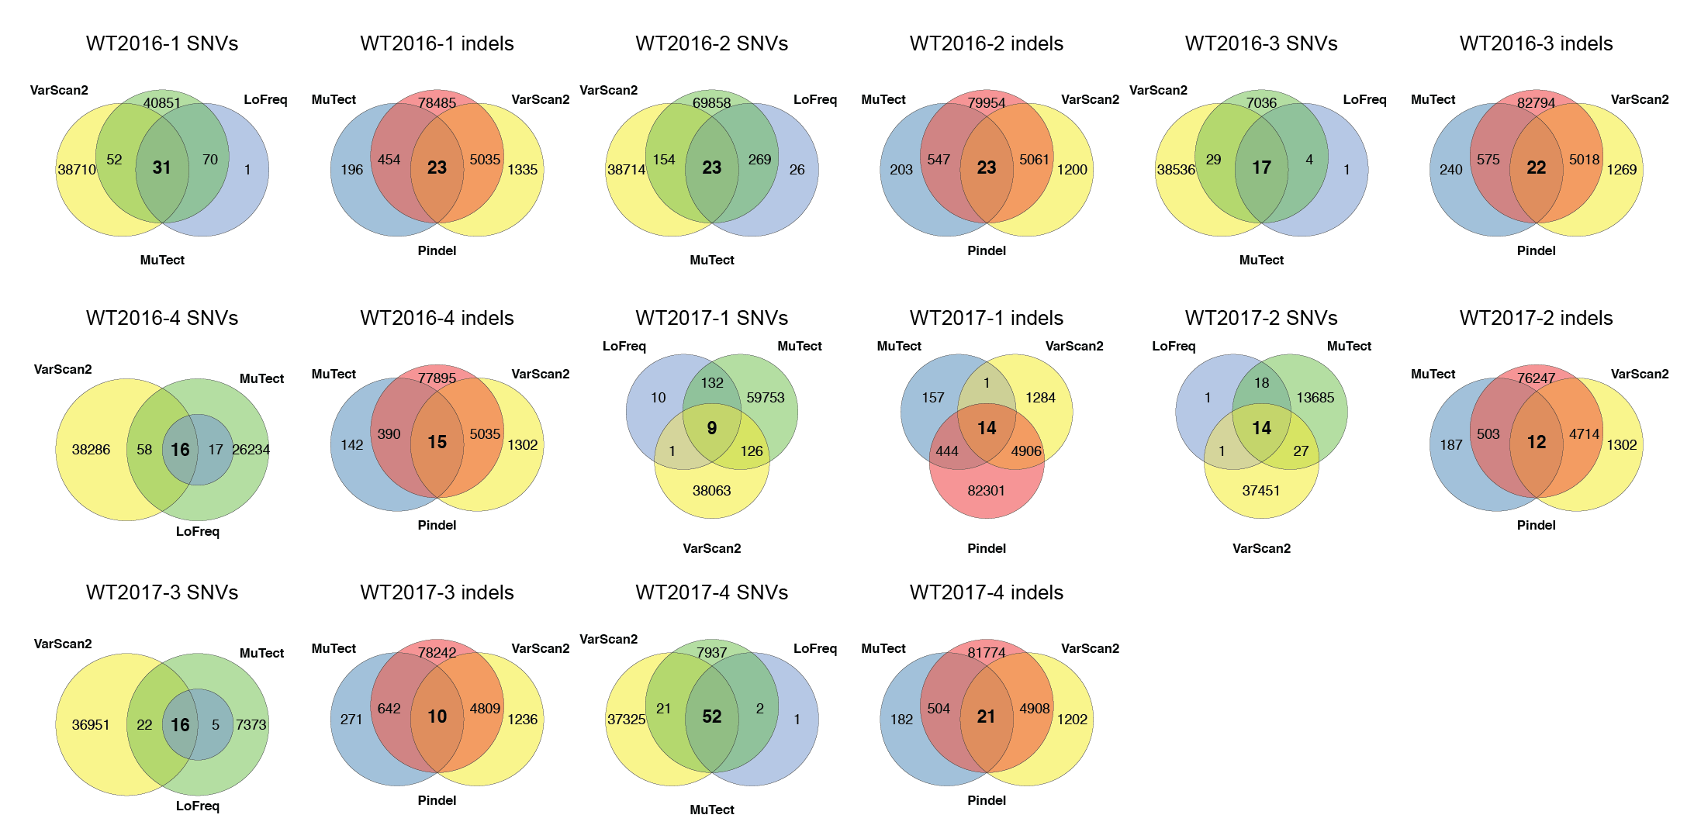
Figure S3 Venn diagram of SNVs and indels detected by multiple variant callers in WT plants for three consecutive generations.

Slide 6
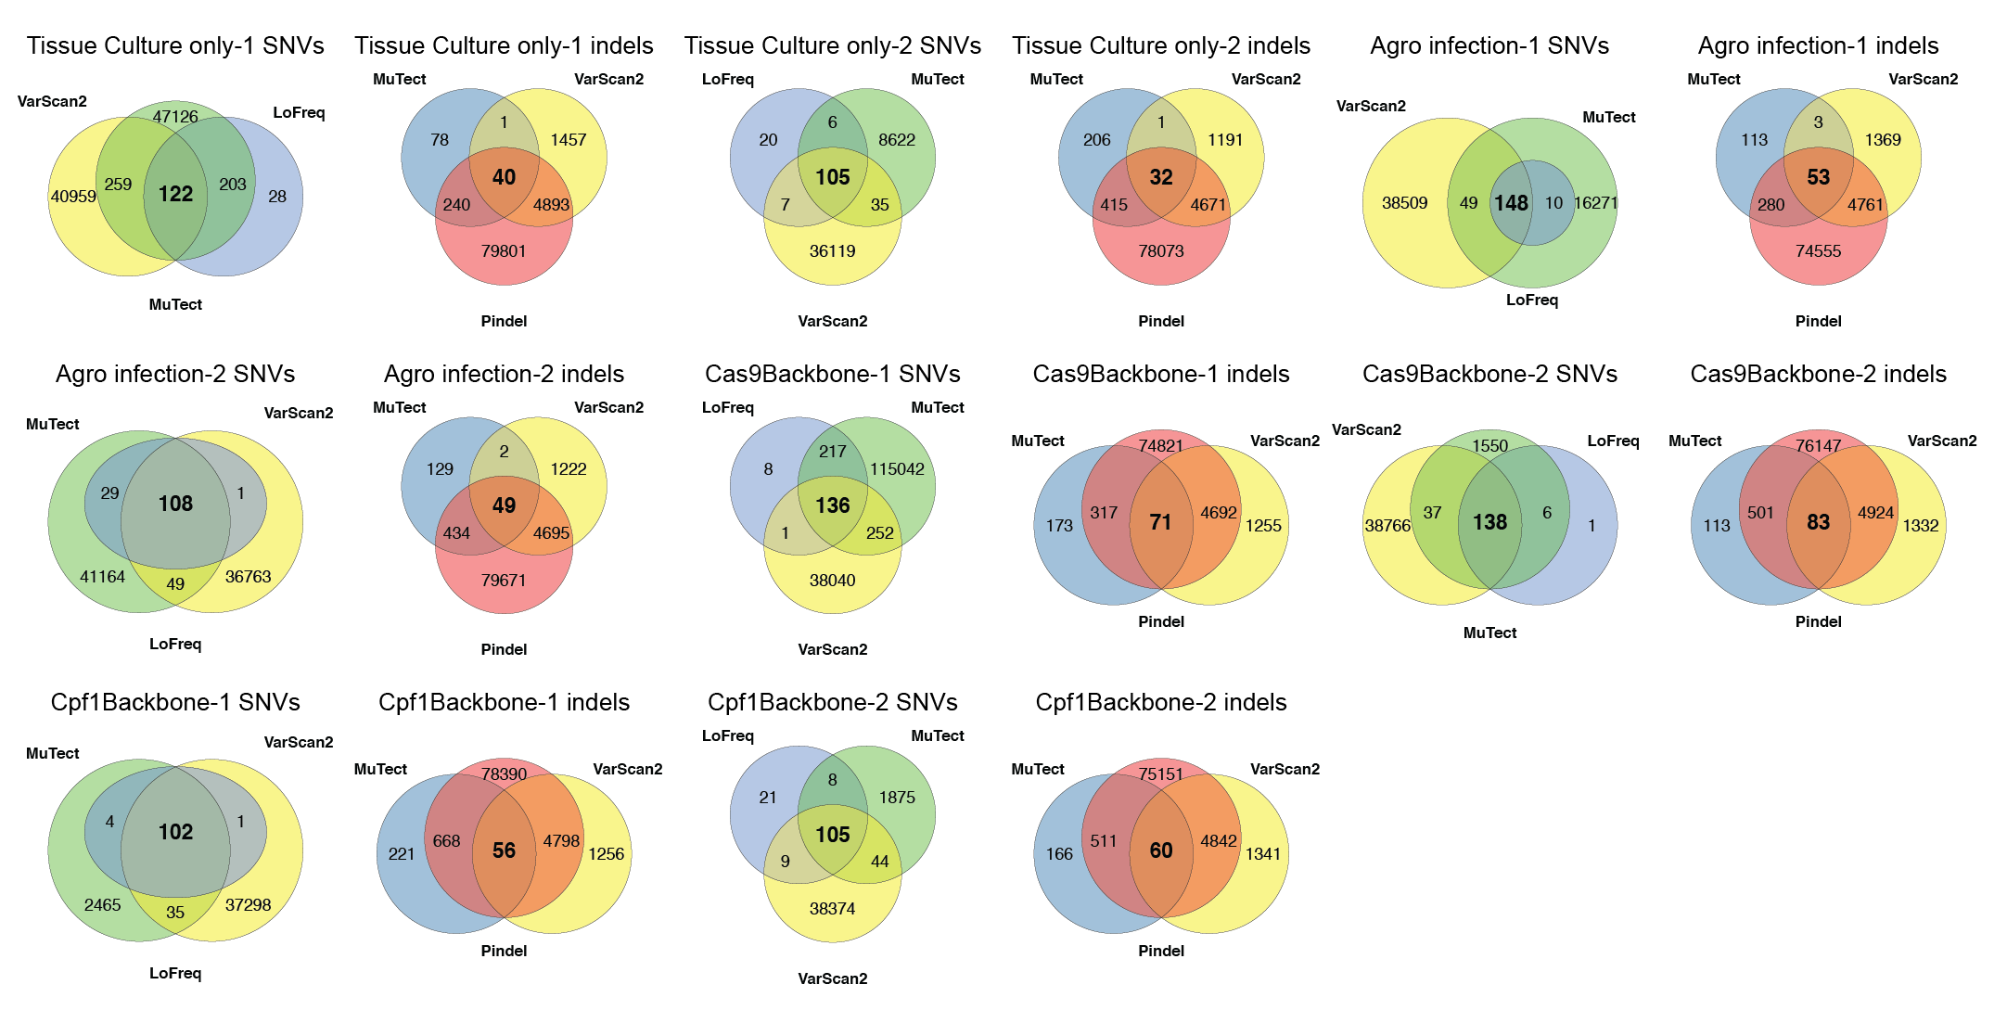
Figure S4 Venn diagram of SNVs and indels detected by multiple variant callers in four types of tissue culture related control samples.

Slide 7
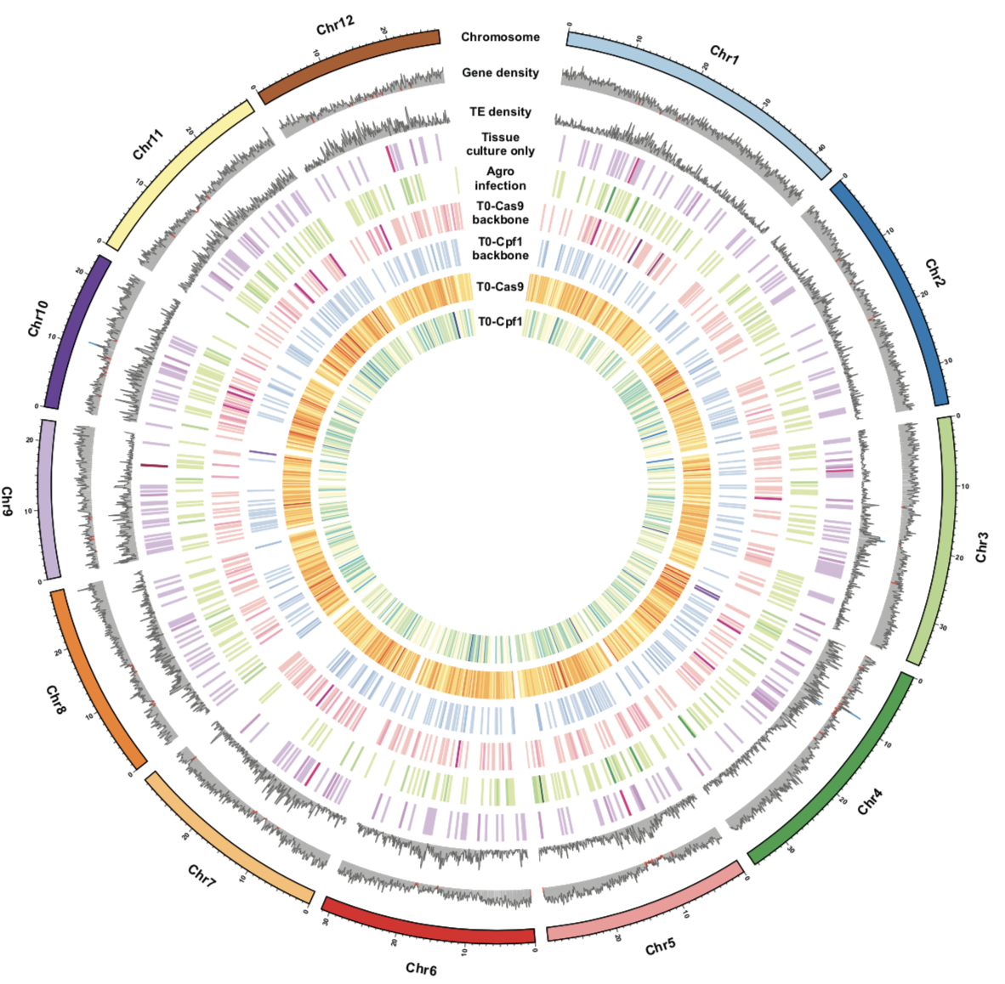
Figure S5 Genome-wide distribution of mutations from tissue culture only, Agro-infected, Cas9 backbone, Cpf1 backbone, Cas9 T0 and Cpf1 T0 samples.

Slide 8
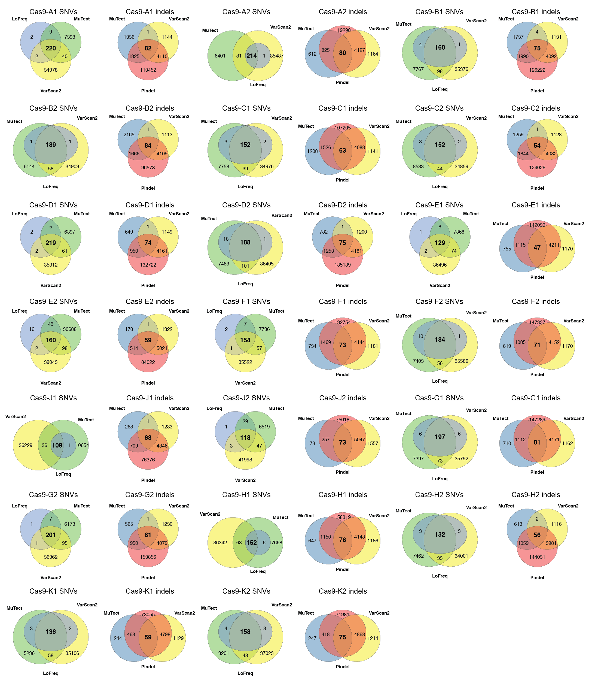
Figure S6 Venn diagram of SNVs and indels detected by multiple variant callers in Cas9-edited T0 lines.

Slide 9
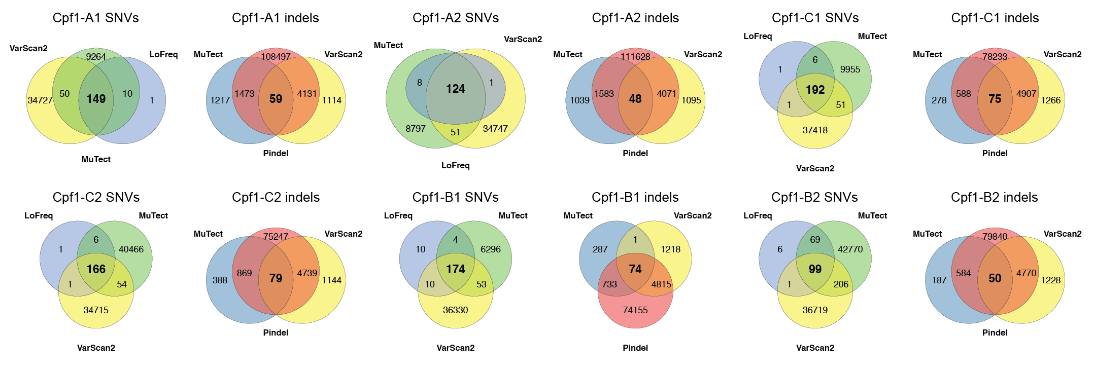
Figure S7 Venn diagram of SNVs and indels detected by multiple variant callers in Cpf1-edited T0 lines.

Slide 10
Figure S8 Mapped T-DNA insertion site for each T0 line. T-DNA insertion sites are shown in black lines. Samples with more than 1 T-DNA insertion are marked in red.

Slide 11
Figure S9 Alignment of top candidate off-target sites to the target sites based on WGS-discovered mutations in Cas9 T0 lines. The putative off-target sites are aligned with the on-target sequences. They are identified based on meeting three criteria: (1) contain a PAM (NGG for Cas9), (2) allow up to 10 nt mismatches with the on-target sequences (20 nt for Cas9 and 23 nt for Cpf1) and (3) contain mutations in these sequences.

