Slide 1
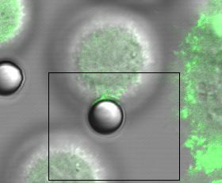
SUPPLEMENTARY VIDEO S1
a

Slide 2
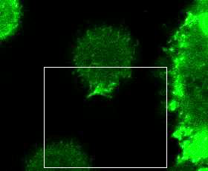
SUPPLEMENTARY VIDEO S1
b

Slide 3
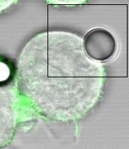
SUPPLEMENTARY VIDEO S2
a

Slide 4
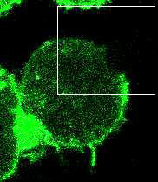
SUPPLEMENTARY VIDEO S2
b

Slide 5
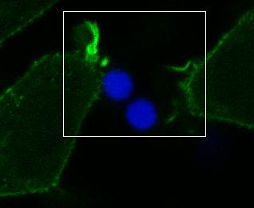
SUPPLEMENTARY VIDEO S3

Slide 6
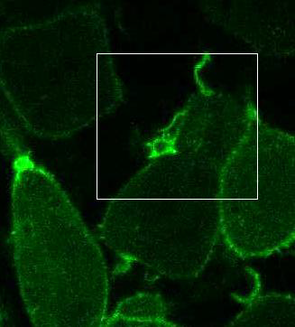
SUPPLEMENTARY VIDEO S4

Slide 7
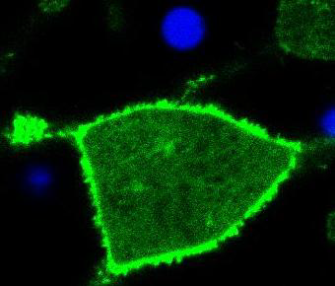
SUPPLEMENTARY VIDEO S5

Slide 8
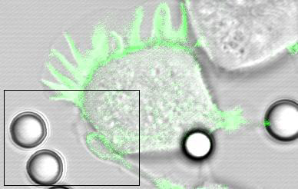
SUPPLEMENTARY VIDEO S6
a

Slide 9
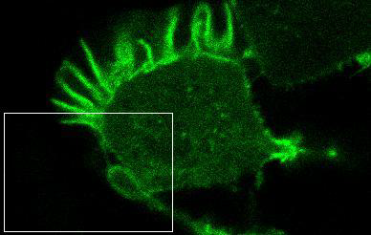
SUPPLEMENTARY VIDEO S6
b

Slide 10
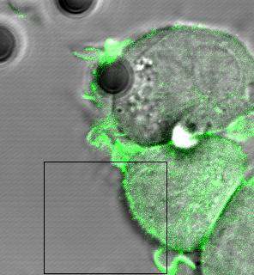
SUPPLEMENTARY VIDEO S7
a

Slide 11
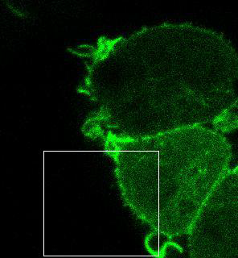
SUPPLEMENTARY VIDEO S7
b

Slide 12
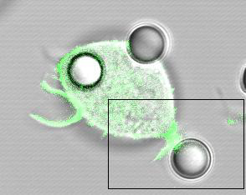
SUPPLEMENTARY VIDEO S8
a

Slide 13
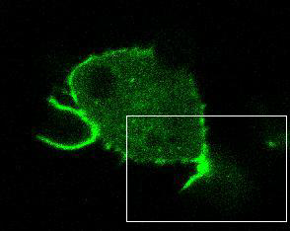
SUPPLEMENTARY VIDEO S8
b

Slide 14
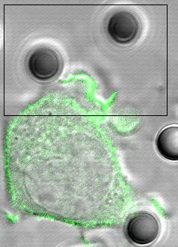
SUPPLEMENTARY VIDEO S9
a

Slide 15
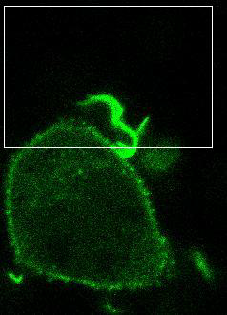
SUPPLEMENTARY VIDEO S9
b

Slide 16
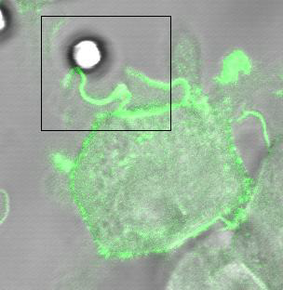
SUPPLEMENTARY VIDEO S10
a

Slide 17
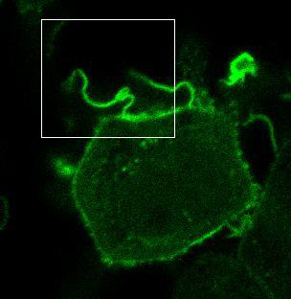
SUPPLEMENTARY VIDEO S10
b

Slide 18
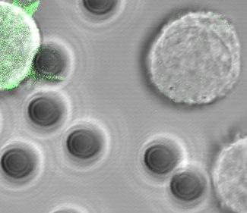
SUPPLEMENTARY VIDEO S11
a

Slide 19
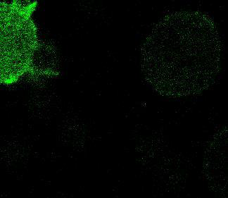
SUPPLEMENTARY VIDEO S11
b

Slide 20
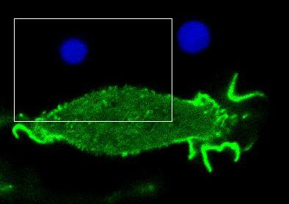
SUPPLEMENTARY VIDEO S12

