Slide 1
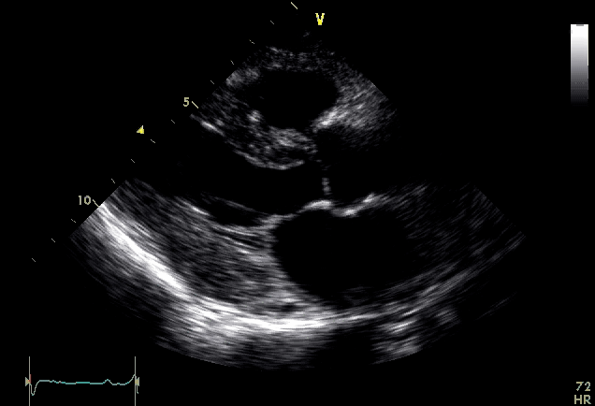

Figure S1. Pre-PBSCT

Slide 2
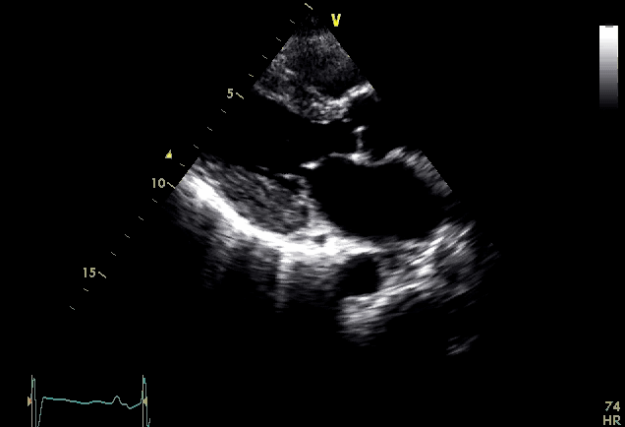
Figure S2. 12 months post-PBSCT

Slide 3
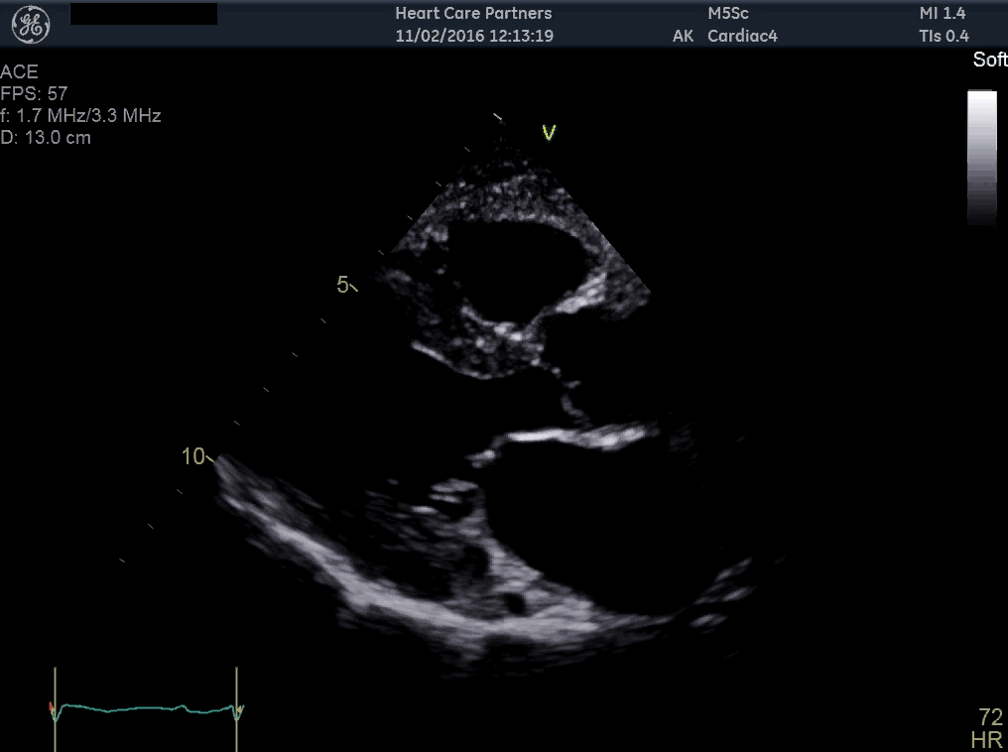

Figure S3. 18 months post-PBSCT

Slide 4
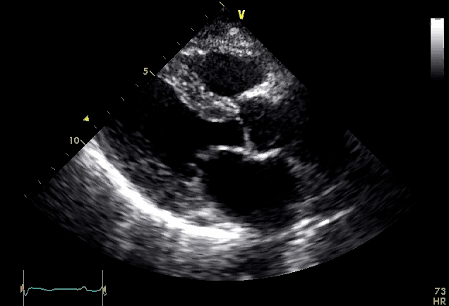
Figure S4. 24 months post-PBSCT

Slide 5
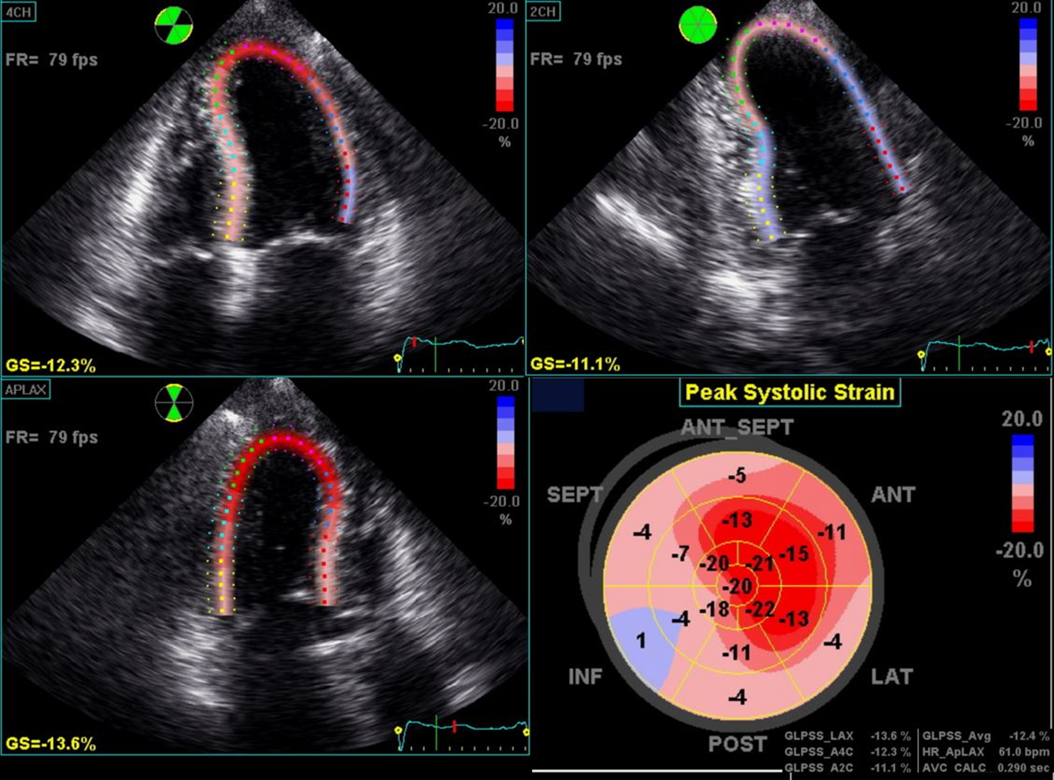
Figure S5.
Pre-PBSCT

Slide 6
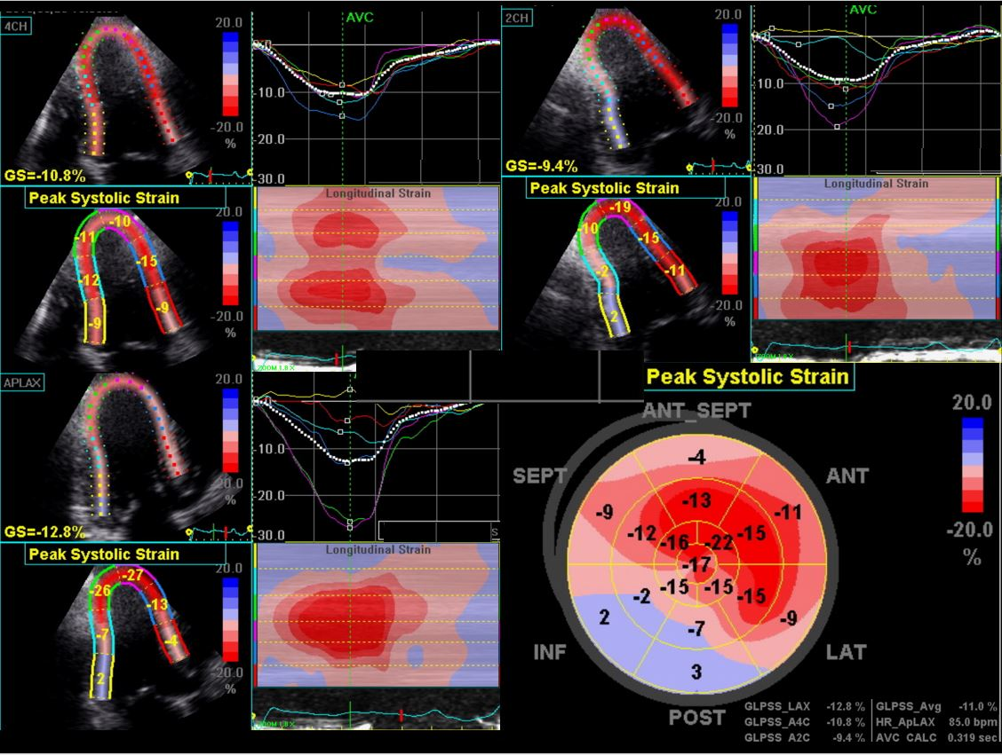
Figure S6.
12 months
post-PBSCT

Slide 7
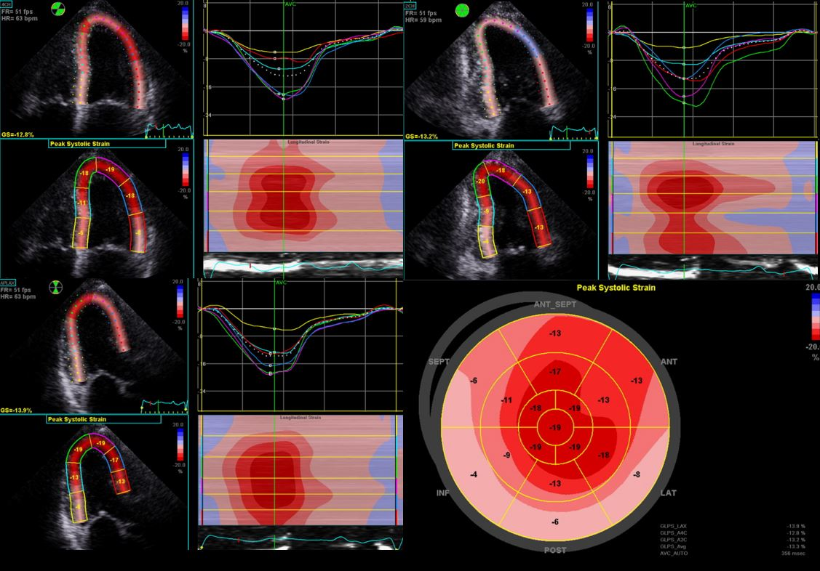
Figure S7.
18 months
post-PBSCT

Slide 8
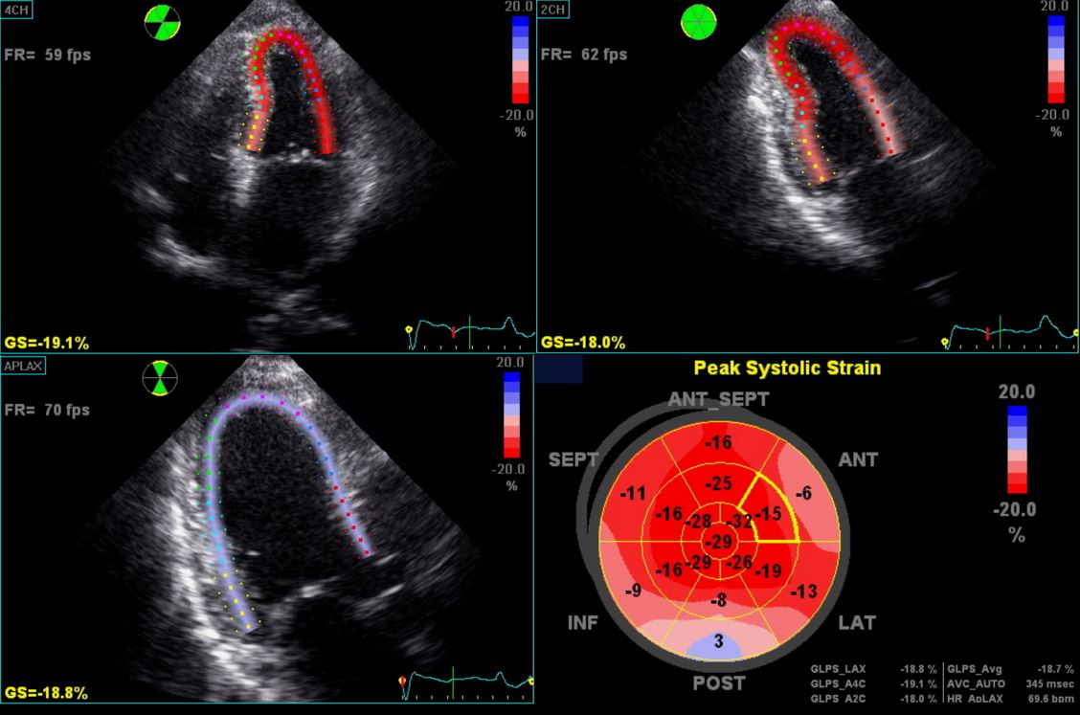
Figure S8.
24 months
post-PBSCT

