Slide 1
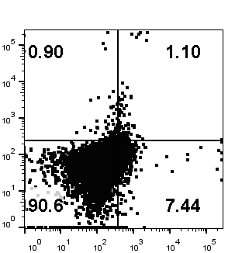
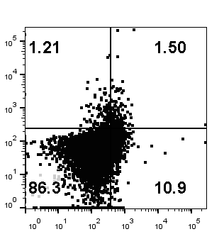


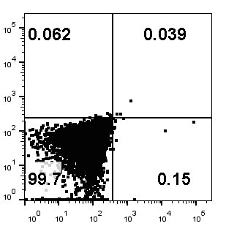
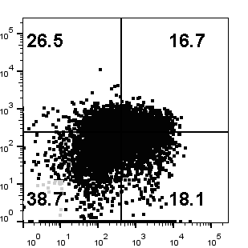
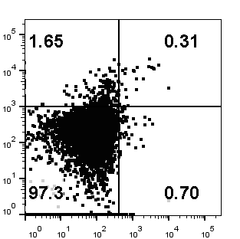
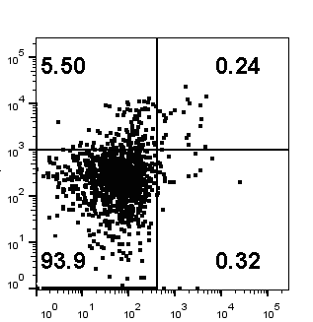
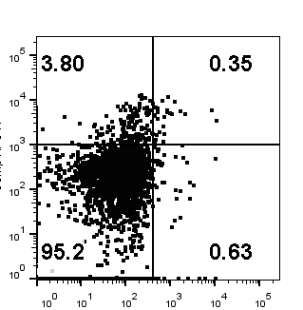
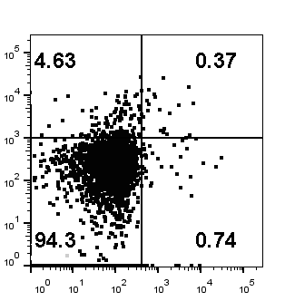
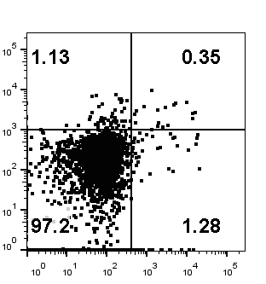
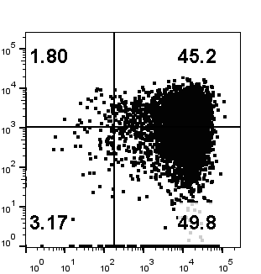
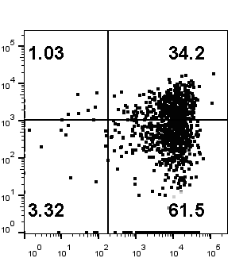
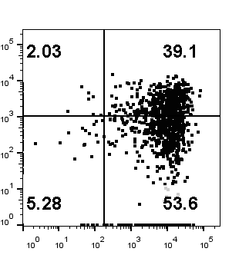
a
CD3+ gating
Isotype control
Positive control
UNT
GFP-NKG2D-z
GFP-NKG2D-BBz
GFP-NKG2D-27z
Pacific Blue ISO
TIM3
TIM3
APC ISO
PD-1
PD-1
CD3+CAR+ gating
b
UNT
GFP-NKG2D-z
GFP-NKG2D-BBz
GFP-NKG2D-27z
T cell only
+MDA-MB-231
PD-1
CD137

