Slide 1
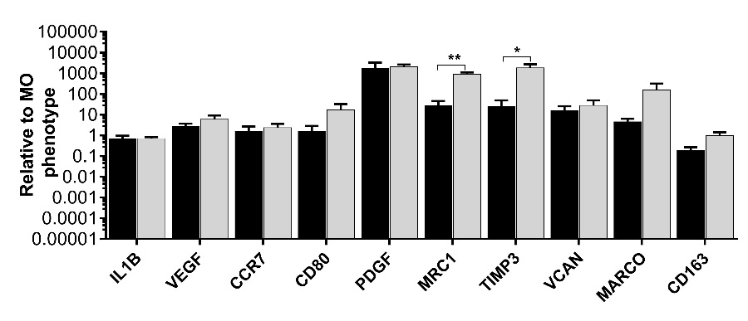
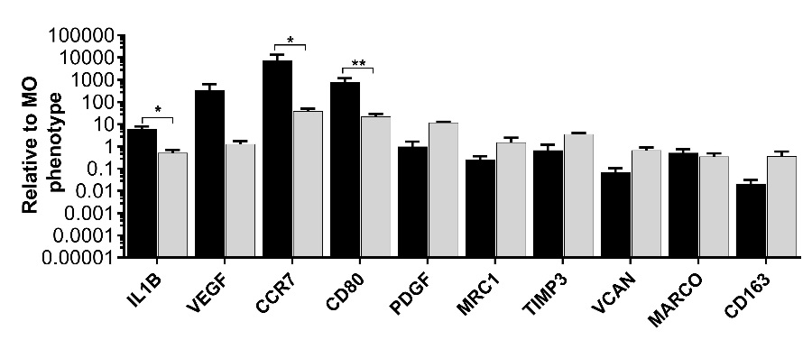

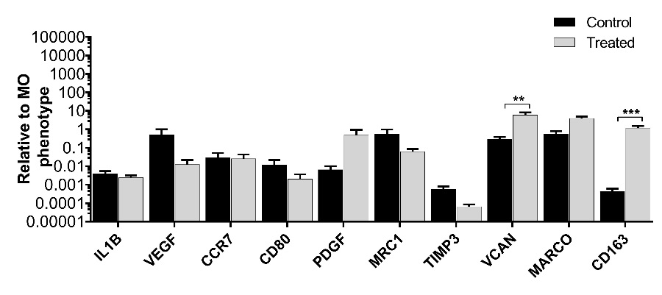
S1 Figure 1. Gene expression changes of macrophages phenotypes markers after gallein treatment
M1 Phenotype
M2A Phenotype
(A)
(B)
M1 markers
M2A
markers
M2C
markers
M1 markers
M2A
markers
M2C
markers
(C)
M2C Phenotype
M1 markers
M2A
markers
M2C
markers

