Slide 1
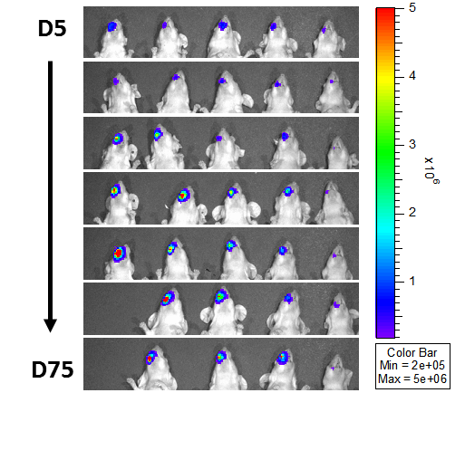
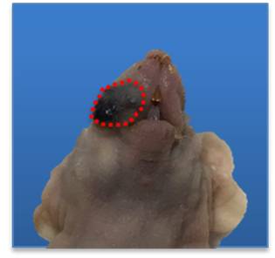
A
B
C
Supplementary Figure S5
Notes:
Supplemental Figure 1. Buccal tumors arising from HPV16-E6/E7 and AKT oncogenes. Athymic nude mice (n=5) received submucosal injection of DNA plasmid followed with electroporation in buccal area. These plasmids contained EF1a_LucHPV16 E6E7, CLP_AKT and CMV_SB100 with each 10 μg in weight and 30 μL in total volume. (A) Bioluminescence kinetics of buccal tumor in each mouse were recorded by IVIS Spectrum. Red colors indicate mice with gross tumor formation in the end of experiment. (B) Dynamic realtime bioluminescence image (C) Gross picture of the buccal tumor. (D) Microscopic features of the buccal tumor.

