Slide 1
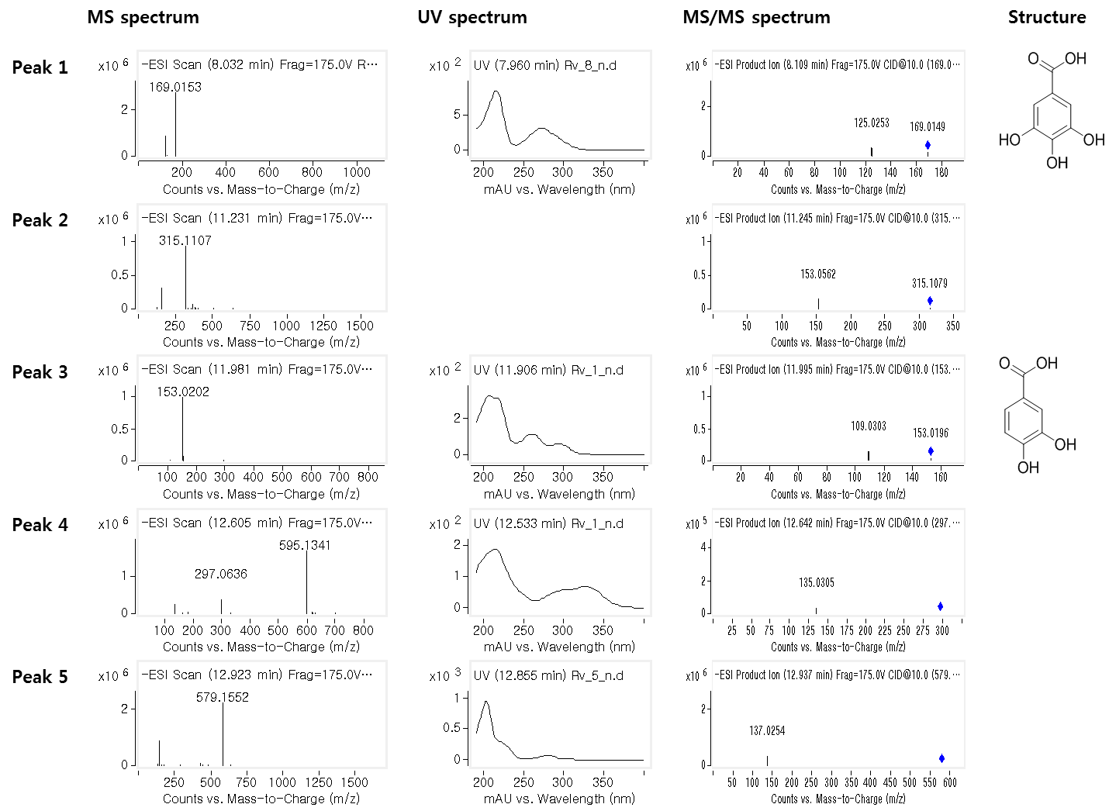
S2 Fig. MS and UV spectrum of compounds identified by LC-MS-MS analysis

Slide 2
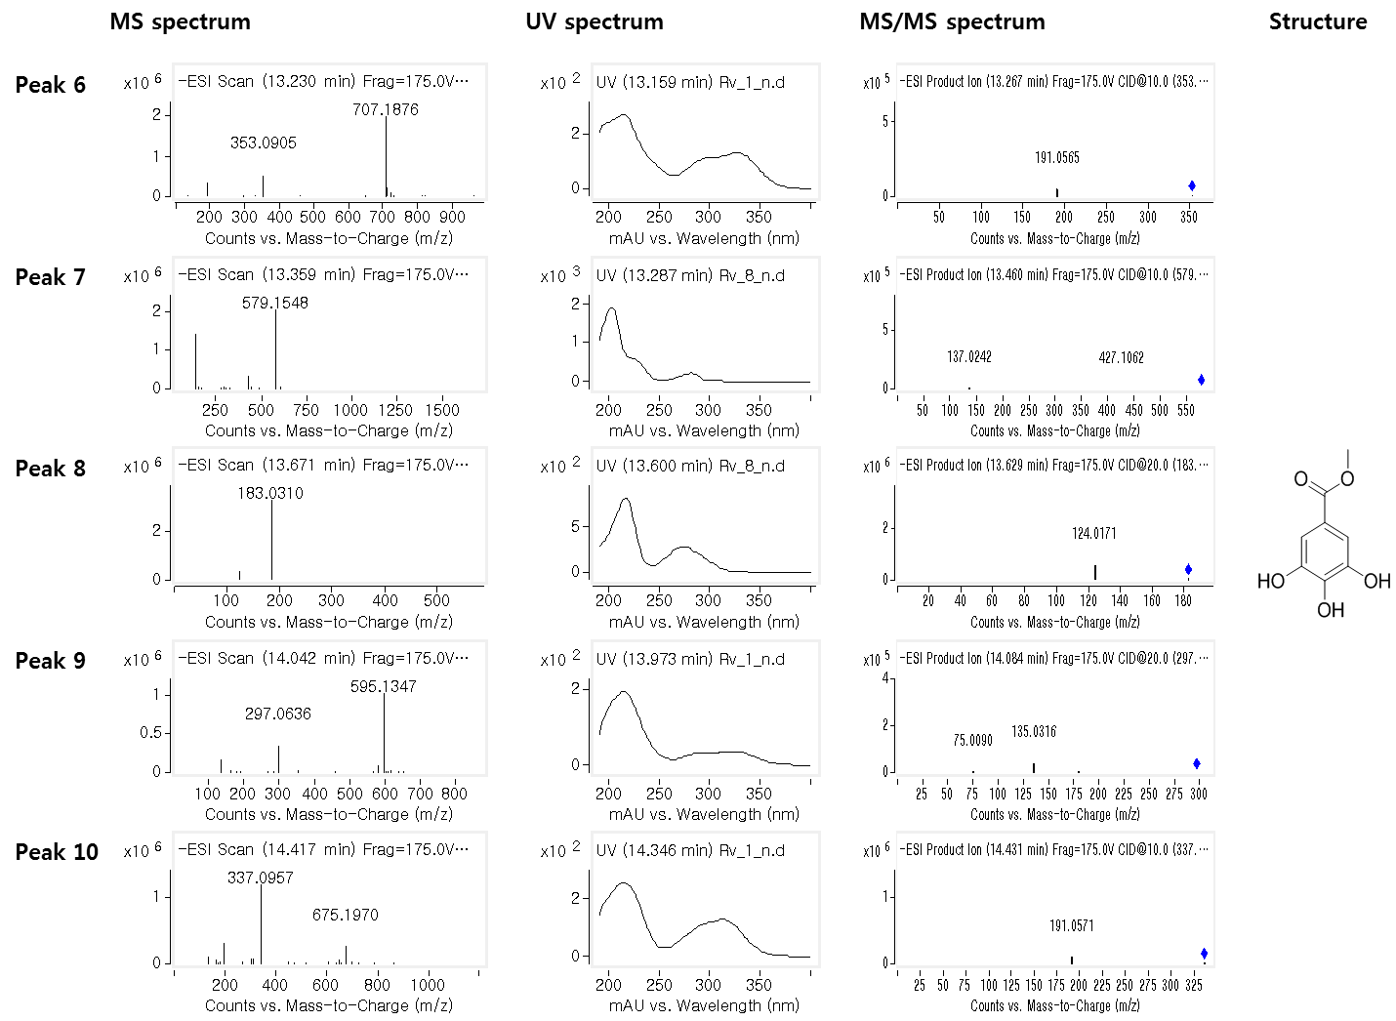
S2 Fig. MS and UV spectrum of compounds identified by LC-MS-MS analysis (Continued)

Slide 3
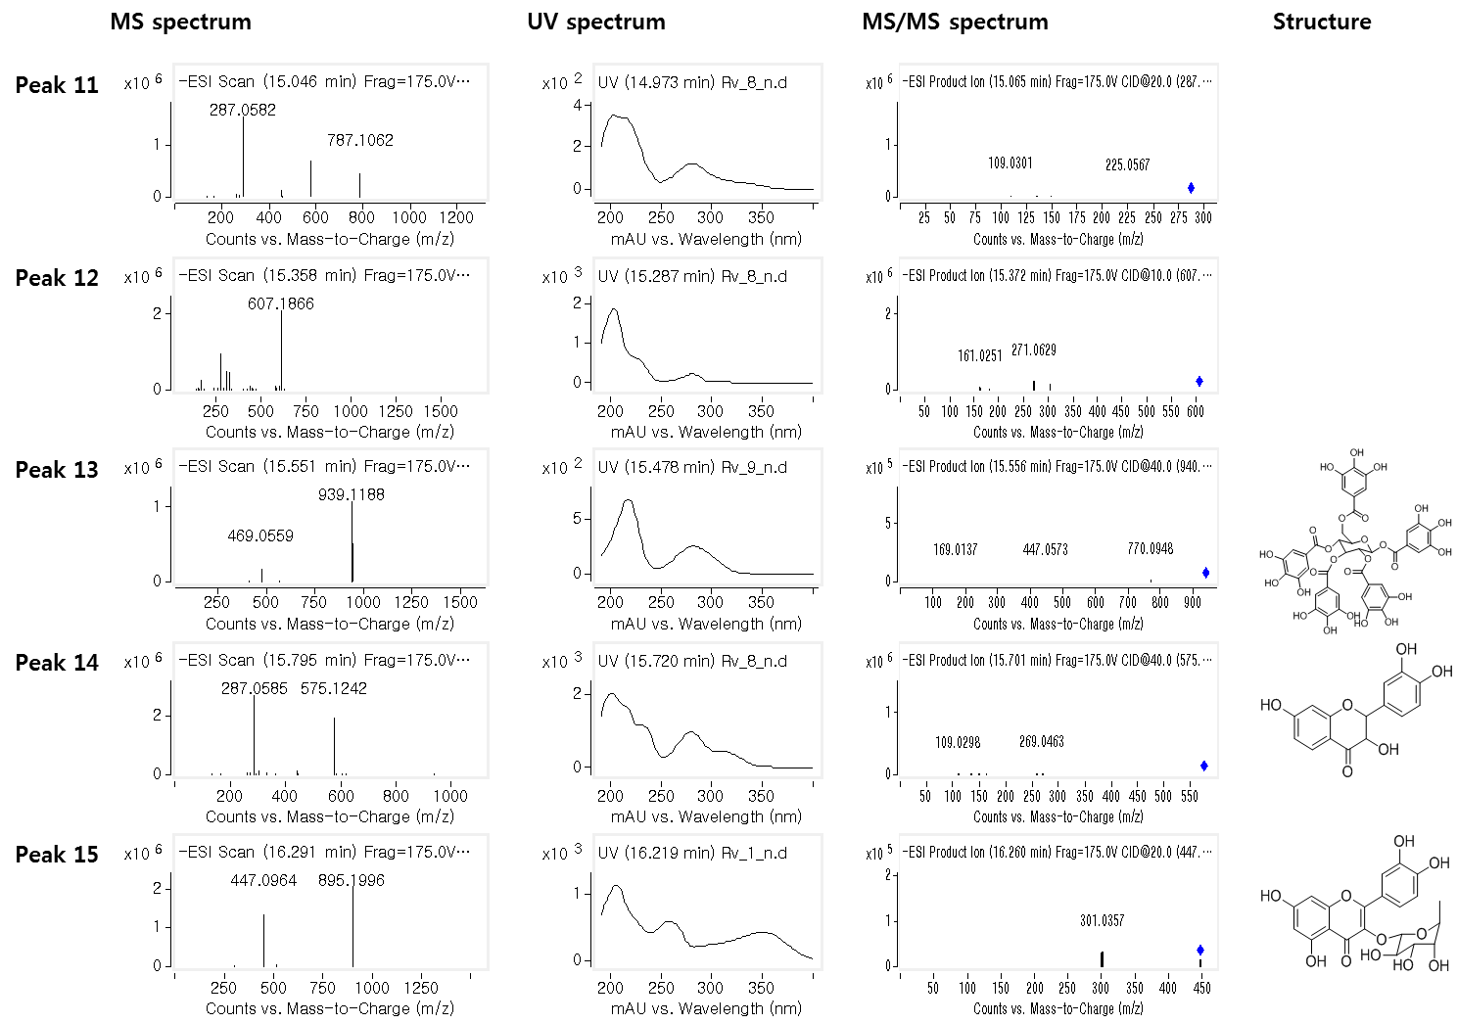
S2 Fig. MS and UV spectrum of compounds identified by LC-MS-MS analysis (Continued)

Slide 4
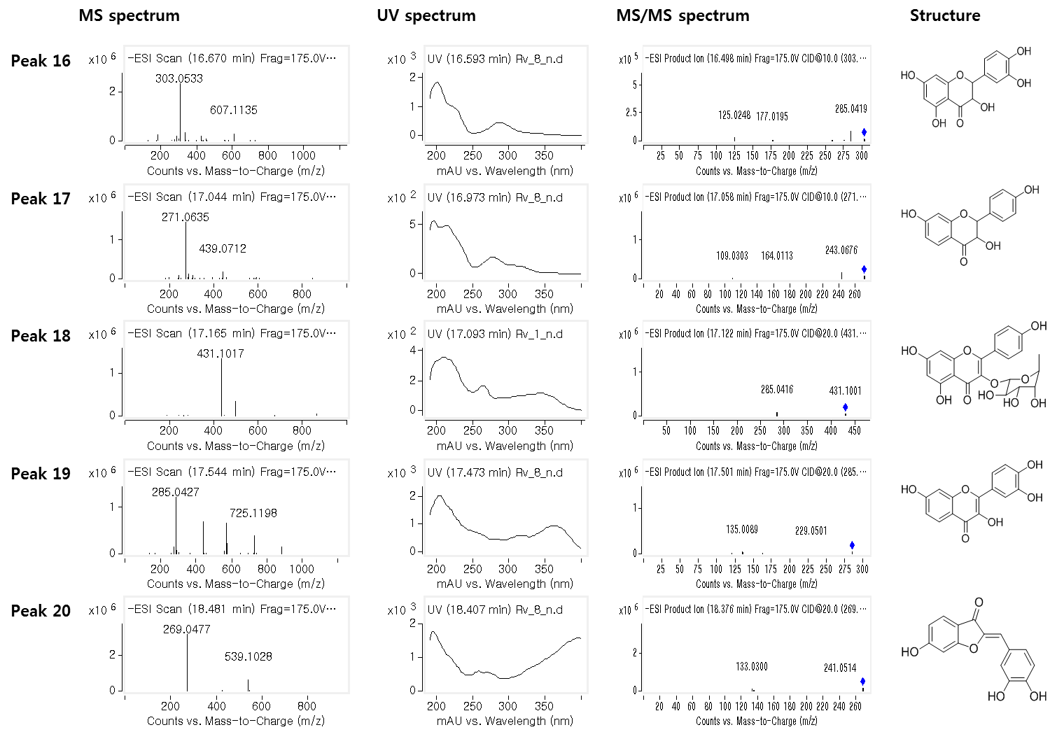
S2 Fig. MS and UV spectrum of compounds identified by LC-MS-MS analysis (Continued)

Slide 5
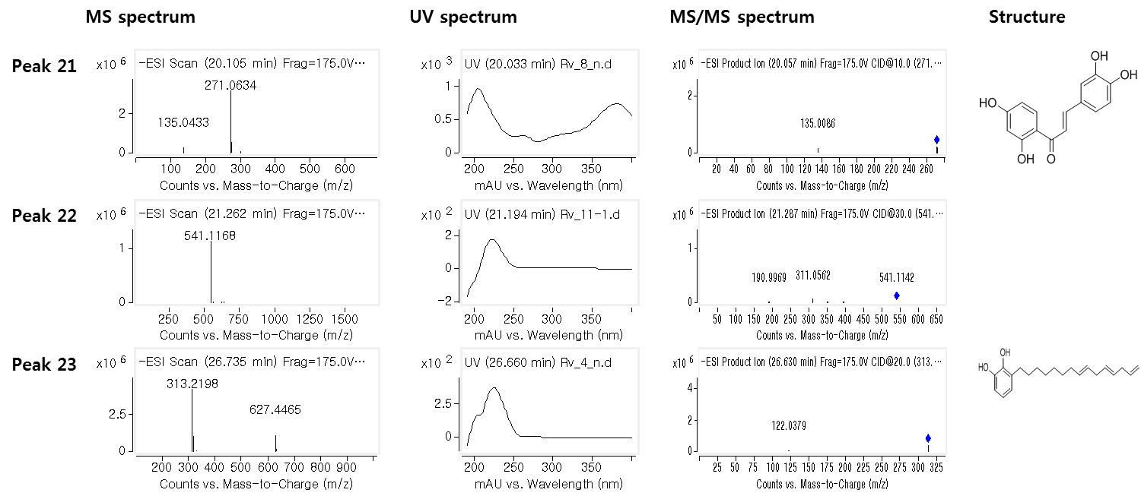
S2 Fig. MS and UV spectrum of compounds identified by LC-MS-MS analysis (Continued)

