Slide 1
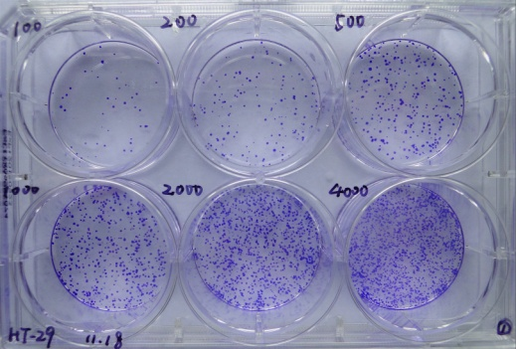
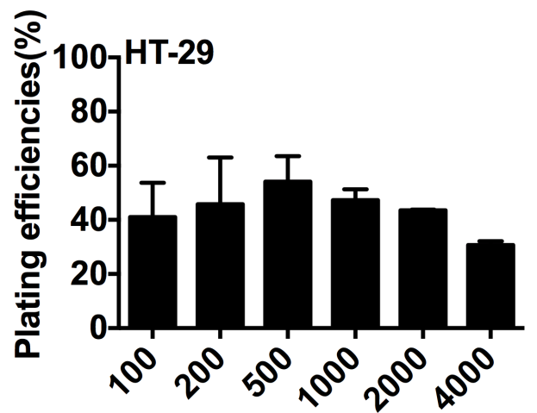
Huang_et al. Supplementary Fig. 1
A
B
Input No. of cells
100
200
500
1000
2000
4000
Input No. of cells

