Slide 1
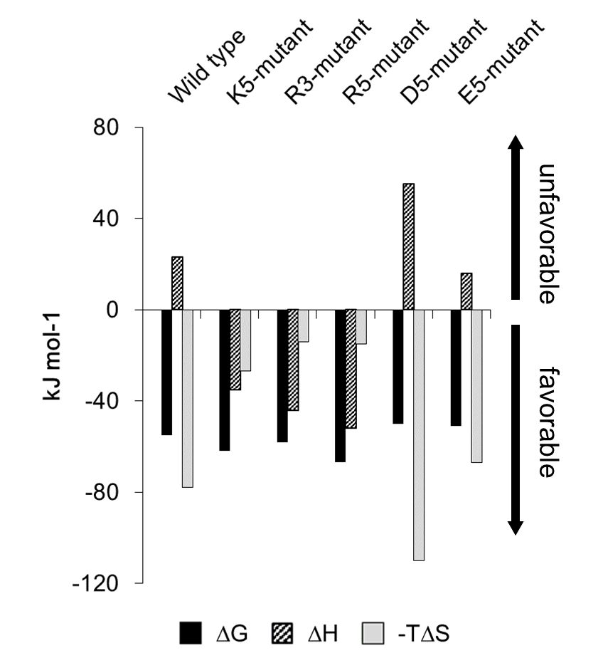
Supplementary Figure 1 Thermodynamic parameters governing Fabs binding to insulin and their comparison.

Slide 2
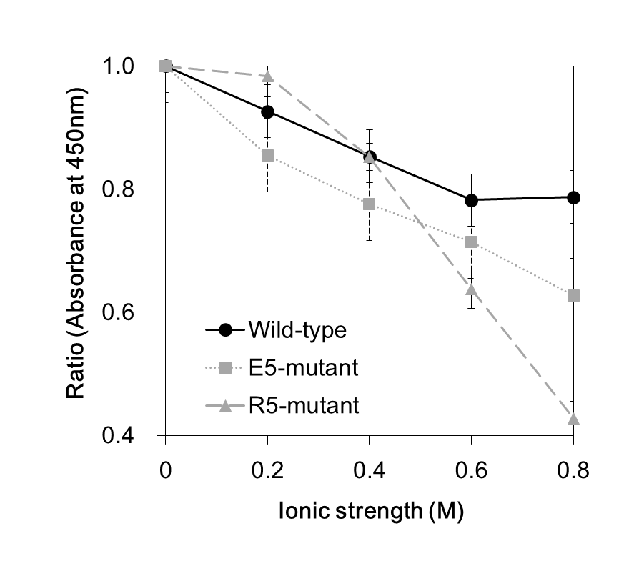
Supplementary Figure 2 Fab reactivity to insulin in different concentrations of sodium chloride.

Slide 3
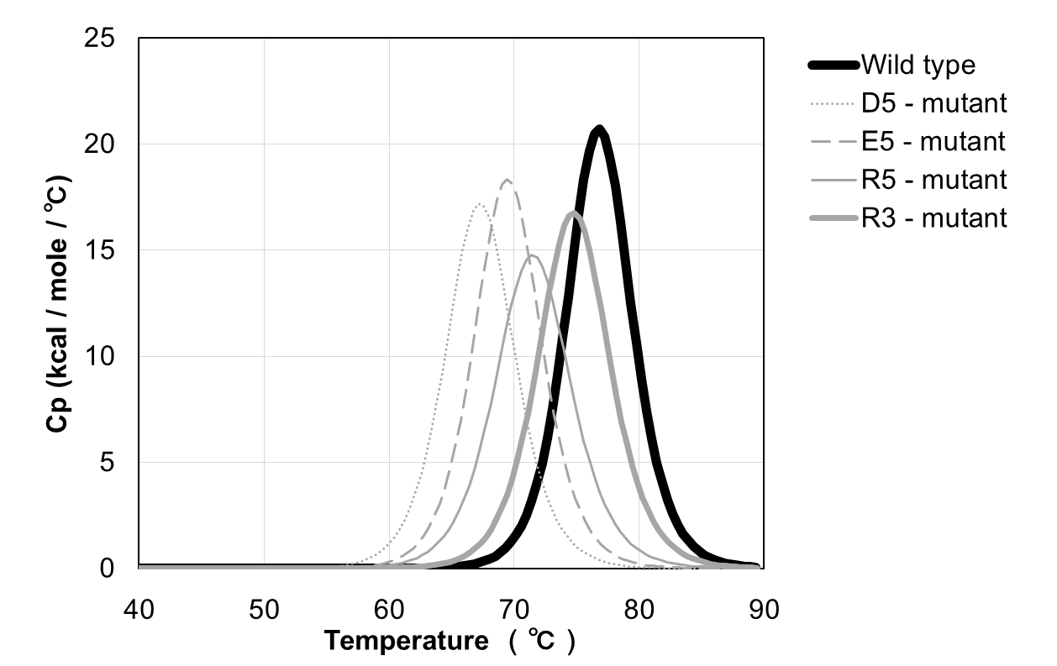
Supplementary Figure 3 DSC analysis of each mutant

