Slide 1
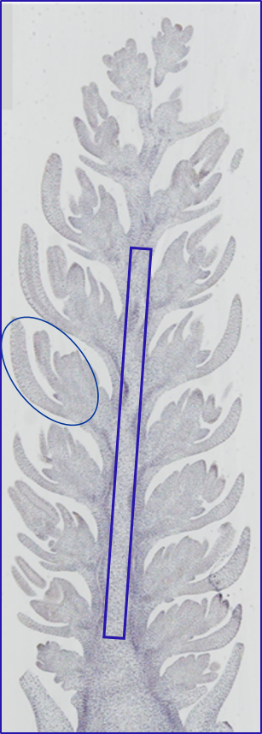
FIG. S5. Flower and rachis tissues isolated from immature spikes at awn primordium stage by laser-microdissection.

