Slide 1
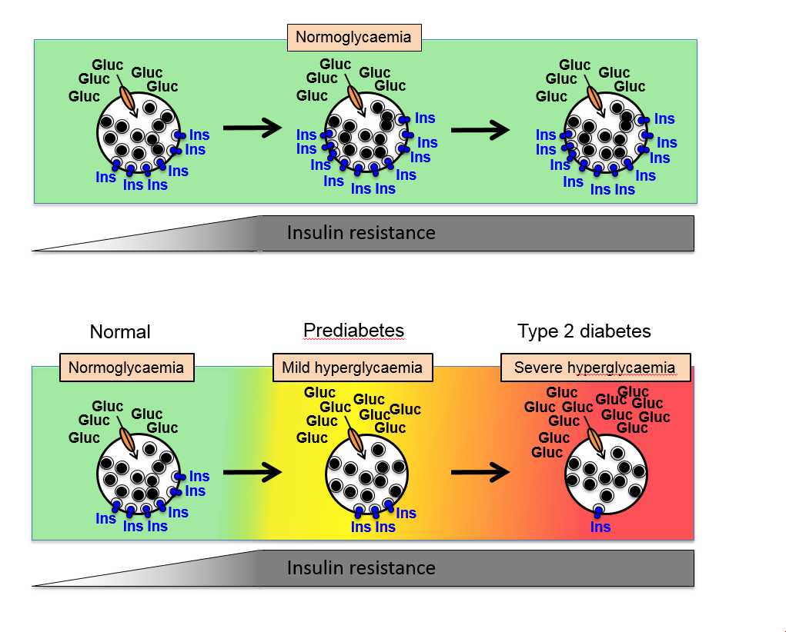
Relationship between beta cell insulin release and peripheral insulin sensitivity in determining states of glycaemic control
FIGURE HERE
Salunkhe et al (2018) Diabetologia DOI 10.1007/s00125-018-4658-3
©Springer-Verlag GmbH Germany, part of Springer Nature 2018

Slide 2
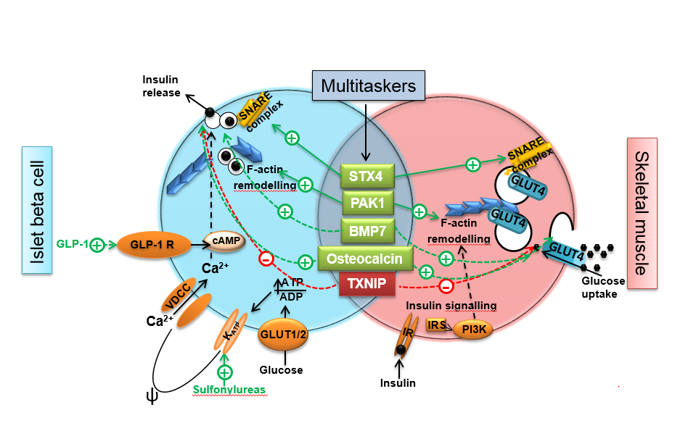
Beta cell function, peripheral insulin sensitivity and points of entry for therapeutic targeting
Salunkhe et al (2018) Diabetologia DOI 10.1007/s00125-018-4658-3
©Springer-Verlag GmbH Germany, part of Springer Nature 2018

