Slide 1
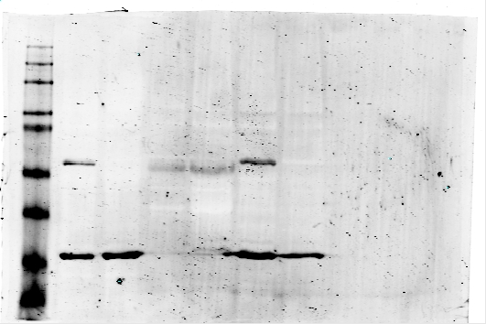
SUPPLEMENTARY FIGURE 2
S2a
S2b
S2c
BICR10
shControl
H413
H157
BICR10
shPAK2
0.5
shControl
63
0.4
shPAK2
PAK2
PAK2
63
0.3
***
0.69
1
0.52
GAPDH
1
0.01
Cell viability
(Abs at 600 nm)
GAPDH
35
35
0.2
BICR10
0.1
0
0h
12h
24h
48h
60h
S2d
H157
S2e
H413
S2f
Control
PAK2_OE
40
shControl
30
shControl
PAK2-Flag
63
30
shPAK2
shPAK2
**
1
21.40
20
c-Myc
63
Cell number (X10000)
**
Cell number (X10000)
20
**
1
5.01
10
**
10
ns
**
PKM2
63
ns
*
**
ns
1
2.02
0
0
GAPDH
35
day 1
day 2
day 3
day 4
day 5
day 1
day 2
day 3
day 4
day 5
BICR10
S2g
S2h
S2i
1.0
Control
120
120
shControl
120
120
shControl
0.8
PAK2_OE
***
100
100
shPAK2
100
100
shPAK2
0.6
80
80
80
80
Cell viablity
(Abs at 600 nm)
60
60
60
60
0.4
40
CCND1/GAPDH
PAK2/GAPDH
***
CCND1/GAPDH
***
PAK2/GAPDH
40
**
40
40
0.2
20
***
20
20
20
0
0
PAK2
0
CCND1
0
PAK2
0
CCND1
0h
12h
24h
48h

