Slide 1
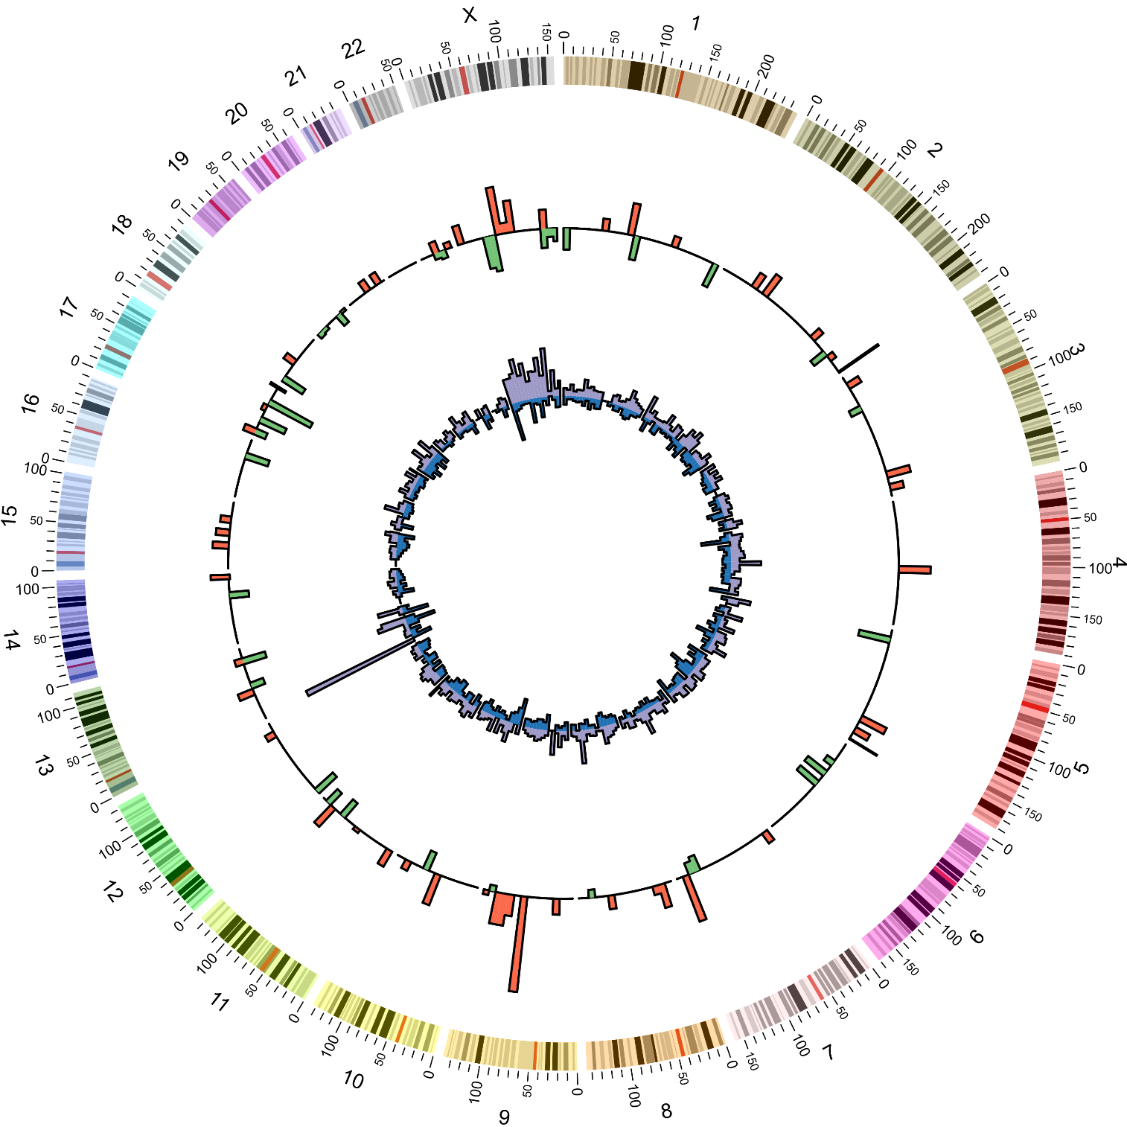
A
B
C
***
17.5
***
**
15.0
12.5
10.0
Intra-chromosomal distance between
two miRNA genes in three groups
(bpx10⁷)
7.5
5.0
2.5
0.0
D
FmiR gene
MmiR gene
NmiR gene
FmiR gene
MmiR gene
FG
MG

