Slide 1
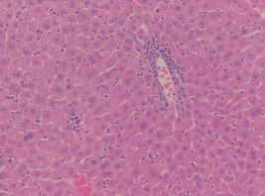
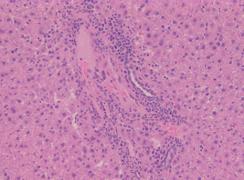
Supplemental Figure 1
a
IFN-γ
b
IL-17A
c
Liver
d
Liver
e
GI tract
[pg/ml]
*
[pg/ml]
*
*
**
250
800
C3H.sw→B6
20
15
200
600
15
10
150
GVHD score
100
400
10
5
50
200
C3H.sw→
LysM-Cre/ Stat3^{fl/-}
5
0
0
0
0
C3H.sw→B6
C3H.sw→LysM-Cre/Stat3^{fl/-}
C3H.sw→B6
C3H.sw→LysM-Cre/Stat3^{fl/-}

Slide 2
Supplemental Figure 2
a
B6-WT DC
[cpm]
LysM-Cre/Stat3^{fl/-} DC
100000
80000
60000
40000
20000
0
DCs
-
+
+
+
-
+
+
+
T cells
B6
B6
BALB/c
-
B6
B6
BALB/c
-
b
IL-2
c
IL-4
d
IL-10
e
IFN-γ
[pg/ml]
[pg/ml]
[pg/ml]
[pg/ml]
200
5
500
2500
150
4
400
2000
100
3
300
1500
50
2
200
1000
1
100
500
0
0
0
0
B6
BALB/c
B6
BALB/c
B6
BALB/c
B6
BALB/c
B6
BALB/c
B6
BALB/c
B6
BALB/c
B6
BALB/c
Responder T cells
Responder T cells
Responder T cells
Responder T cells
B6-WT DCs
LysM-Cre/Stat3^{fl/-} DCs

Slide 3
Supplemental Figure 3
a
IL-1β
b
IL-6
c
TNF-α
d
IL-10
[pg/ml]
[pg/ml]
[pg/ml]
[pg/ml]
20
*
500
****
250
****
500
****
15
400
200
400
10
300
150
300
5
200
100
200
100
50
100
0
0
0
0
LysM-Cre/Stat3^{fl/-}
WT-B6+LPS
LysM-Cre/Stat3^{fl/-}+LPS

Slide 4
Supplemental Figure 4
a
IL-1β
b
IL-6
c
TNF-α
d
IL-10
[pg/ml]
N.S
[pg/ml]
N.S
[pg/ml]
N.S
[pg/ml]
N.S
150
2500
2000
500
2000
1500
400
100
1500
300
1000
1000
200
50
500
500
100
0
0
0
0
WT-B6
WT-B6+LPS
LysM-Cre/Stat3^{fl/-}
LysM-Cre/Stat3^{fl/-}+LPS

