Slide 1
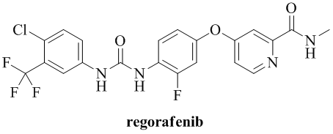
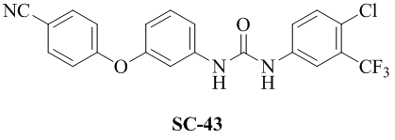
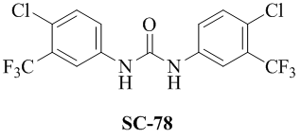
Supplementary Figure 1
A
B
C
Notes:
Supplementary Figure 1. The chemical structure of (A) regorafenib, (B) SC-43 and (C) SC-78.

