Slide 1
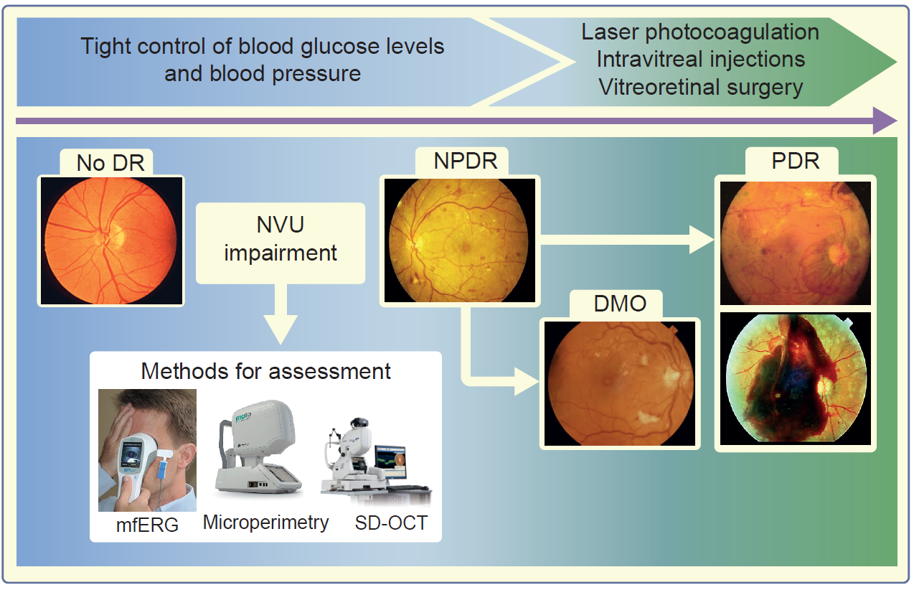
Natural history of diabetic retinopathy, based on retinal microvascular disease progression, and current treatment options
Simó et al (2018) Diabetologia DOI 10.1007/s00125-018-4692-1
Schematic: © BMJ Publishing Group Limited. Adapted from Simó and Hernández (2012). mfERG image, distributed under the terms of the CC BY-SA 4.0 License (https://creativecommons.org/licenses/by-sa/4.0/); microperimetry image, used with permission from CenterVue SpA; SD-OCT image, 3D OCT-2000, used by permission of Topcon GB Ltd

Slide 2
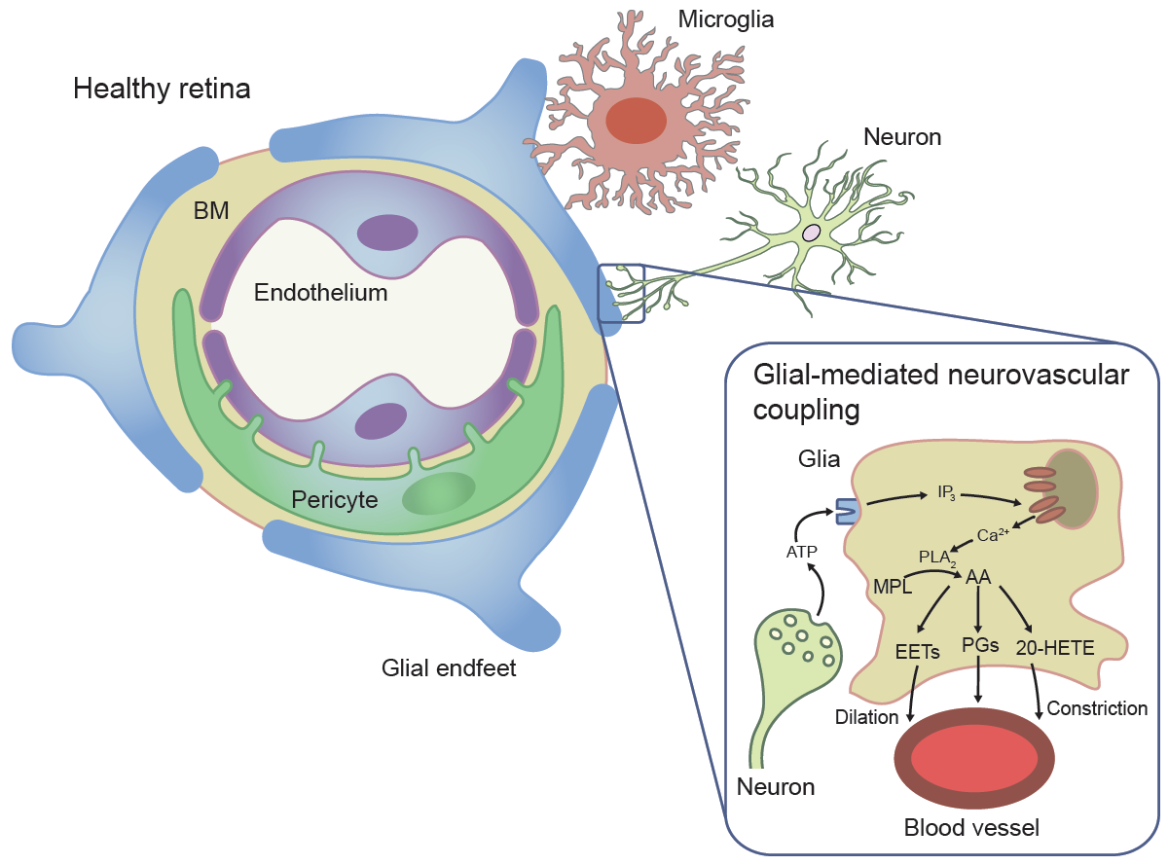
Composition of the retinal neurovascular unit
Simó et al (2018) Diabetologia DOI 10.1007/s00125-018-4692-1
Healthy retina: adapted from illustration by R. Davidowitz in Duh et al (2017), distributed under the terms of the CC BY 4.0 Attribution License (http://creativecommons.org/licenses/by/4.0/). Glial-mediated neurovascular coupling: adapted from illustration by A. Mishra in Newman (2013); © SAGE Publications

Slide 3
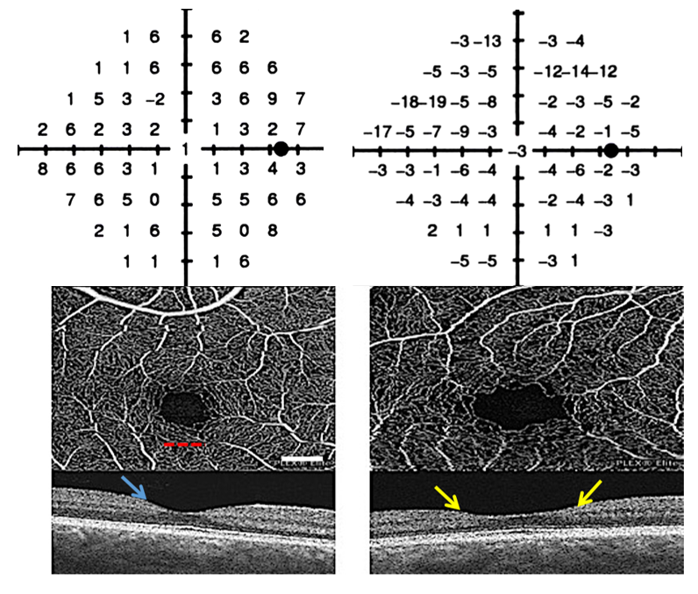
Frequency-doubling perimetry field tests with corresponding OCT angiograms and macular OCT
Foveal avascular zone
Normal foveal depression
Inner retinal thinning
Control
Type 2 diabetes
Healthy 58 year old woman with 20/16 visual acuity
62 year old woman with:
18 year history of type 2 diabetes
20/25 visual acuity
Gastroparesis
Normal clinical examination and fluorescein angiogram
Simó et al (2018) Diabetologia DOI 10.1007/s00125-018-4692-1
© The Authors 2018

Slide 4
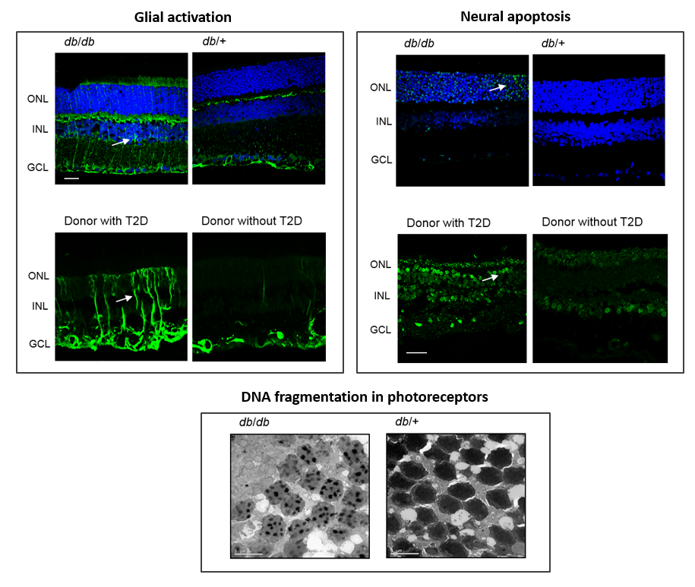
Main features of neurodegeneration: glial activation and neural apoptosis
Simó et al (2018) Diabetologia DOI 10.1007/s00125-018-4692-1
© The Authors 2018, except for image of glial activation in donor with type 2 diabetes (T2D): adapted from Carrasco et al (2008), distributed under the terms of the CC BY-NC-ND 3.0 License (http://creativecommons.org/licenses/by-nc-nd/3.0/)

Slide 5
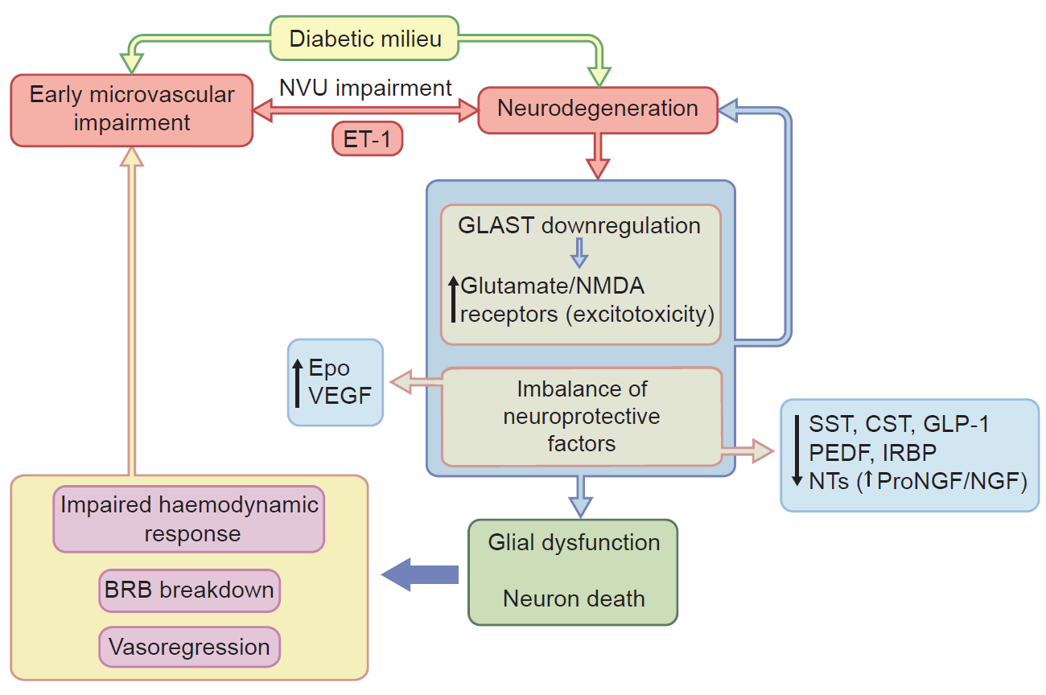
Main mechanisms involved in the link between retinal neurodegeneration and microvascular impairment in diabetes
Simó et al (2018) Diabetologia DOI 10.1007/s00125-018-4692-1
© Elsevier. Adapted from Simó and Hernández (2014)

