Slide 1
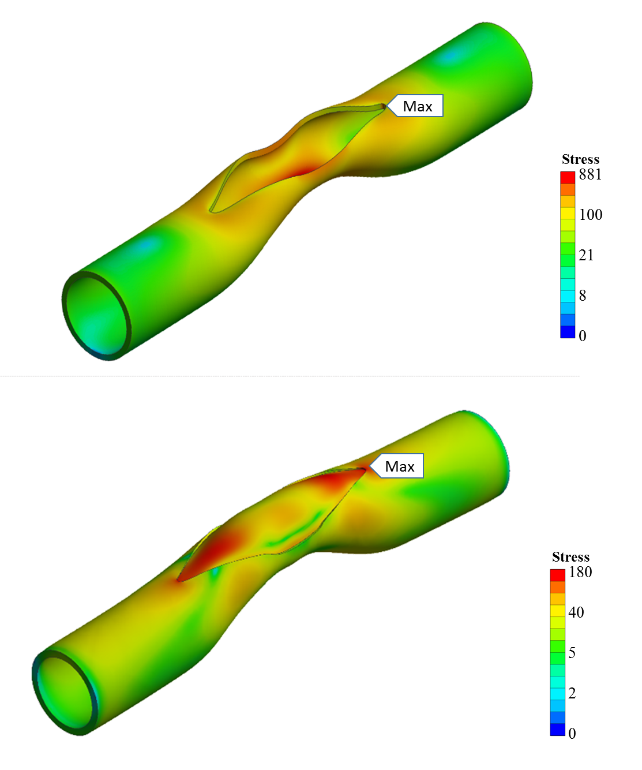
Supplementary Figure 1: (a) Equivalent stress distribution on the artery for the case Stenosis during the opening of slit in surgery. (b) Equivalent stress distribution on the patch and artery after pressurizing to post-operative blood pressure level on the case Stenosis. Stress gradient maps are shown in logarithmic scale to highlight the vessel and patch connection region’s stress contours in various colors.

Slide 2
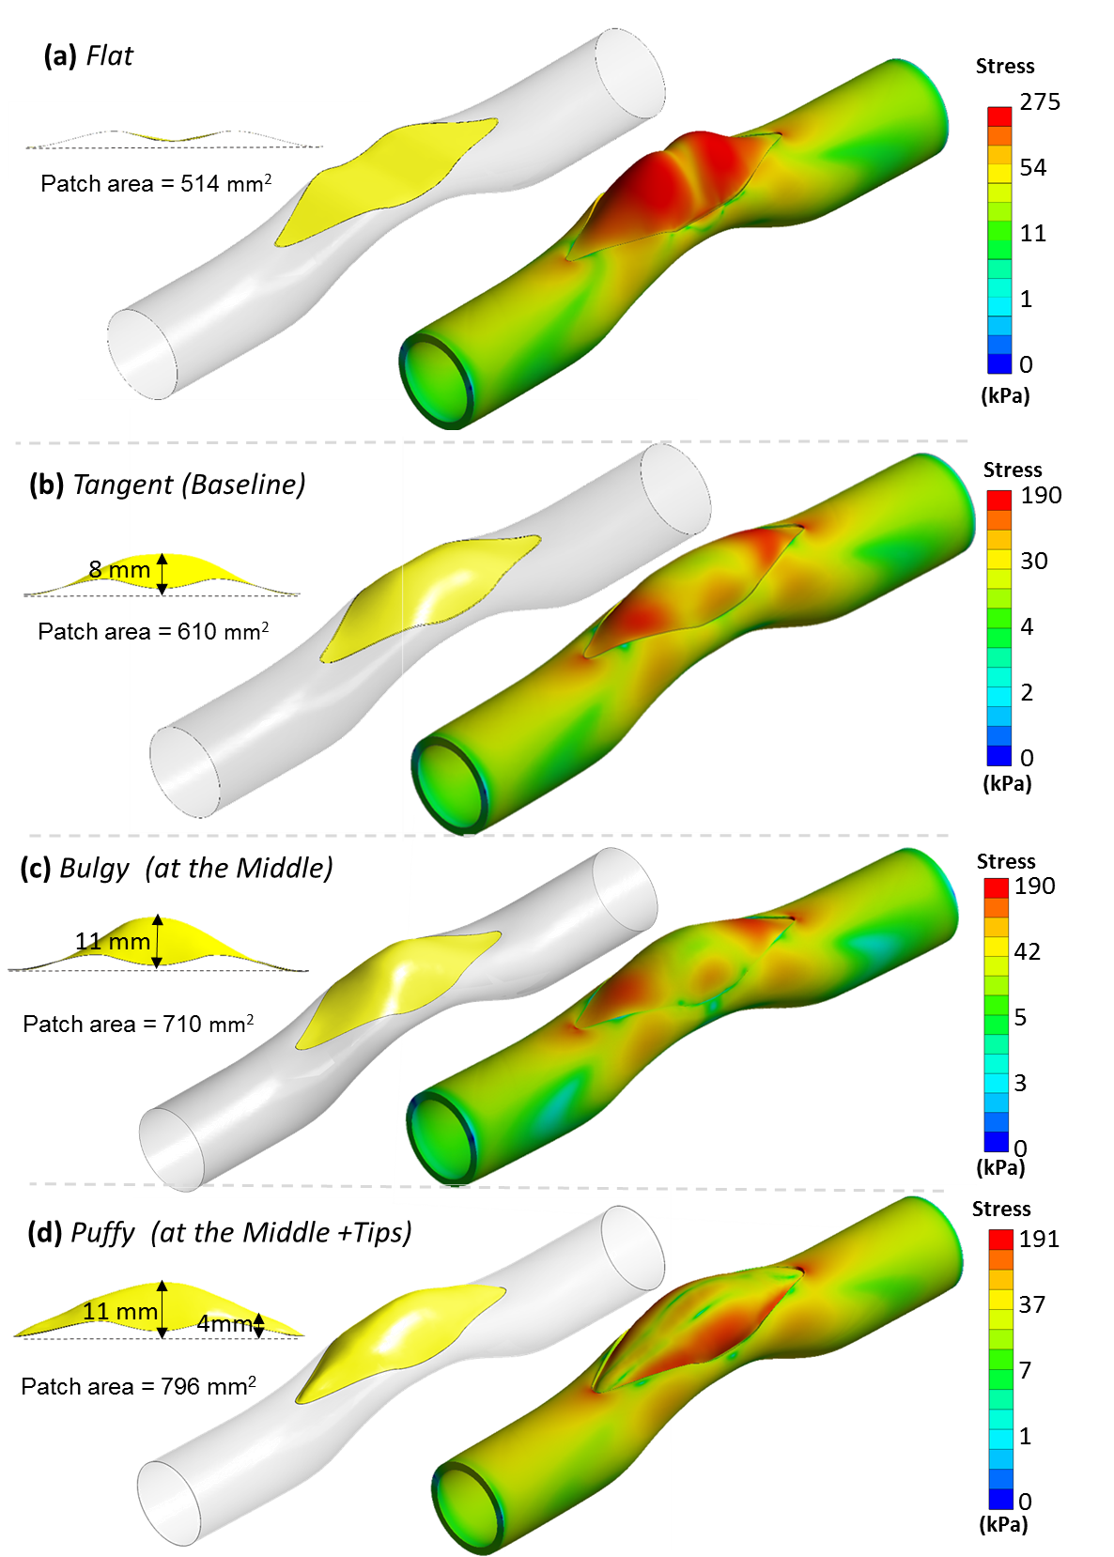
Supplementary Figure 2: The effect of initial patch shape on post-operative stress and deformations is studied on an idealized main pulmonary outflow tract. Simulations are performed for the initial patch configurations; (a) Flat patch with no lateral camber, (b) Tangent patch (baseline) with moderate camber (lateral height: 8 mm), (c) Bulgy patch with intense camber (lateral height: 11 mm), (d) a Puffy patch with excessive patch surface area causes bumped middle section and corners (lateral height: at the middle 11 mm, at the tips: 4 mm).

