Slide 1
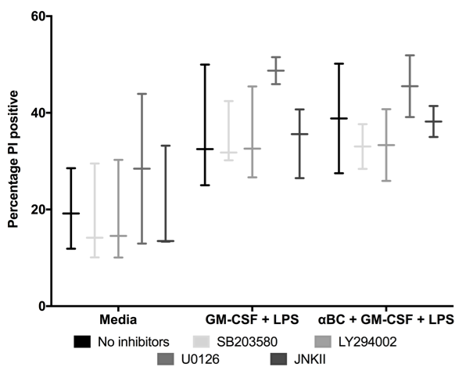
Finlay et al. – Supplementary Figure 4
A)
B)
C)
*
Notes:
Cell number as well?
Propidium iodide (PI) is a popular red-fluorescent nuclear and chromosome counterstain. Since propidium iodide is not permeant to live cells, it is also commonly used to detect dead cells in a population.PI binds to DNA by intercalating between the bases with little or no sequence preference. In aqueous solution, the dye has excitation/emission maxima of 493/636 nm. Once the dye is bound, its fluorescence is enhanced 20- to 30-fold, the fluorescence excitation maximum is shifted ~30–40 nm to the red and the fluorescence emission maximum is shifted ~15 nm to the blue, resulting in an excitation maximum at 535 nm and fluorescence emission maximum at 617 nm.PI is widely used in fluorescence microscopy, confocal laser scanning microscopy, flow cytometry, and fluorometry.

