Slide 1
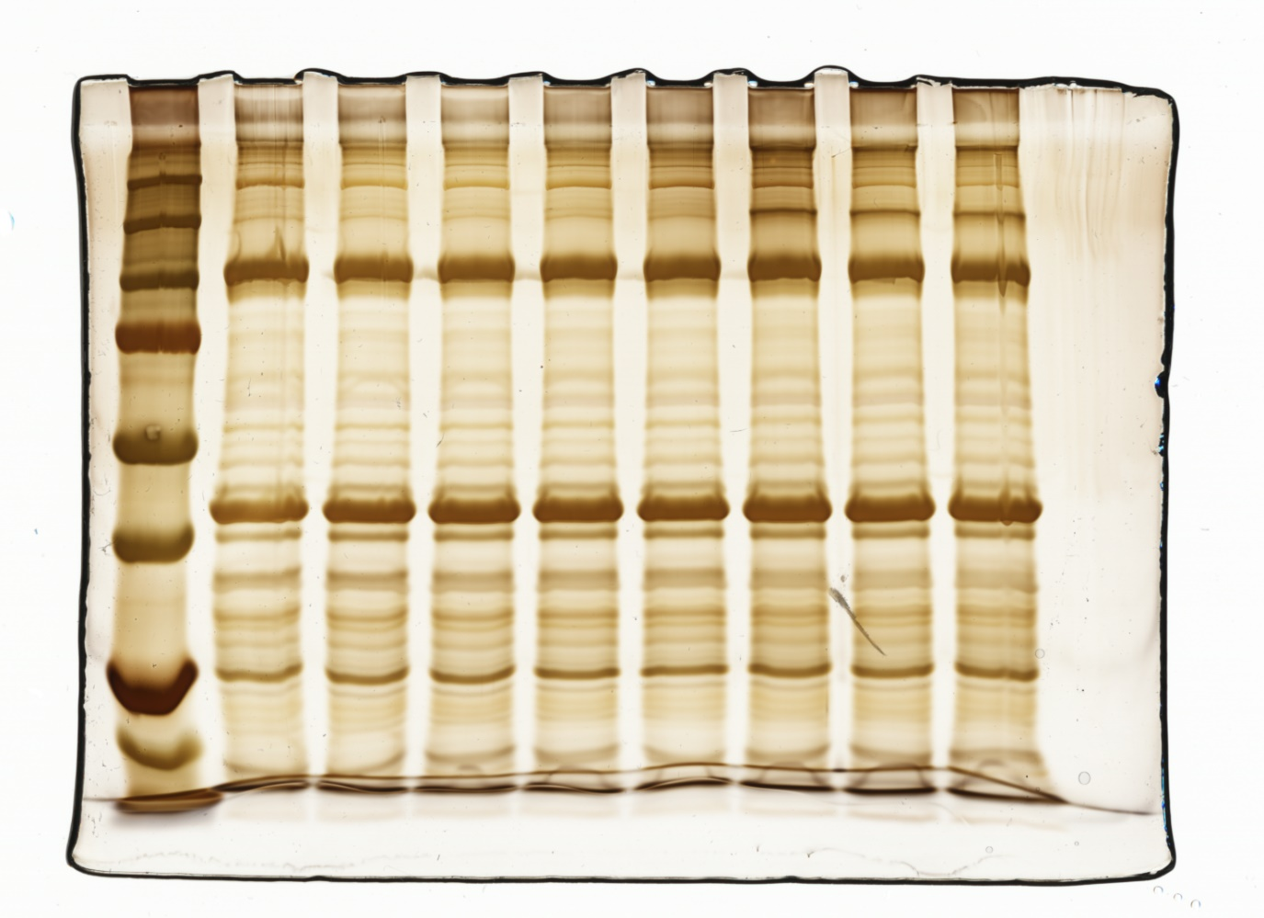
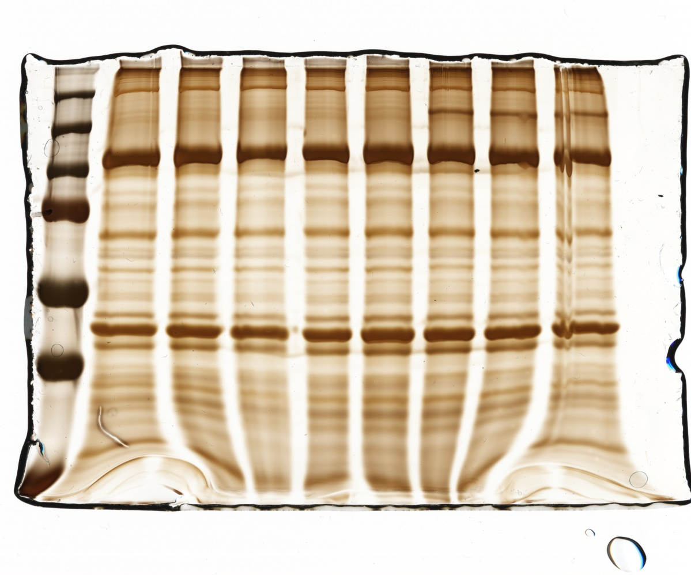
Densitometric scanning of highlighted XL band
XL wt Microsomes
kDa
0µg 0.1µg 0.5µg 1µg 2µg 5µg 7.5µg 10µg
250
150
100
XL mdx-4cv Microsomes
kDa
0µg 0.1µg 0.5µg 1µg 2µg 5µg 7.5µg 10µg
250
150
100
μg cross-linker BS³ per mg protein

