Slide 1
Supplementary information
for
A Cytotoxic Three-Dimensional-Spheroid, High-Throughput Assay using Patient Derived Glioma Stem Cells.
Victor Quereda^{1†}, Shurong Hou^{2†}, Franck Madoux³, Louis Scampavia², Timothy P. Spicer^{2γ} Derek Duckett^{1 γ}
¹Department of Molecular Medicine, Scripps Florida, 130 Scripps Way, Jupiter, Florida, USA
²The Scripps Research Institute Molecular Screening Center, Scripps Florida, 130 Scripps Way, Jupiter, Florida, USA
³F.M. Current address: Amgen, One Amgen Center Drive, Thousand Oaks, CA 91320, USA †These authors had equal contribution
^{γ}Co-Communicated by Duckett and Spicer
Address correspondence to:
Derek Duckett or Timothy Spicer
Scripps Florida
130 Scripps Way
Jupiter, FL 33458
Email: ducketdr@scripps.edu or spicert@scripps.edu

Slide 2
Supplementary Methods
Immunostaining
Spheroids from GBM6 were plated in a coverslip coated with 0.5 µg/ml matrigel (Part 356237, Corning, Corning, NY) at the indicated day. After 15 min in the matrigel, the spheres were attached to the coverslip. All incubations were performed at room temperature. Fixation of the spheres was done using PBS-4%PFA (Part 15710, Electron Microscopy Sciences, Hatfield, PA) for 20 min. Spheres were permeabilized with PBS-Tx100 0.5% (Part T8787, Sigma-Aldrich, St. Louis, MO) for 15 min (only for Sox2 and Sox9) and blocked with PBS-3%BSA-0.15%Tx100 (for Sox2 and Sox9) or PBS-3%BSA (for Nestin) for 30 min. After blocking the cells were incubated for 45 min with the following antibodies at the indicated dilution: Sox2 (1:500, Part AB5603, Millipore, Billerica, MA) or Sox9 (1:500, Part AB5535, Millipore, Billerica, MA) in their blocking buffer or Nestin (1:10, rat-401, Developmental Studies Hybridoma Bank, Iowa city, IA) in PBS-3%BSA-0.1%Tx100. The spheroids were washed with PBS and incubated with the respective secondary Alexa Fluor® antibodies diluted 1:250 in the same buffer as the primary antibody: goat anti-Rabbit Alexa Fluor 488 (Part R37116, ThermoFisher Scientific, Waltham, MA) or goat anti-Mouse Alexa Fluor 488 (Part A11017, ThermoFisher Scientific, Waltham, MA). After washes with PBS the spheroids were mounted in ProLong gold antifade with DAPI (Part P36935, ThermoFisher Scientific, Waltham, MA). Slides were visualized using an Olympus FluoView 1000 confocal microscope (Olympus, Shinjuku, Tokyo, Japan).

Slide 3
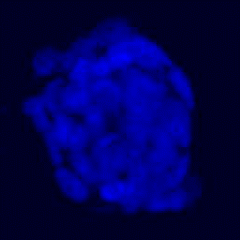
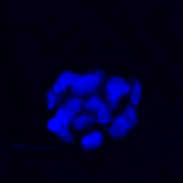
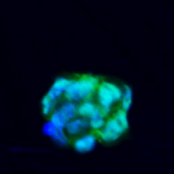
A)
Sox2
DAPI
Merge
Sox2
DAPI
Merge
Day 2
Day 5
B)
Sox9
DAPI
Merge
Sox9
DAPI
Merge
Day 2
Day 5
C)
Nestin
DAPI
Merge
Nestin
DAPI
Merge
Day 2
Day 5
Supplementary Figure S1. Characterization of Glioma Stem Cells.
Spheroids collected at the indicated time points were stained for the glioma stem cell markers: Sox2 (A), Sox9 (B), Nestin (C) and counterstained with DAPI for nucleus visualization. Scale bars shown represent 10 µm.

Slide 4
GBM6 cytotoxicity
100
50
% Cytotoxicity
SR-3029 1000cells 2D-glo
0
SR-3029 1000cells 3D-glo
-10
-8
-6
-4
Log[Compound], M
Supplementary Figure S2. CellTiter Glo vs CellTiter Glo 3D lysis buffers.
Concentration Response Curves of SR-3029 for 1000 GBM6 cells, 5 days cytotoxicity assay, lysed with CellTiter Glo or CellTiter Glo 3D.

