Slide 1
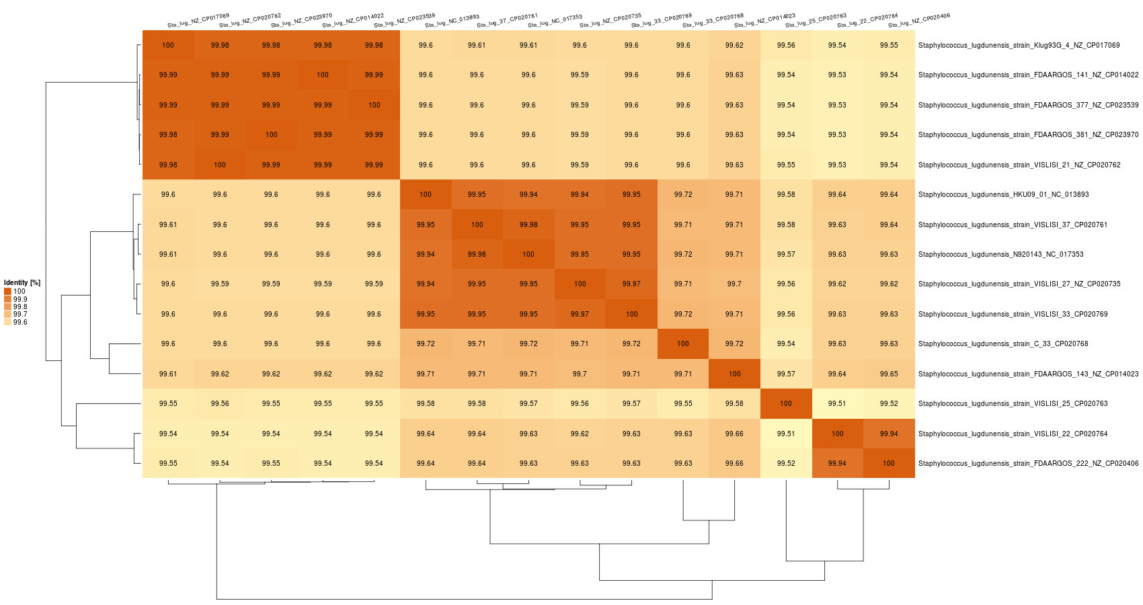
Additional File 2. Average nucleotide identity (ANI), and average amino acid identity (AAI) of S. lugdunensis (A-B), S. aureus (C-D), and S. epidermidis (E-F) using EDGAR interface. ANIs were calculated as the mean identity of all BLASTN matches that showed more than 30% overall sequence identity over at least 70% of an alignable region.
A

Slide 2
B

Slide 3
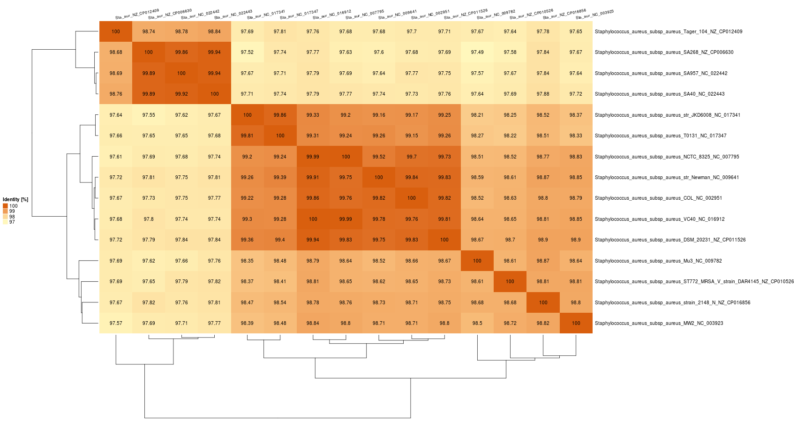
C

Slide 4
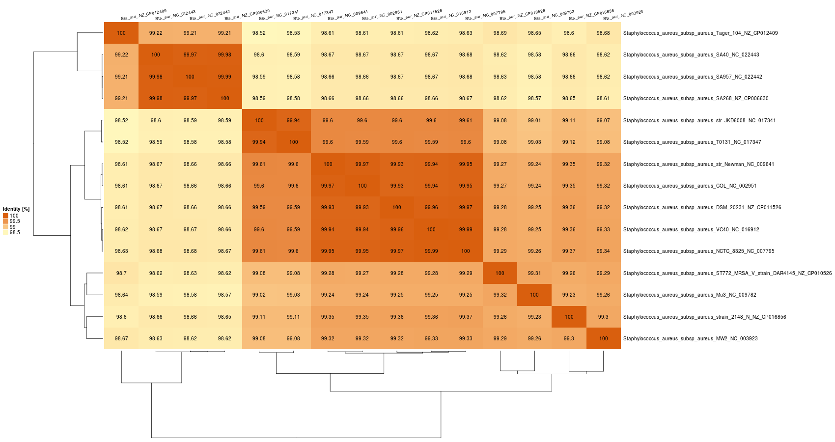
D

Slide 5
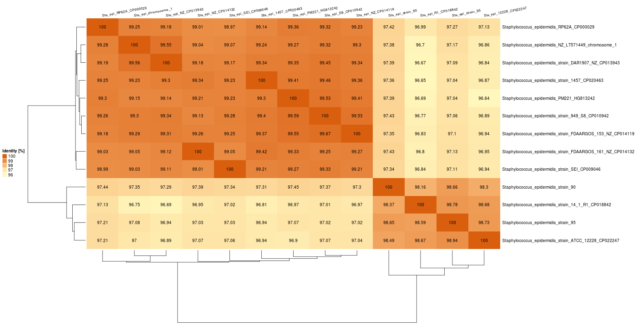
E

Slide 6
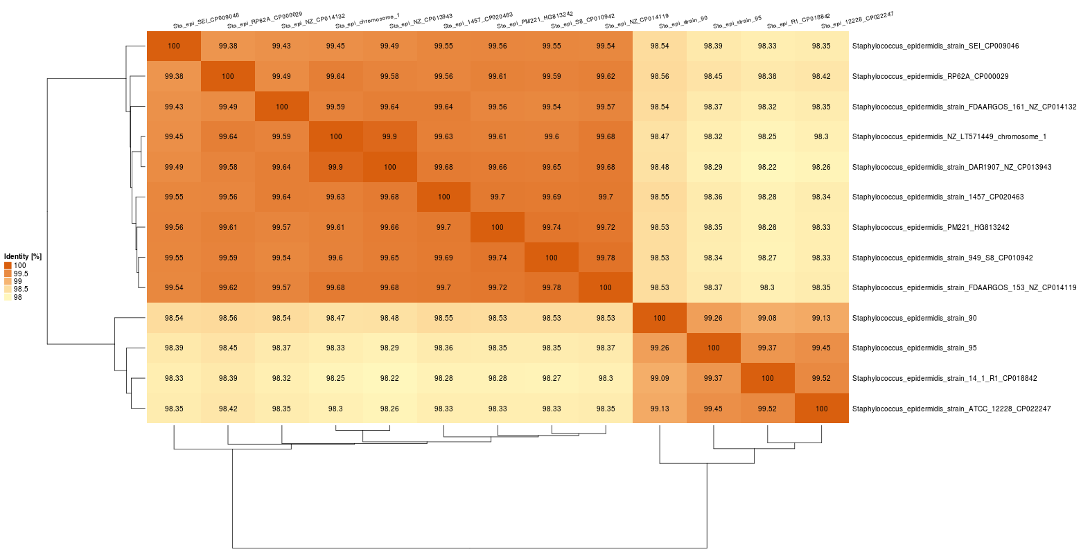
F

