Slide 1
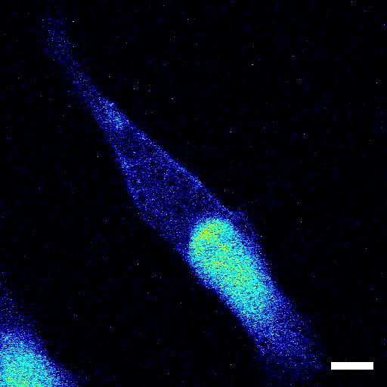
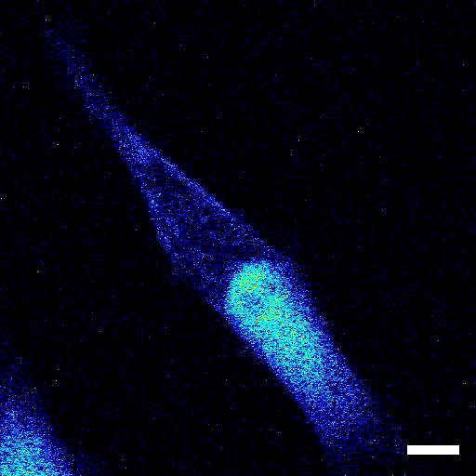
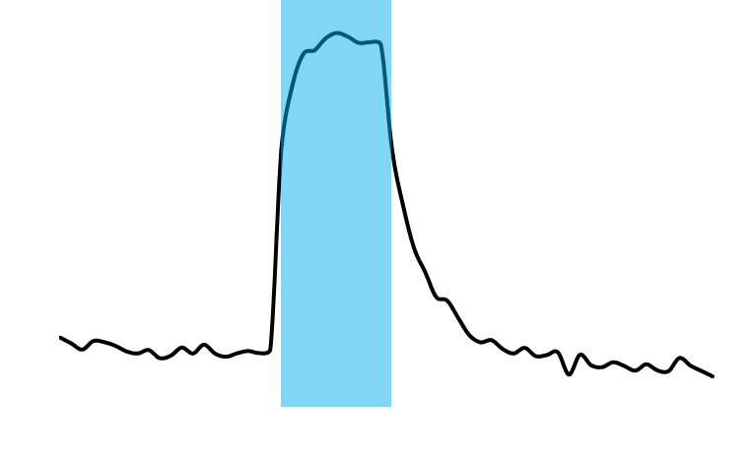

A
[Ca²⁺]_{o}, 5 mM
B
[Ca²⁺]_{o}, 0 mM
C
D
5%
2 s
Supplementary movie S2. Representative movies of light-induced intracellular Ca²⁺ increase in a ChRGR_{ER}-expressing C2C12 cell. (A and B) The R-GECO1 signals were sampled at 2 Hz and the fluorescence intensity (F) was imaged during an optical stimulation (OS: 451 nm; duration, 20 ms; 10 Hz for 5 s) in the presence (A) and absence (B) of extracellular Ca²⁺ ([Ca²⁺]_{o}). The images were sampled at 2 Hz and pseudocolor-displayed at 20 Hz. Scale bar, 10 μm. (C and D) The changes (ΔF/F₀) of R-GECO1 fluorescence of ROIs above the cells shown in (A) and (B), respectively. Each OS was indicated as a cyan stripe.

