Slide 1
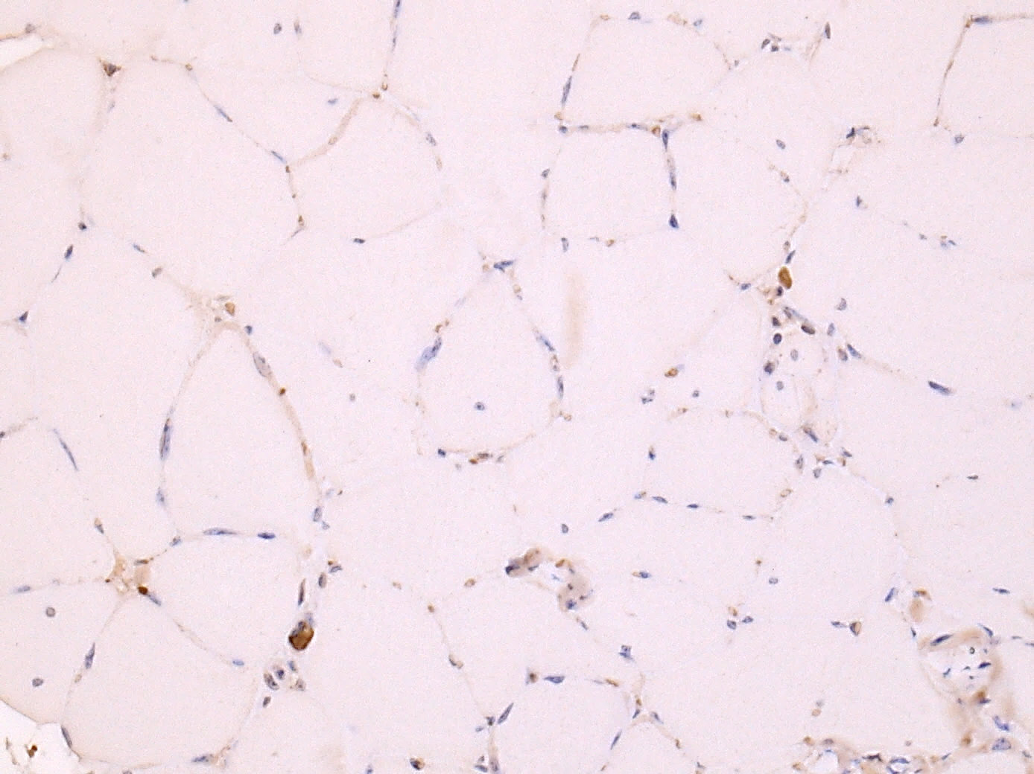
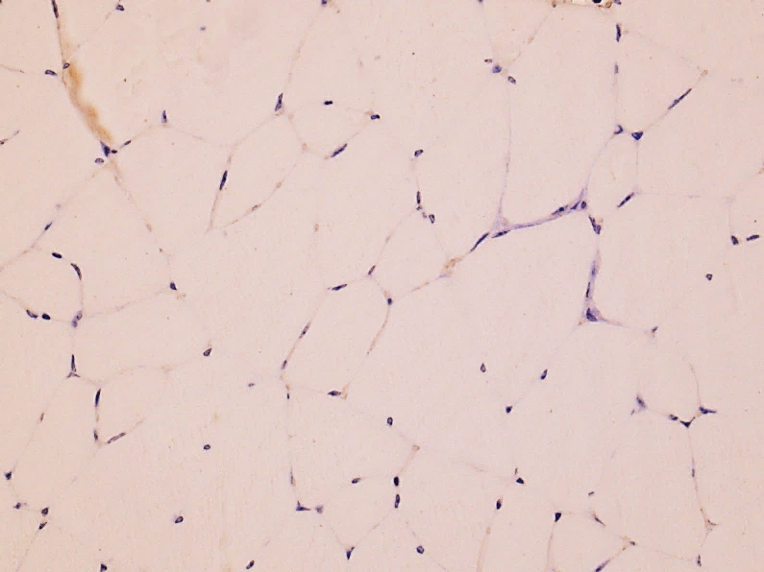
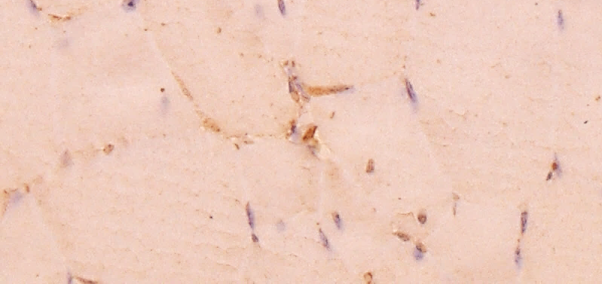
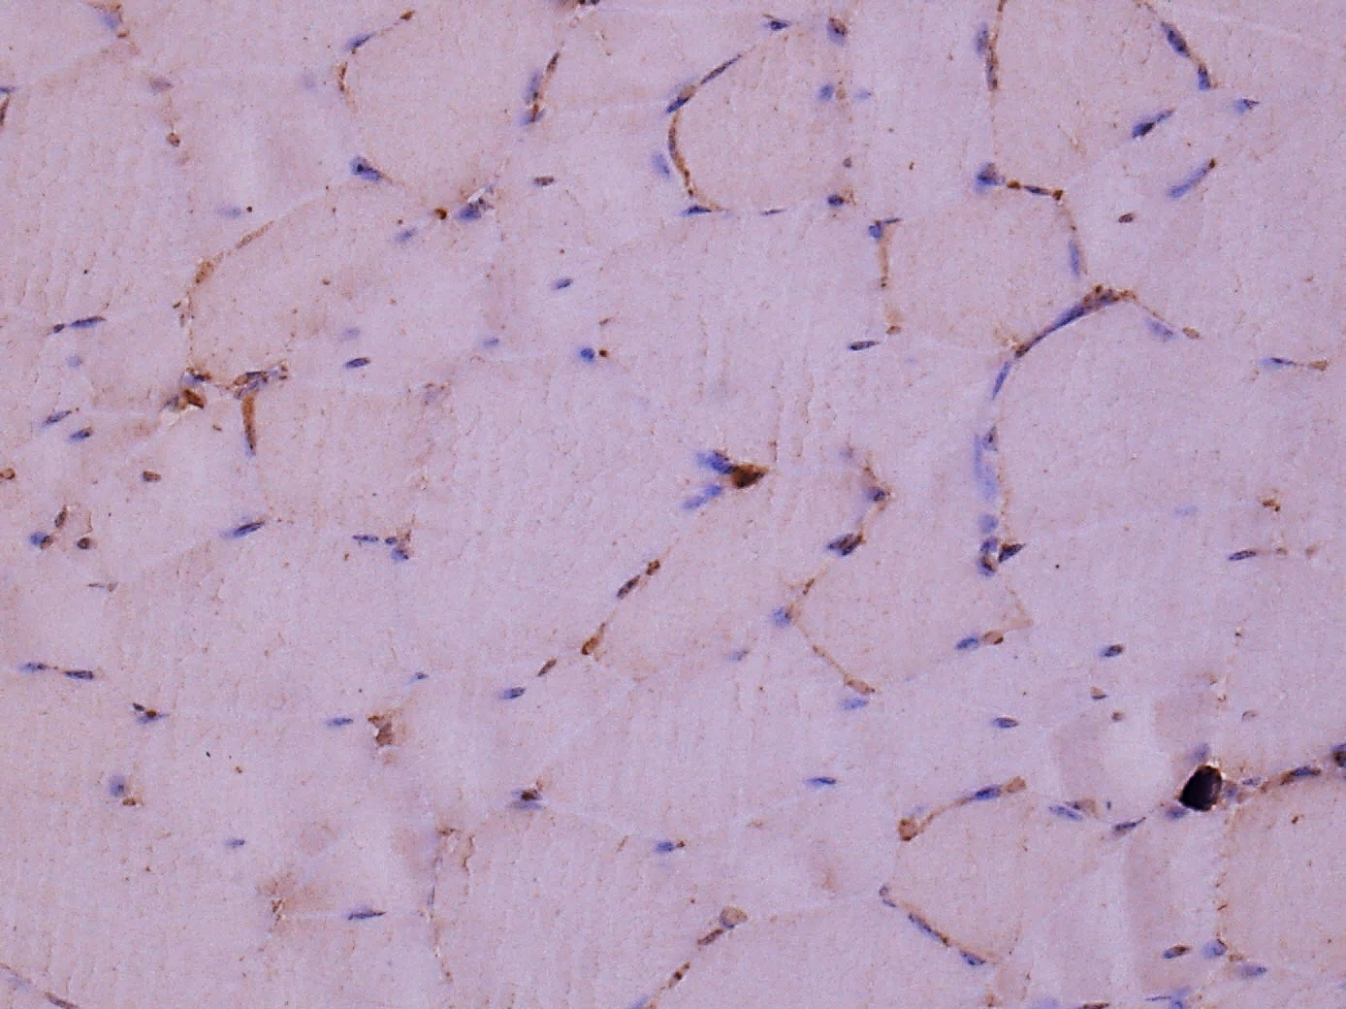
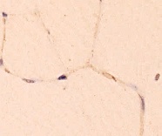
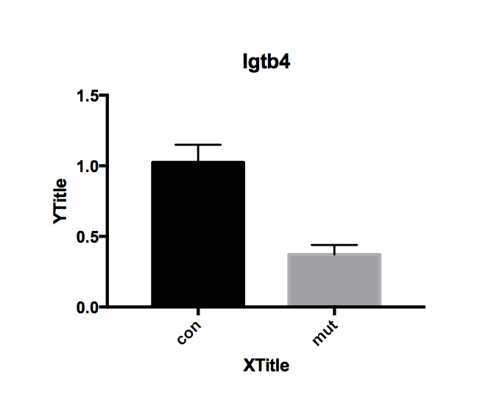
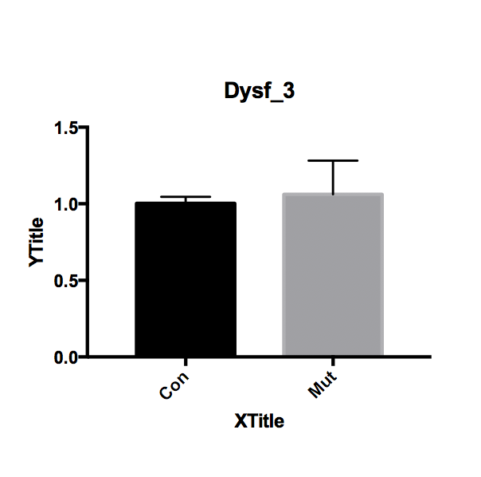
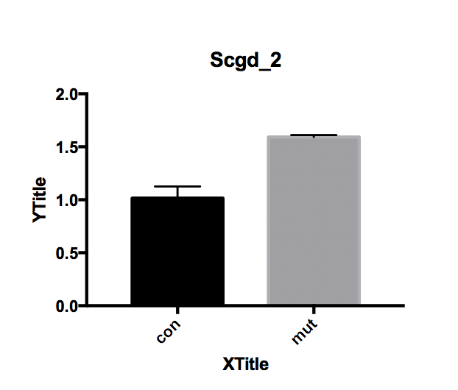
A
WT
p.P104L
ITGA5
A.1
A.2
A.3
25 µm
30 µm
30 µm
ITGB4
A.4
A.5
A.6
25 µm
25 µm
25 µm
B
Itgb transcripts
Dysf transcripts
Scgd transcripts
ns
*
*
Relative expression
Relative expression
Relative expression
WT
p.P104L
WT
p.P104L
WT
p.P104L
C
ns
Protein/Coomassie
ns
ns
ns
*
ns
**
**
ns
Protein/Coomassie
ns
Calpain Calpain (cleaved)
LC3

Slide 2
n.s
Protein/Coomassie
n.s
*
*
*
*
*

