Slide 1
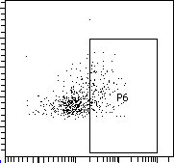
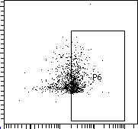
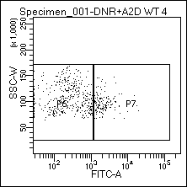
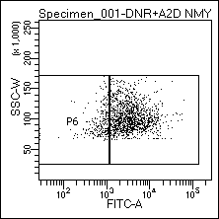
Figure S1
a
b
100
Ctrl+DNR
B-ALL+DNR
75
50
Annexin-V⁺ cells (%)
SSC
25
Annexin-V
0
Ctrl+DNR
B-ALL+DNR
c
d
Ctrl+DNR
B-ALL+DNR
100
ROS level
80
60
Percentage of cells (%)
SSC
40
ROS
20
0
ROS^{low}
ROS^{high}

