Slide 1
Fig. S1

Slide 2
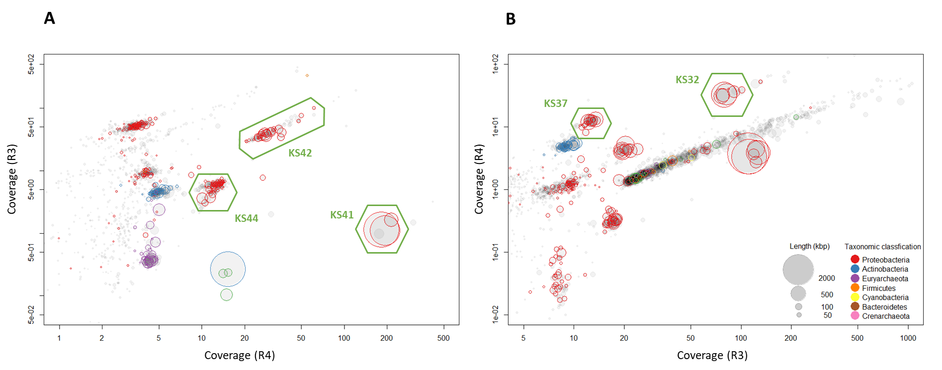
Fig. S2

Slide 3
Fig. S3
A
--/100
Methylomonas methanica S1 (NR_041815)
Methylococcus capsulatus Texas (AJ563935)
Methylocella silvestris BL2^{T} (AJ491847)
100/100
65/63
Methyloferula stellata AR4^{T} (FR686343)
Methylocella palustris K^{T} (Y17144)
Methylocapsa acidiphila B2^{T} (AJ278726)
99/99
Methylosinus trichosporium OB3b^{T} (AB008108)
100/--
86/92
Methylosinus sporium NCIMB 11126 (Y18946)
Methylocystis parvus OBBP^{T} (Y18945)
0.02
81/80
Methylocystis echinoides IMET 10491^{T} (AJ458473)
90/97
100/100
Methylocystis bryophila S284 (HE798551)
Methylocystis bryophila H2s^{T} (FN422003)
95/98
KS42
64/--
88/94
KS32
Methylocystis heyeri Sakb1 (AM285681)
99/98
Methylocystis heyeri H2^{T} (AM283543)
78/60
Uncultured peat methanotroph UP5 (AY080912)
100/100
Uncultured peat methanotroph UP4 (AY080911)
Methylocystis rosea SV97 (AJ414656)
100/100
Methylocystis hirsuta CSC1^{T} (DQ364433)
B
99/99
Methylomonas methanica S1 (U31653)
Methylococcus capsulatus Bath (L40804)
100/100
Methylocapsa aurea KYG^{T} (FN433470)
Methylocapsa acidiphila B2^{T} (AJ278727)
99/99
Methylosinus trichosporium OB3b^{T} (U31650)
--/99
Methylosinus trichosporium O19/1 (AJ459021)
Methylosinus sporium F10/1b (AJ459026)
0.05
99/99
94/93
Methylocystis rosea SV97^{T} (AJ414657)
93/92
Methylocystis hirsuta CSC1^{T} (DQ364434)
Methylocystis parvus OBBP^{T} (U31651)
68/66
54/61
68/75
83/79
Methylocystis echinoides IMET 10491^{T} (AJ459000)
Methylocystis heyeri Sakb1 (AJ868287)
Methylocystis heyeri H2^{T} (AM283546)
87/79
78/86
KS42
87/90
KS32
Methylocystis bryophila S284 (HE798547)
99/100
Methylocystis bryophila H2s^{T} (FN422005)

Slide 4
Fig. S4
A
B
100/100
Methylocystis parvus OBBP^{T} (Y18945)
--/99
Methylocystis parvus OBBP^{T} (U31651)
Methylococcus capsulatus Texas (AJ563935)
Methylocapsa acidiphila B2^{T} (AJ278726)
Methylocapsa acidiphila B2^{T} (CT005238)
98/99
100/100
Methylocaldum sp. BFH2 (KP828774)
95/94
Methylocaldum sp. BFH2 (KT921321)
98/98
Methylocaldum sp. BFH1 (GQ130271)
58/65
Methylocaldum sp. BFH1 (GQ130270)
Methylocaldum szegediense OR2^{T} (NR 026064)
Methyloparacoccus murrellii R-49797^{T} (HF954363)
98/98
Methylocaldum marinum S8^{T} (AB894129)
99/98
Methylocaldum szegediense OR2^{T} (U89303)
98/98
Methyloparacoccus murrellii R-49797^{T} (HF558990 )
85/85
Methylocaldum marinum S8^{T} (AB900159)
Methyloglobulus morosus KoM1^{T} (JN386974)
Methylococcus capsulatus Texas (WP_010961050)
82/86
Methylovulum psychrotolerans Sph2 (KT381580)
99/--
Methyloglobulus morosus KoM1^{T} (JN386975)
0.02
77/--
100/100
Methylovulum psychrotolerans Sph1^{T} (KT381578)
100/99
Methylosarcina lacus LW14^{T} (AY007286)
64/--
Methylococcaceae bacterium M200 (HM564015)
Methylomicrobium album BG8^{T} (U31654)
Methylovulum miyakonense HT12^{T} (AB501287)
91/85
100/99
Methylomicrobium japanense NI^{T} (AB253367)
Methylosoma difficile LC2^{T} (DQ119050 )
0.05
Methylomicrobium alcaliphilum 20Z^{T} (CCE22213)
72/--
Crenothrix polyspora (DQ295887 )
68/52
62/60
Methylomonas methanica S1^{T} (U31653)
78/83
81/75
Methylomonas sp. LW13 (AF150792)
98/98
Methylomonas koyamae Fw12E-Y^{T} (AB538965)
100/99
Methylomonas koyamae Fw12E-Y^{T} (AB538964)
99/99
Methylomonas sp. LW13 (AF150793)
Methylomonas methanica S1 (NR 041815)
88/78
Methylomonas paludis MG30^{T} (HE801217)
62/62
77/74
Methylomonas paludis MG30^{T} (HE801216)
89/88
Methylobacter sp. BB5.1 (AF016982)
Methylosarcina fibrate AML-C10^{T} (NR_025039)
55/56
Methylobacter marinus A45^{T} (WP 020158144)
64/69
Methylosarcina lacus LW14^{T} (AY007296)
94/92
Methylomicrobium alcaliphilum 20Z^{T} (EF495157)
68/68
Methylobacter luteus NCIMB 11914 (WP_027159170)
99/99
100/100
Methylomicrobium japanense NI^{T} (D89279)
Methylobacter whittenburyi ACM 3310 (WP_036297036)
100/100
Methylomicrobium agile ACM 3308 (X72767)
Methylobacter psychrophilus Z-0021^{T} (AY945762)
96/94
Methylomicrobium album BG8 (X72777)
Methylobacter tundripaludum SV96^{T} (AJ414658)
“Methylobacter luteus” ACM 3304 (X72772)
Methylobacter sp. CMS7 (KC878619)
98/98
99/99
Methylobacter whittenburyi ACM 3310 (X72773)
52/--
KS41
58/60
95/96
Methylobacter psychrophilus Z-0021^{T} (NR 025016)
Methylosoma difficile LC2^{T} (DQ119047)
100/99
Methylobacter tundripaludum SV96^{T} (AJ414655)
Methylovulum miyakonense HT12^{T} (AB501285)
Methylobacter sp. T20 (AF131868)
Methylococcaceae bacterium M200 (HM564018)
KS41
62/63
72/77
Methylobacter luteus NCIMB 11914 (AF304195)
92/91
Methylovulum psychrotolerans HV10_M2 (WP_088620576)
98/99
Methylobacter sp. BB5.1 (AF016981)
Methylovulum psychrotolerans Sph2 (KT381581)
100/99
Methylobacter marinus A45^{T} (AF304197)
96/95
Methylovulum psychrotolerans Sph1^{T} (KT381579)

Slide 5
Fig. S5
82
Methylobacter marinus A45^{T} (ARVS00000000)
100
Methylobacter whittenburyi ACM-3310 (NZ_JQNS00000000)
Methylobacter luteus IMV-B-3098 (NZ_ATYJ00000000)
80
67
Methylobacter tundripaludum SV96^{T} (NZ_AEGW00000000)
100
Methylobacter tundripaludum 21/22 (JMLA00000000)
Methylobacter tundripaludum 31/32 (JPOH00000000)
KS41
99
Methylovulum psychrotolerans HV10_M2 (NZ CP022129)
100
Methylovulum miyakonense HT12^{T} (NZ_AQZU00000000)
Methylomarinum vadi IT-4^{T} (JPON00000000)
74
100
Methylomonas lenta R-45370 (NZ_LUUI00000000)
100
Methylomonas methanica MC09 (NC 015572)
99
Methylomonas koyamae Fw12E-Y^{T} (NZ_BBCK00000000)
71
Methylomonas denitrificans FJG1 (NZ_CP014476)
100
100
Methylomonas methanica NCIMB 11130 (LUUF00000000)
Methylomicrobium alcaliphilum 20Z^{T} (NC_016112)
100
Methylomicrobium buryatense 5G (NZ_AOTL00000000)
99
Crenothrix polyspora (NZ_FUKI00000000)
0.1
Methyloglobulus morosus KoM1^{T} (NZ_AYLO00000000)
100
76
Methylosarcina fibrata AML-C10 (NZ_ARCU00000000)
100
Methylosarcina lacus LW14 (NZ_AZUN00000000)
99
Methylomicrobium agile ATCC 35068 (NZ_JPOJ00000000)
100
Methylomicrobium album BG8 (NZ_CM001475)
100
Methylococcus capsulatus Bath (NC 002977)
Methylococcus capsulatus Texas (NZ_AMCE00000000)
100
Methyloterricola oryzae 73a^{T} (NZ_JYNS00000000)
Methylocaldum szegediense O-12 (NZ_ATXX00000000)
88
Methylomagnum ishizawai 175^{T} (NZ_FXAM00000000)
Methylocapsa acidiphila B2^{T} (NZ_ATYA00000000)
Methylocystis parvus OBBP^{T} (NZ_AJTV00000000)

Slide 6
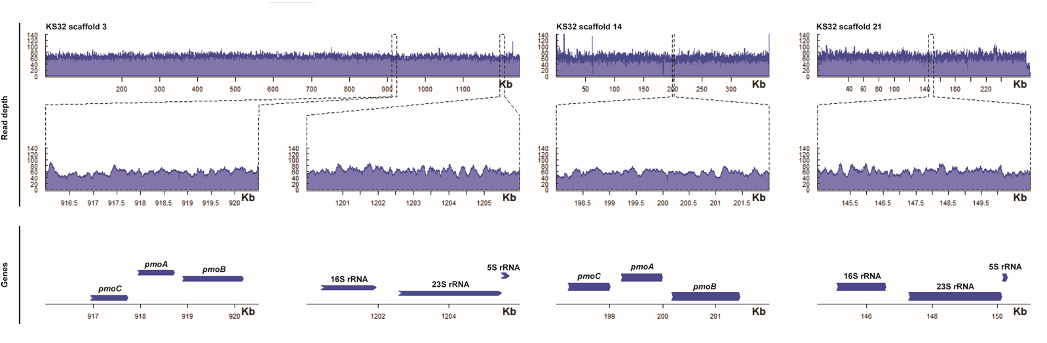
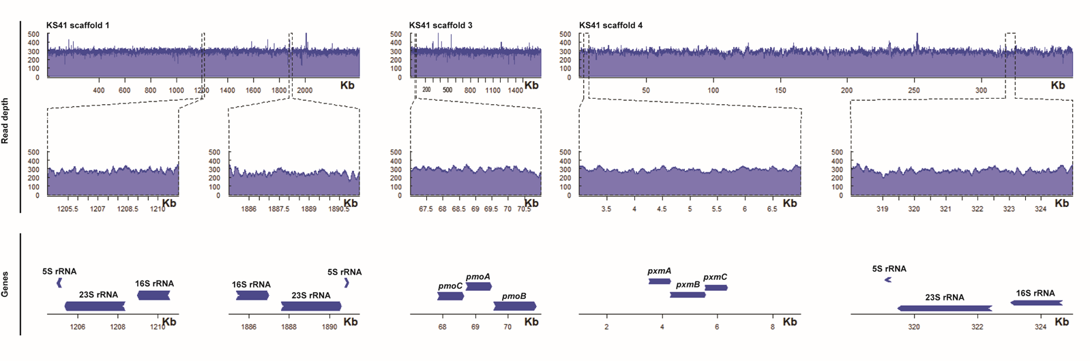
Fig. S6
A
B

Slide 7
Fig. S7
99
Methylovulum miyakonense HT12^{T} (NZ_AQZU00000000)
99
Methylovulum psychrotolerans HV10_M2 (NZ_CP022129)
A
67
KS41
Methylosarcina fibrata AML-C10 (NZ_ARCU00000000)
95
98
Methylomicrobium agile ATCC 35068 (NZ_JPOJ00000000)
100
Methylomicrobium album BG8 (NZ_CM001475)
Methylomonas methanica MC09 (NC 015572)
0.1
100
Methylomonas koyamae Fw12E-Y^{T} (NZ_BBCK00000000)
72
100
Methylomonas denitrificans FJG1^{T} (NZ_CP014476)
100
Methylomonas methanica NCIMB 11130 (LUUF00000000)
98
100
Methylomicrobium alcaliphilum 20Z^{T} (NC 016112)
Methylomicrobium buryatense 5G (NZ_AOTL00000000)
Methyloglobulus morosus KoM1^{T} (NZ_AYLO00000000)
69
Crenothrix polyspora (NZ_FUKI00000000)
84
Methylobacter luteus IMV-B-3098 (NZ_ATYJ00000000)
100
Methylobacter marinus A45^{T} (ARVS00000000)
97
Methylobacter whittenburyi ACM-3310 (NZ_JQNS00000000)
Methylocaldum szegediense O-12 (NZ_ATXX00000000)
84
Methyloterricola oryzae 73a^{T} (NZ_JYNS00000000)
Methylomagnum ishizawai 175^{T} (NZ_FXAM00000000)
Methylosinus sp. LW4 (NZ_KB900626)
100
Methylosinus sp. R-45379 (NZ_LUUM01000090)
B
100
100
Methylovulum miyakonense HT12^{T} (NZ_AQZU00000000)
96
Methylovulum psychrotolerans HV10_M2 (NZ_CP022129)
83
KS41
Methylosarcina fibrata AML-C10 (NZ_ARCU00000000)
94
Methylosarcina lacus LW14 (NZ_AZUN00000000)
Methyloglobulus morosus KoM1^{T} (NZ_AYLO00000000)
99
99
Methylomonas koyamae Fw12E-Y^{T} (NZ_BBCK00000000)
Methylomonas denitrificans FJG1 (NZ_CP014476)
Methylomonas lenta R-45370 (NZ_LUUI00000000)
0.1
Methyloterricola oryzae 73a^{T} (NZ_JYNS00000000)
88
Methylococcus capsulatus Bath^{T} (NC 002977)
100
Methylococcus capsulatus Texas^{T} (NZ_AMCE00000000)
Methylomagnum ishizawai 175^{T} (NZ_FXAM00000000)
Crenothrix polyspora (NZ_FUKI00000000)
100
Methylobacter tundripaludum SV96^{T} (NZ_AEGW00000000)
100
Methylobacter tundripaludum 21/22 (JMLA00000000)
100
Methylobacter tundripaludum 31/32 (JPOH00000000)
Methylocapsa acidiphila B2^{T} (NZ_ATYA00000000)
100
Methylocystis parvus OBBP^{T} (NZ_AJTV00000000)

Slide 8
Fig. S8
59
Methylomarinum vadi IT-4^{T} (WP_031432237)
Methyloprofundus sediment WF1^{T} (WP_080522457)
A
Methylomicrobium alcaliphilum 20Z^{T} (WP_014148134)
57
Methylomonas methanica MC09^{T} (WP_013819003)
Subunit A Subunit B
285 295 318 481 560 157 370
E. hirae -G---GKTV---ER---F--QNAF--L---R-
M. stanieri -G---GKTV---ER---Y--QDAF--F---R-
R. maiorica -G---GKTV---ER---Y--QDAF--F---R-
R. brasiliensis -G---GKTV---ER---Y--QDAF--F---R-
N. marinus -G---GKTV---ER---Y--QDAF--F---R-
M. sedimenti -G---GKTV---ER---Y--QDAF--F---R-
M. methanica -G---GKTV---ER---Y--QDAF--F---R-
M. marinus -G---GKTV---ER---Y--QDAF--F---R-
M. alcaliphilum -G---GKTV---ER---Y--QDAF--F---R-
M. buryatense -G---GKTV---ER---Y--QDAF--F---R-
H. ilicicola -G---GKTV---ER---Y--QDAF--F---R-
M. luteus -G---GKTV---ER---Y--QDAF--F---R-
M. whittenburyi -G---GKTV---ER---Y--QDAF--F---R-
M. fibrata -G---GKTV---ER---Y--QDAF--F---R-
KS41 -G---GKTV---ER---Y--QDAF--F---R-
M. sedula -G---GKTV---ER---Y—-QNAY--L---R-
H. butylicus -G---GKTV---ER---Y--QNAF--M---R-
A. hospitalis -G---GKTV---ER---F--QNAF--L---R-
Methylobacter luteus IMV-B-3098 (WP_027158199)
B
86
Methylobacter marinus A45^{T} (WP_020160691)
51
100
Methylobacter whittenburyi ACM-3310 (WP_036250094)
Marinobacterium stanieri S30^{T} (WP_010323418)
78
Neptuniibacter marinus ATR 1.1^{T} (WP_067862529)
0.1
Halomonas ilicicola DSM 19980 (WP_072818686)
100
99
Halomonas xianhensis CGMCC 1.6848 (WP_035557755)
Rhodopirellula europaea 6C^{T} (WP_039961964)
Rubripirellula obstinate CECT 8602^{T} (WP_068261063)
Candidate division KSB3 bacterium (PIE34925)
Halophilic/Marine-MOB
Deltaproteobacteria bacterium SM23 61 (KPK94639)
97
Uncultured Gemmatimonas sp. SG8 (KPK62437)
75
KS41
Rhodopirellula maiorica SM1^{T} (WP_008695190)
84
Rhodopirellula sallentina SM41^{T} (WP_008687276)
Neutral-MOB
82
61
Rubinisphaera brasiliensis DSM 5305 (WP_013629335)
64
Dethiobacter alkaliphilus AHT1^{T} (WP_008516574)
Thermoanaerobacter ethanolicus ATCC 33223 (EAO65277)
Acidophilic-MOB
Caloramator fervidus DSM 5463 (ABD18895)
100
Streptococcus pneumoniae TIGR4 (WP 000400484)
88
Clostridium perfringens 13 (WP 003456004)
98
Enterococcus faecalis V583 (NP 815215)
95
82
Enterococcus hirae ATCC 9790 (EOU06998)
Carboxydothermus hydrogenoformans Z-2901 (WP 011345416) F-type ATPase
Spiroplasma citri (CAK98400) F-type ATPase
100
Escherichia coli (WP 069358413) F-type ATPase
93
Enterococcus hirae ATCC 9790 (P26682) F-type ATPase
93
Lactobacillus plantarum WCFS1 (NP 785835) F-type ATPase
Loop Physiological
condition
E. hirae 74 FLIFINLGSDMSVVQGLNFLGASLPIAFTGLFSGIAQGKVAAAGIQILAKKPEHAT----KGIIFAAMVETYAILGFVISFLLVLNA----- 156 Na+
S. pneumoniae 76 ILIWLQLTPELPLEKGVAYFFVALPIAIVGYFSAKHQGNVAVAGMQILAKRPKEFM----KGAILAAMVETYAILAFVVSFILTLRV----- 158 Na+
M. acetivorans 16 ---------------GMKALGAALAITVTGLASAWAEKEIGTAAIGAMAENEGLFG----KGLILTVIPETIVIFGLVVALLINSA------ 82 Na+/H+
M. stanieri 64 IVVMFSLNRAVTLDNAPGLFAIGILAGLALMFSAIRQGQCCASAINVSKIKPEIFG----MSVAPAAIVEGFAVFAFIFALVISAGIPG--- 148
R. maiorica 64 IVVTMALPAAISSGNSPGMFALGALSGVALMFSALAQGSACAAAINASKSKPEVFG----ISLAPAALIEGFAVFAFVFALVLAGRLPE--- 148
R. brasiliensis 64 IVVTMALPTTITSQNAPGIFALGSLSGAALLVSAMAQGAGCAAAINASKSKPEVFG----ISLAPAALIEGFAVFAFVFALVLAGRLPT--- 148
N. marinus 64 IVVMFALNREITVDNAPGLAAIGLLCGLALLFSAAWQGRCCASAINVAKIRPEIFG----MSLAPAAIVEGFAVFAFIFALVISAGVPA--- 148
M. vadi 64 IVIMFTLNRPIDVENAAGIFAIGVLAGLALLFSAVYQGQCCASAIHAAKAKPEIFG----LSIAPAAIVEGFAVFAFIFALVISAGIPQAAV 150
M. sedimenti 64 IVVMFTLNRPVTADVSPGLFAIGVLAGIALMASAIYQGQCCASAIHATKSKPEIFG----LSIAPAAIVEGFAVFAFIFALVISANIPQAVA 150
M. methanica 64 IVVMFTLNRPVNVDNAAGLFSVGVLSGLALLFSGIYQGQCCAAAIHASKAKPEIFG----LSIVPAAIVEGFAVFAFIFALVISGGIPKV–- 149
M. marinus 65 IVIMFTLNRTITAEIAPSIFAIGILSGLALMLSAIYQGQCCASAIHAVKAKPEVFG----LSIAPASIVEGFAVFAFIFALVLAGGIPQT-- 150
M. alcaliphilum 64 IVVMFTLNRPITEANASGIFAVGVLAGFALMFSAIYQGQCCASAIHASKAKPEIFG----LSVAPAAIVEGFAVFAFIFALVISGGIPQS-- 149
H. ilicicola 64 IVVMFTLQRPVTLATSAGLFSVGILAGVALLLSAVYQGNCCASAINSAKSKPEIFG----LSIAPAAIVEGFGVFAFIFALVIAGNIPAQ–– 149
Gemmatimonas sp. SG8 64 IVVMLTLNRPVTLGNSPGLFVLGSLTGVALLISAMAQGSACAASINASKSKPEVFG----ISIAPAAVIEGFAVFVFVFALVLAGTIPD--- 148
M. luteus 65 IVVMFTLNRTITANIAPGIFAIGILSALALMLSAIYQGQCCASAIHAAKAKPEIFG----LSIAPAAIVEGFAVFTFIFALVLADGIPKT-- 150
M. whittenburyi 65 IVIMFTLNRTITAEIAPSIFAIGILSGLALMLSAIYQGQCCASAIHAVKAKPEVFG----LSIAPASIVEGFAVFAFIFALVLAGGIPQT-- 150
M. fibrata 64 IVVMLTLNRPITPEAALGIFVIGLMSGIALMLSAIYQGQCCASAIYAAKSKPEIFG----LAVAPAAFVEGFAVFTFIFALVISAGIPKP-- 149
KS41 64 IVVTMSLNRPLTLENSPGIFSLGVLTGLALLYCATAQGDACAASINASKSKVEVFG----ISMAPAALIEGFAVFAFVFALVLAAGIPK--- 148
B. subtilis 1 --------------MSLGVIAAAIAIGLSALGAGIGNGLIVSRTIEGVARQPELKGALQTIMFIGVALVEALPIIGVVIAFIVMNK------ 72 H+
M. sedula 40 -------------------IGAGLAVGLAAIGAGMAVGMAAAAGIGVLTERRDMFG----TVLIFVAIGEGIAVYGILFAVLMLFGKF---- 104 H+
H. butylicus 40 ---------------GWKAIAAALAMGLSAIGAGIALGRTGSAASAAVAEKPEVSG----KLLIYLVLGEGIAIYGLLVAILIIFTG----- 107 H+
A. hospitalis 37 -------------------IGAGLAIGLAAIGAGVAVGMAAAAGIGVLTERRDMFG----TVLIFVAIGEGIVVYGLVFAVLMLFAHV---- 101 H+
C
*
Halophilic-MOB
Neutral-MOB
Acidophilic-MOB

Slide 9
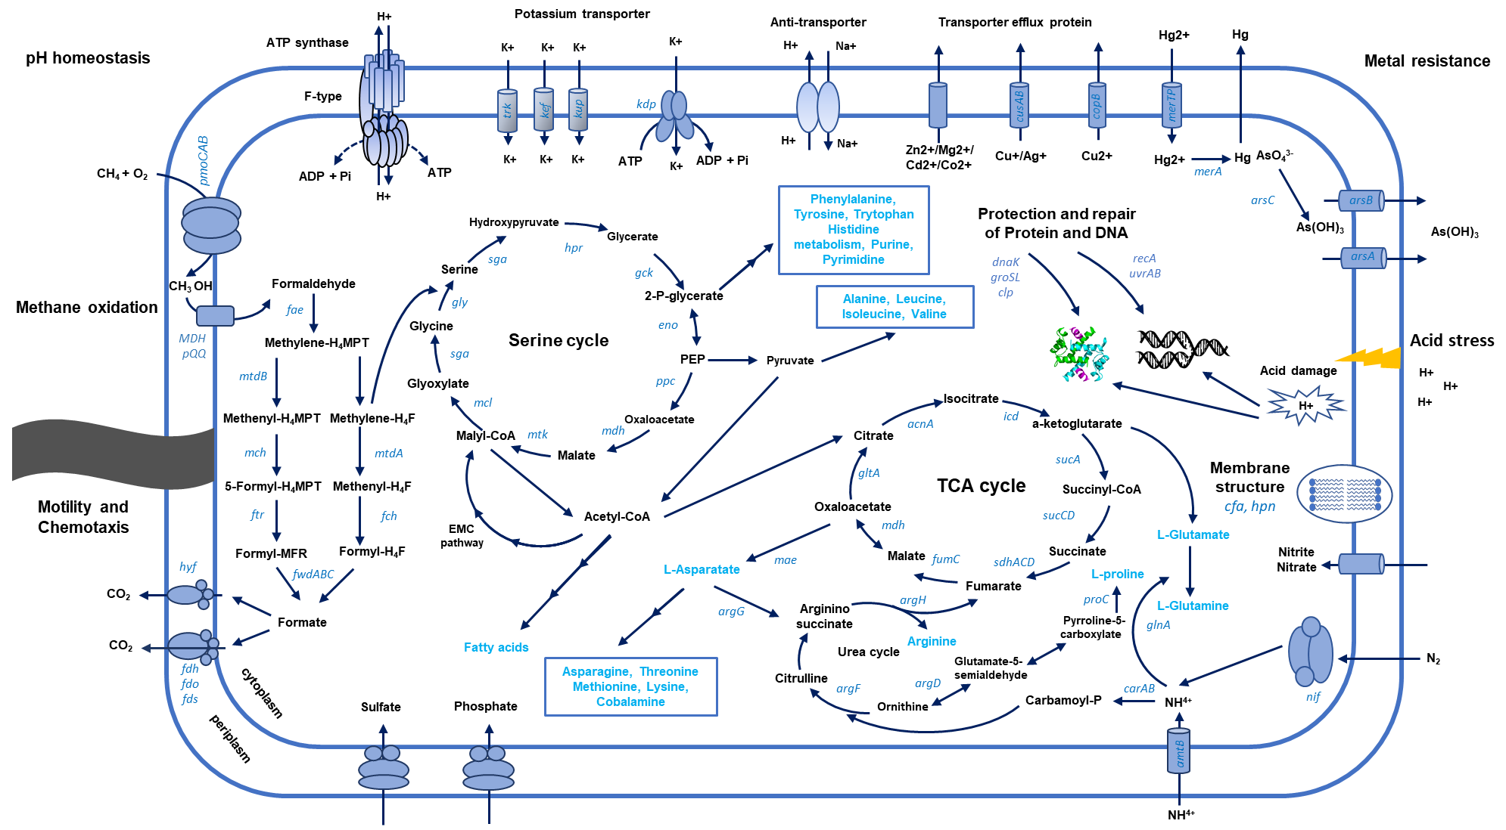
Fig. S9

