Slide 1
A Self-Reported Needs Assessment Survey of Pediatric Orthopaedic Education in Haiti
Electronic Response Survey Questions

Slide 2
Demographic Questions

Slide 3
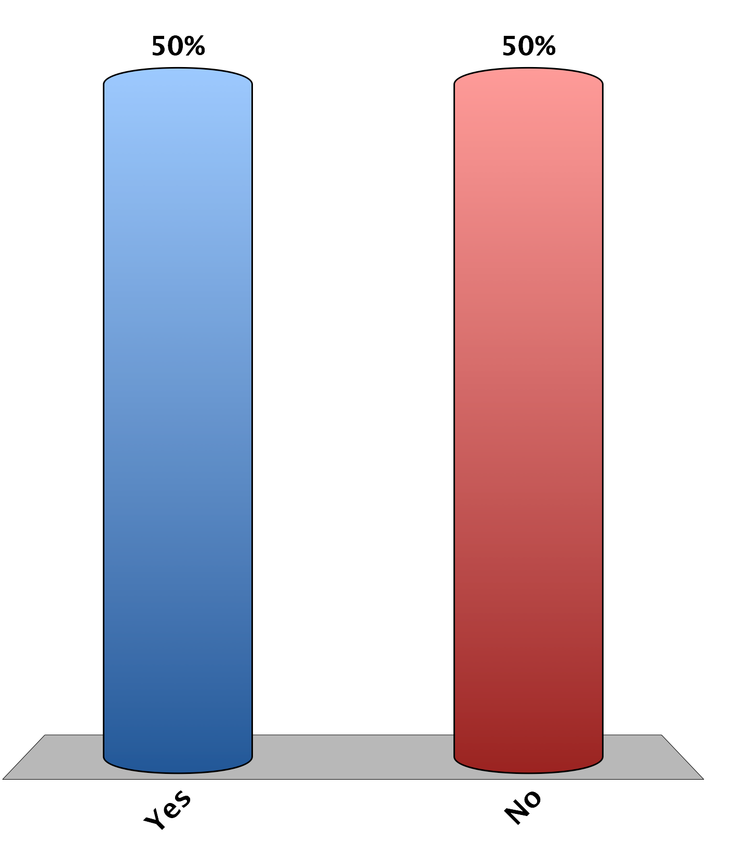
Are you ready for a great day?
(internal control, electronic response system test)
Yes
No
20

Slide 4
Are you Haitian?
Yes
No
25

Slide 5
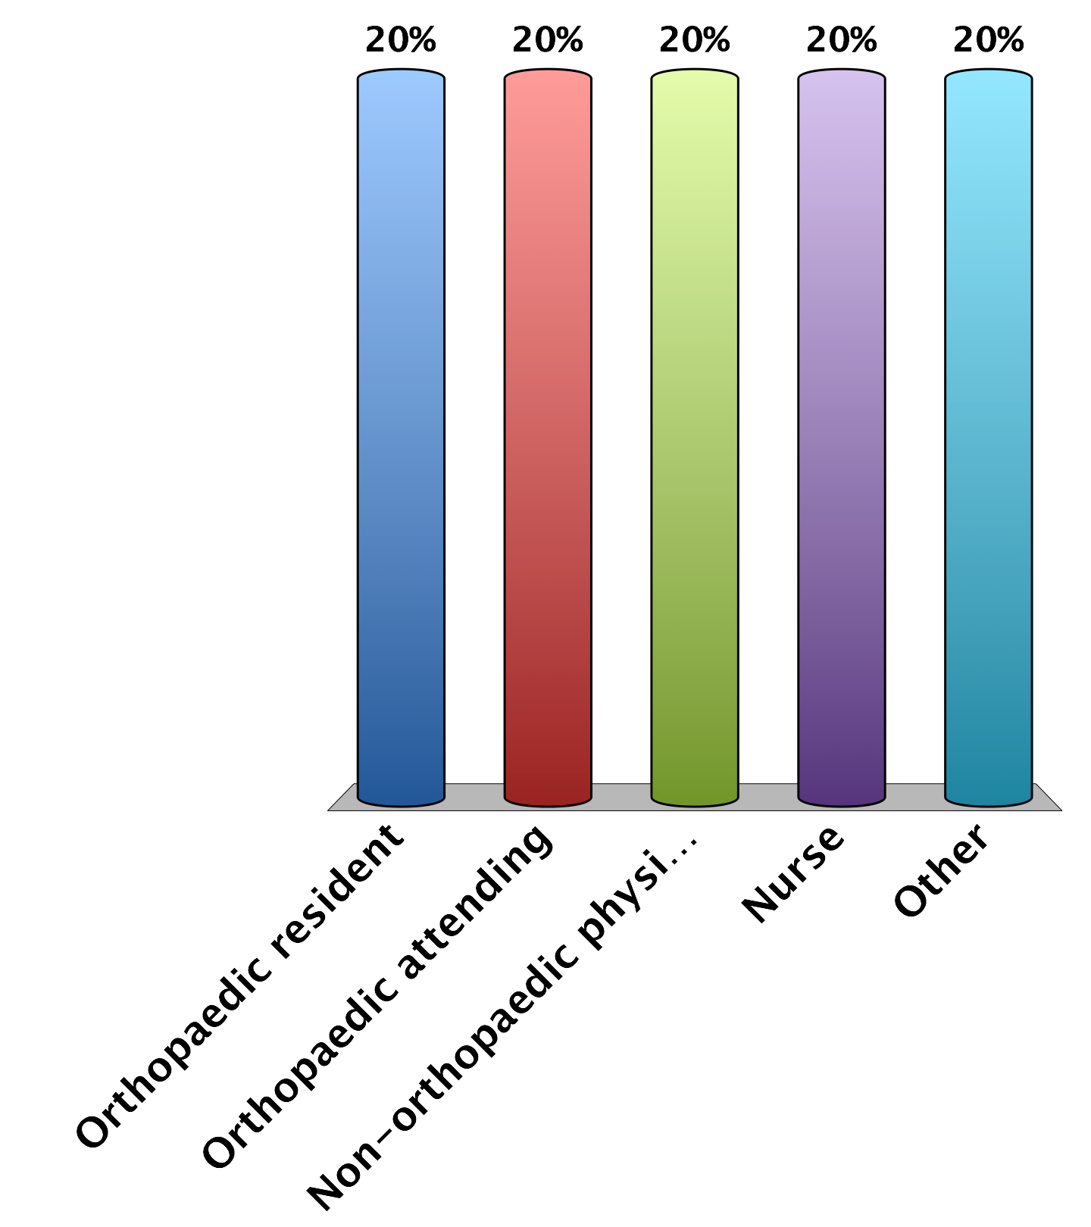
Are you a:
Orthopaedic resident
Orthopaedic attending
Non-orthopaedic physician
Nurse
Other
25

Slide 6
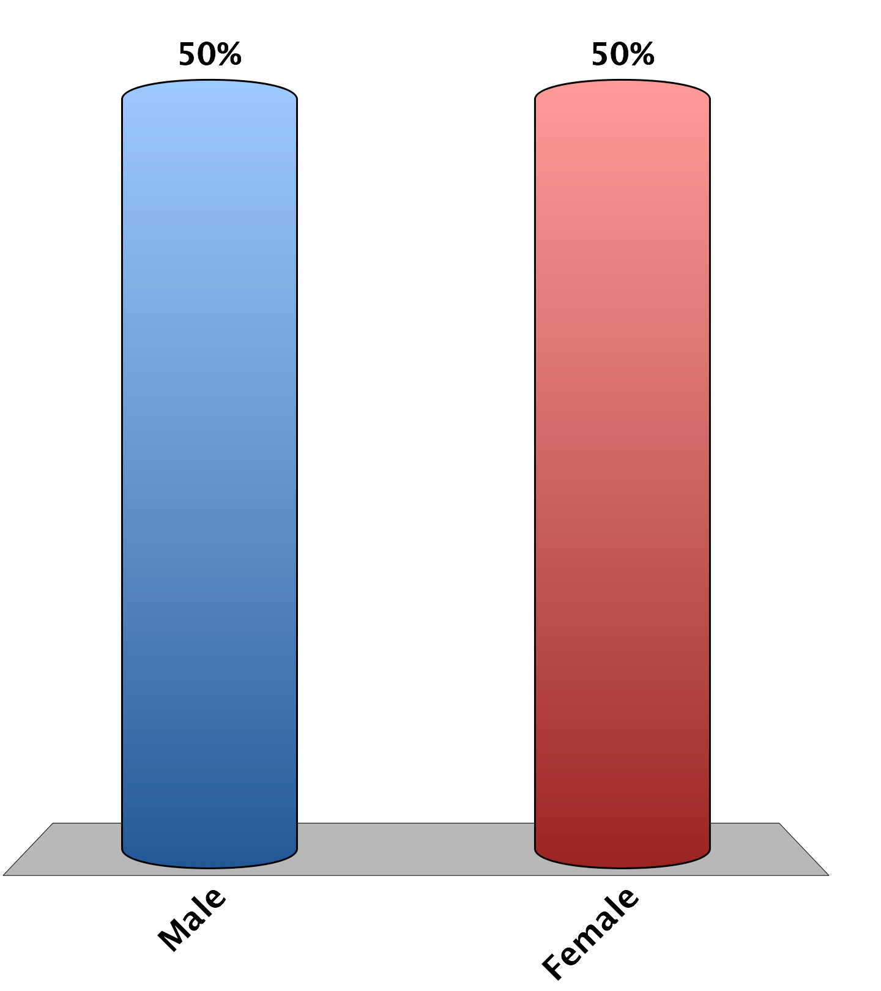
What is your gender?
Male
Female
25

Slide 7
Did you attend HAAOT last year?
Yes
No
25

Slide 8
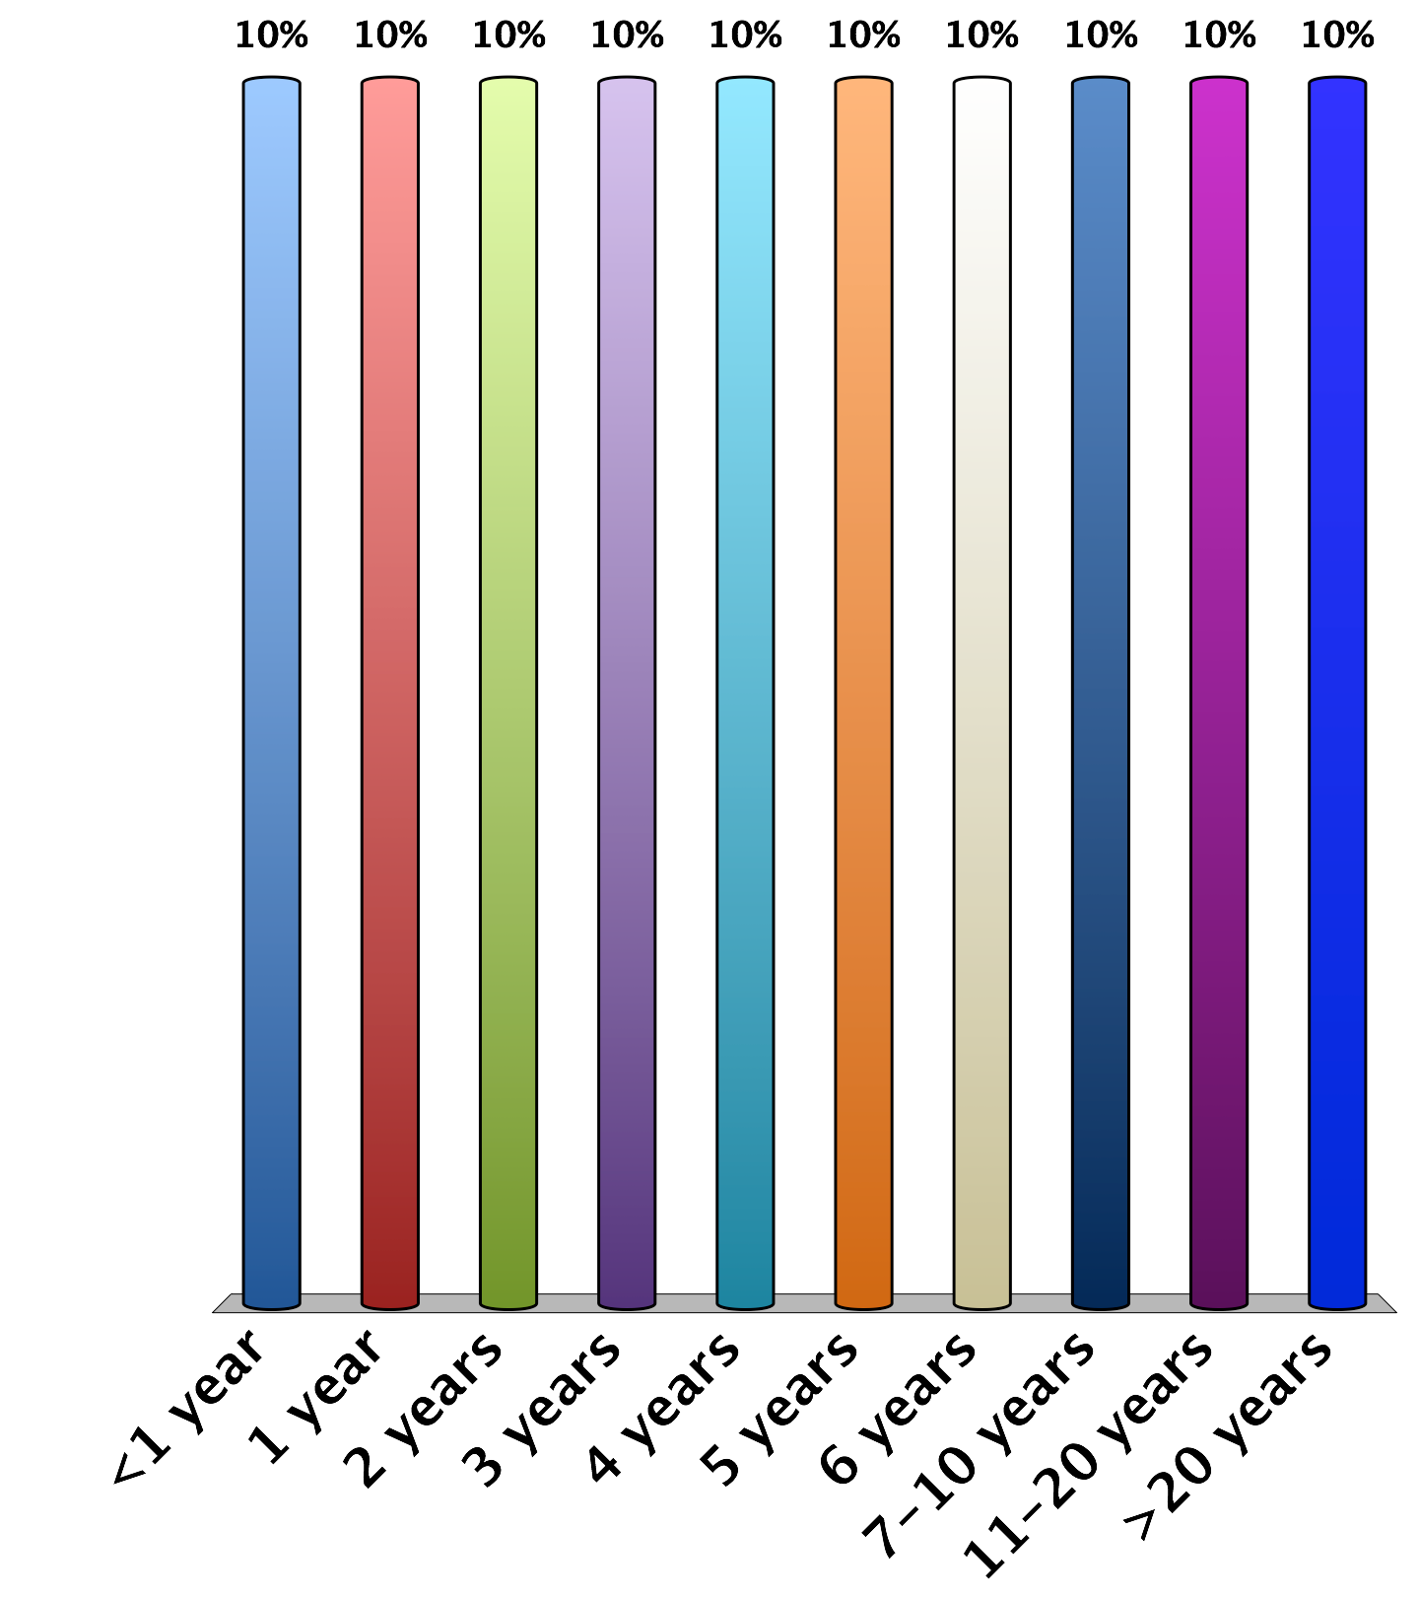
How many years ago did you complete medical school?
<1 year
1 year
2 years
3 years
4 years
5 years
6 years
7-10 years
11-20 years
>20 years
25

Slide 9
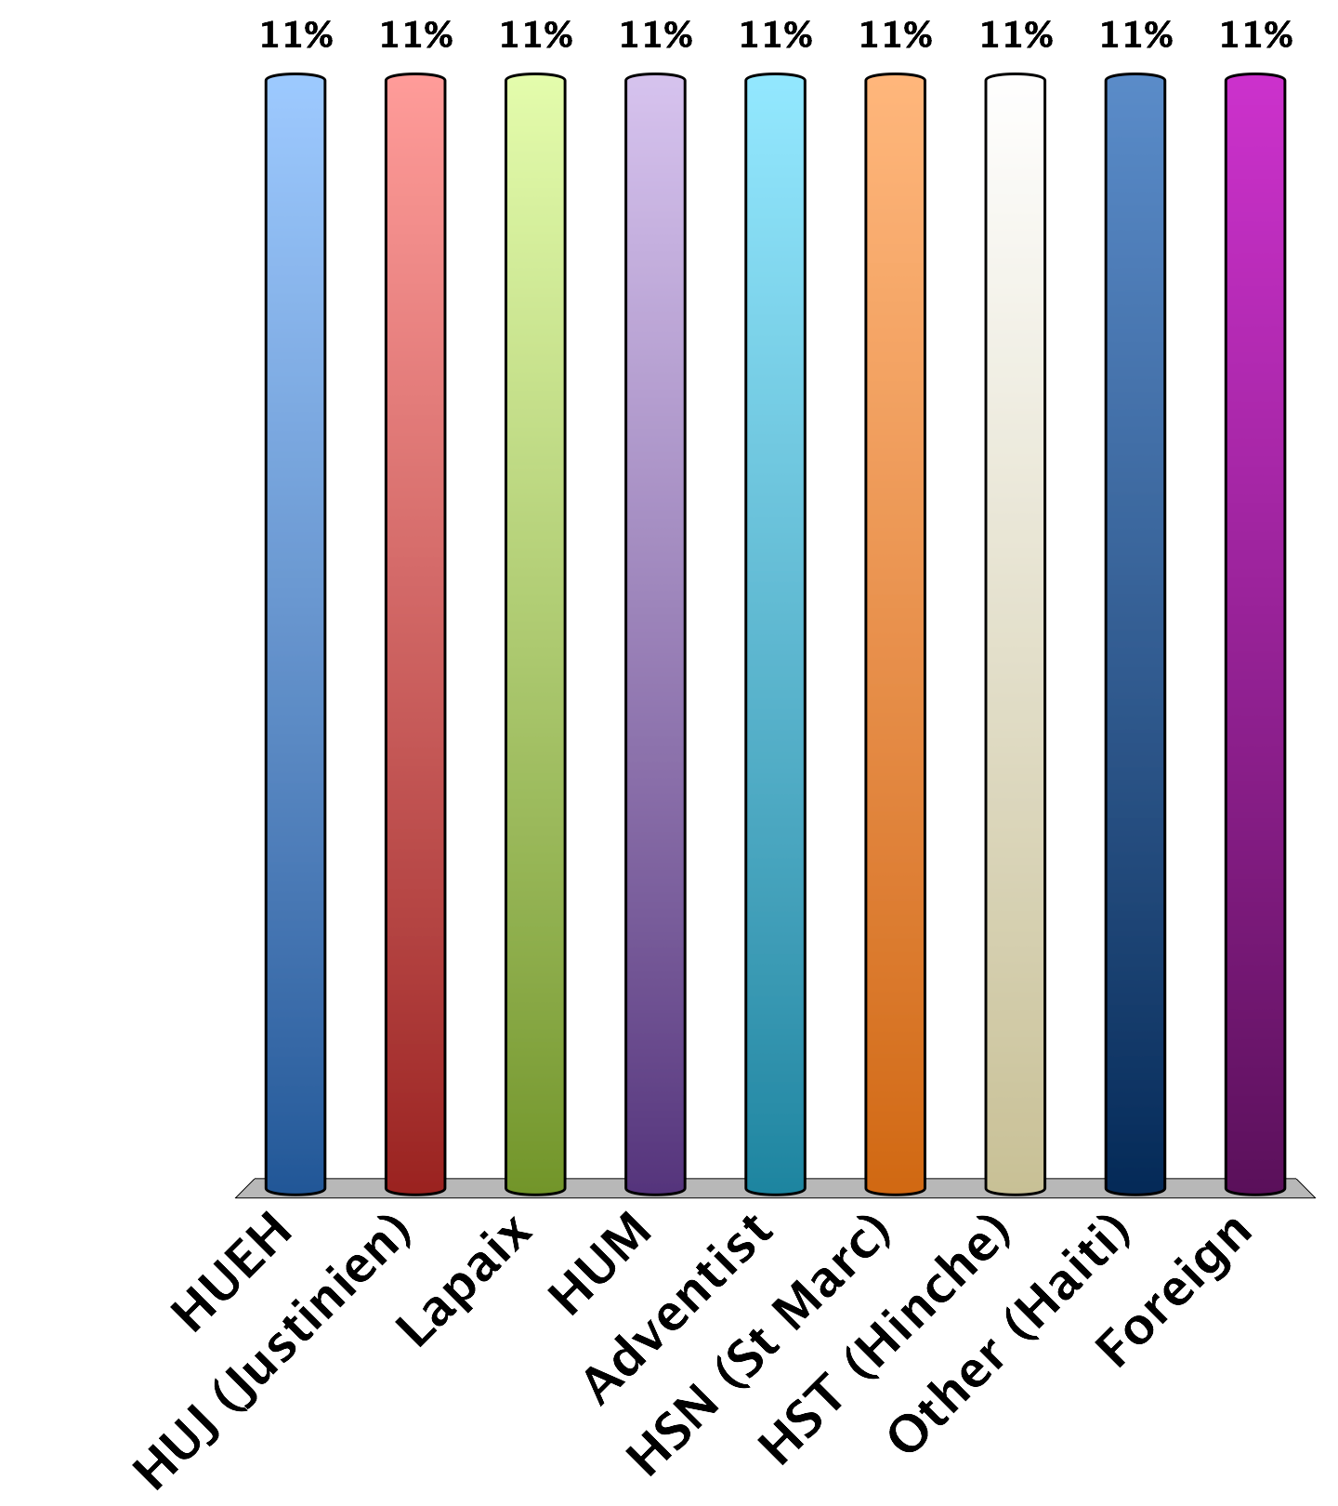
Which hospital are you based from?
HUEH
HUJ (Justinien)
Lapaix
HUM
Adventist
HSN (St Marc)
HST (Hinche)
Other (Haiti)
Foreign
25

Slide 10
Pediatric Orthopaedic Questions

Slide 11
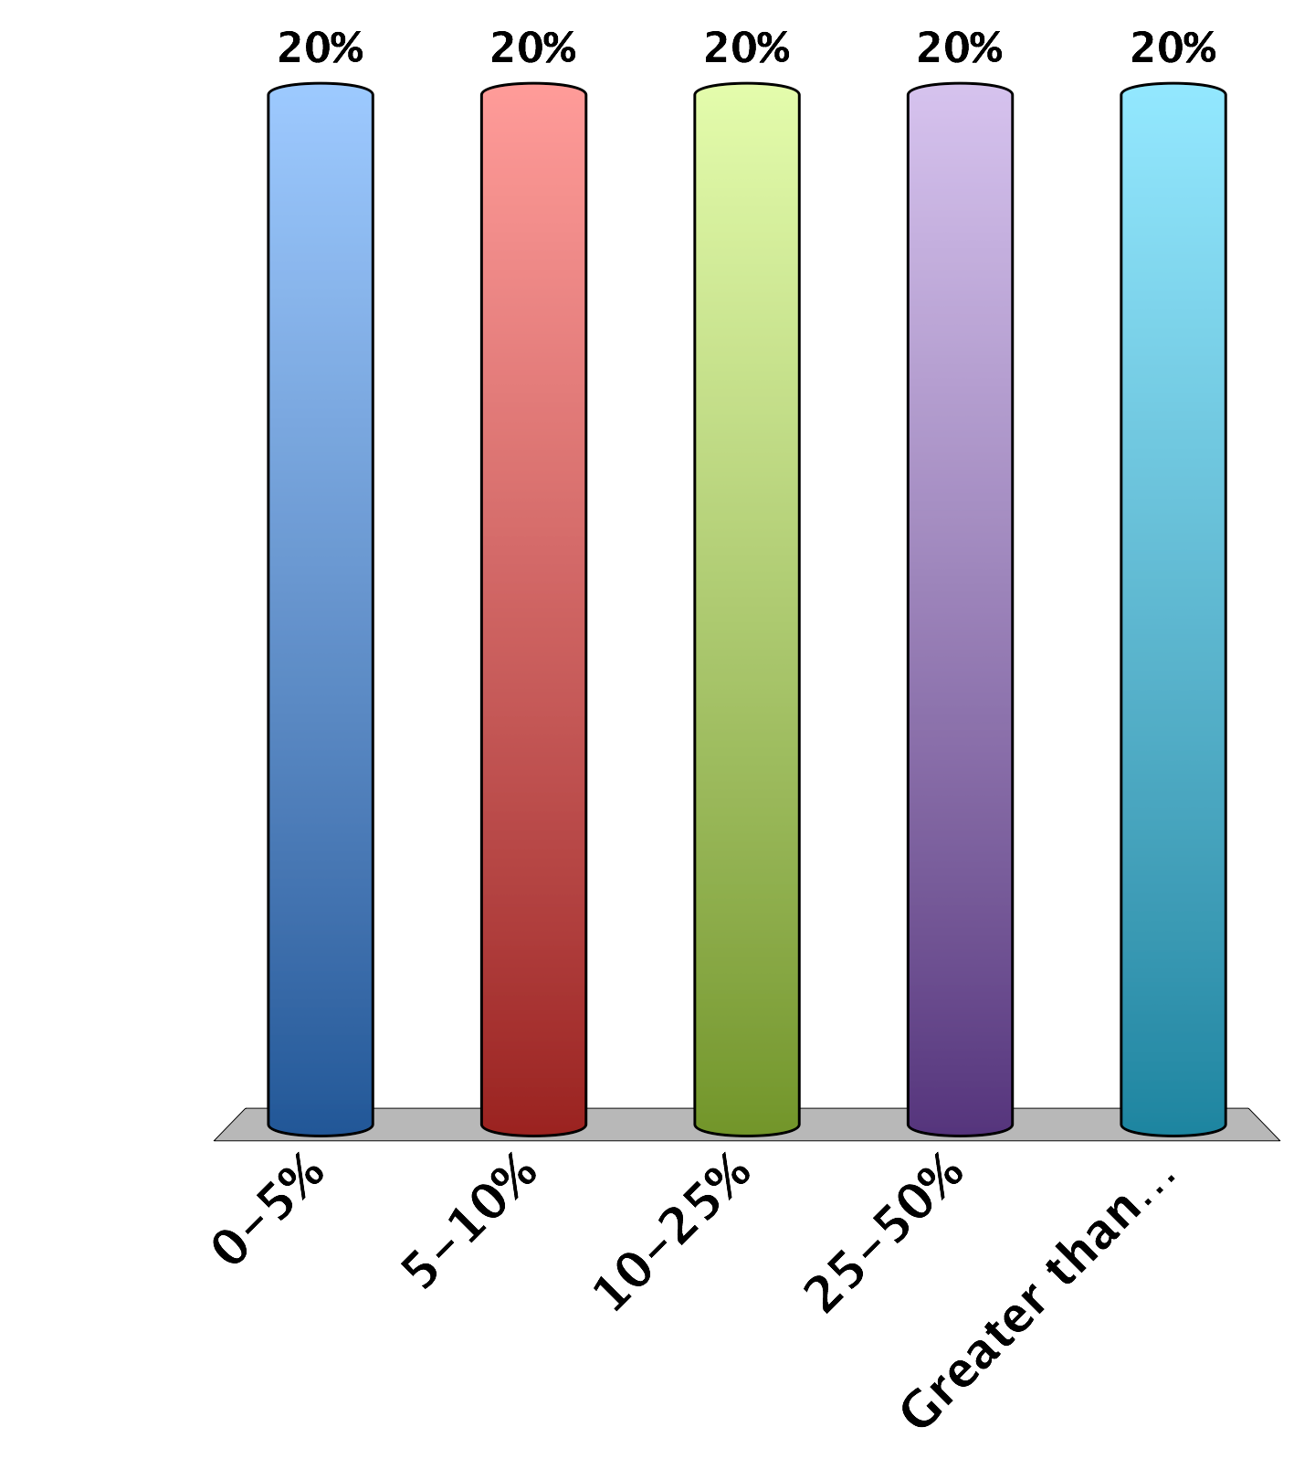
Approximately what percent of your training involves pediatric orthopaedic care?
0-5%
5-10%
10-25%
25-50%
Greater than 50%
20
Notes:
Peds ortho1

Slide 12
What percentage of your career already involves or will involve pediatric orthopaedic care?
0-5%
5-10%
10-25%
25-50%
Greater than 50%
20
Notes:
Peds ortho2

Slide 13
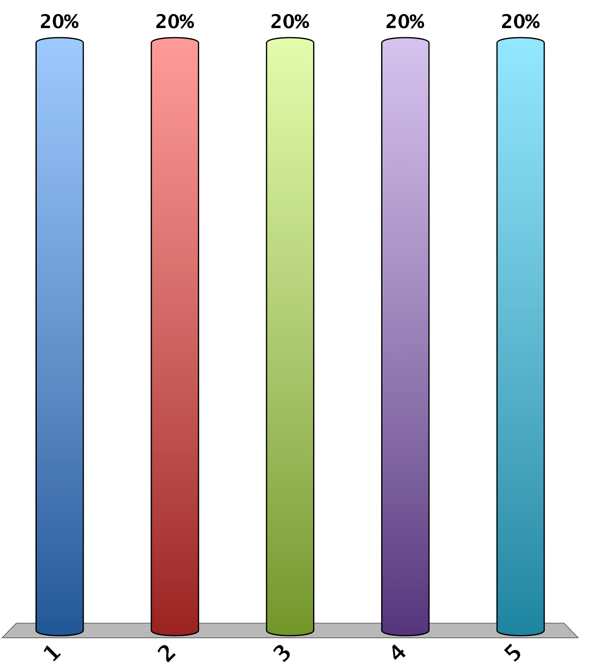
On a scale of 1 to 5
(5 being the most important), how important is Pediatric Orthopedic Education in Haiti?
1
2
3
4
5
20
Notes:
Peds ortho3

Slide 14
On a scale of 1 to 5
(5 being the most comfortable), how comfortable do you feel practicing pediatric orthopaedics?
1
2
3
4
5
20
Notes:
Peds ortho4

Slide 15
On a scale of 1 to 5 (5 being the most comfortable), how comfortable are you independently applying a Spica Cast for a femur fracture?
1
2
3
4
5
20

Slide 16
On a scale of 1 to 5 (5 being the most comfortable), how comfortable are you independently treating a Type III Supracondylar Humerus Fracture?
1
2
3
4
5
20

Slide 17
On a scale of 1 to 5 (5 being the most comfortable), how comfortable are you independently applying a clubfoot cast?
1
2
3
4
5
20

Slide 18
On a scale of 1-5 (5 being the most comfortable), how comfortable are you independently applying a long leg cast for a pediatric tibia fracture?
1
2
3
4
5
20

Slide 19
On a scale of 1-5 (5 being the most comfortable), how comfortable are you with the Salter-Harris Classification System?
1
2
3
4
5
20

Slide 20
On a scale of 1-5 (5 being the most), how much do you need more didactics (lectures) on pediatric orthopaedic topics?
1
2
3
4
5
20

Slide 21
On a scale of 1-5 (5 being the most), how much do you need more hands-on skills workshops on pediatric orthopaedic topics?
1
2
3
4
5
20

Slide 22
On a scale of 1-5 (5 being the most), how much do you need a dedicated pediatric orthopaedic rotation in training?
1
2
3
4
5
20

Slide 23
On a scale of 1-5 (5 being the most), how much do you feel you need more access to trained pediatric orthopaedic peers and mentors from foreign countries?
1
2
3
4
5
20
Notes:
Peds ortho13

Slide 24
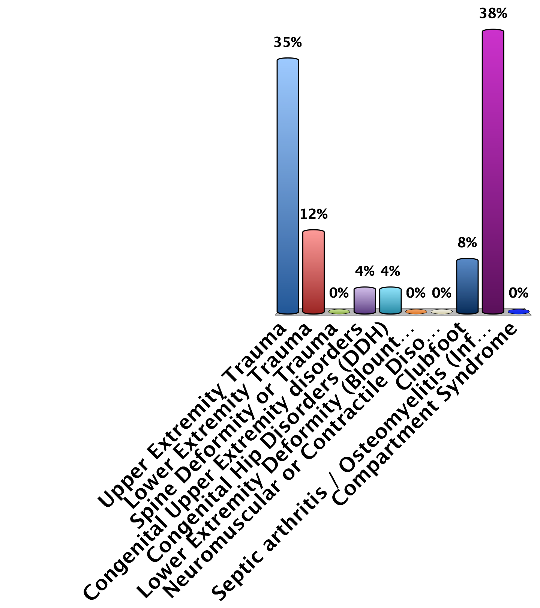
Please select which 3 areas of Pediatric Orthopaedics you SEE THE MOST in Haiti:
#1
Upper Extremity Trauma
Lower Extremity Trauma
Spine Deformity or Trauma
Congenital Upper Extremity disorders
Congenital Hip Disorders (DDH)
Lower Extremity Deformity (Blount’s, Rickets)
Neuromuscular or Contractile Disorders (Spasticity, Arthrogryposis)
Clubfoot
Septic arthritis / Osteomyelitis (Infection)
Compartment Syndrome
0
Notes:
q14

Slide 25
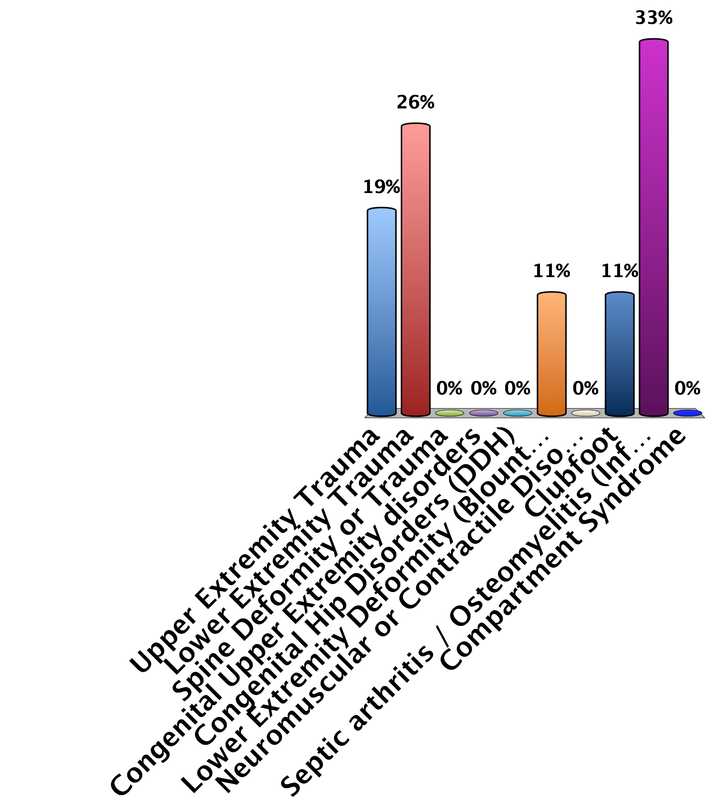
Please select which 3 areas of Pediatric Orthopaedics you SEE THE MOST in Haiti:
#2
Upper Extremity Trauma
Lower Extremity Trauma
Spine Deformity or Trauma
Congenital Upper Extremity disorders
Congenital Hip Disorders (DDH)
Lower Extremity Deformity (Blount’s, Rickets)
Neuromuscular or Contractile Disorders (Spasticity, Arthrogryposis)
Clubfoot
Septic arthritis / Osteomyelitis (Infection)
Compartment Syndrome
0

Slide 26
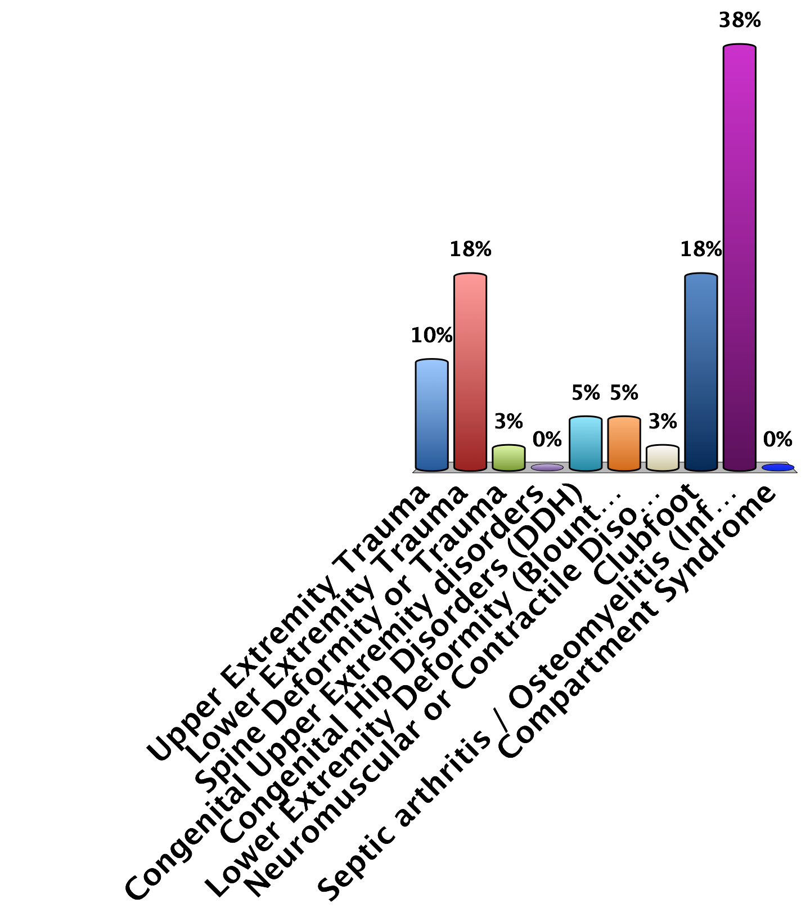
Please select which 3 areas of Pediatric Orthopaedics you SEE THE MOST in Haiti:
#3
Upper Extremity Trauma
Lower Extremity Trauma
Spine Deformity or Trauma
Congenital Upper Extremity disorders
Congenital Hip Disorders (DDH)
Lower Extremity Deformity (Blount’s, Rickets)
Neuromuscular or Contractile Disorders (Spasticity, Arthrogryposis)
Clubfoot
Septic arthritis / Osteomyelitis (Infection)
Compartment Syndrome
0

Slide 27
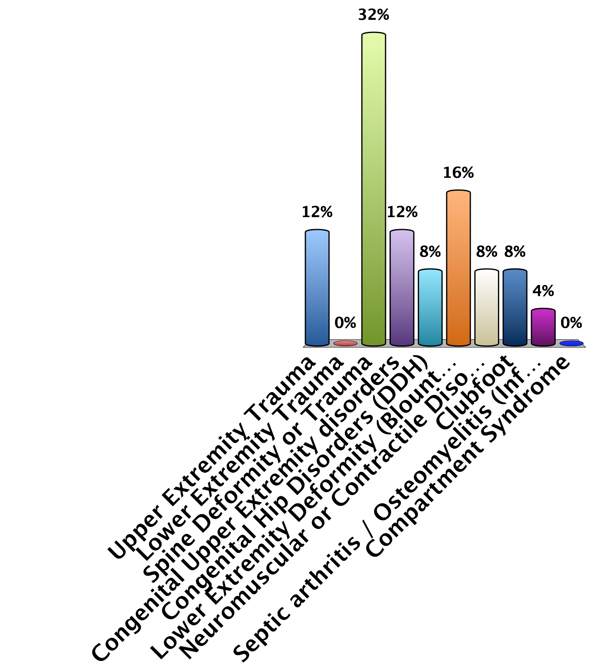
Please select which 3 areas of Pediatric Orthopaedics you are LEAST COMFORTABLE with:
#1
Upper Extremity Trauma
Lower Extremity Trauma
Spine Deformity or Trauma
Congenital Upper Extremity disorders
Congenital Hip Disorders (DDH)
Lower Extremity Deformity (Blount’s, Rickets)
Neuromuscular or Contractile Disorders (Spasticity, Arthrogryposis)
Clubfoot
Septic arthritis / Osteomyelitis (Infection)
Compartment Syndrome
0

Slide 28
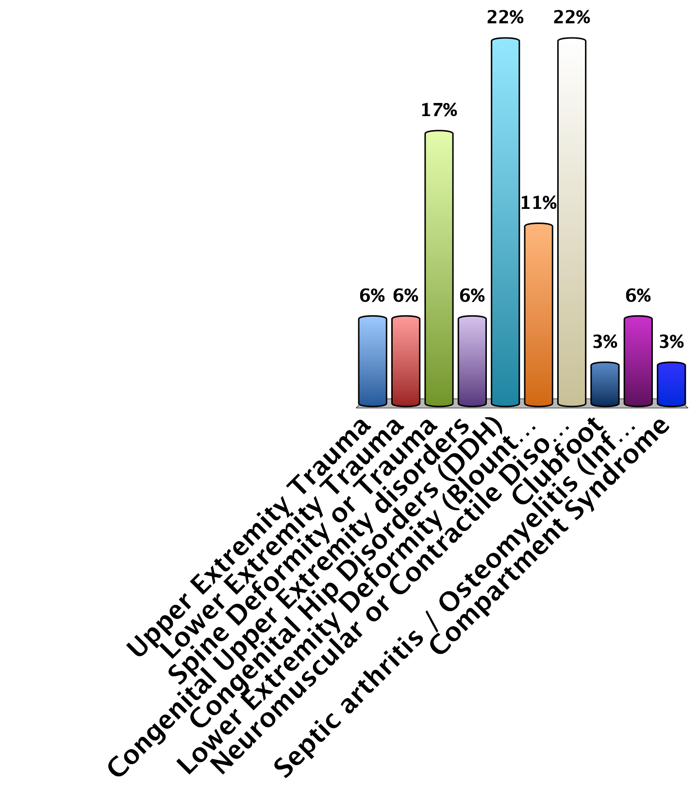
Please select which 3 areas of Pediatric Orthopaedics you are LEAST COMFORTABLE with:
#2
Upper Extremity Trauma
Lower Extremity Trauma
Spine Deformity or Trauma
Congenital Upper Extremity disorders
Congenital Hip Disorders (DDH)
Lower Extremity Deformity (Blount’s, Rickets)
Neuromuscular or Contractile Disorders (Spasticity, Arthrogryposis)
Clubfoot
Septic arthritis / Osteomyelitis (Infection)
Compartment Syndrome
0

Slide 29
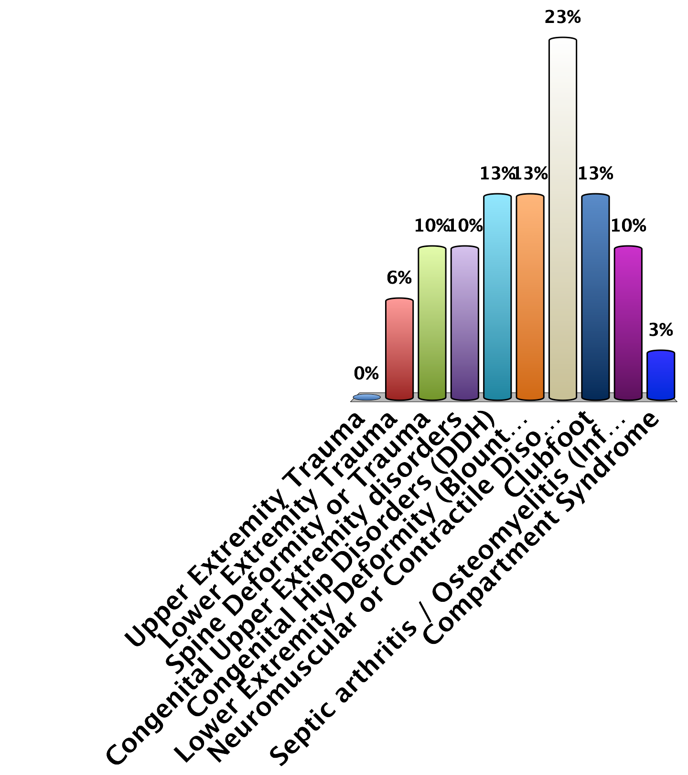
Please select which 3 areas of Pediatric Orthopaedics you are LEAST COMFORTABLE with:
#3
Upper Extremity Trauma
Lower Extremity Trauma
Spine Deformity or Trauma
Congenital Upper Extremity disorders
Congenital Hip Disorders (DDH)
Lower Extremity Deformity (Blount’s, Rickets)
Neuromuscular or Contractile Disorders (Spasticity, Arthrogryposis)
Clubfoot
Septic arthritis / Osteomyelitis (Infection)
Compartment Syndrome
0

Slide 30
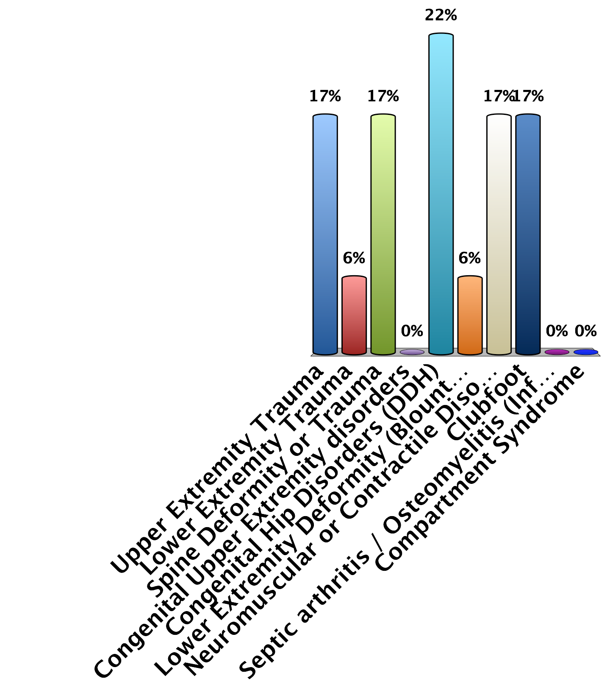
What 3 topics in pediatric orthopedics would you most like to be focused on in future events?
#1
Upper Extremity Trauma
Lower Extremity Trauma
Spine Deformity or Trauma
Congenital Upper Extremity disorders
Congenital Hip Disorders (DDH)
Lower Extremity Deformity (Blount’s, Rickets)
Neuromuscular or Contractile Disorders (Spasticity, Arthrogryposis)
Clubfoot
Septic arthritis / Osteomyelitis (Infection)
Compartment Syndrome
0

Slide 31
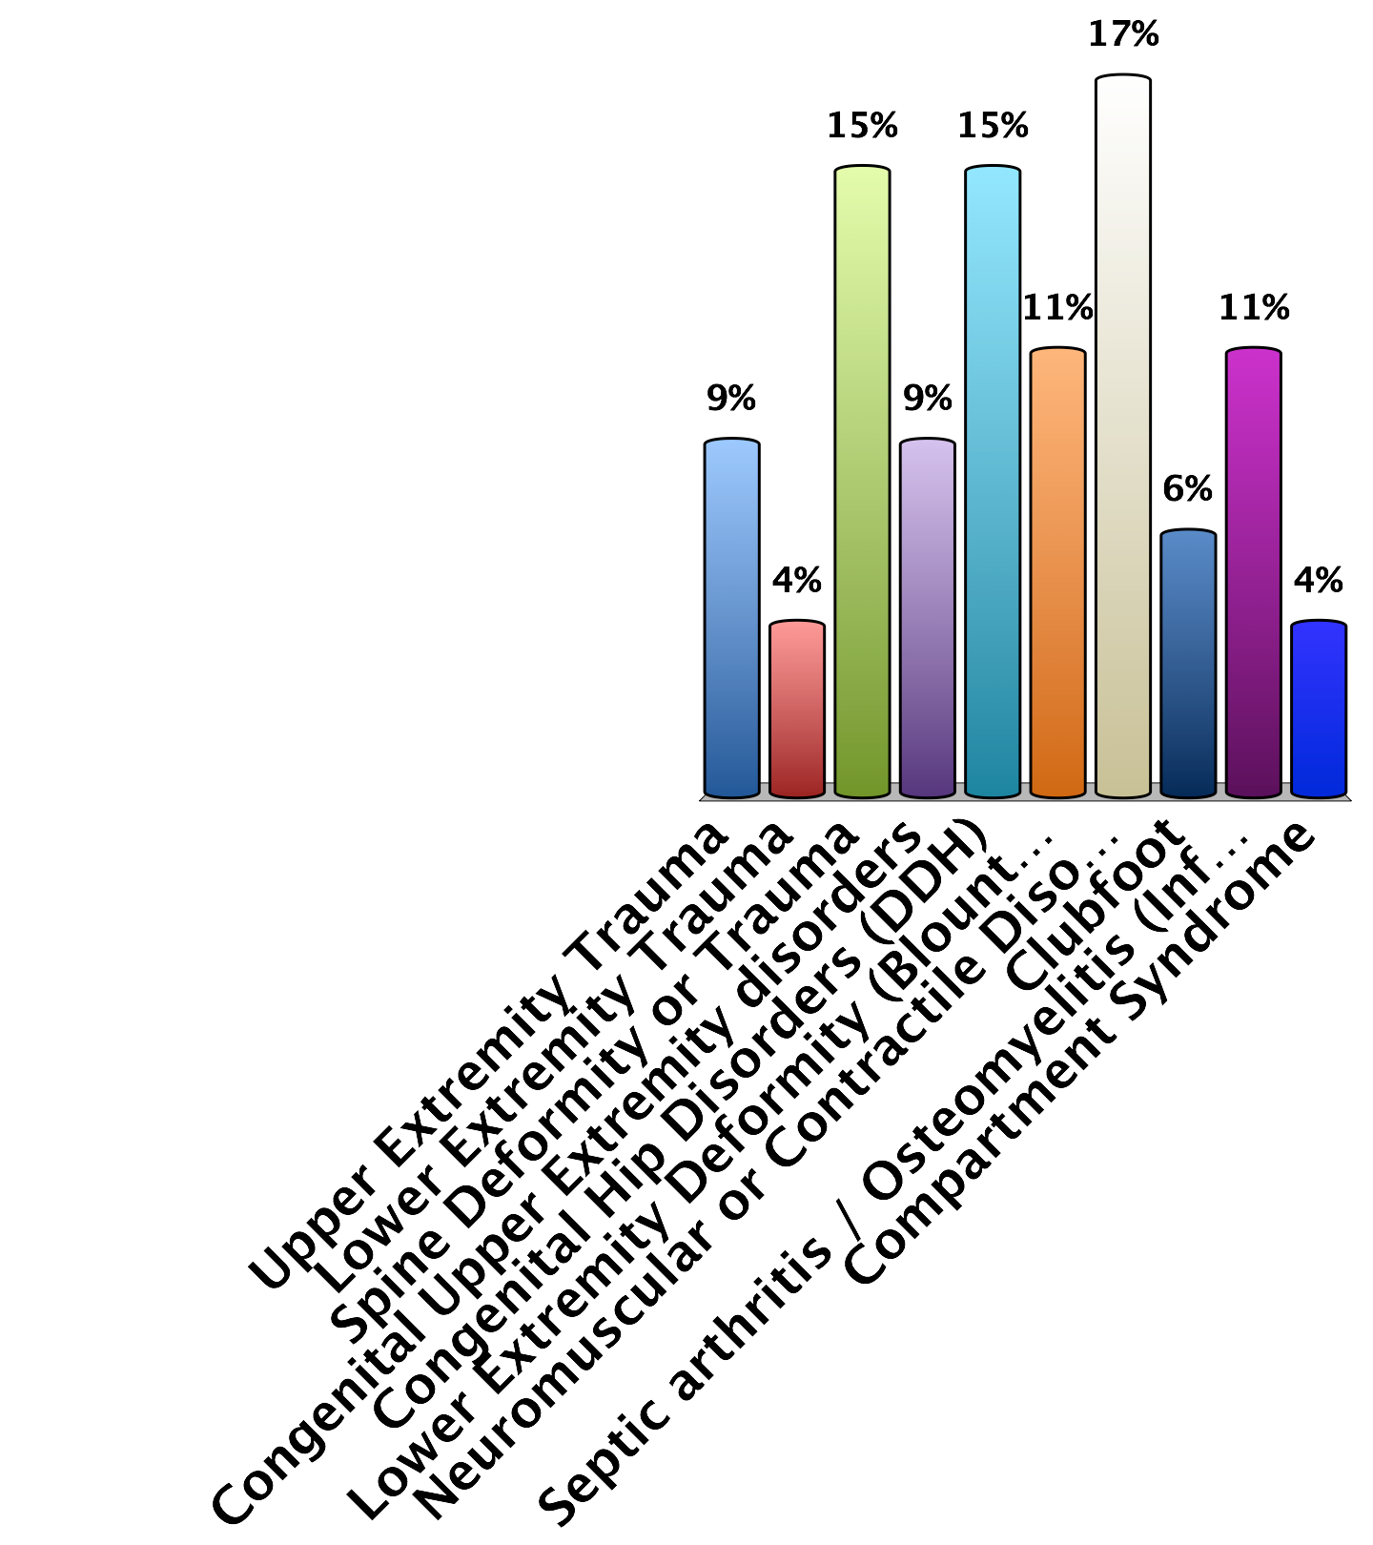
What 3 topics in pediatric orthopedics would you most like to be focused on in future events?
#2
Upper Extremity Trauma
Lower Extremity Trauma
Spine Deformity or Trauma
Congenital Upper Extremity disorders
Congenital Hip Disorders (DDH)
Lower Extremity Deformity (Blount’s, Rickets)
Neuromuscular or Contractile Disorders (Spasticity, Arthrogryposis)
Clubfoot
Septic arthritis / Osteomyelitis (Infection)
Compartment Syndrome
0

Slide 32
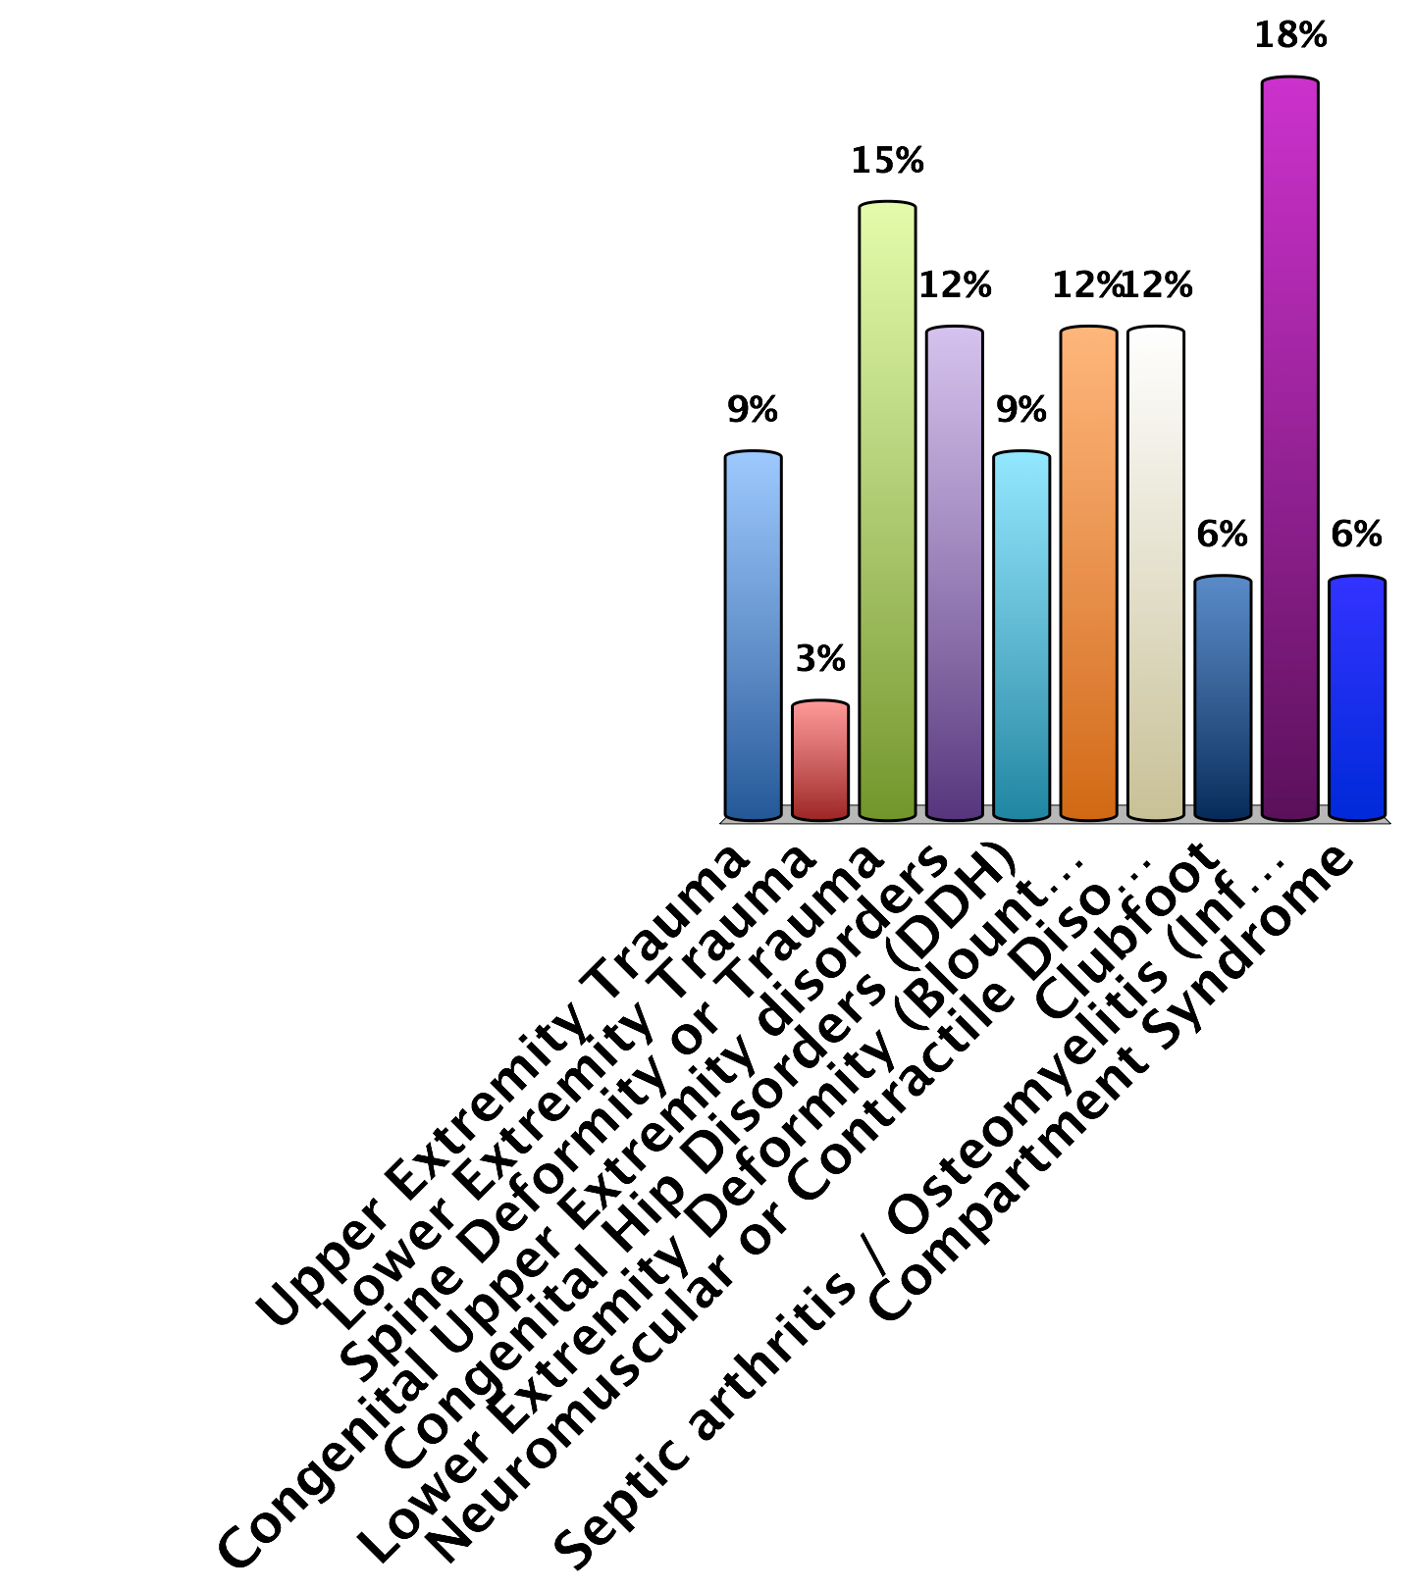
What 3 topics in pediatric orthopedics would you most like to be focused on in future events?
#3
Upper Extremity Trauma
Lower Extremity Trauma
Spine Deformity or Trauma
Congenital Upper Extremity disorders
Congenital Hip Disorders (DDH)
Lower Extremity Deformity (Blount’s, Rickets)
Neuromuscular or Contractile Disorders (Spasticity, Arthrogryposis)
Clubfoot
Septic arthritis / Osteomyelitis (Infection)
Compartment Syndrome
0
Notes:
Peds ortho23

