Slide 1
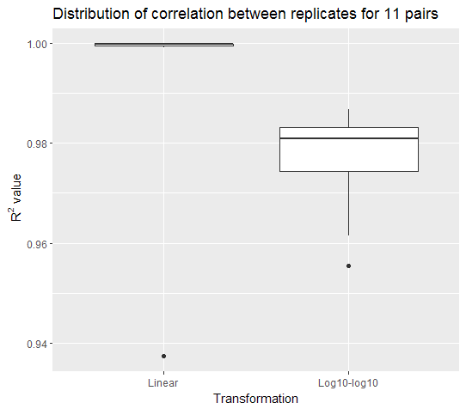
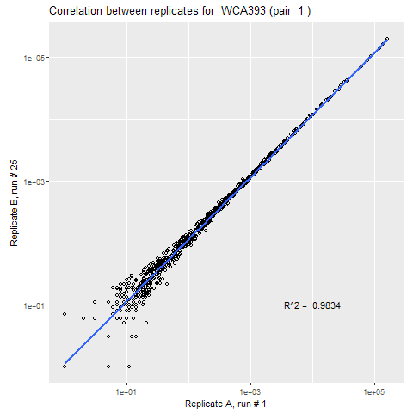
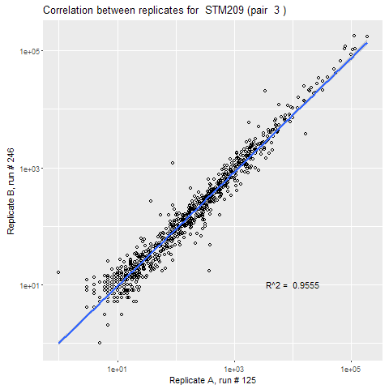
A
B
C
Supplementary Figure 1. Quality check. Correlation between (A) nanostring runs of replicates, (B) two nanostring technical replicates, (C) two tissue samples from the same patient

Slide 2
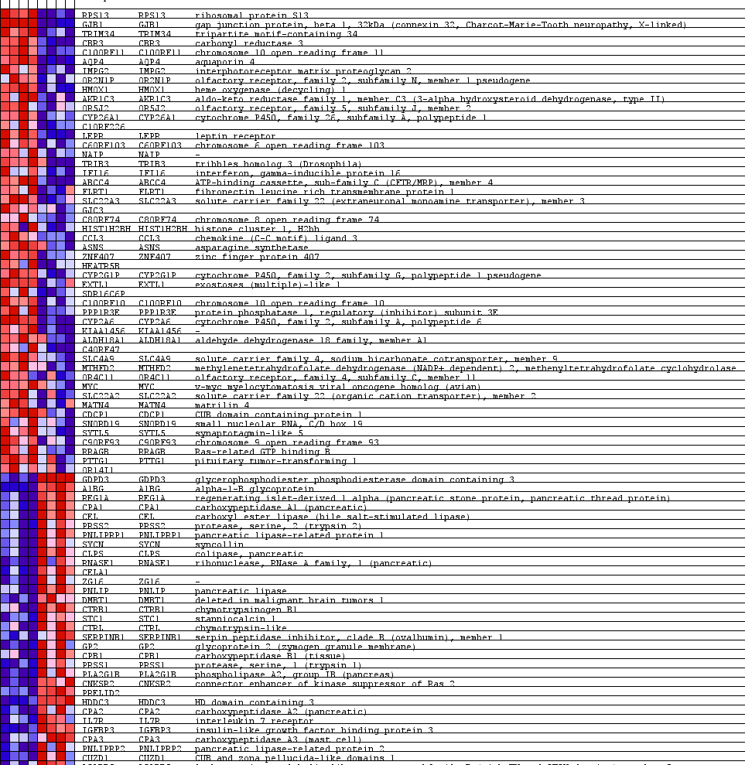
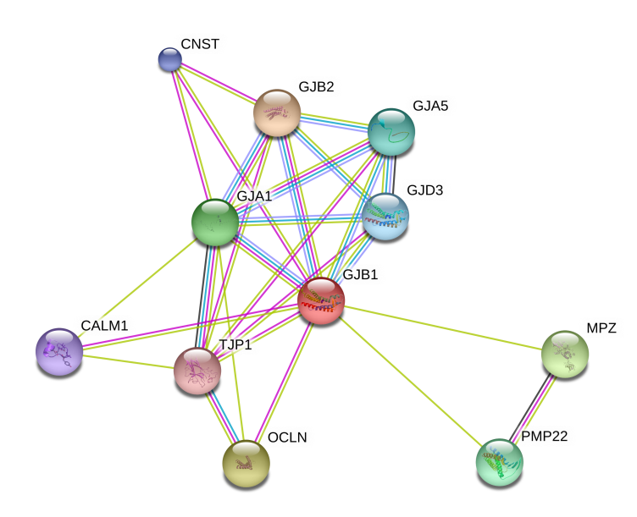
A
WT Cx32KO
B
Supplementary Figure 2. The connexome: a group of genes and proteins related to Cx32

Slide 3
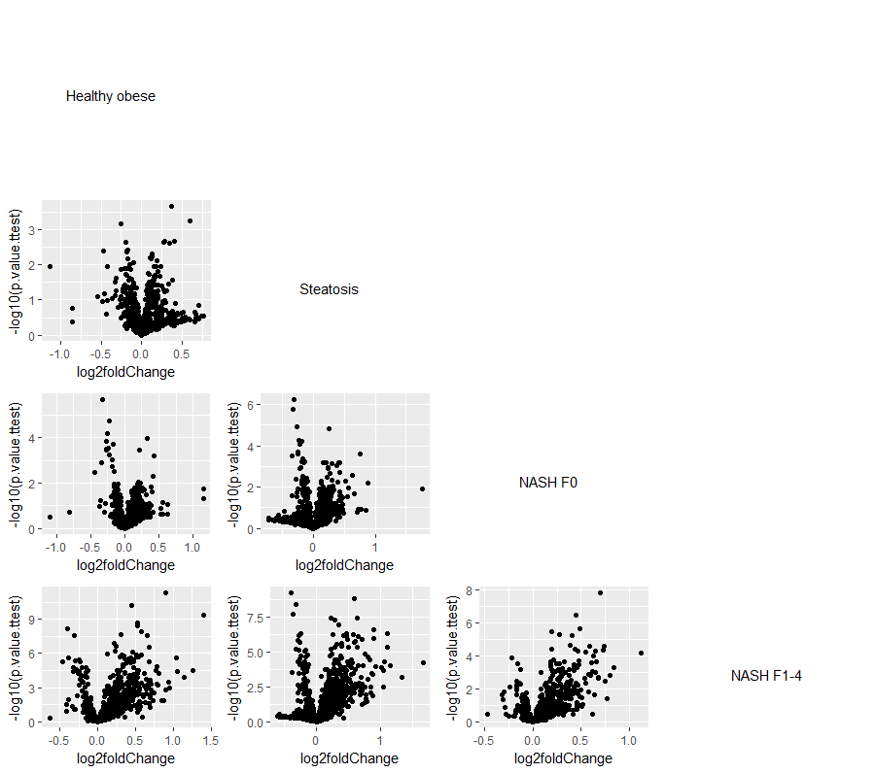
Supplementary Figure 3. Volcano plot of pairwise differential expression of all genes

