Slide 1
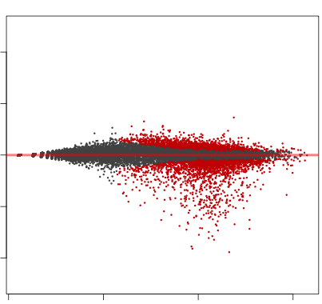
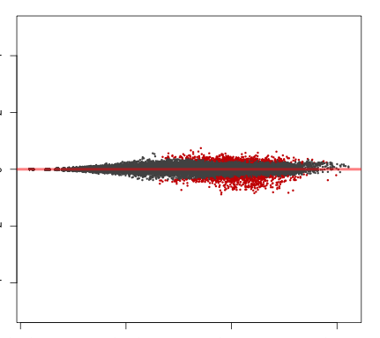
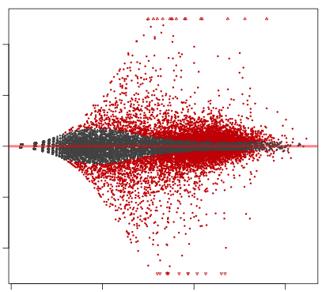
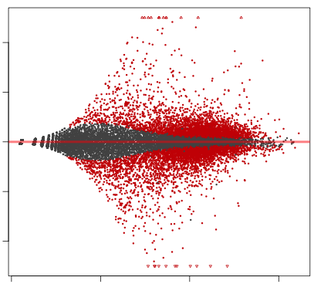
A
PD : CTRL
B
L4-PDR1 : LAPC4
RNAseq conditions:
LAPC4
L4-PDR1
CTRL
PD
LAPC4
L4-PDR1
4
4
4
4
2
2
2
2
0
0
0
0
CTRL
Log ratio (M)
Log ratio (M)
PD
-2
-2
-2
-2
*In triplicate
-4
4168
-4
1001
-4
8909
-4
7903
10⁻¹
10¹
10³
10⁵
10⁻¹
10¹
10³
10⁵
10⁻¹
10¹
10³
10⁵
10⁻¹
10¹
10³
10⁵
Average log intensity (A)
Average log intensity (A)
C
D
 | L4-PDR1
ONCOGENIC SIGNATURE | CTRL | PD
LEF1_UP.V1_UP
P53_DN.V1_DN
KRAS.AMP.LUNG_UP.V1_UP
JNK_DN.V1_DN
PTEN_DN.V1_UP
MEL18_DN.V1_UP
ALK_DN.V1_UP
SNF5_DN.V1_DN
BMI1_DN_MEL18_DN.V1_UP
KRAS.600.LUNG.BREAST_UP.V1_DN
KRAS.50_UP.V1_UP
JNK_DN.V1_UP
PTEN_DN.V2_UP
ATF2_S_UP.V1_UP
TGFB_UP.V1_UP
CAHOY_ASTROCYTIC
KRAS.KIDNEY_UP.V1_UP
PIGF_UP.V1_DN
KRAS.PROSTATE_UP.V1_DN
PRC2_EDD_UP.V1_DN
BMI1_DN.V1_UP
KRAS.LUNG.BREAST_UP.V1_DN
ATF2_UP.V1_UP
CAHOY_NEURONAL
IL15_UP.V1_DN
SRC_UP.V1_UP
KRAS.600.LUNG.BREAST_UP.V1_UP
KRAS.LUNG.BREAST_UP.V1_UP
CYCLIN_D1_KE_.V1_DN
KRAS.600_UP.V1_DN
KRAS.LUNG_UP.V1_DN
KRAS.PROSTATE_UP.V1_UP
JAK2_DN.V1_UP
STK33_NOMO_UP
WNT_UP.V1_DN
KRAS.300_UP.V1_UP
KRAS.600_UP.V1_UP
RELA_DN.V1_UP
KRAS.AMP.LUNG_UP.V1_DN
CRX_DN.V1_DN
E2F3_UP.V1_UP
IL2_UP.V1_DN
ESC_J1_UP_EARLY.V1_DN
PRC2_SUZ12_UP.V1_UP
P53_DN.V2_UP
NOTCH_DN.V1_UP
NOTCH_DN.V1_DN
PTEN_DN.V2_DN
PRC2_EZH2_UP.V1_DN
MEL18_DN.V1_DN
CAHOY_OLIGODENDROCUTIC
IL21_UP.V1_UP
KRAS.300_UP.V1_DN
GCNP_SHH_UP_EARLY.V1_DN
BMI1_DN_MEL18_DN.V1_DN
ATM_DN.V1_UP
PTEN_DN.V1_DN
DCA_UP.V1_UP
IL21_UP.V1_DN
ALK_DN.V1_DN
AKT_UP_MTOR_DN.V1_UP
 | L4-PDR1
ONCOGENIC SIGNATURE | CTRL | PD
RB_P107_DN.V1_UP
CSR_LATE_UP.V1_UP
RB_DN.V1_UP
PRC2_EZH2_UP.V1_UP
E2F1_UP.V1_UP
GCNP_SHH_UP_LATE.V1_UP
MTOR_UP.V1_UP
RB_P130_DN.V1_UP
ESC_J1_UP_LATE.V1_DN
GCNP_SHH_UP_EARLY.V1_UP
CORDENONSI_YAP_CONSERVED_SIGNATURE
P53_DN.V2_DN
BRCA1_DN.V1_DN
CYCLIN_D1_KE_.V1_UP
SNF5_DN.V1_UP
ATF2_S_UP.V1_DN
NFE2L2.V2
CRX_NRL_DN.V1_UP
CRX_DN.V1_UP
KRAS.BREAST_UP.V1_UP
SRC_UP.V1_DN
PDGF_UP.V1_DN
IL15_UP.V1_UP
ESC_V6.5_UP_EARLY.V1_DN
MTOR_UP.V1_DN
PRC1_BMI_UP.V1_UP
BCAT_GDS748_UP
ESC_V6.5_UP_LATE.V1_DN
P53_DN.V1_UP
AKT_UP.V1_UP
CTIP_DN.V1_DN
TBK1.DN.48HRS_UP
BCAT.100_UP.V1_DN
RAF_UP.V1_DN
KRAS.LUNG_UP.V1_UP
ATM_DN.V1_DN
CSR_LATE_UP.V1_DN
HOXA9_DN.V1_UP
CSR_EARLY_UP.V1_DN
ESC_J1_UP_EARLY.V1_UP
PDGF_ERK_DN.V1_UP
EGFR_UP.V1_DN
ESC_V6.5_UP_LATE.V1_UP
RAPA_EARLY_UP.V1_UP
TBK1.DF_DN
VEGF_A_UP.V1_DN
BRCA1_DN.V1_UP
RB_P130_DN.V1_DN
ERB2_UP.V1_DN
STK33_DN
RAF_UP.V1_UP
PRC2_EDD_UP.V1_UP
RPS14_DN.V1_DN
EIF4E_DN
CAMP_UP.V1_UP
HOXA9_DN.V1_DN
MEK_UP.V1_UP
GLI1_UP.V1_UP
KRAS.DF.V1_UP
PIGF_UP.V1_UP
LEF1_UP.V1_DN
ERB2_UP.V1_UP
LTE2_UP.V1_UP
LAPC4
L4-PDR1
0.5µM PD - + - - + -
0.5µM LEE - - + - - +
Total RB =
Lamin B -
1 0.58 0.88 0.56 0.44 0.55
E
 | L4-PDR1
HALLMARK | CTRL | PD
INFLAMMATORY_RESPONSE
KRAS_SIGNALING_DN
KRAS_SIGNALING_UP
MYOGENESIS
ALLOGRAFT_REJECTION
EPITHELIAL_MESENCHYMAL_TRANSITION
TNFA_SIGNALING_VIA_NFKB
HEDGEHOG_SIGNALING
CHOLESTEROL_HOMEOSTASIS
ANDROGEN_RESPONSE
OXIDATIVE_PHOSPHORYLATION
MYC_TARGETS_V1
MTORC1_SIGNALING
G2M_CHECKPOINT
ADIPOGENESIS
PROTEIN_SECRETION
PEROXISOME
FATTY_ACID_METABOLISM
UNFOLDED_PROTEIN_RESPONSE
E2F_TARGETS
INTERFERON_ALPHA_RESPONSE
DNA_REPAIR
PI3K_AKT_MTOR_SIGNALING
BILE_ACID_METABOLISM
APICAL_SURFACE
HEME_METABOLISM
ESTROGEN_RESPONSE_EARLY
NOTCH_SIGNALING
ESTROGEN_RESPONSE_LATE
GLYCOLYSIS
APOPTOSIS
SPERMATOGENESIS
UV_RESPONSE_UP
MITOTIC_SPINDLE
IL6_JAK_STAT3_SIGNALING
NES
2.5
-2.5
Supplementary Figure 3: Acquired CDK4/6 inhibitor resistance is associated with rewired transcriptional programs including RB function. A. RNAseq was performed on PDR1 and parental LAPC4 cells treated 24h with 0.5µM PD or vehicle (CTRL). MA plots were generated as per Figure 2, again revealing a set of downregulated genes set in the parental cells (indicated with a blue arrow) that was not observed in the PDR cells (q-value<0.1; red dots and inset number represent significant hits). B. MA plots show vastly different gene expression in PDR1 compared to parental cells (left, q-value<0.1; number represents hits). C. RT-PCR and immunoblotting shows that RB mRNA and protein expression are reduced, and remaining RB protein is hyperphosphorylated (upper band tRB) in PDR cells under CTRL conditions or after 24h CDK4/6 inhibitor treatment (0.5µM PD or LEE). Numbers reflect relative total-RB protein, controlled for loading (Lamin B). D. GSEA analyses were performed as per Figure 1 (FDR<0.25), revealing enrichment of Oncogenic Signatures for RB knockdown in PDR cells (indicated with pink arrows). E. GSEA Hallmark enrichments (FDR<0.25) include G2M checkpoint and E2F targets, indicated with orange arrows. NES = Normalized Enrichment Score.

