Slide 1
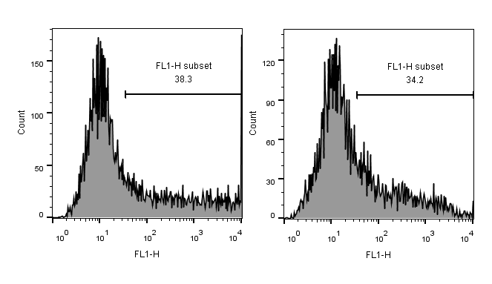
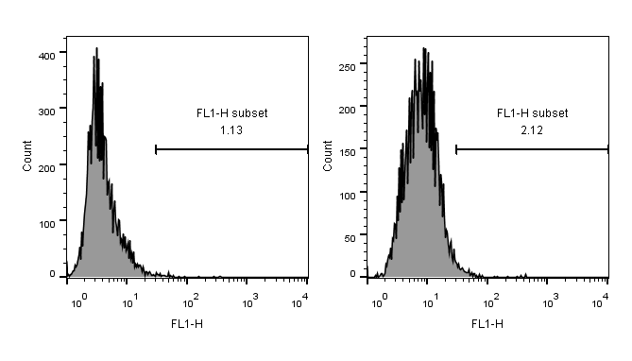


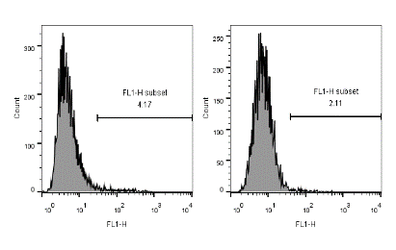

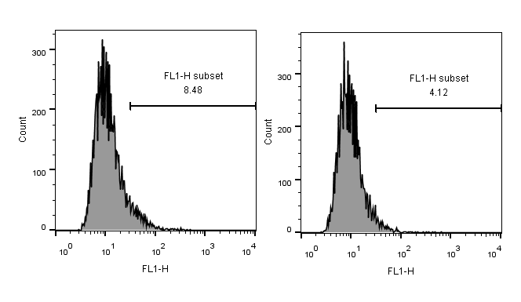
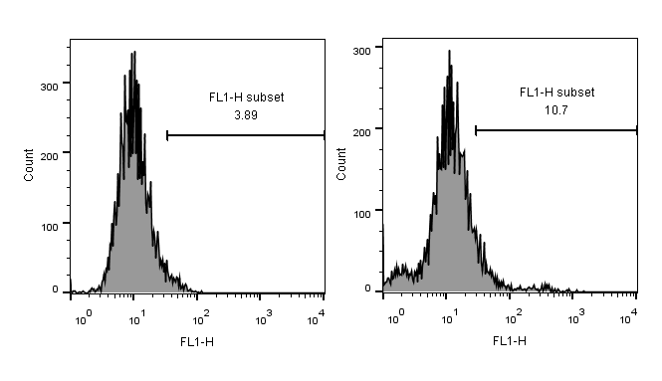


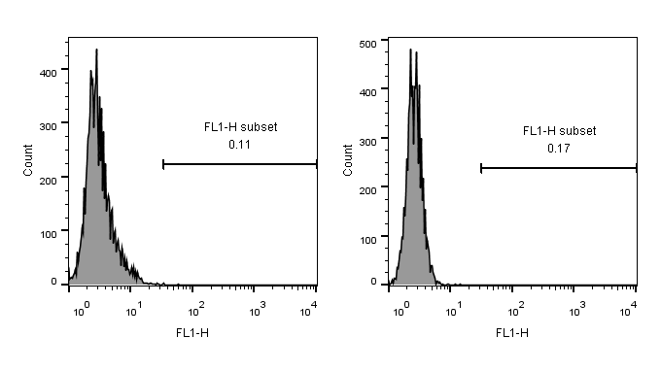





Fig.2C
Fig.2D
Fig.2E
ROS
ROS
apoptosis
Fig.2F
Fig.3B
apoptosis
ROS
Fig.3C
Fig.4C
Fig.4D
apoptosis
ROS
ROS
Fig.4E
Fig.4F
apoptosis
apoptosis
Fig.5B
Fig.5C
ROS
apoptosis
Fig.5F
apoptosis(A549)
apoptosis(CL1-5)
ROS(A549)
ROS(CL1-5)

