Slide 1
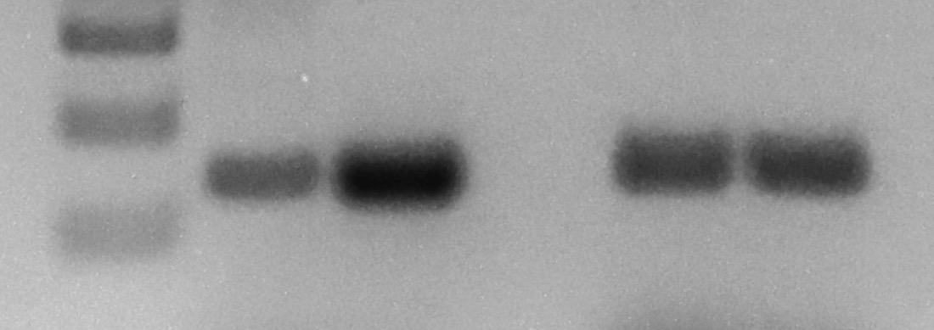
S5_File
Results from a set of control experiments
Neo brain
Neo brain
Neo brain
S. M.
Neo brain
PCR with
F2-R2
(bp)
300
circE-E2 (161 bp)
100
M-MuLV
AMV
Nested RT-PCRs with two sets of primers in divergent direction derived a 161-bp product with two different reverse transcriptases, thus confirming that the PCR product is indeed derived from a genuine circular RNA, circPeg3.

