Slide 1
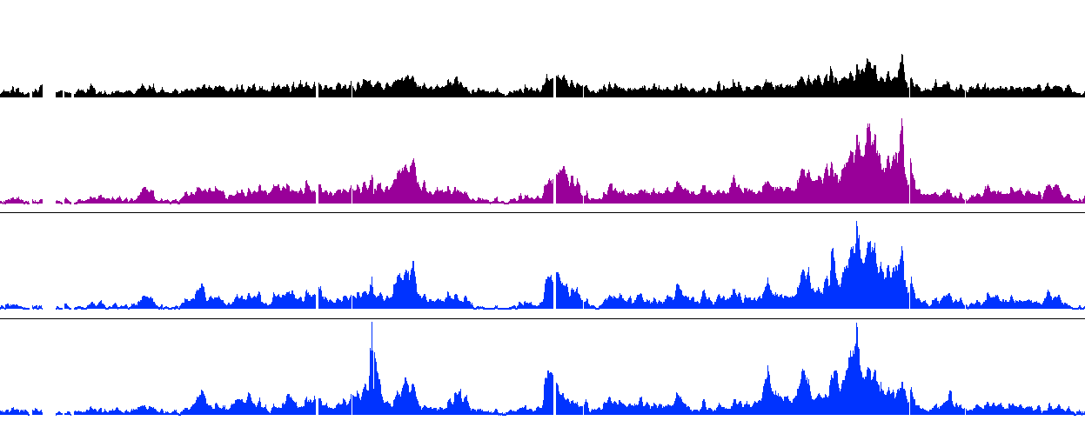
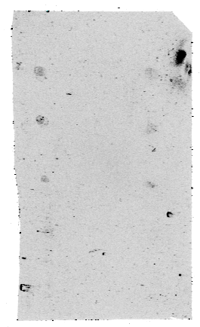
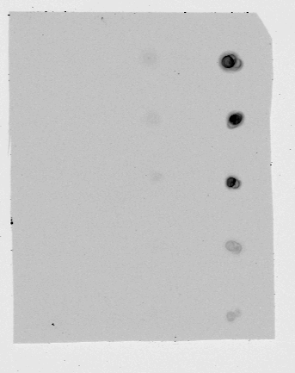
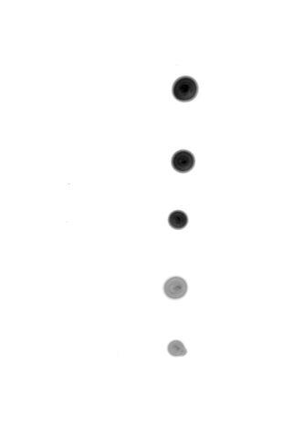
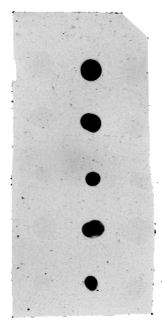
A
8.0
Krause et al – Sup Fig 1
Phospho-indep
(8WG16)
0.5
8.0
Ser-5-P
(DB)
Fold Enrichment
0.5
8.0
Ser-2-P
(ab5095)
0.5
ChV
9,940k
9,960k
9,980k
10,000k
10,020k
10,040k
10,060k
B
Unmodified
Unmodified
Unmodified
Unmodified
Ser-2-P
Ser-5-P
Ser-2-P
Ser-5-P
Ser-2-P
Ser-5-P
Ser-2-P
Ser-5-P
100 ng
80 ng
50 ng
20 ng
10 ng
8WG16
Ser-5-P (DB)
Ser-2-P (ab5095)
Ser-2-P (DB)

Slide 2
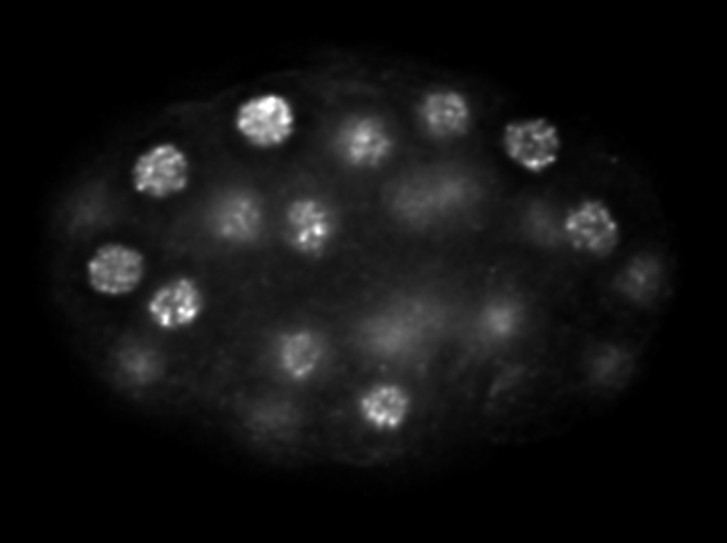
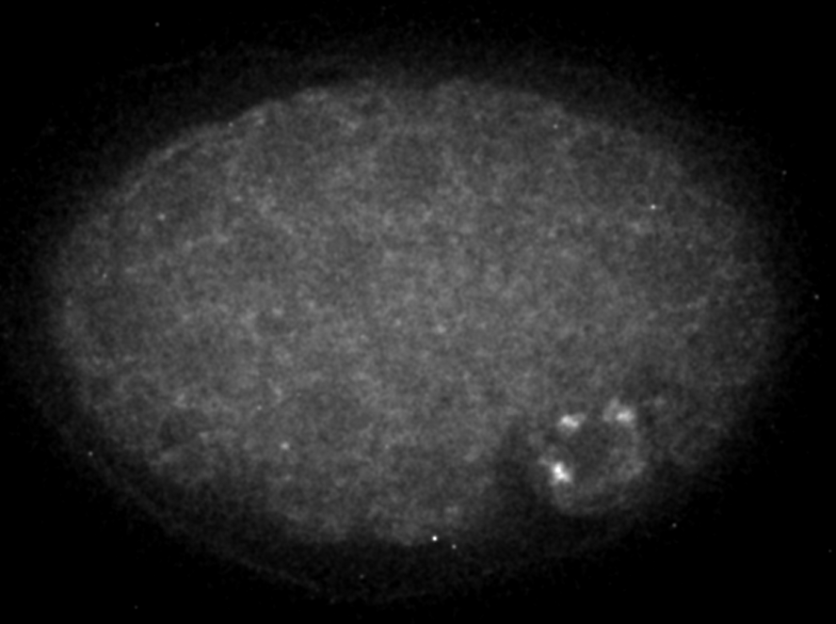
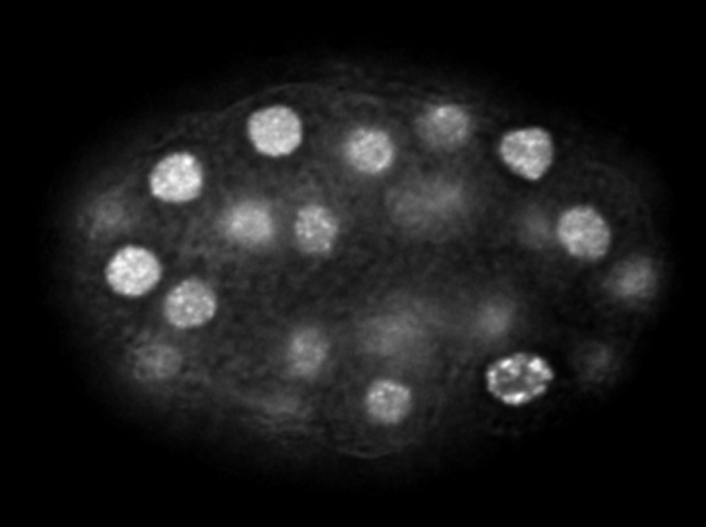
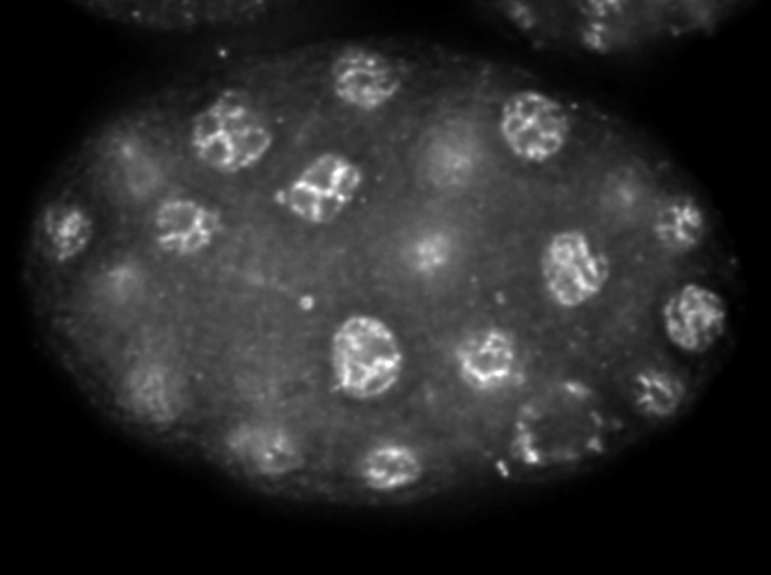
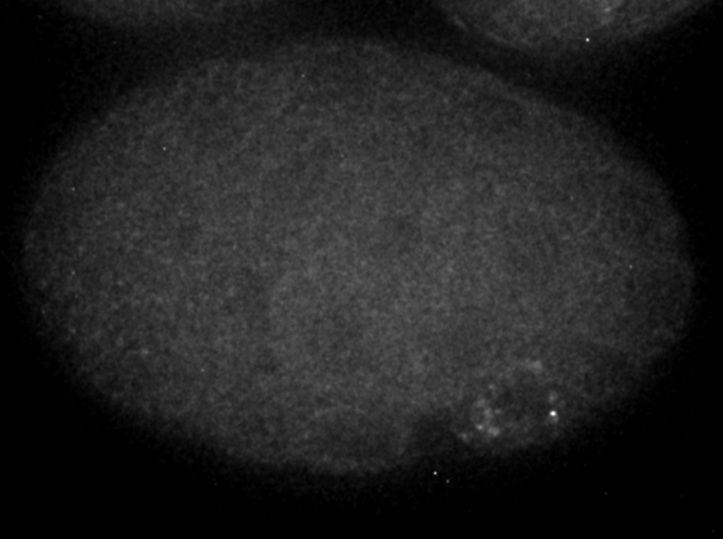
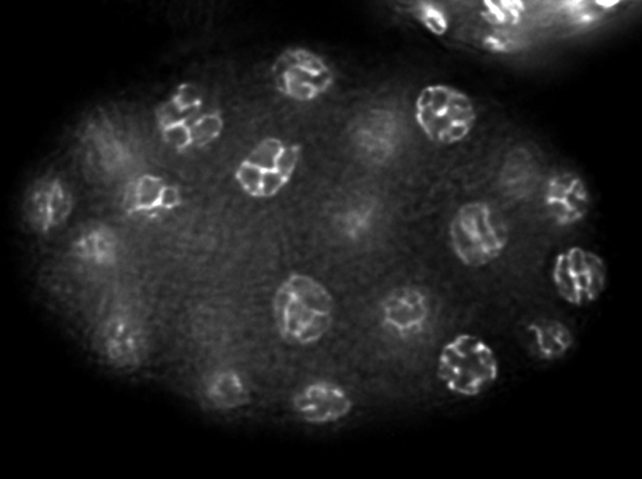
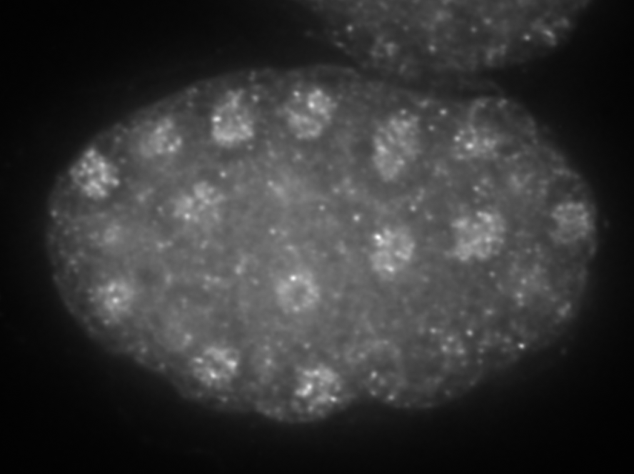
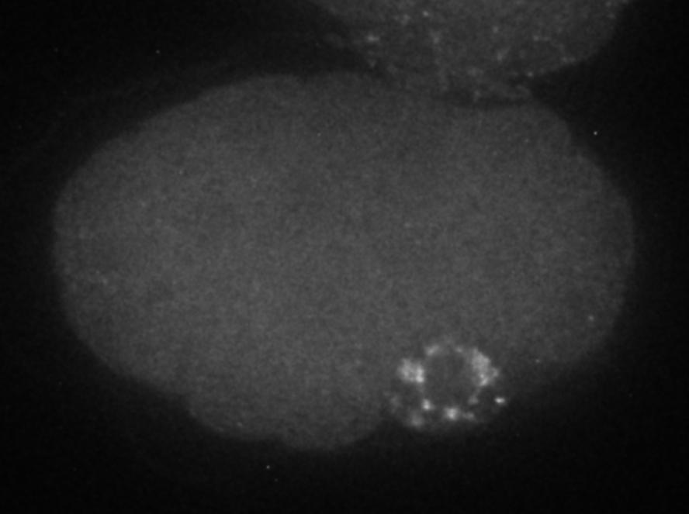
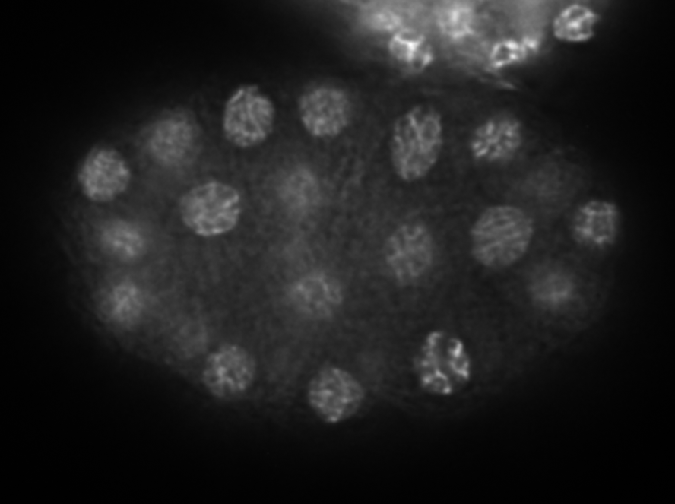
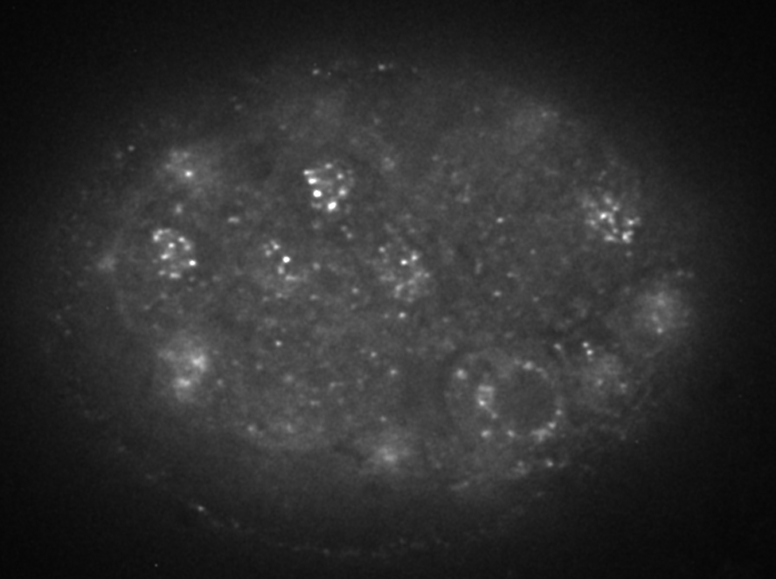
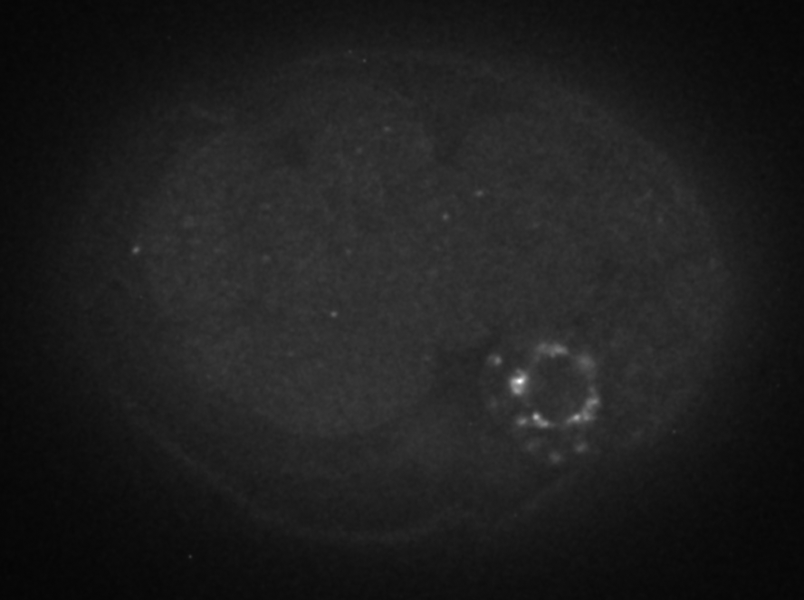
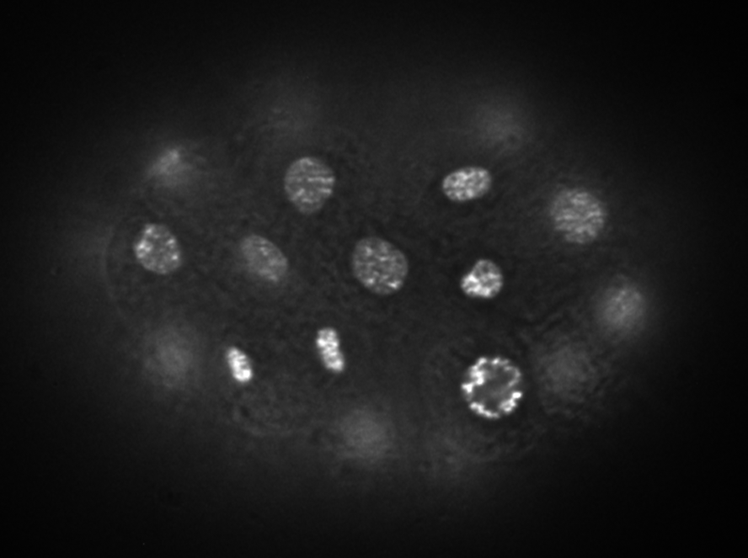
Krause et al – Sup Fig 2
Ser-5-P (DB)
P-Granule
DAPI
Ser-2-P (5095)
P-Granule
DAPI
Ser-2-P (DB)
P-Granule
DAPI
Ser-2-P (H5)
P-Granule
DAPI

Slide 3
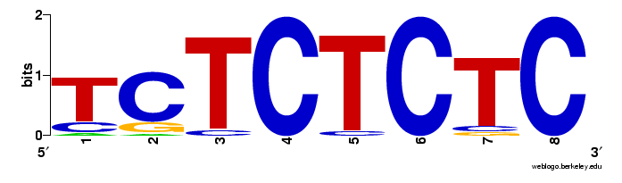
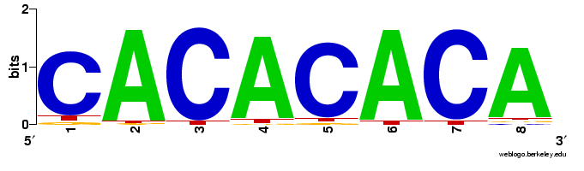
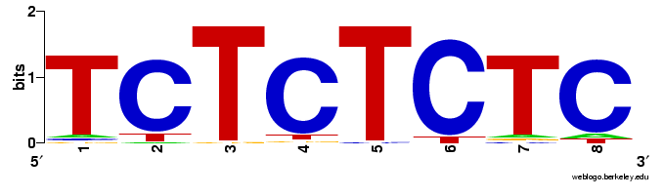
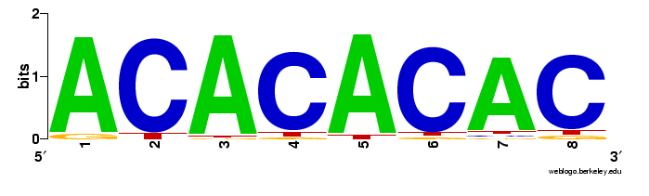
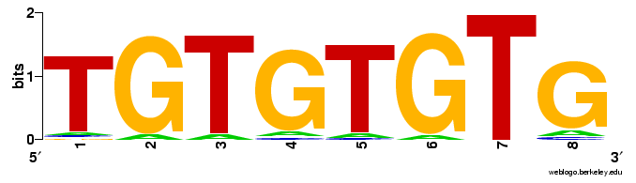
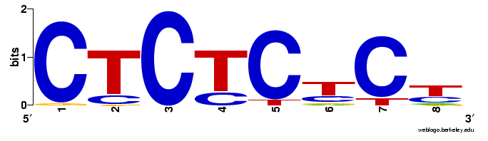
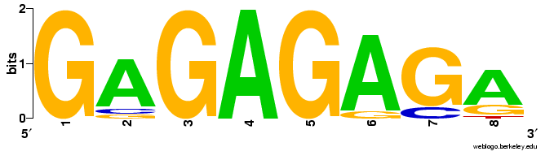
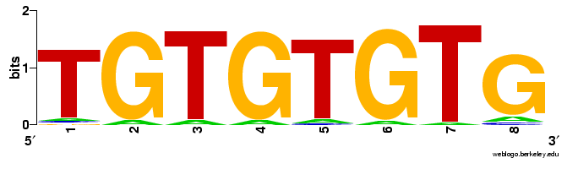
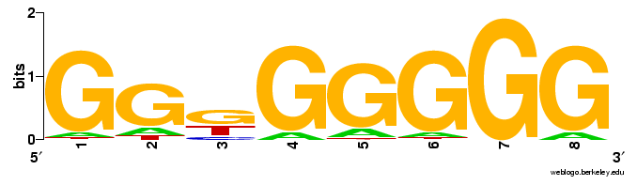
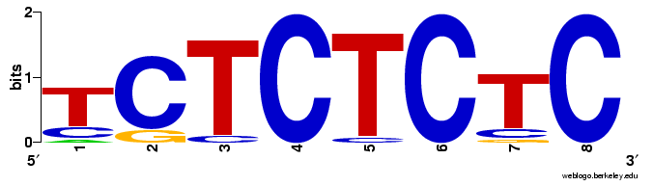
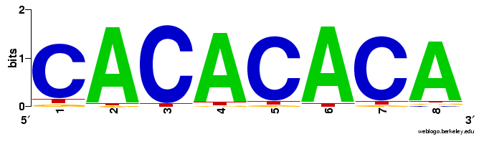
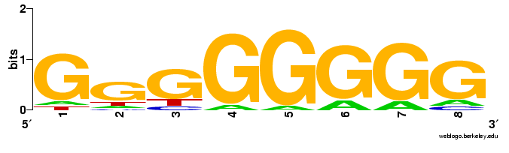
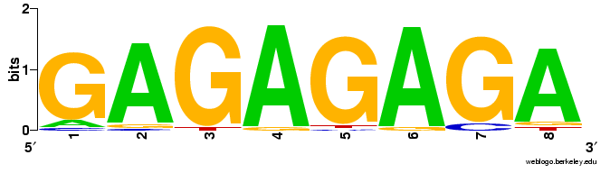
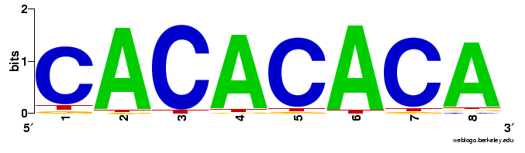
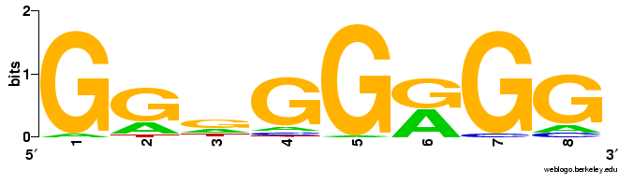
Krause et al – Sup Fig 3
Rank Order of O-GlcNAc Intervals in OGA Mutants
25
20
15
10
5
0
Top 5 Motifs

Slide 4
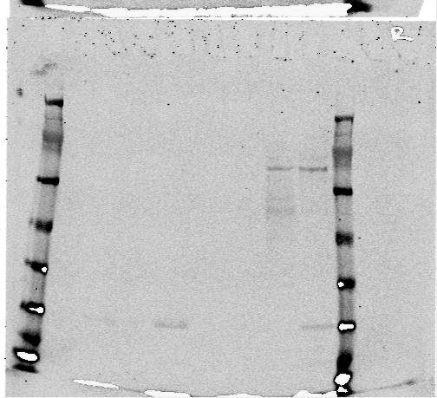
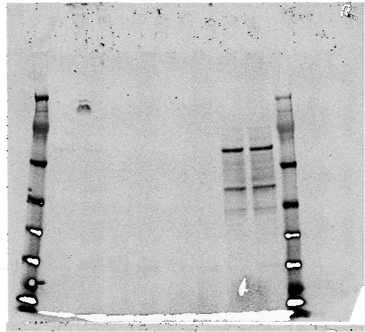
Krause et al – Sup Fig 4
A
B
C
Starved
Fed
Quantification
Band Intensity Normalized to Actin
M
]
]
]
]
M
M
]
]
]
]
M
]
]
]
]
WT
WT
WT
ogt-1 (ok430)
ogt-1 (ok430)
ogt-1 (ok430)
ogt-1 (ok1474)
ogt-1 (ok1474)
ogt-1 (ok1474)
oga-1(ok1207)
oga-1(ok1207)
oga-1(ok1207)

Slide 5
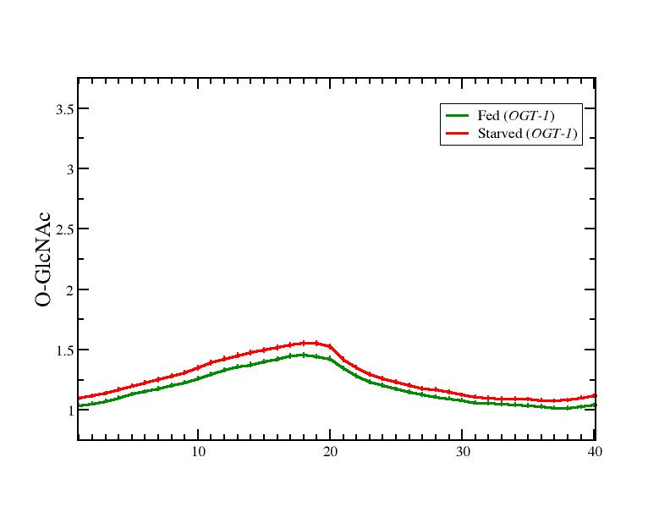
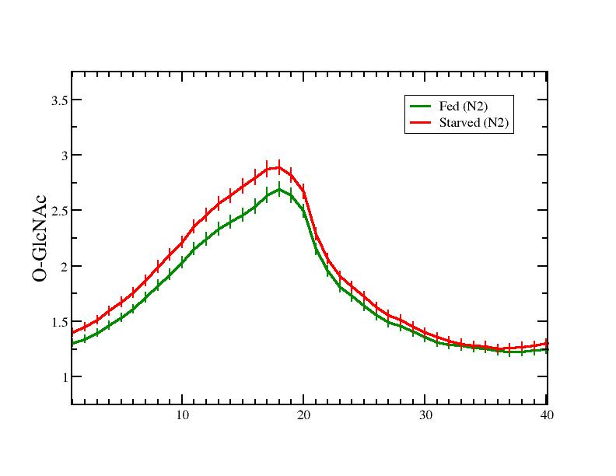
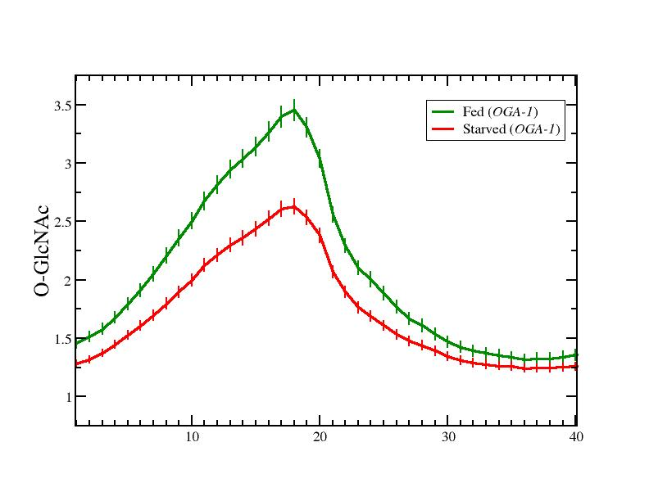
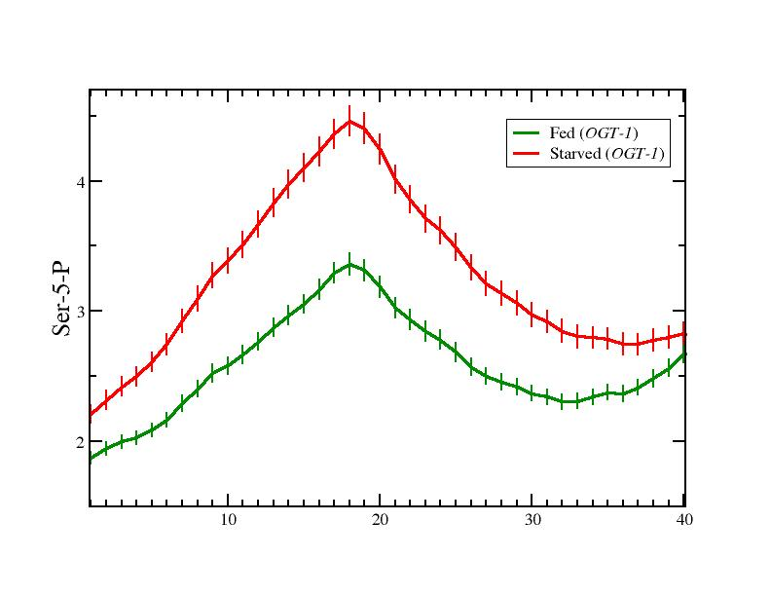
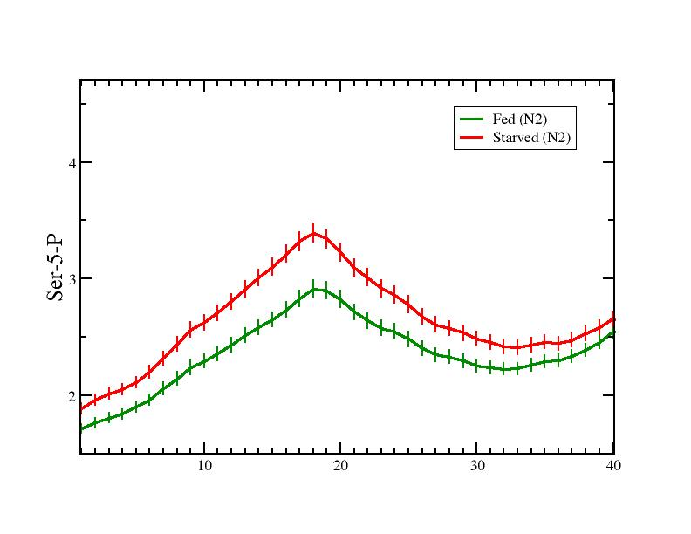
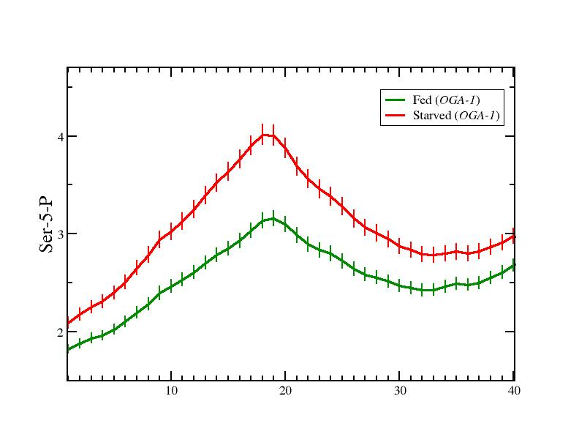
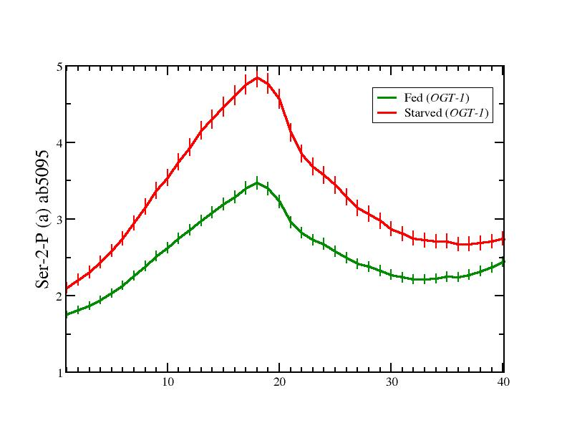
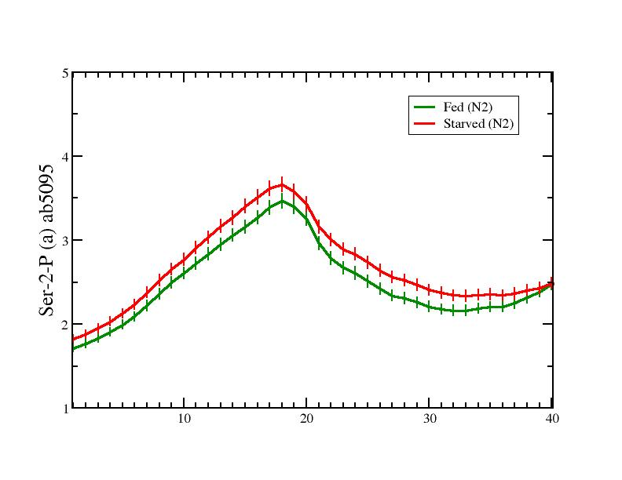
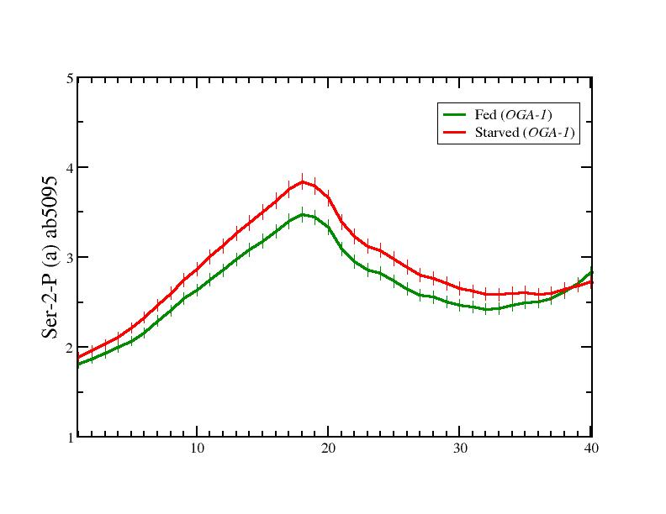
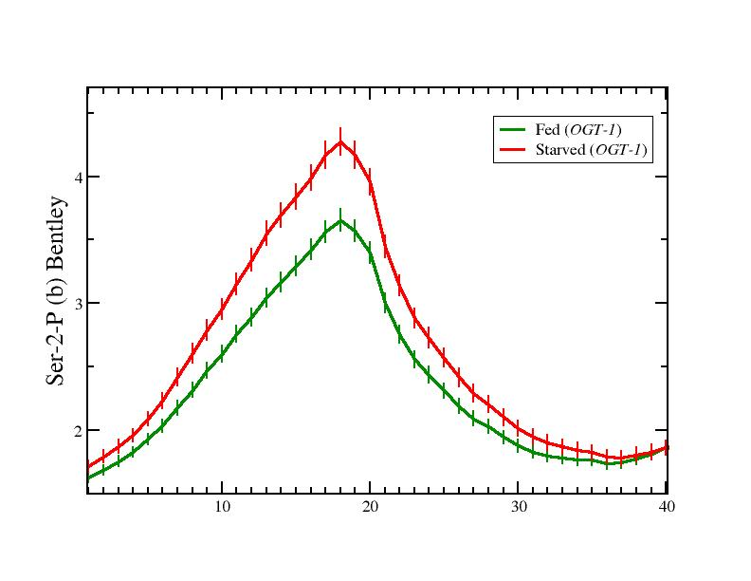
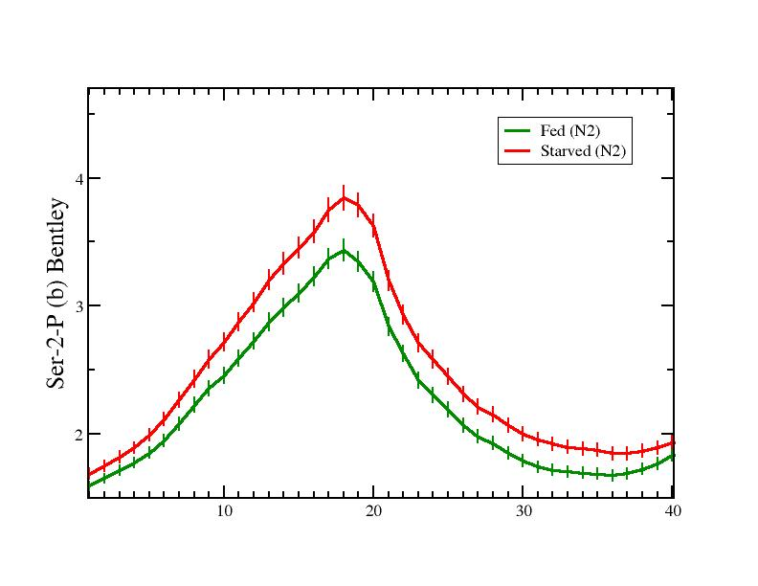
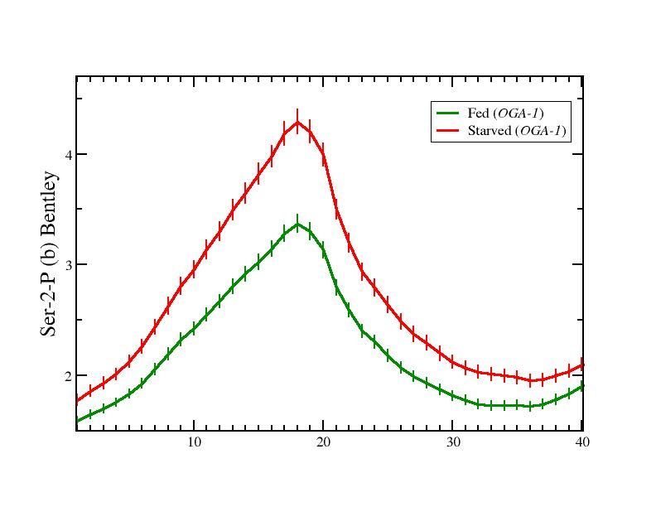
O-GlcNAc Marked Genes
Krause – Sup Fig 5
ogt-1(ok430)
Wild Type
oga-1(ok1207)
O-GlcNAc
Ser-5-P (DB)
Ser-2-P (ab5095)
Ser-2-P (DB)

Slide 6
Krause – Sup Fig 6
A
B
O-GlcNAc Marked Genes
O-GlcNAc Marked Genes
823
821
0
3
4
1
oga-1(ok1207)
oga-1(ok1207)
17
2
51
7
10
ogt-1(ok430)
7
ogt-1(ok430)
Deregulated in Fed Conditions
Deregulated in Starved Conditions

